Slide 1

Unit 8: THE WEATHER
Review 2
Page 119

Slide 2
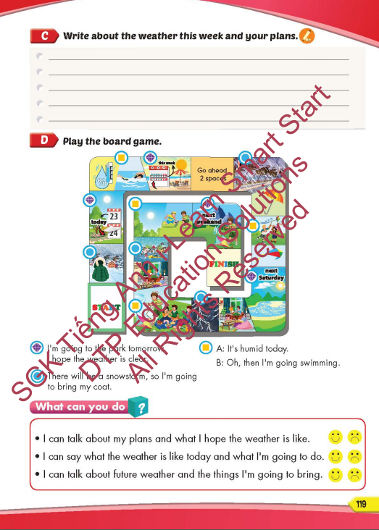
Lesson Outline
Warm-up
Listening
Reading
Writing
Wrap-up

Slide 3
Objectives
By the end of this lesson, students will be able to review and practice the target language and skills in unit 8.
Vocabulary: unit 8
Structure: unit 8

Slide 4

CONSOLIDATION

Slide 5


REVIEW
Look and say.
START
CHECK
There will be __________
Oh, then I’m going to ______________________.
a flood
stay at home

Slide 6

REVIEW
Look and say.
START
CHECK
I’m going to the beach _____________
I hope the weather is __________________.
next Monday
sunny

Slide 7

REVIEW
Look and say.
START
CHECK
It’s __________ today
Oh, then I’m going to ______________________.
breezy
the park

Slide 8

REVIEW
Look and say.
START
CHECK
I’m going to the _______________________
I hope the weather is _________.
mountains tomorrow
clear

Slide 9

WRAP-UP

Slide 10
Today’s lesson
Vocabularies
Unit 8
Structures/ Sentence patterns
Unit 8

Slide 11
Homework
Practice the vocabularies and structure, and make sentences using them.
Do the exercises in Tiếng Anh 5 i-Learn Smart Start WB (page 120).
Do the exercises in Tiếng Anh 5 i-Learn Smart Start Notebook.
Prepare the next lesson (page 81 SB).
Play the consolidation games in Tiếng Anh 5 i-Learn Smart Start DHA App on www.eduhome.com.vn

Slide 12

Enjoy your day!

Slide 13

Lesson 3
Stay positive and have a nice day!

