Slide 1

Unit 8: THE WEATHER
Lesson 3.1
Page 112

Slide 2
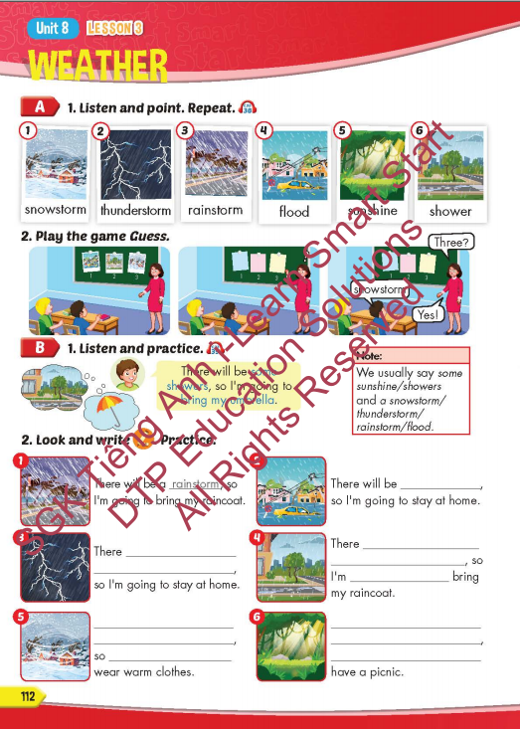
Lesson Outline
Warm-up
Vocabulary
Structure
Consolidation
Wrap-up

Slide 3
Objectives
By the end of this lesson, students will be able to to talk about future weather and the things they're going to do.
Vocabulary: snowstorm, thunderstorm, rainstorm, flood, sunshine, shower.
Structure: There will be some showers, so I'm
going to bring my umbrella.

Slide 4

WARM-UP

Slide 5
MATCHING GAME

Slide 6
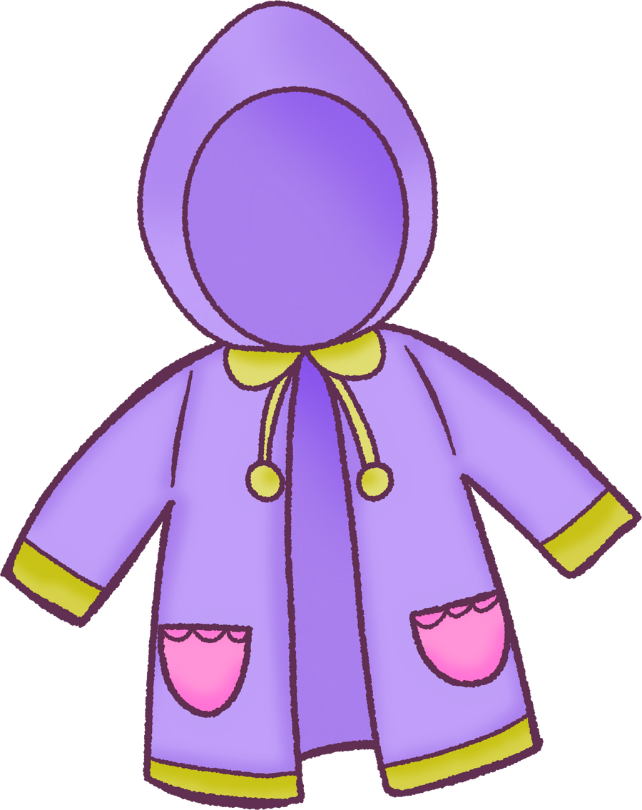


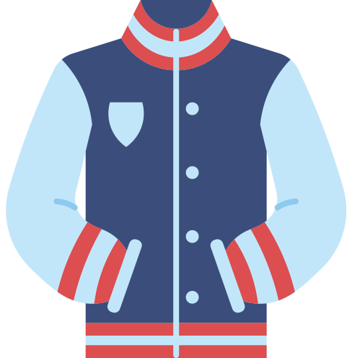



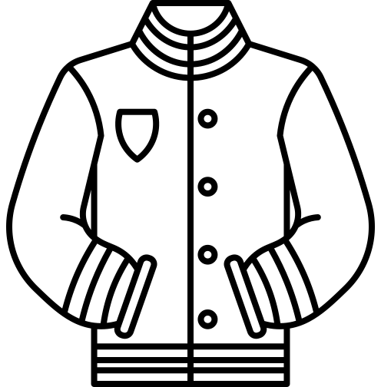




Find the umbrella

Slide 7
Find the raincoat

Slide 8
Find the cap

Slide 9
Find the hat

Slide 10
Find the sunglasses

Slide 11
Find the jacket

Slide 12

It’s time to learn …

Slide 13
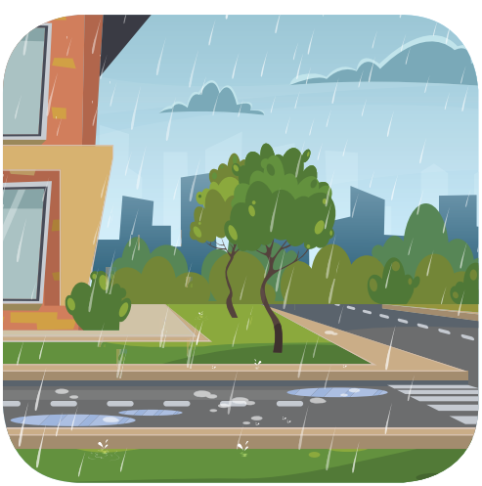
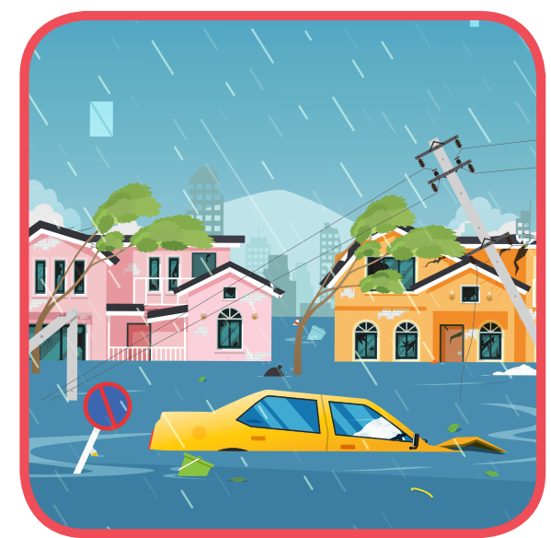


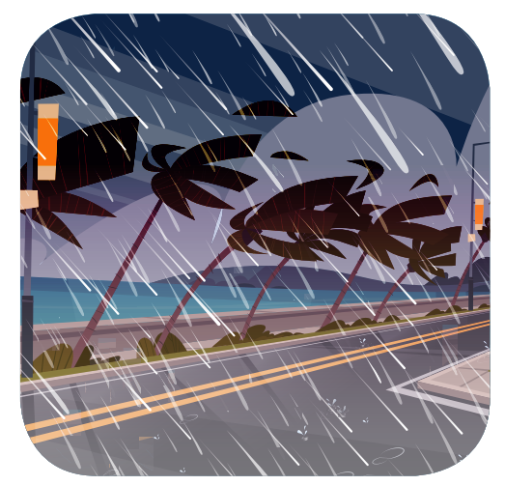
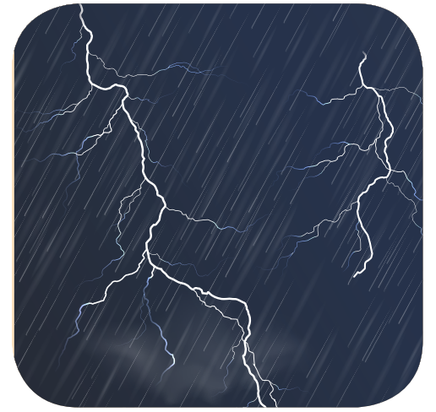
WHAT’S MISSING?
1
2
3
?
?
?
4
5
6
?
?
?

Slide 14

Lesson 3
Stay positive and have a nice day!

