Slide 1

Unit 7: JOBS
Lesson 2.1
Page 95

Slide 2
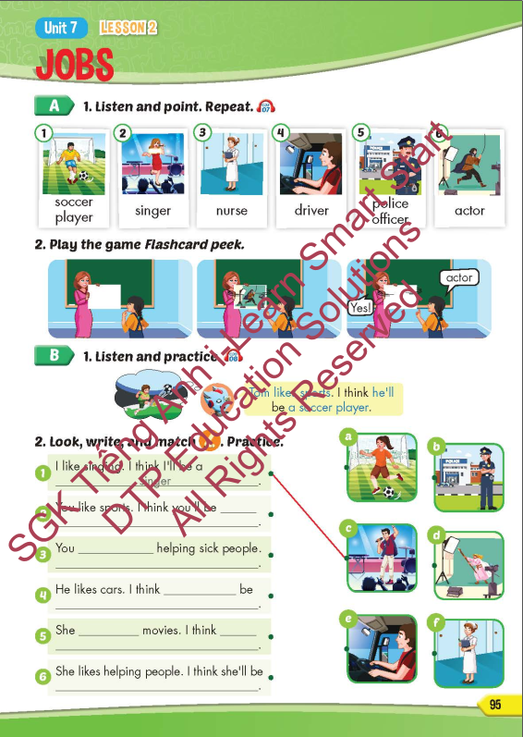
Lesson Outline
Warm-up
Vocabulary
Structure
Consolidation
Wrap-up

Slide 3

Tuesday March 25th 2025
Unit 7. Jobs – Lesson 2.1 (P.95)
New words. 2. Model sentence
soccer player Tom likes sports.
singer I think he’ll be a soccer player.
nurse
driver
police officer
actor

Slide 4
Objectives
By the end of this lesson, students will be able to recognize the vocabulary and get to know the structure of predicting someone’s future job based on what they like.
Vocabulary: soccer player, singer, nurse, driver, police officer, actor
Structure: Tom likes sports. I think he’ll be a soccer player.

Slide 5

New words
soccer player,
singer,
nurse,
driver,
police officer,
actor.

Slide 6
Structure
Tom likes sports. I think he’ll
be a soccer player

Slide 7

WRAP-UP

Slide 8
Today’s lesson
Vocabularies
soccer player, singer, nurse, driver, police officer, actor.
Structures/ Sentence patterns
Tom likes sports. I think he’ll be a soccer player.

Slide 9

Enjoy your day!

Slide 10

Lesson 3
Stay positive and have a nice day!

