Slide 1

Unit 7: JOBS
Lesson 1.1
Page 92

Slide 2
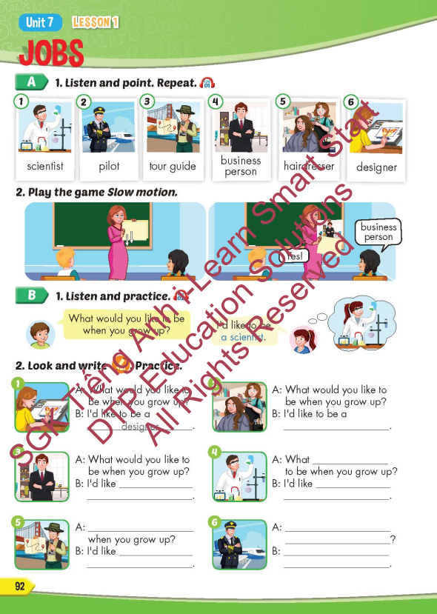
Lesson Outline
Warm-up
Vocabulary
Structure
Consolidation
Wrap-up

Slide 3
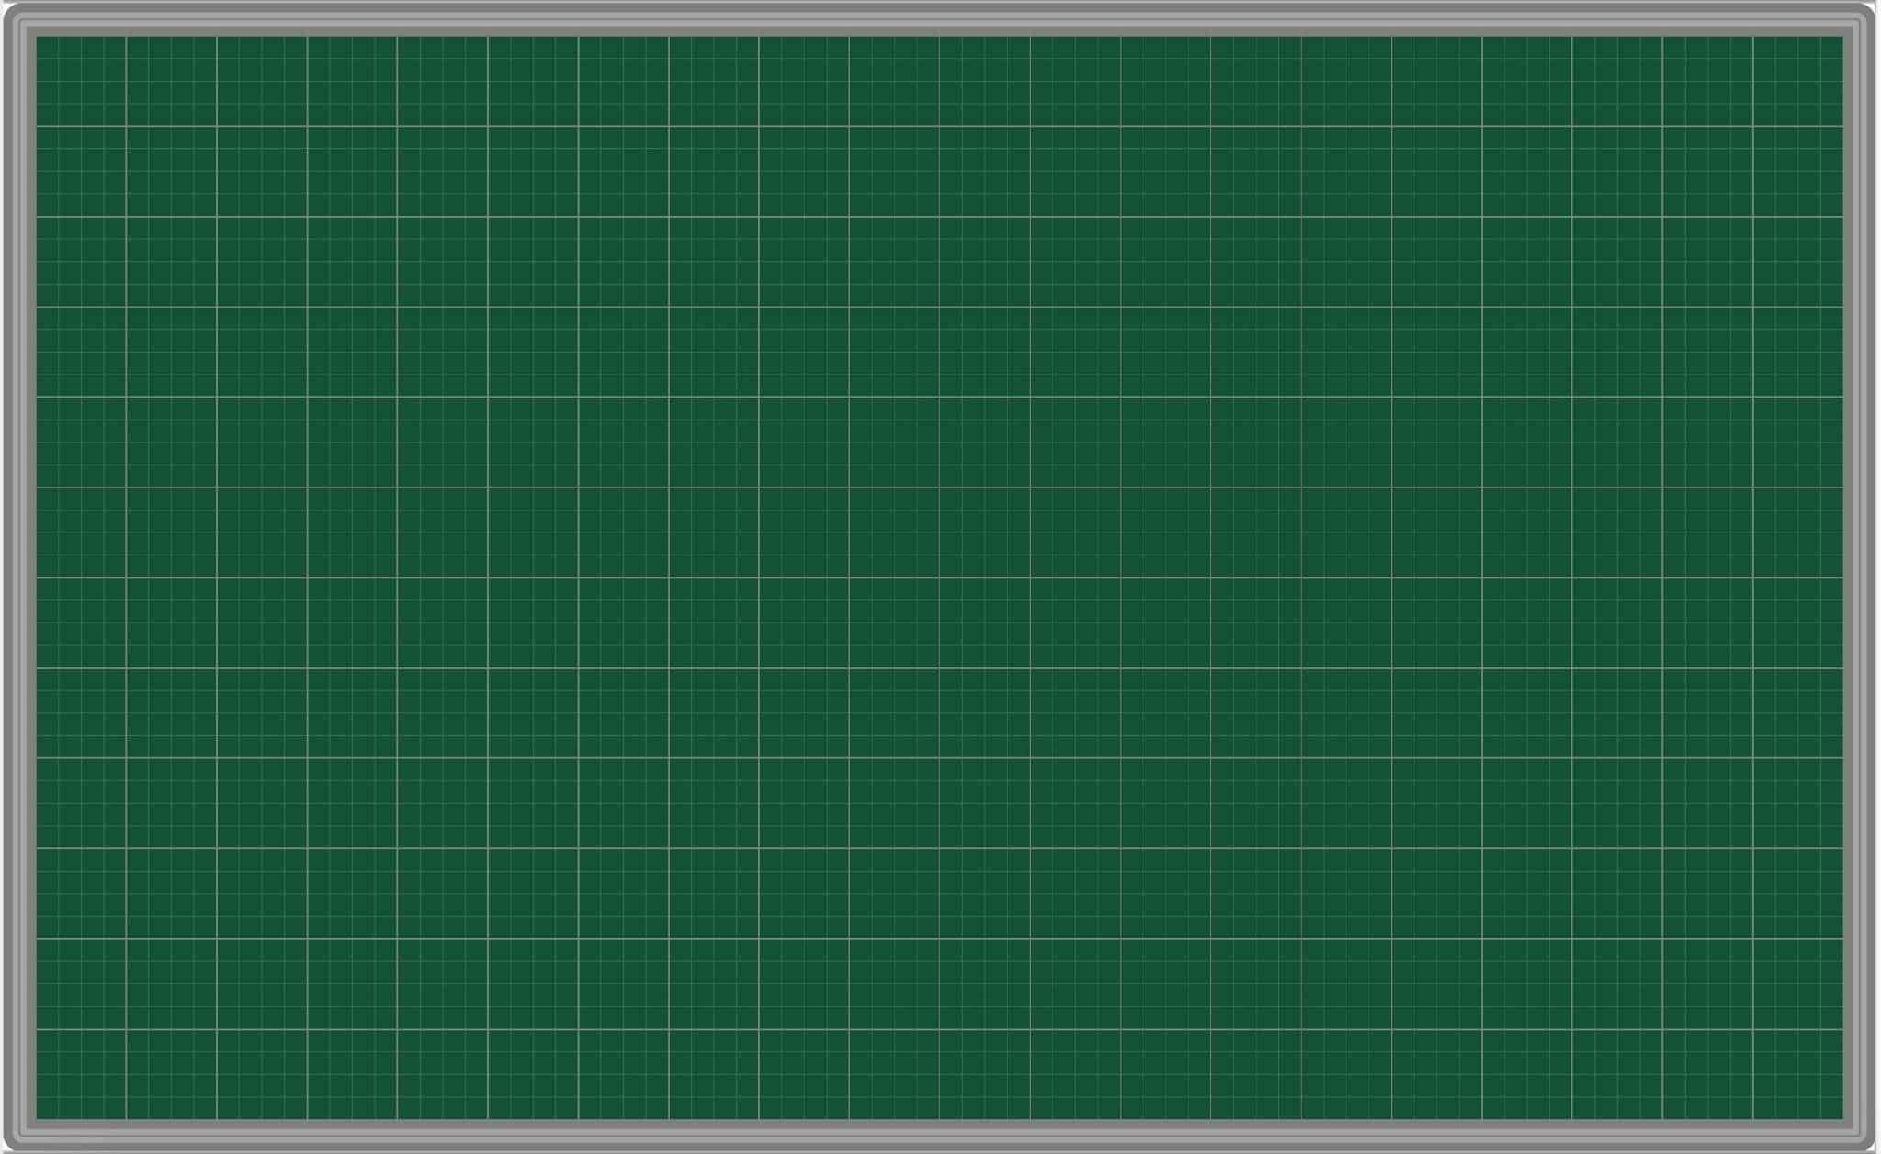
Wednesday March 19th 2025
Unit 7. Jobs – Lesson 1.1 (P.92)
New words. 2. Model sentence
scientist [A:What would you like to be when you grow up?
pilot B: I’d like to be a scientist.]
tour guide
business person
hairdresser
designer

Slide 4
Objectives
By the end of this lesson, students will be able to point out and name different jobs.
Vocabulary: scientist, pilot, tour guide, business person, hairdresser, designer.
Structure: What would you like to be when you grow up?
- I’d like to be a scientist.

Slide 5

WARM-UP

Slide 6

New words
scientist,
pilot,
tour guide,
business person,
hairdresser
designer

Slide 7
Structure
What would you like to be
when you grow up?
- I’d like to be a scientist.

Slide 8

WRAP-UP

Slide 9
Today’s lesson
Vocabularies
scientist, pilot,
tour guide, business person, hairdresser, designer.
Structures/ Sentence patterns
What would you like to do when you grow up?
- I’d like to be a scientist.

Slide 10

Enjoy your day!

Slide 11

Lesson 3
Stay positive and have a nice day!

