Slide 1

Unit 7: MY FAMILY
Lesson 2.1
Page 95

Slide 2
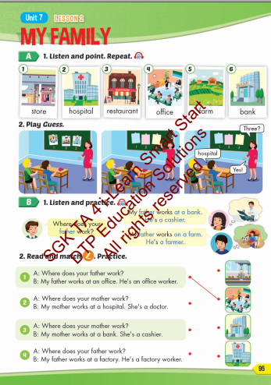
Lesson Outline
Warm-up
Vocabulary
Structure
Consolidation
Wrap-up

Slide 3
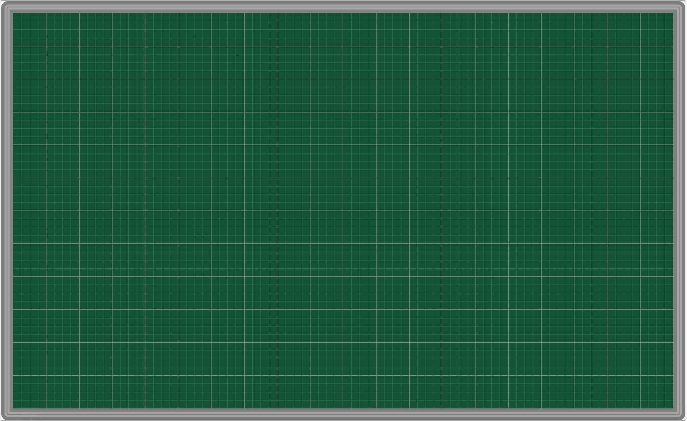
Tuesday March 25th 2025
Unit 7. My family – Lesson 2.1 (P.95)
New words 2. Model sentences
store [A: Where does your father work?
hospital B: My father works at a bank. restaurant He's a cashier. ]
office
farm
bank

Slide 4
Objectives
By the end of this lesson, students will be able to talk about where their family members work.
Vocabulary: store, hospital, restaurant, office, farm, bank.
Structure: Where does your father work?
My father works at a bank. He's a cashier.

Slide 5

New words
store,
hospital,
restaurant,
office,
farm,
bank.

Slide 6
Structures:
Where does your father work?
My father works at a bank.
He's a cashier.

Slide 7

WRAP-UP

Slide 8
Lesson 3
Today’s lesson
Vocabularies
store, hospital, restaurant, office, farm, bank.
Structures/ Sentence patterns
Where does your father work?
My father works at a bank. He's a cashier.

Slide 9

Have a nice day!

