Slide 1

Unit 7: MY FAMILY
Lesson 1.1
Page 92

Slide 2
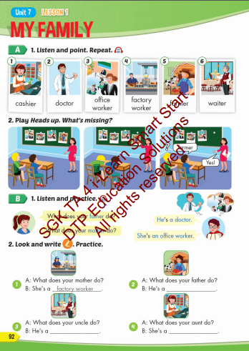
Lesson Outline
Warm-up
Vocabulary
Structure
Consolidation
Wrap-up

Slide 3
Objectives
By the end of this lesson, students will be able to talk about what job their family members do.
Vocabulary: cashier, doctor, office worker, factory worker, farmer, waiter.
Structure: What does your father do?
He's a doctor.
What does your mother do?
She's an office worker.

Slide 4
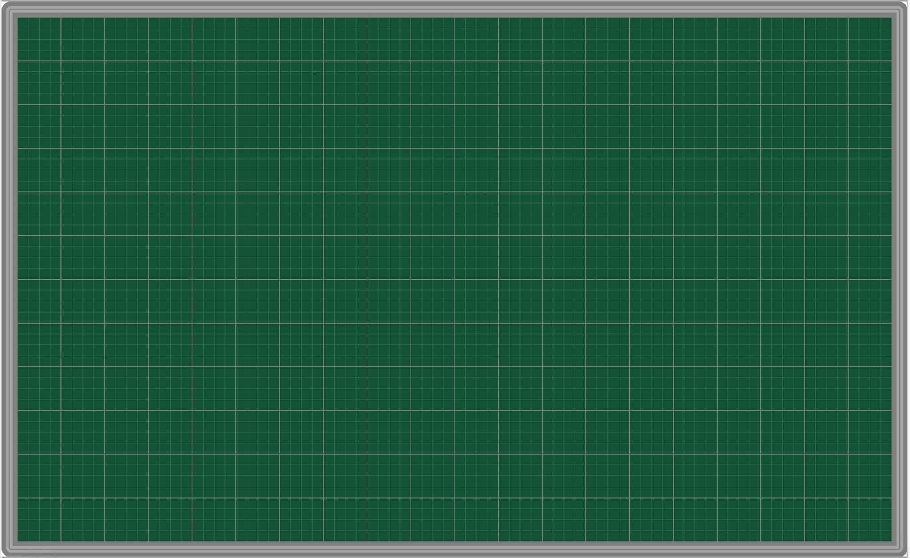
Wednesday March 19th 2025
Unit 7. My family – Lesson 1.1 (P.92)
New words 2. Model sentences
cashier [A: What does your father do? doctor B: He’s a doctor.
office worker A: What does your mother do? factory worker B: She’s an office worker.]
farmer
waiter.

Slide 5
Talk about what your family members look like.
Pair work:
Students take turns to talk what their family members look like.
E.g. My grandfather is handsome and old.
My brother is tall and cute.
My sister has long, blond hair.

Slide 6

New words
cashier,
doctor,
office worker, factory worker, farmer,
waiter.

Slide 7
Structures:
What does your father do?
He's a doctor.
What does your mother do?
She's an office worker.

Slide 8

WRAP-UP

Slide 9
Lesson 3
Today’s lesson
Vocabularies
cashier, doctor, office worker, factory worker, farmer, waiter.
Structures/ Sentence patterns
What does your father do?
He's a doctor.
What does your mother do?
She's an office worker.

Slide 10

Have a nice day!

