Slide 1

Unit 3: WEATHER
Lesson 3.1
Page 40

Slide 2

It’s time to learn …

Slide 3

New words
sunglasses,
coat,
cap,
raincoat,
umbrella,
gloves

Slide 4

Vocabulary

Slide 5

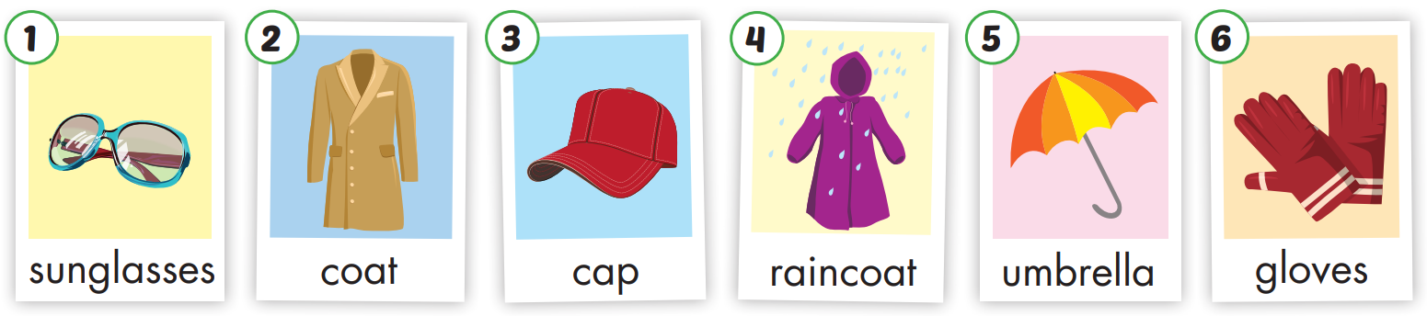

Slide 6
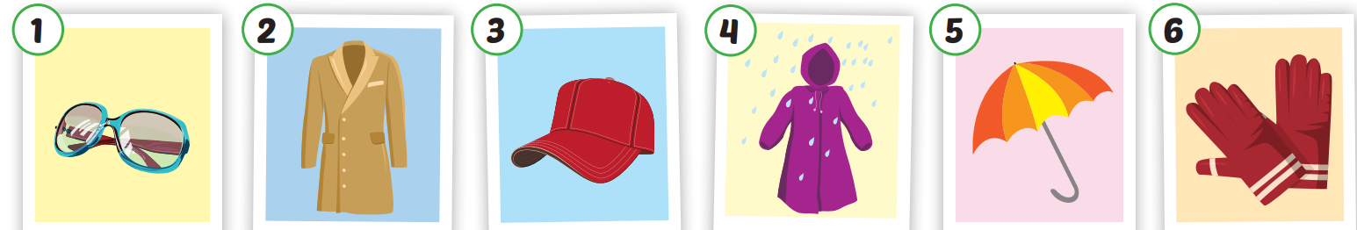
Click each English word to hear the sound.
sunglasses
coat
cap
raincoat
umbrella
gloves
/ˈsʌnɡlæsɪz/
Kính râm
/koʊt/
Áo choàng
/kæp/
Mũ lưỡi trai
/ ˈreɪnkoʊt/
Áo mưa
/ʌmˈbrelə/
Cái ô
/ɡlʌvz/
Găng tay

Slide 7
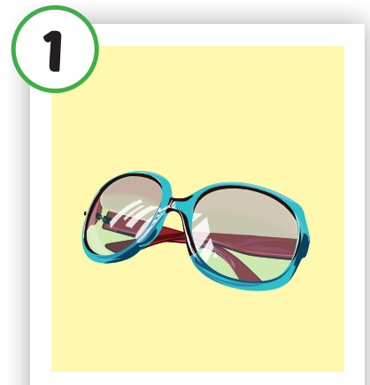
Click each English word to hear the sound.
sunglasses
/ˈsʌnɡlæsɪz/
Kính râm

Slide 8
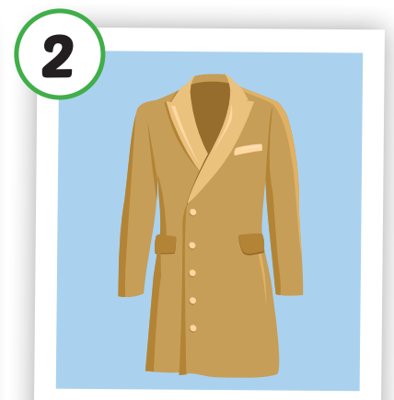
Click each English word to hear the sound.
coat
/koʊt/
Áo choàng

Slide 9
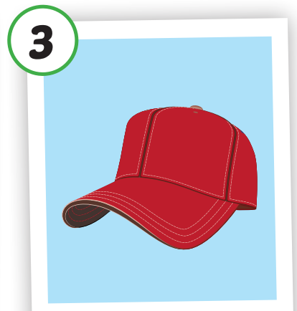
Click each English word to hear the sound.
cap
/kæp/
Mũ lưỡi trai

Slide 10
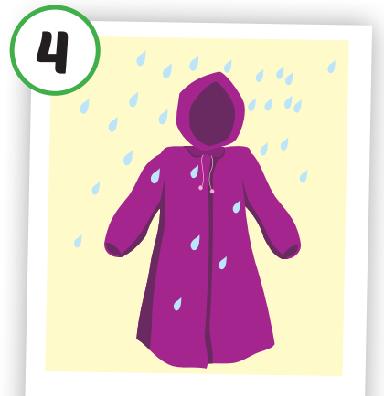
Click each English word to hear the sound.
raincoat
/ˈreɪnkoʊt/
Áo mưa

Slide 11
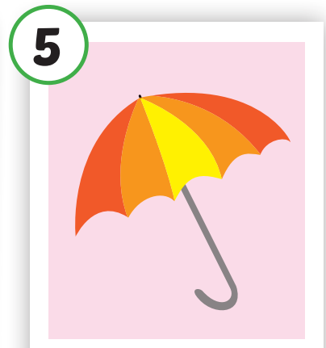
Click each English word to hear the sound.
umbrella
/ʌmˈbrelə/
Cái ô

Slide 12
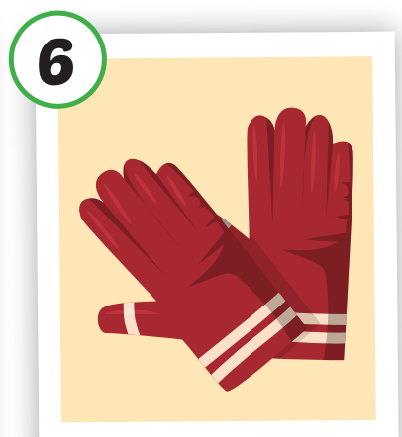
Click each English word to hear the sound.
gloves
/ɡlʌvz/
Găng tay

Slide 13
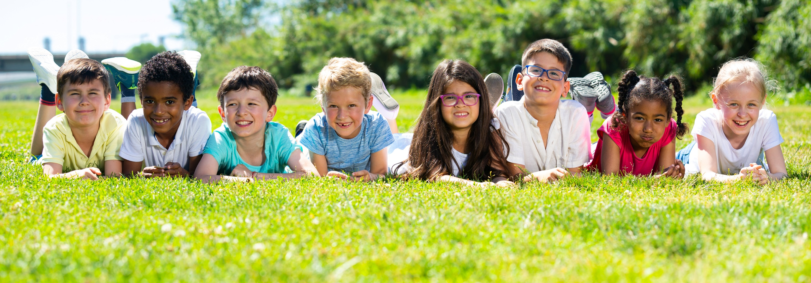
Have a nice day!

