Slide 1

Unit 3: WEATHER
Lesson 3.1
Page 40

Slide 2

Structures:
Bring your sunglasses because it's sunny today.
OK, thank you.

Slide 3


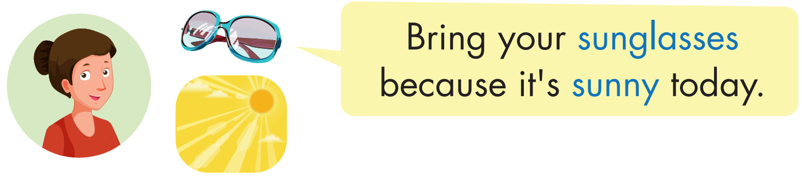
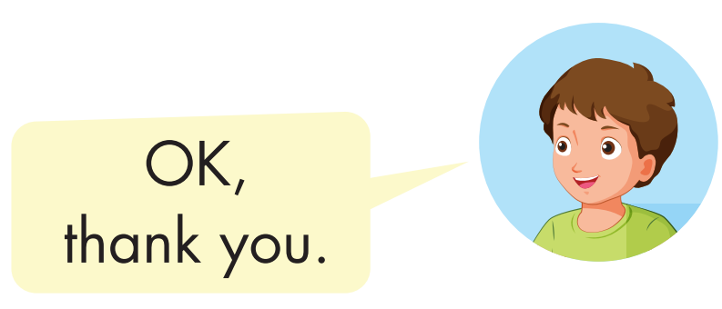
Click each English word to hear the sound.

Slide 4

Practice

Slide 5



Bring your umbrella because it's rainy today.
OK,
thank you.

Slide 6

Bring your cap because it's sunny today.
OK,
thank you.

Slide 7

Bring your gloves because it's snowy today.
OK,
thank you.

Slide 8

Bring your coat because it's windy today.
OK,
thank you.

Slide 9

Bring your raincoat because it's rainy today.
OK,
thank you.

Slide 10
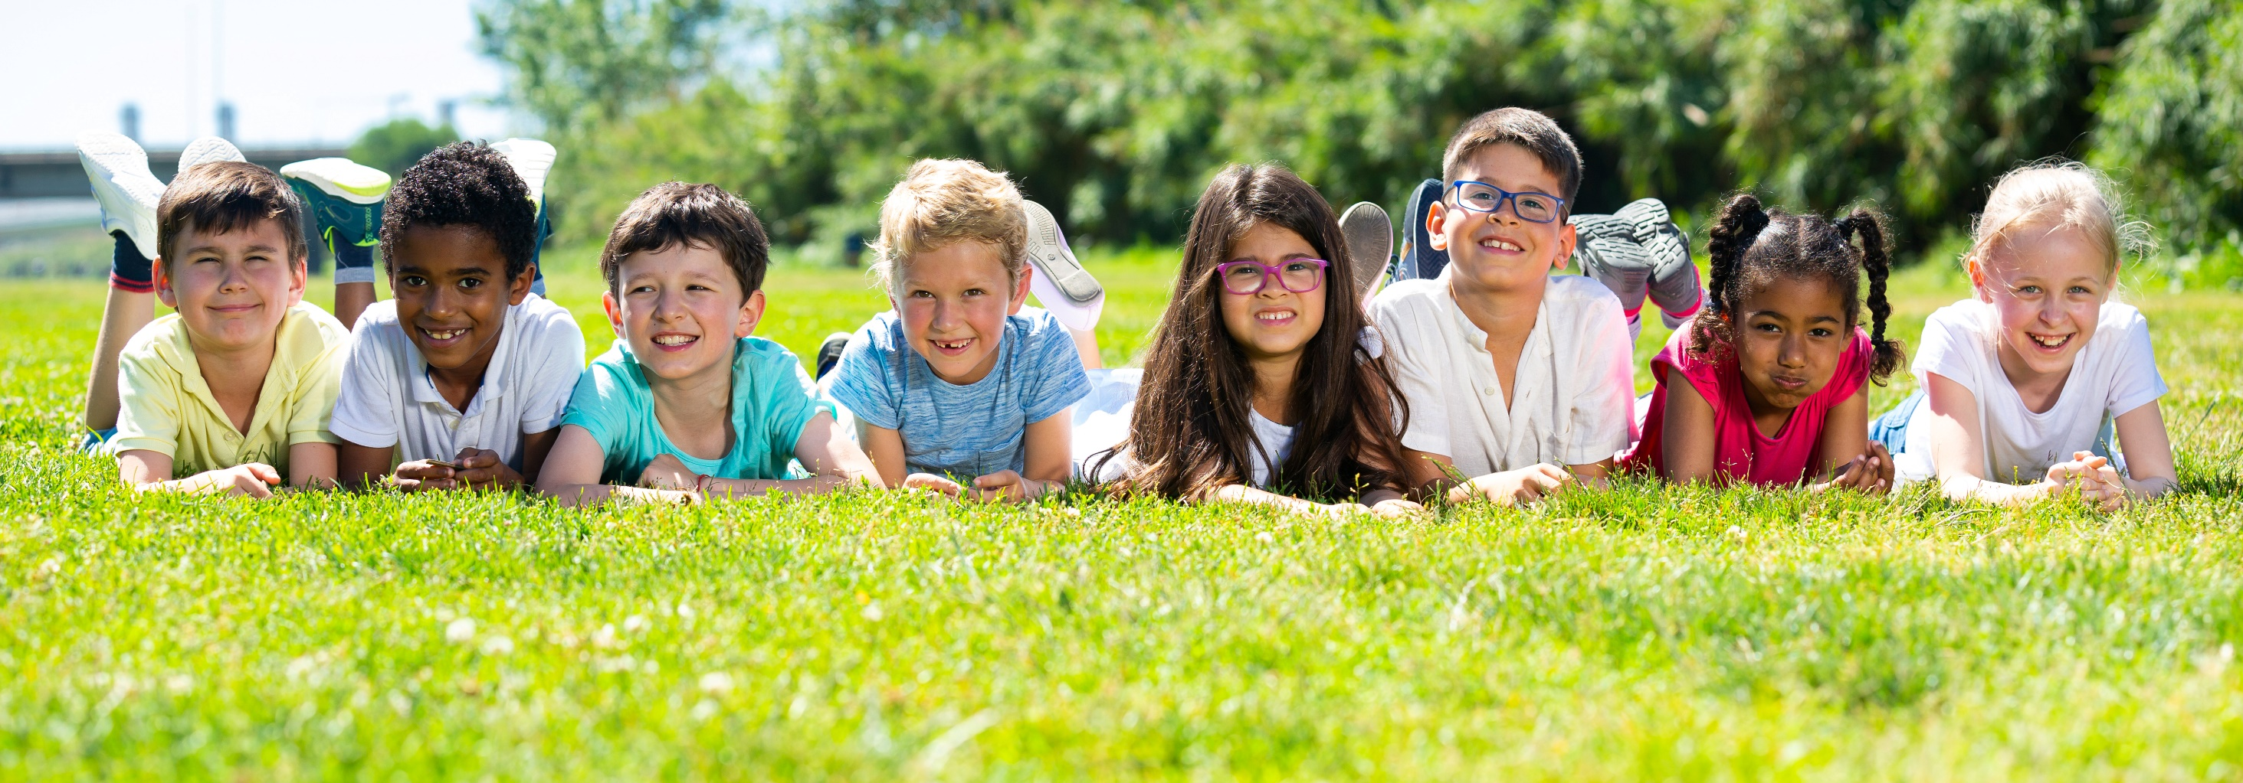
Have a nice day!

