Slide 1

WARM-UP

Slide 2
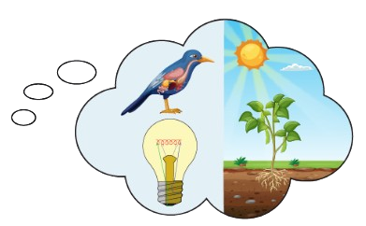






History
Science

Slide 3
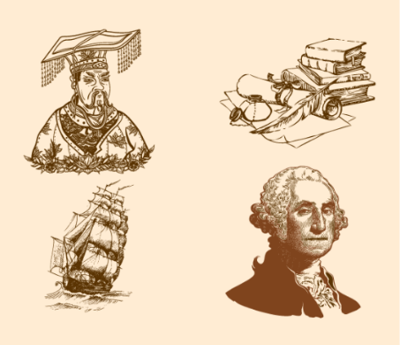
History
English

Slide 4
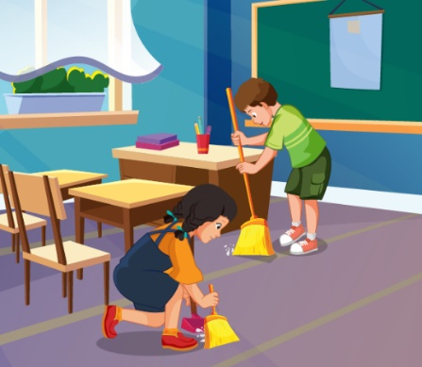
IT
Ethics

Slide 5

Geography
Science

Slide 6
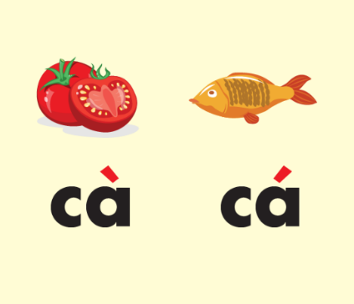
History
Vietnamese

Slide 7

using computers
making things

Slide 8

reading stories
learning languages

Slide 9
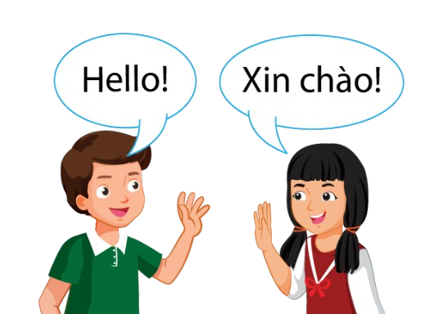
learning languages
do experiments

Slide 10
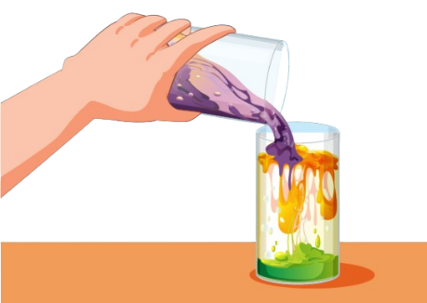
do experiments
solving problems

Slide 11
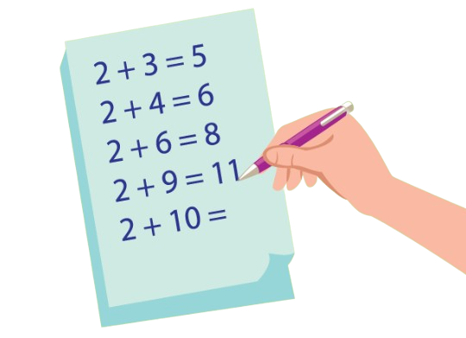
using computers
solving problems

Slide 12


