Slide 1

Practice

Slide 2
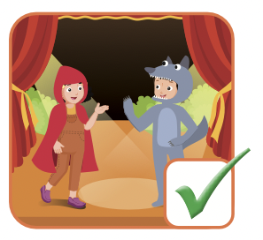
I can act.

Slide 3
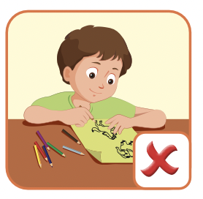
I can’t draw.

Slide 4
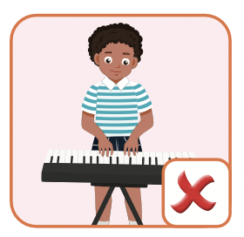
I can’t play the keyboard.

Slide 5
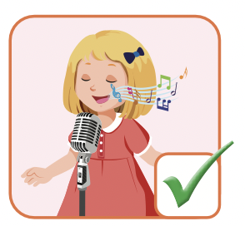
I can sing.

