Slide 1
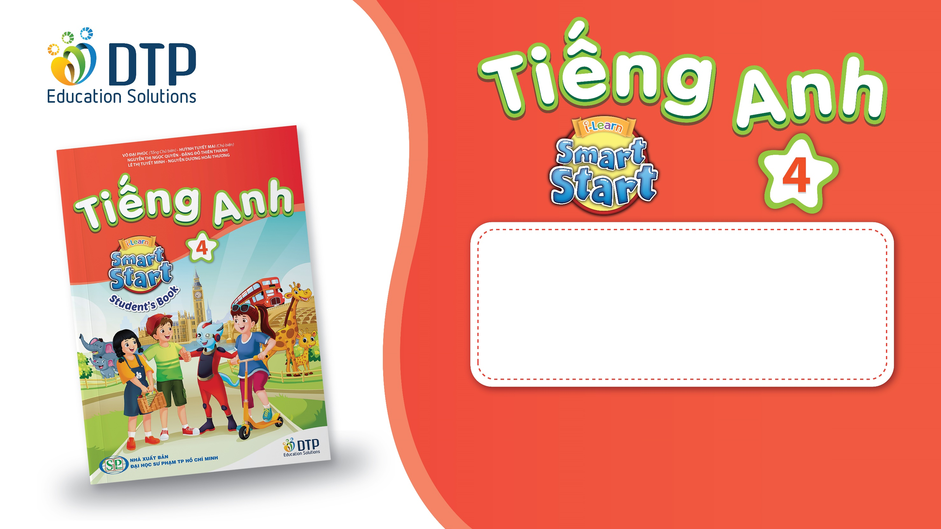
Unit 1: Animals
Lesson 1.2
Page 7

Slide 2

Phonics
/h/

Slide 3
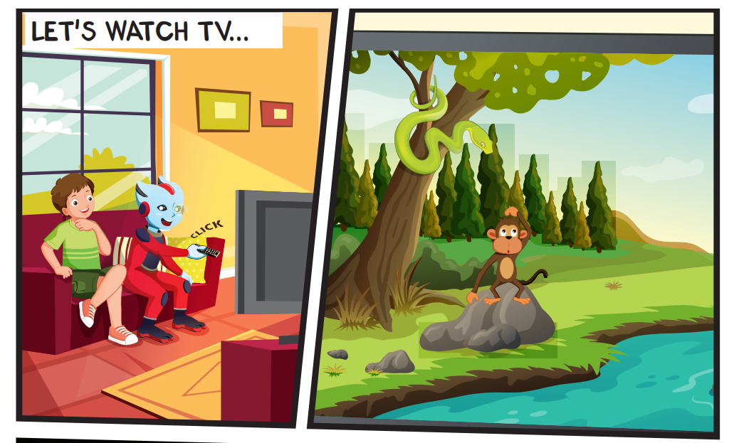
Look at the picture and answer.
Pre-Listening
How many monkeys can you see?
one monkey.

Slide 4
Today’s lesson
Structures/ Sentence patterns
This is a monkey.
These are monkeys.
That's a snake.
Those are snakes
Vocabularies
snake, monkey, horse, camel, hippo, rhino.
Phonics
Identify the /h/ sound and practice the conversations.

Slide 5
Homework
Practice the vocabularies and structure; and make sentences using them.
Do the exercises in Tiếng Anh 4 i-Learn Smart Start WB (page 3)
Do the exercises in Tiếng Anh 4 i-Learn Smart Start Notebook (page 6)
Prepare the next lesson (page 8 SB)
Play the consolidation games in Tiếng Anh 4 i-Learn Smart Start DHA App on www.eduhome.com.vn

