Slide 1

Unit 1: Animals
Lesson 1.1
Page 6

Slide 2

New words
snake, monkey, horse,
camel, hippo, rhino

Slide 3

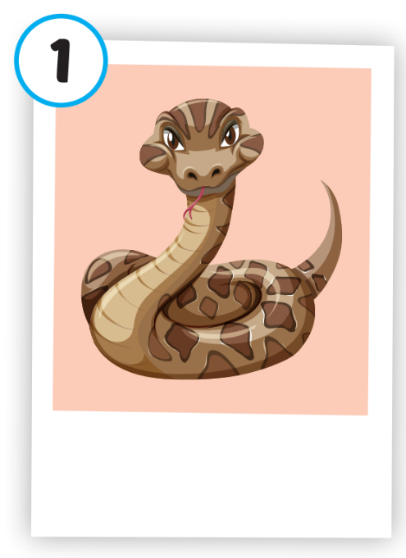
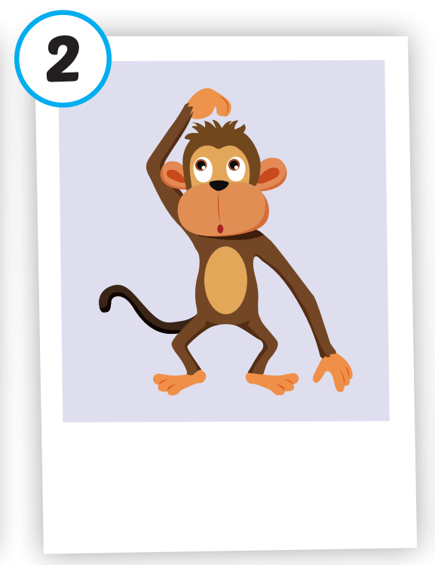
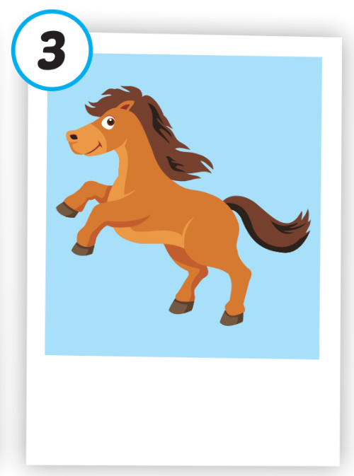
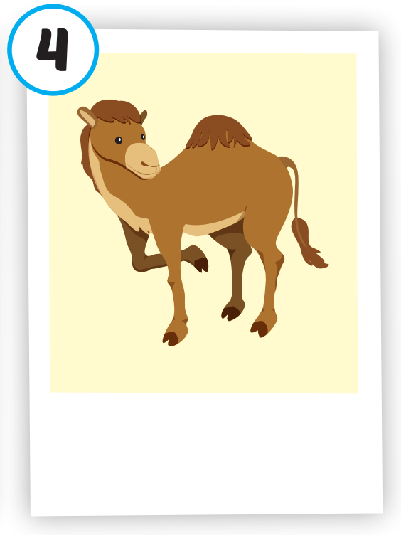
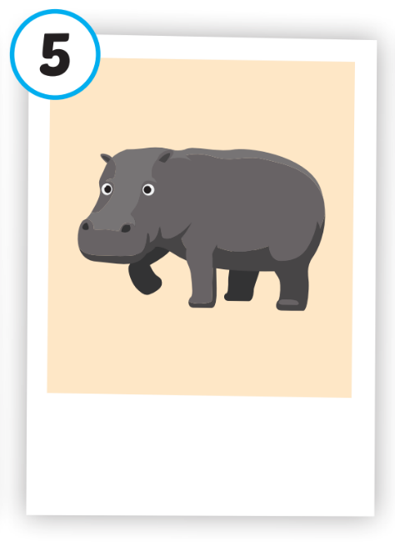
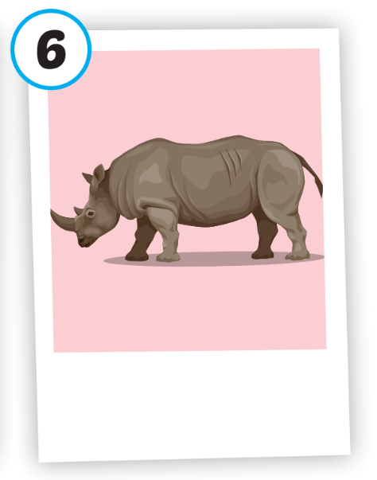






Click on each picture to hear the sound.
/hɔːrs/
con ngựa
/ˈkæməl/
con lạc đà
/ˈhɪpoʊ/
con hà mã
/ˈraɪnoʊ/
con tê giác
/sneɪk/
con rắn
/ˈmʌŋki/
con khỉ
Notes:
Click vào hình A. 1. Listen and point. Repeat để cho cả audio full chạy

Slide 4
Structure
This is a monkey.
These are monkeys.
That's a snake.
Those are snakes

Slide 5
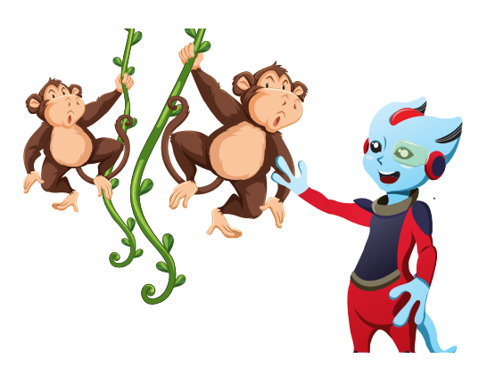
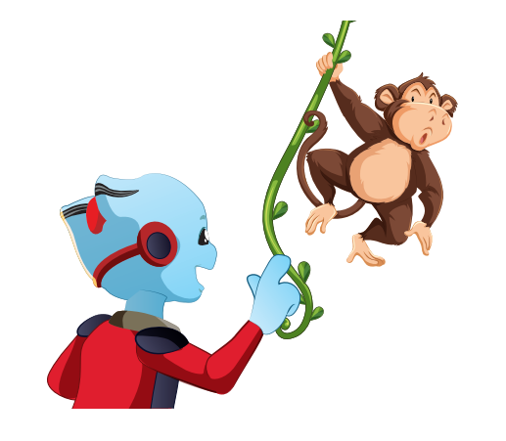


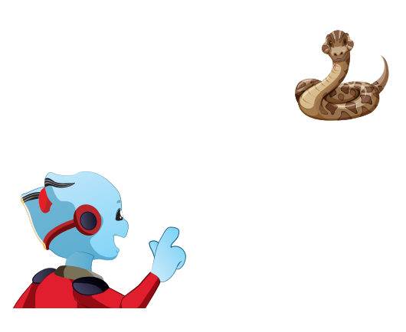
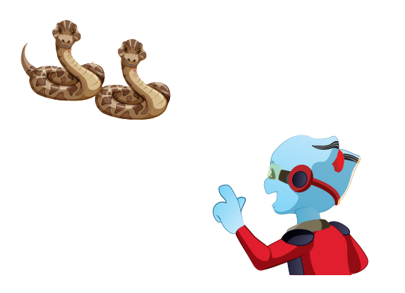



Structure
Click on the sentences to hear.

Slide 6
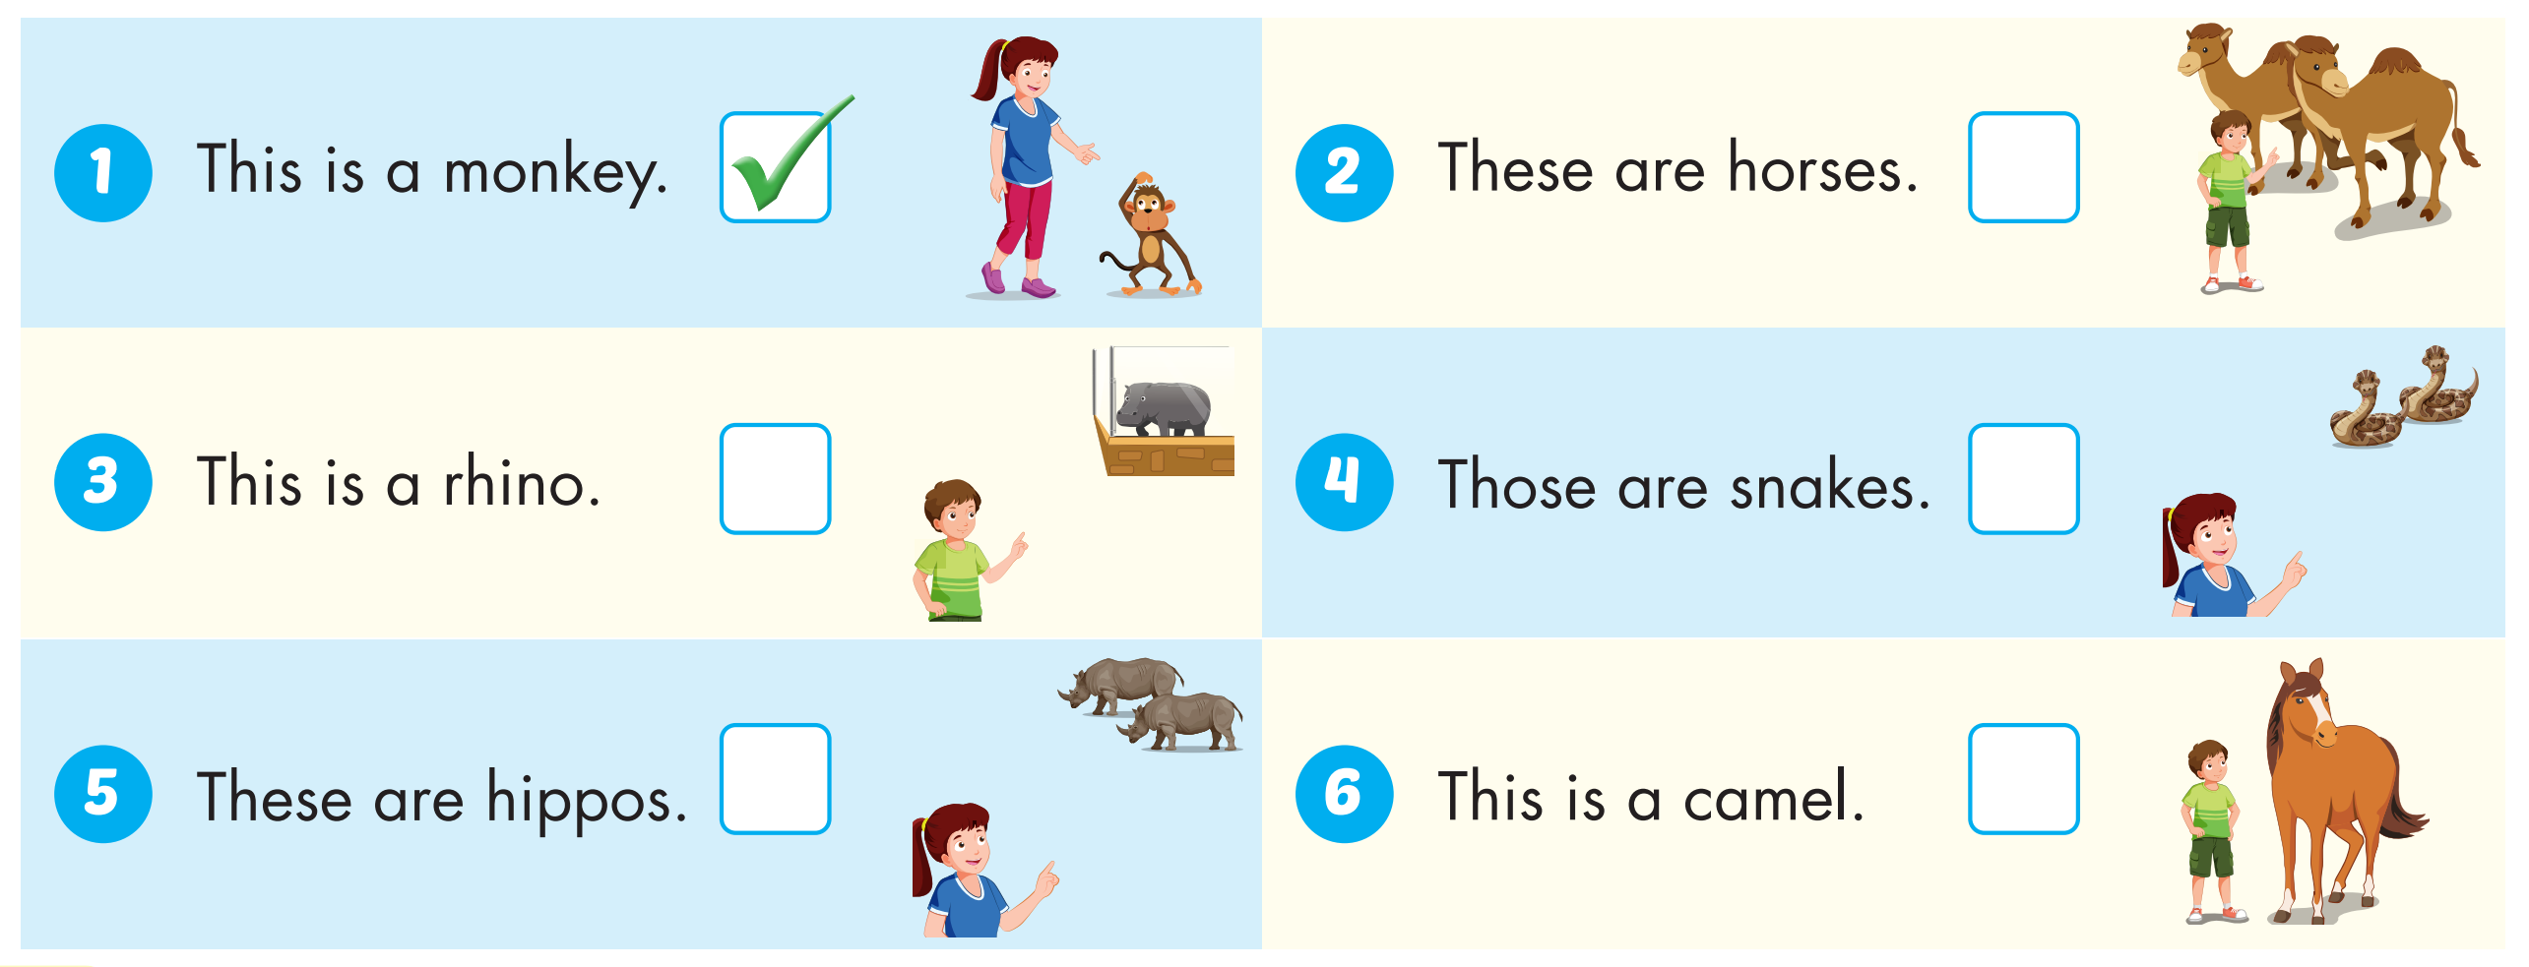



Slide 7

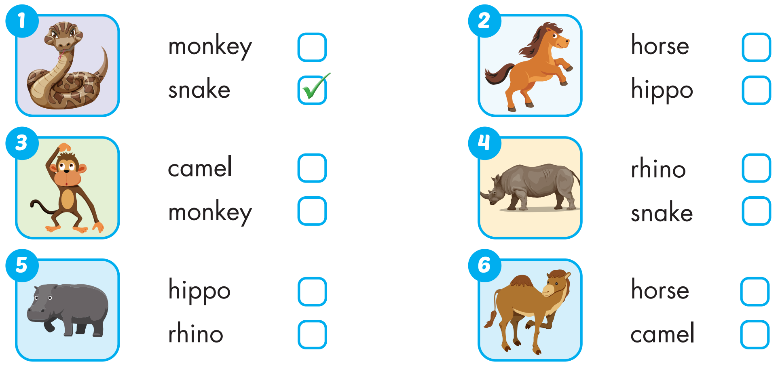
Extra Practice
WB, page 2

Slide 8
Homework
Practice the vocabularies and structure, and make sentences using them.
Do the exercises in Tiếng Anh 4 i-Learn Smart Start WB (page 2)
Do the exercises in Tiếng Anh 4 i-Learn Smart Start Notebook (page 4)
Prepare the next lesson (page 7 SB)
Play the consolidation games in Tiếng Anh 4 i-Learn Smart Start DHA App on www.eduhome.com.vn

