Slide 1

Unit 2
WHAT I CAN DO
LESSON 3.3 - PAGE 28

Slide 2

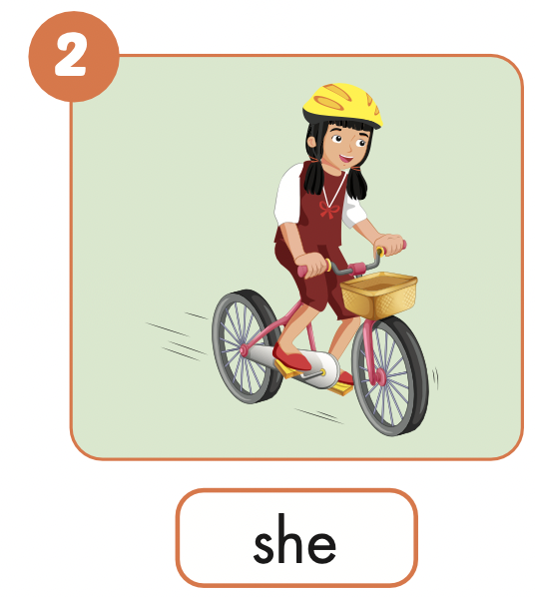
What can she do?
She can ride a bike.

Slide 3
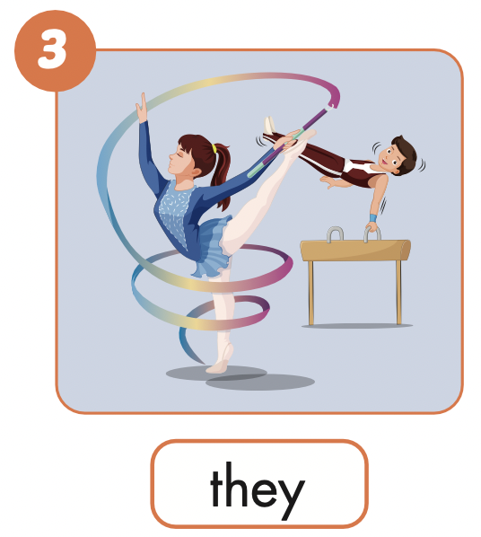
What can they do?
They can do gymnastics.

Slide 4
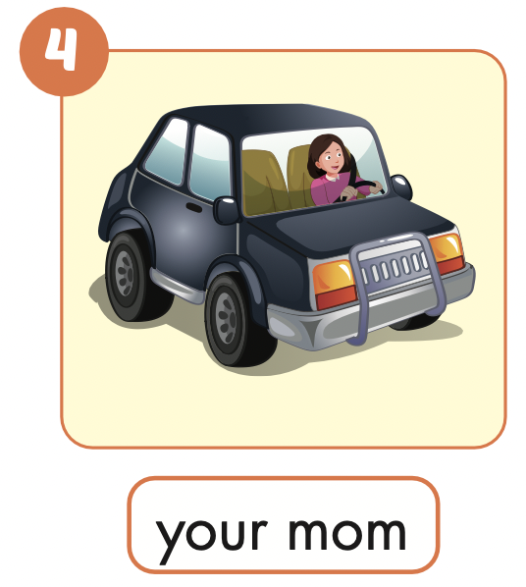
What can your mom do?
She can drive a car.

Slide 5
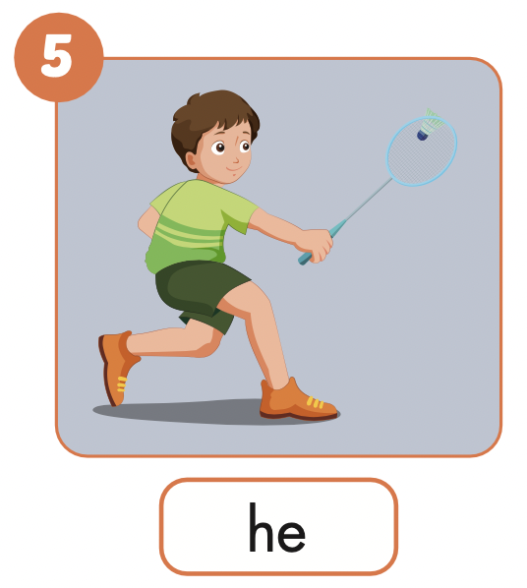
What can he do?
He can play badminton.

Slide 6
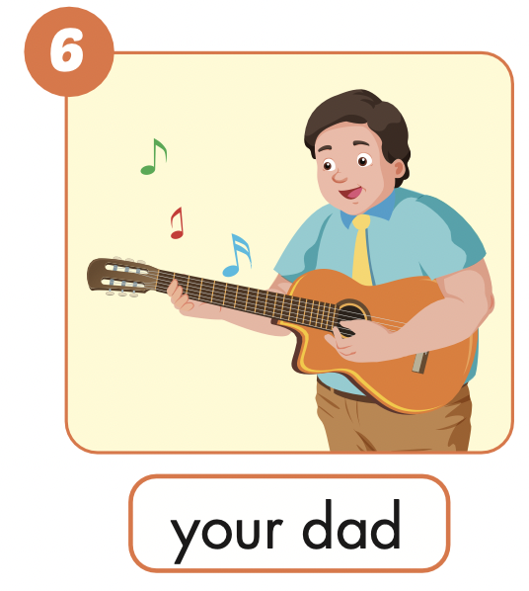
What can your dad do?
He can play the guitar.

Slide 7
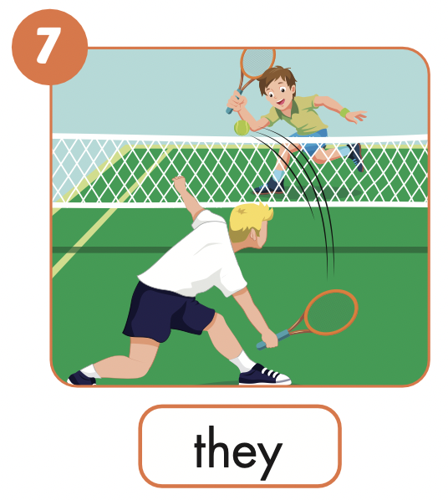
What can they do?
They can play tennis.

Slide 8
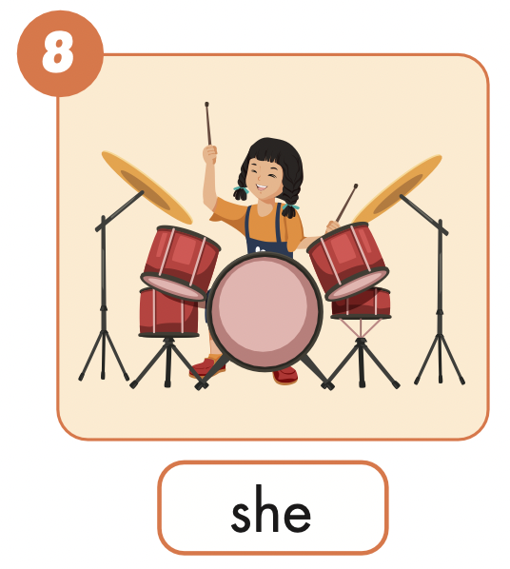
What can she do?
She can play the drums.

Slide 9

Production

Slide 10
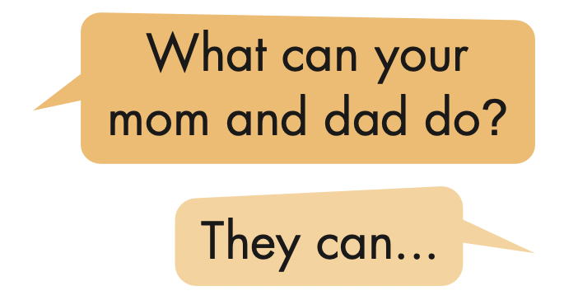
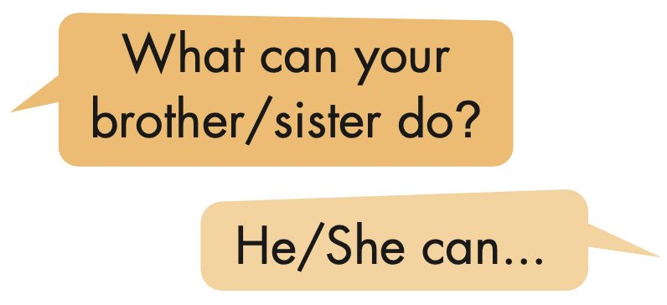
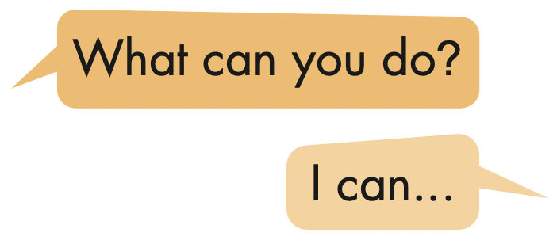
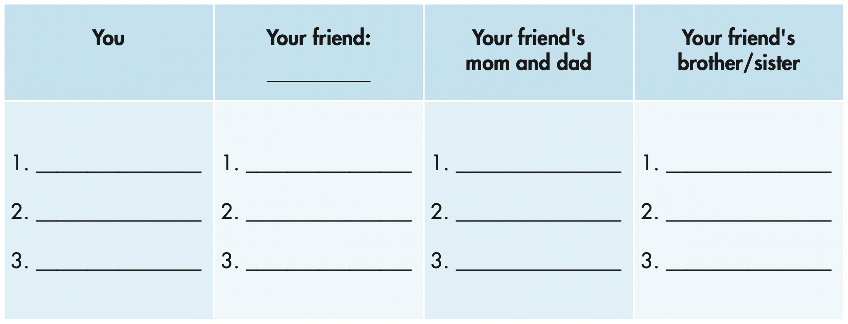

Slide 11
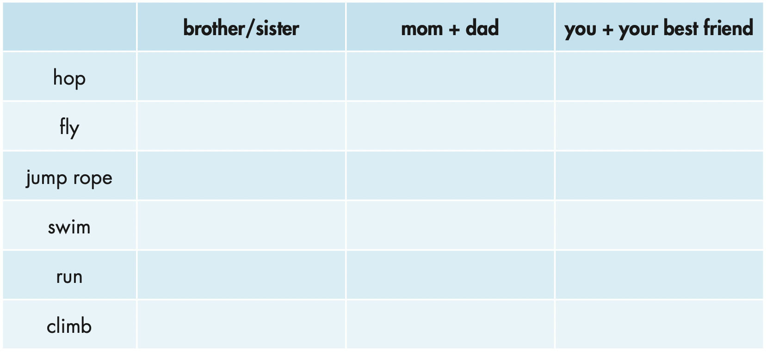


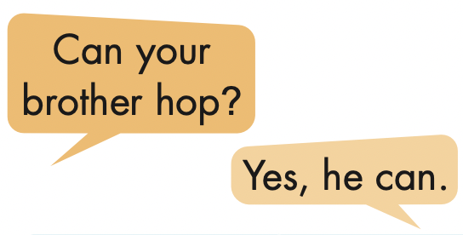
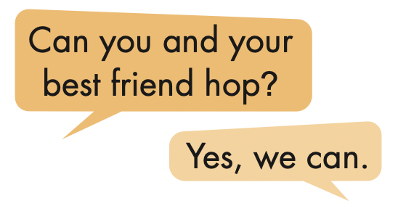
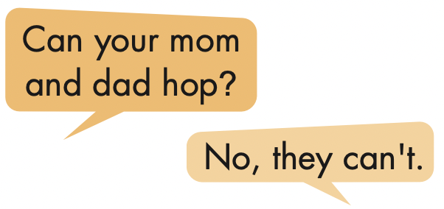

Slide 12

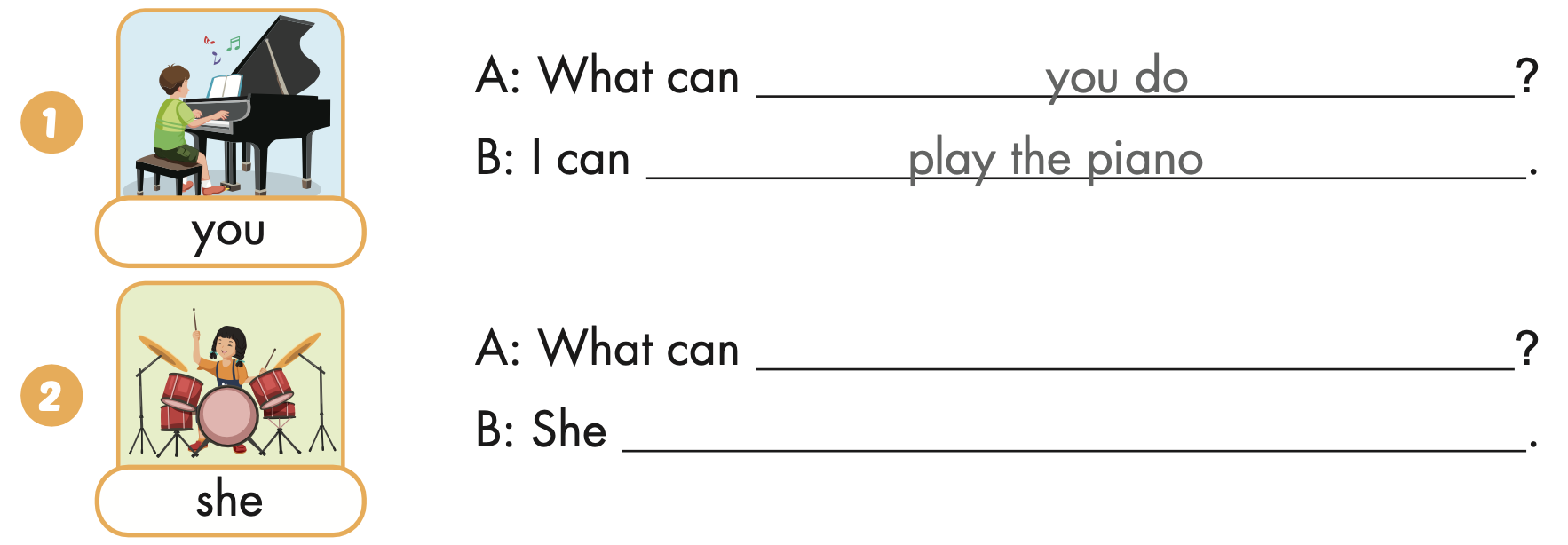
Extra Practice
WB, page 17
she do
can play the drums

Slide 13
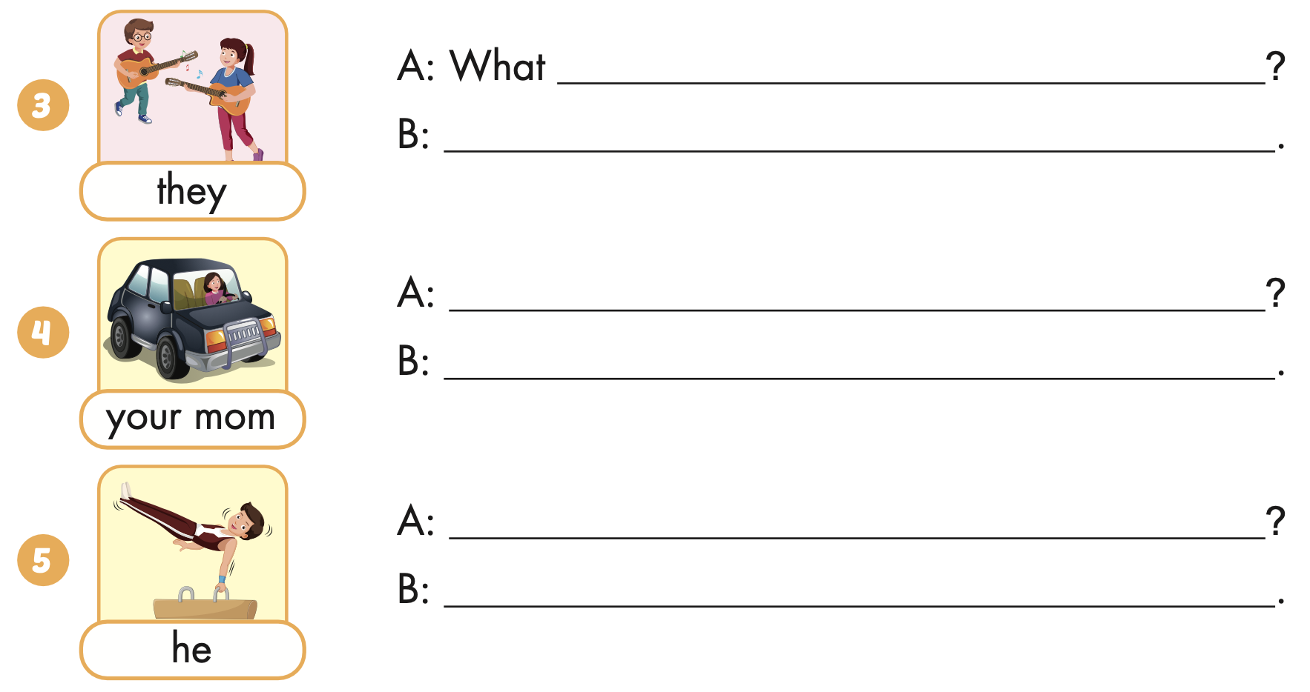
Extra Practice
WB, page 17
can they do
They can play the guitar
What can your mom do
She can drive a car.
What can he do
He can do gymnasyics

