Slide 1

Unit 2
WHAT I CAN DO
LESSON 3.1 - PAGE 26

Slide 2

New words
play the guitar, play the piano, drive a car,
ride a bike,
do gymnastics, play the drums.

Slide 3

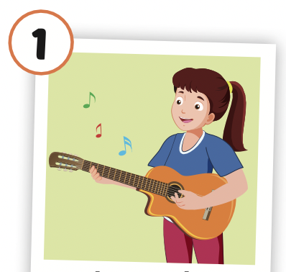

Click the picture to hear the sound.
play the guitar
/pleɪ ðə ɡɪˈtɑːr/
chơi đàn ghi-ta

Slide 4
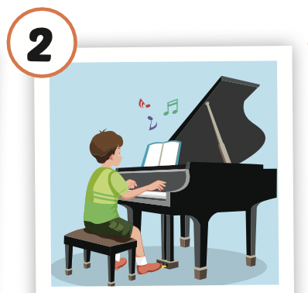
Click the picture to hear the sound.
play the piano
/pleɪ ðə piˈænoʊ/
chơi dương cầm/ đàn pi-a-nô

Slide 5
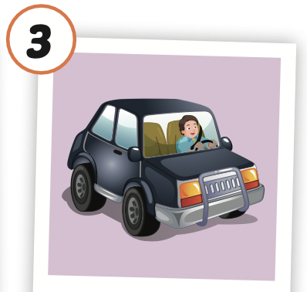
Click the picture to hear the sound.
drive a car
/draɪv ə kɑːr/
lái xe (4 bánh)

Slide 6
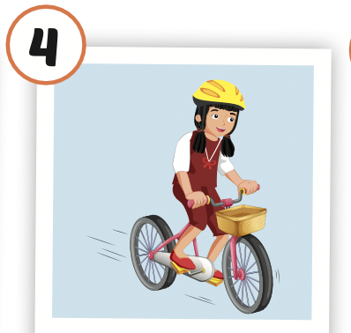
Click the picture to hear the sound.
ride a bike
/raɪd ə baɪk /
cưỡi xe đạp

Slide 7
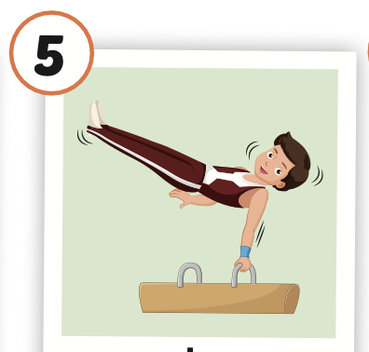
Click the picture to hear the sound.
do gymnastics
/duː dʒɪmˈnæstɪks/
tập thể dục dụng cụ

Slide 8
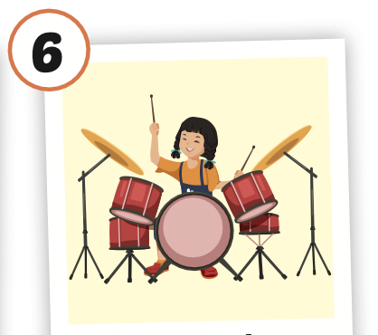
Click the picture to hear the sound.
play the drums
/pleɪ ðə drʌmz/
chơi trống

Slide 9

Practice

Slide 10
Structures
What can you do?
- I can play the piano.
What can your mom do?
- She can drive a car.
What can your friends do?
- They can ride bikes.

Slide 11

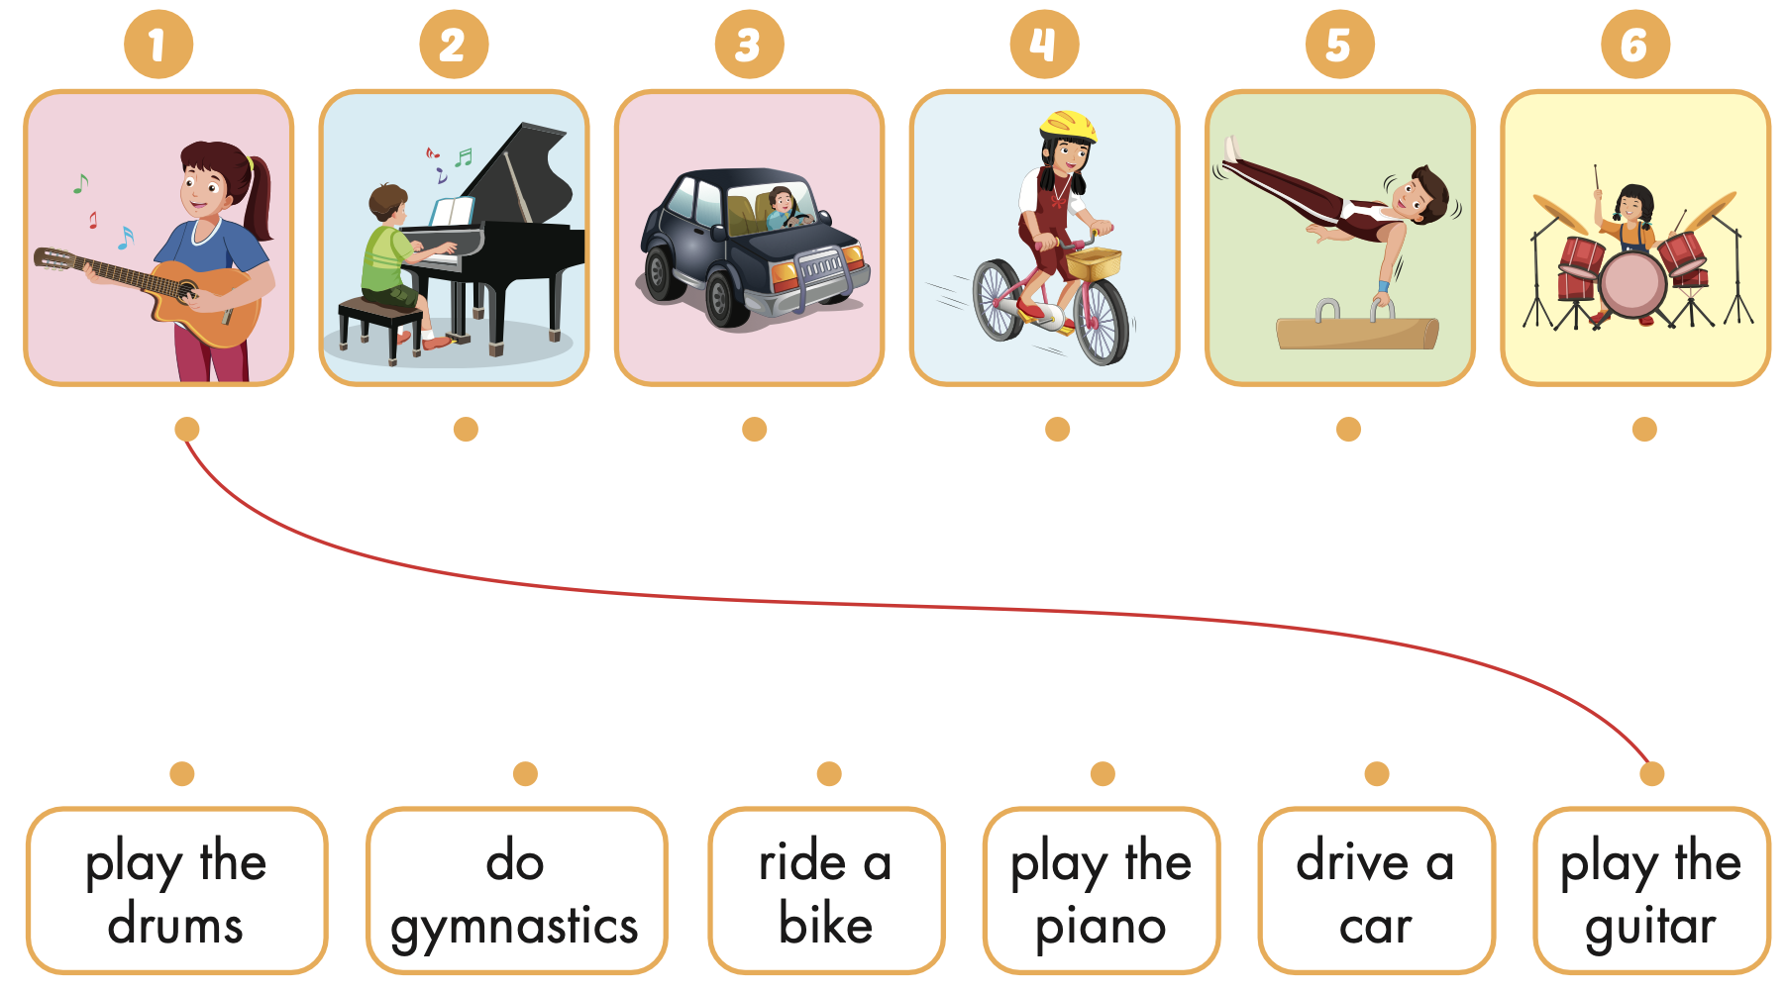
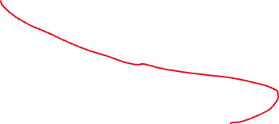


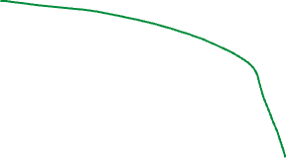

Extra Practice
WB, page 16

Slide 12
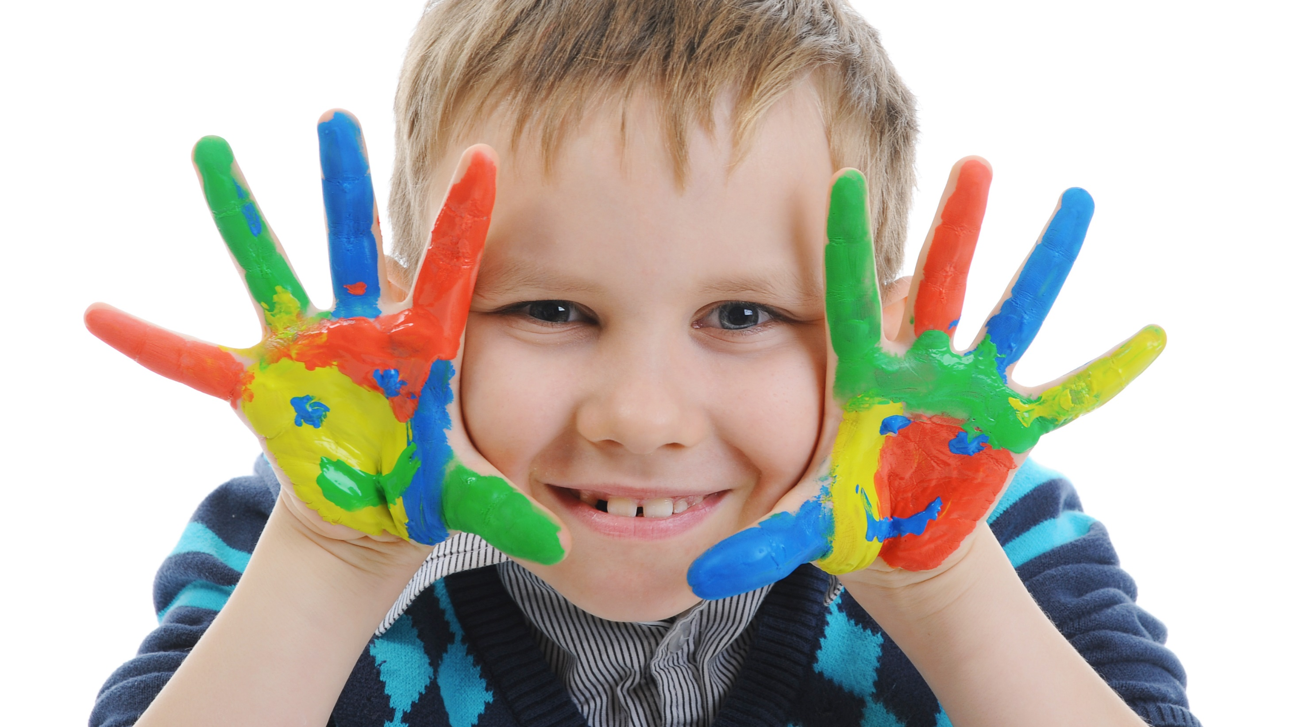
Enjoy your day!

