Slide 1

Unit 2
WHAT I CAN DO
LESSON 2.2 - PAGE 24

Slide 2

Phonics /p/ and /b/

Slide 3
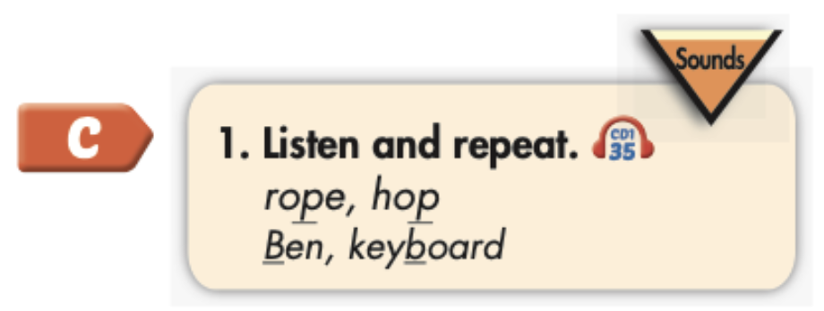

Click the icon to hear the sound.
rope
hop
Ben
keyboard
/roʊp/
/hɑːp/
/ben/
/ˈkiːbɔːrd /

Slide 4

Listening

Slide 5

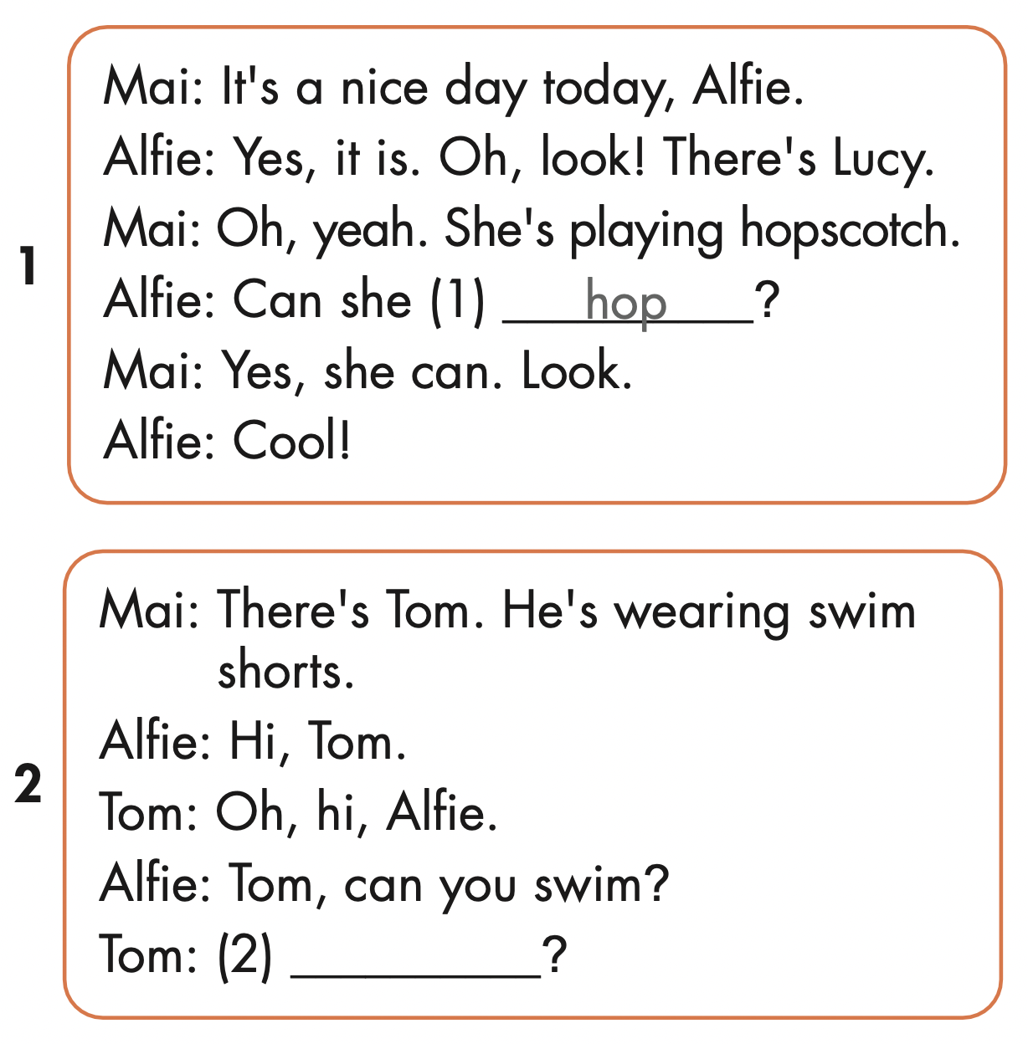
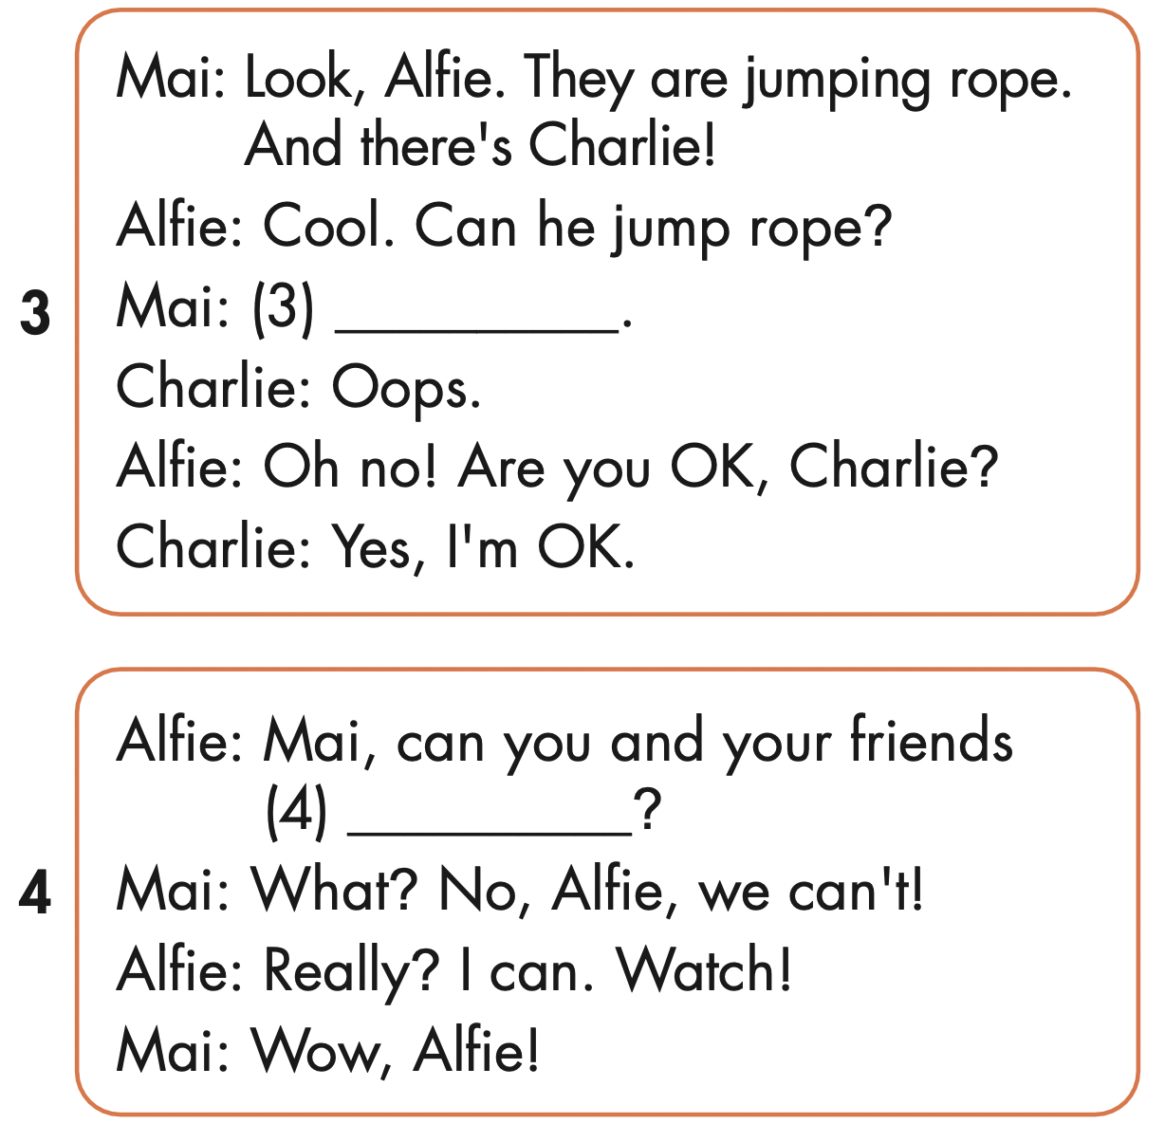
No, he can’t.
fly
Yes, I can.

Slide 6

Writing

Slide 7
MAKE YOUR OWN STORY

Slide 8

CONSOLIDATION

Slide 9

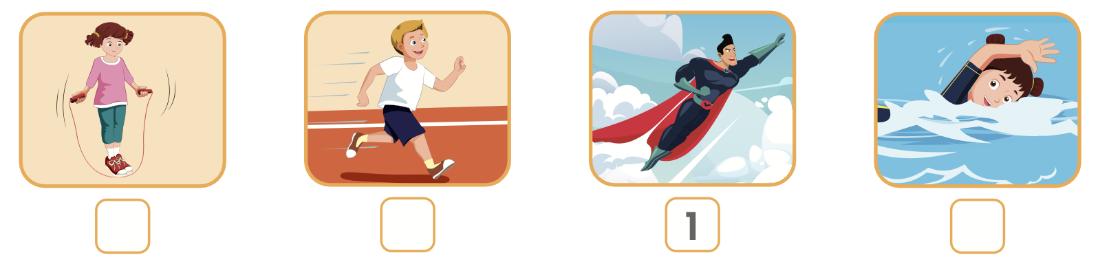
Extra Practice
WB, page 15
3
4
2

Slide 10

Enjoy your day!

