Slide 1
UNIT 2
WHAT I CAN DO
LESSON 2.1
Notes:
/

Slide 2
02
VOCABULARY

Slide 3
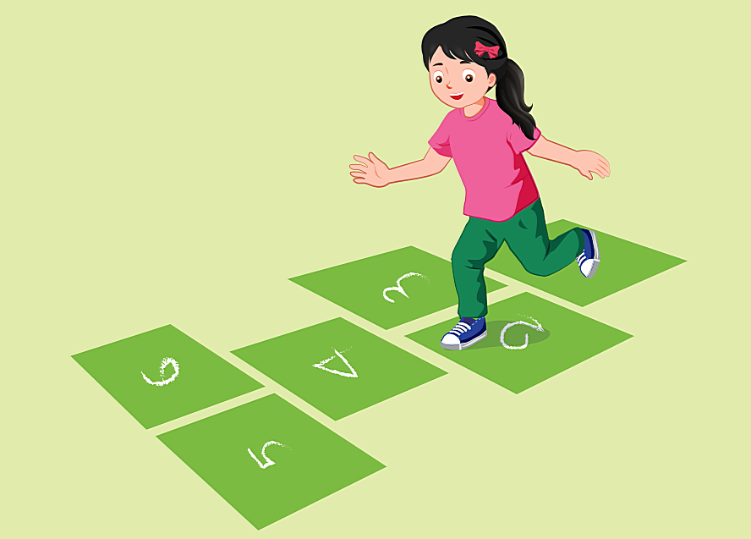

hop
Notes:
/

Slide 4

fly
Notes:
/

Slide 5
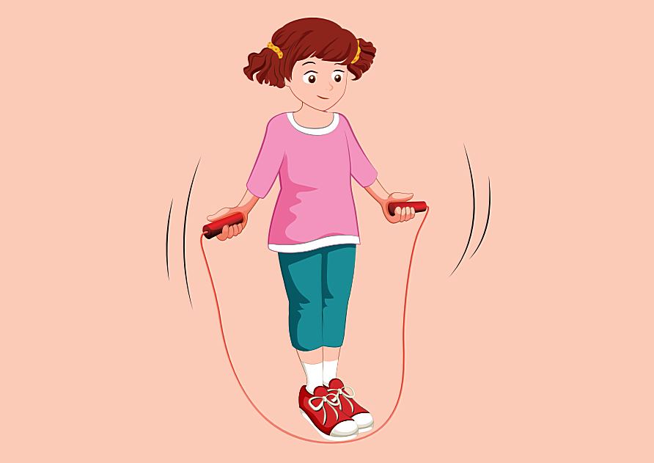
jump
(rope)

Slide 6
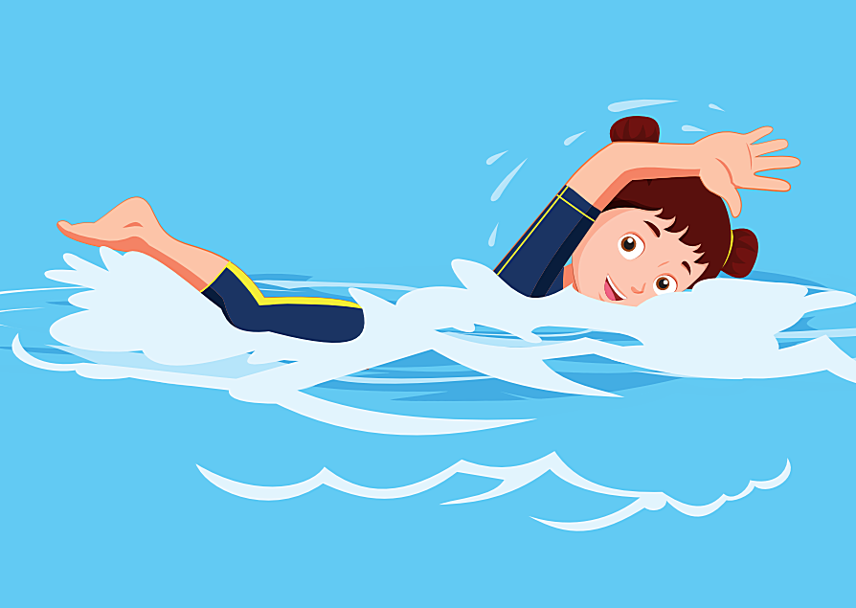
swim
Notes:
/

Slide 7
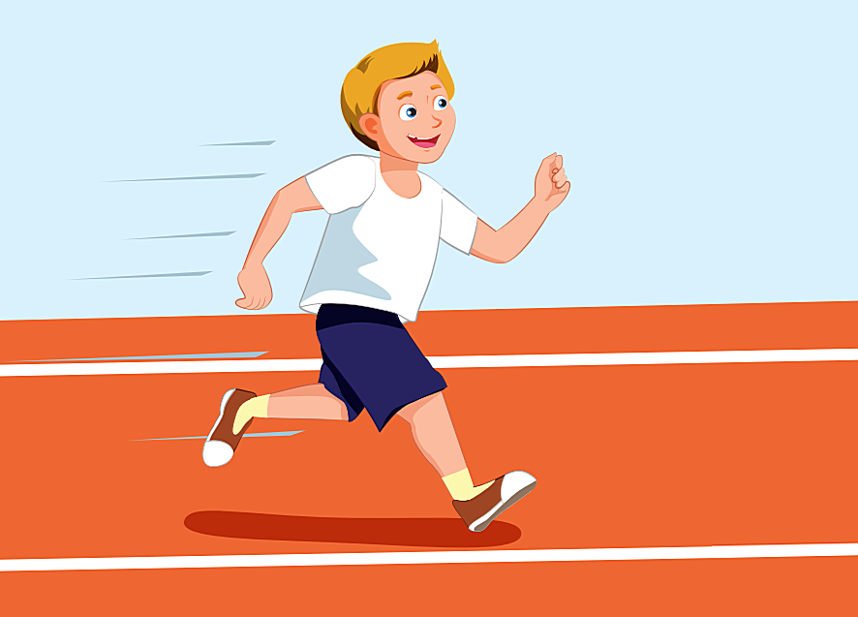
run

Slide 8
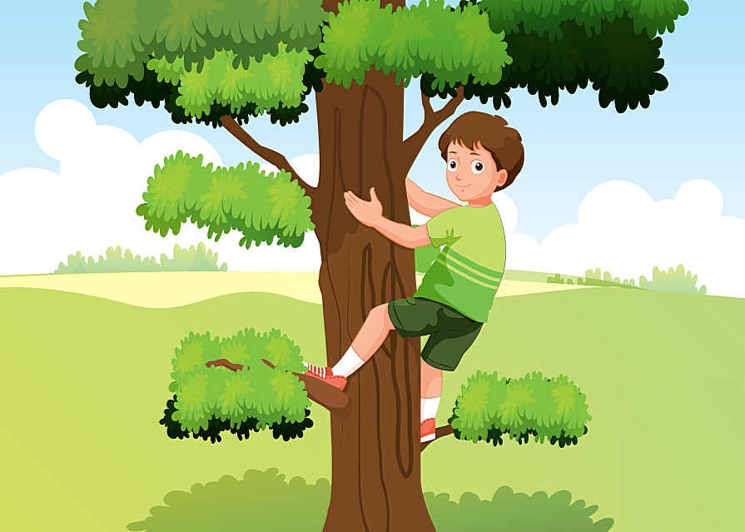
climb
(a tree)

Slide 9
03
GRAMMAR

Slide 10
Can+ he/ she+ V?
Yes, he/she can.// No, he/ she can’t.
1
Ex: Can he swim? Yes, he can.
Can+ you+ V?
Yes, we can.// No, we can’t.
2
Ex: Can you jump rope? No, we can’t.
Can+ they+ V?
Yes, they can.// No, they can’t.
3
Ex: Can they run? Yes, they can.
Notes:
/

Slide 11

GOOD BYE

