Slide 1

Getting Started
Lesson 2
Page 6

Slide 2
Lesson Outline
Warm-up
Vocabulary
Structure
Consolidation
Wrap-up

Slide 3
Objectives
By the end of this lesson, students will be able to follow simple instructions in class.
Vocabulary:
open your book, close your book, hands down
Structures:
Open your book./ Close your book./
Hands down./ Yes, Teacher.

Slide 4

WARM UP

Slide 5


Look, guess, and spell.
h
a
n
d
s
u
p

Slide 6

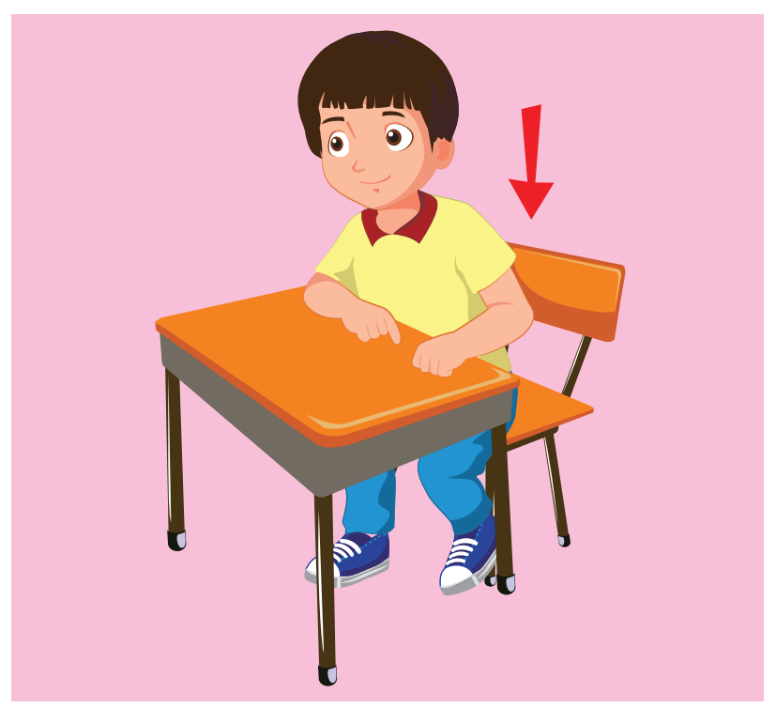
Look, guess, and spell.
s
i
t
d
o
w
n

Slide 7
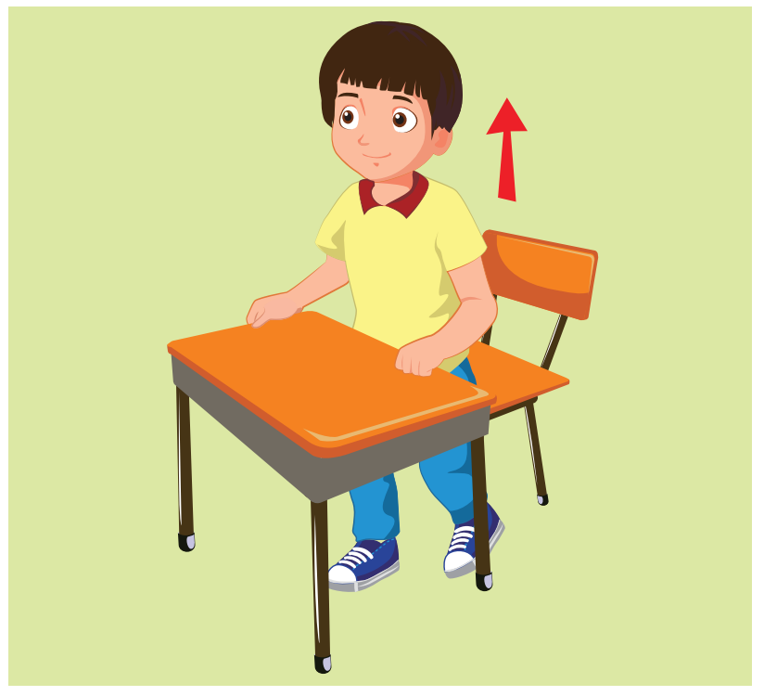

Look, guess, and spell.
s
t
a
n
d
u
p

Slide 8


Look, guess, and spell.
b
o
o
k

Slide 9

It’s time to learn …

Slide 10

New words
open your book close your book hands down

Slide 11

Presentation

Slide 12




A
Listen and point. Repeat. (CD1 Track 04)
1
2
3
open your book
close your book
hands down
/ˈoʊpən jʊr bʊk/
mở sách ra
/kləʊz jʊr bʊk/
đóng sách lại
/hændz daʊn/
hạ tay xuống
Click on each English word to hear the sound.

Slide 13
Look at the vocabulary and do the action.
Perfect!
open your book
close your book
hands down
close your book
close your book
hands down
close your book
hands down
open your book
hands down
hands down
open your book
hands down
hands down
hands down
close your book
open your book
hands down
close your book
hands down
open your book
open your book
hands down
close your book
close your book
hands down
hands down
close your book
hands down
open your book
open your book
close your book

Slide 14
Structures
Close your book,
Open your book,
Hands down/
Yes, Teacher

Slide 15
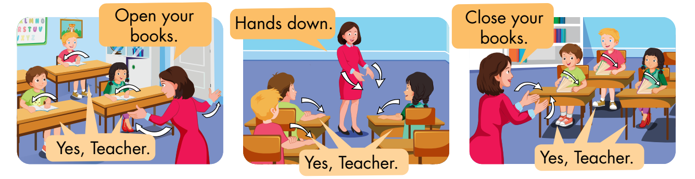
B
Listen and point. Repeat. Role-play. (CD1 Track 05)
Notes:
B. Listen and point. Repeat. Role-play. (CD1 Track 05)
Have students call out the things they can see in each picture.
Play the audio and have them point to the characters.
Play the audio again and have them repeat the new words.
Divide the class into pairs to role-play the dialogue.
Swap roles and repeat.
Invite some pairs to demonstrate the activity in front of the whole class.
Go around the class and support them if necessary.

Slide 16

Practice

Slide 17
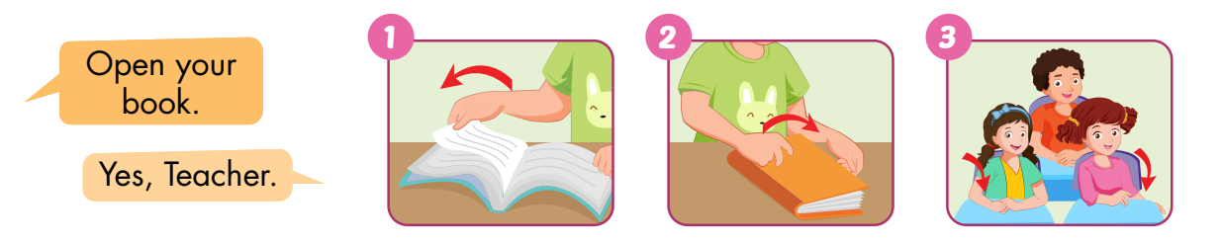
C
Point, say, and do.
Notes:
C. Point, say, and do.
Divide the class into two teams.
Show a flashcard to the class.
Have Team A call out the command and Team B do the action.
Swap roles and repeat.
Monitor the class and support if needed.

Slide 18
Speaking

Slide 19
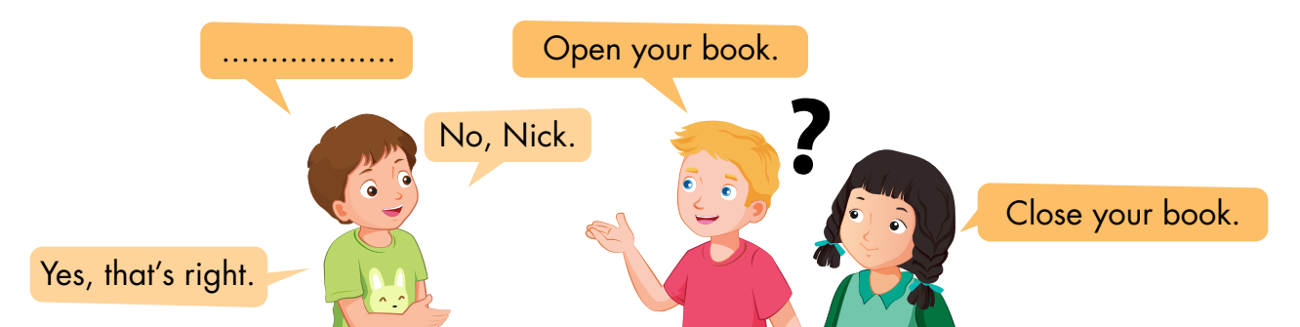
D
Play Read my lips.

Slide 20
Further Practice

Slide 21
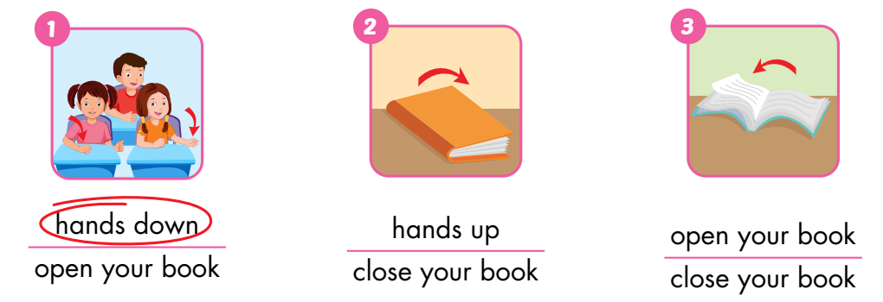
A
Look and circle.

Slide 22
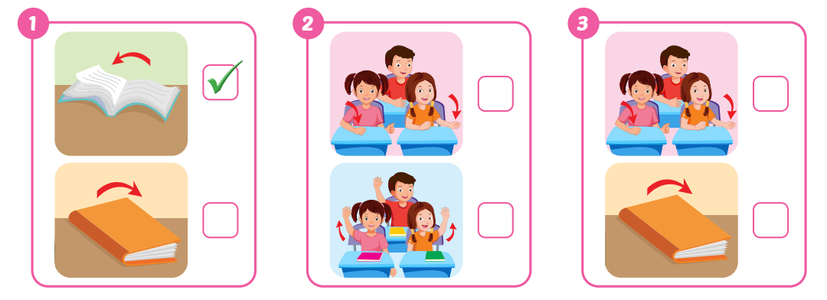
B
Listen and tick (✓) the box. (WB Track 03)
✓
✓

Slide 23
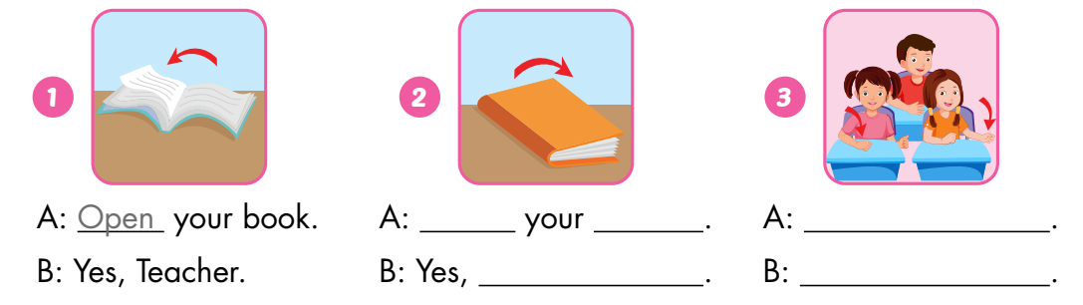
C
Look and write.
Close
book
Hands down
Teacher
Yes, Teacher

Slide 24
Consolidation

Slide 25

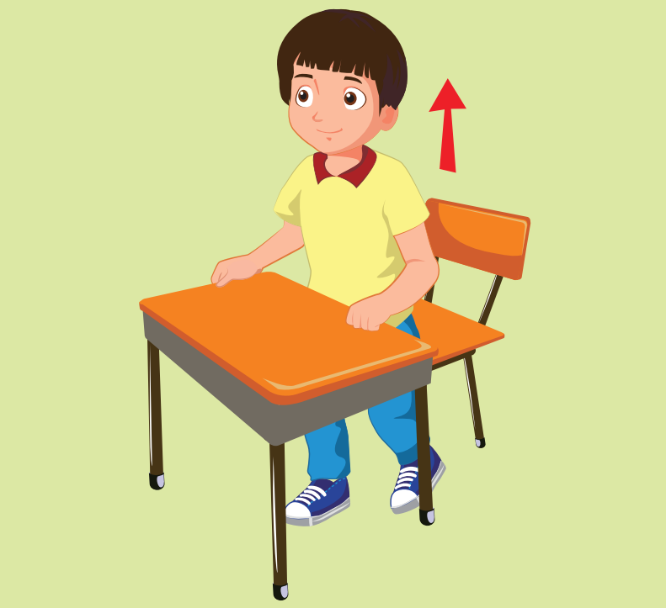
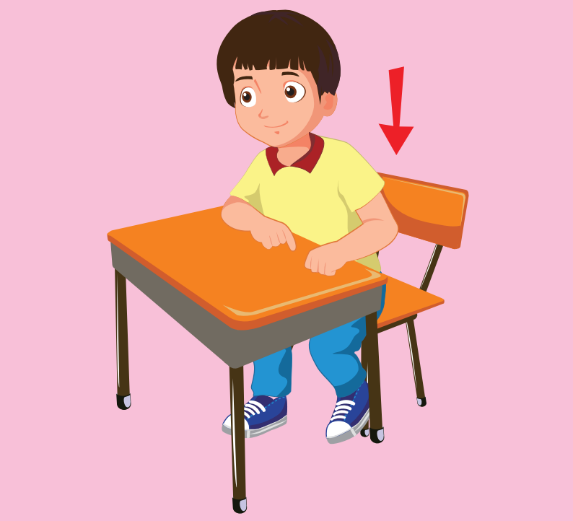

Hot Seat
Notes:
Hot Seat
Divide the class into two groups.
Ask a student from each team to come to the front of the class, sit on chairs, and face to the class.
Show the picture and have other students use their body language to describe the picture.
The student who says the vocabulary first will a point for their team.

Slide 26

WRAP-UP

Slide 27
Today’s lesson
Vocabulary:
open your book, close your book, hands down
Structures:
Open your book./ Close your book./
Hands down./ Yes, Teacher.

Slide 28
Homework
Practice vocabularies and structure. Make sentences using them.
Do the exercises in Tiếng Anh 3 i-Learn Smart Start Workbook (page 4).
Practice the vocabulary and structure in Tiếng Anh 3 i-Learn Smart Start Notebook (page 4).
Play the consolidation games in Tiếng Anh 3 i-Learn Smart Start DHA App on www.eduhome.com.vn
Prepare the next lesson (page 7).

Slide 29

Have a nice day!

