Slide 1

Unit 1: My friends
Lesson 1.2
Page 11

Slide 2

1
2
A
E
H
L
F
D
G
O
C
B
S
A =>
B =>
C =>
E =>
F
D =>
G => H => L => O => S
3
4
M
N
I
Y
R
J
U
W
Z
S
F
T
X
P
M =>
N => R => T => U => W
F =>
I => J => P => S => X => Y => Z
Notes:
- There are 4 rounds

Slide 3

Phonics
/sp/

Slide 4


spell
space
Act1. Read and say YES
or NO Listen and check.
spider
spring
strong
speak
spider
spring
surprise
spicy
sport
speak
sport
star
spoil
spicy
spoil
spa
spa
Notes:
(spider, strong, surprise, sport, spoil, spring, speak, spicy, star, spa) audios from Cambridge Dictionary
Click the picture to hear the sound the Aud 14
Click each word to hear the sound of each word
Act 1; click the words to hear the sounds

Slide 5

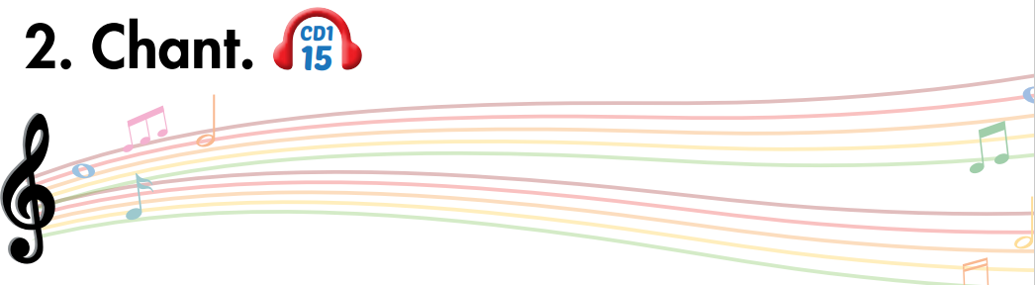
sp
spell
space

Slide 6


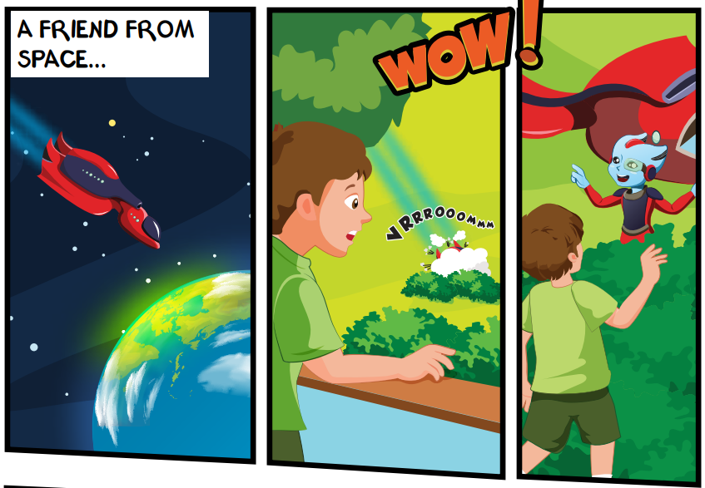
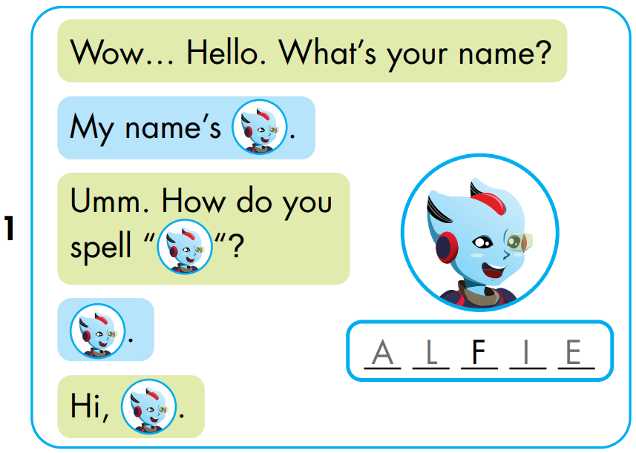


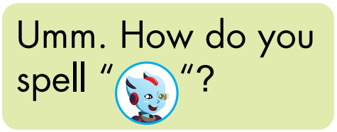


A
L
I
E
Notes:
Click the picture to hear the entire story
Click on the BIG PORTRAIT OF ALFIE to hear the CONVERSATION
Click on each sentence to hear the sound.
Click on THE SPACE (BACKGROUND) to reveal the answer.

Slide 7
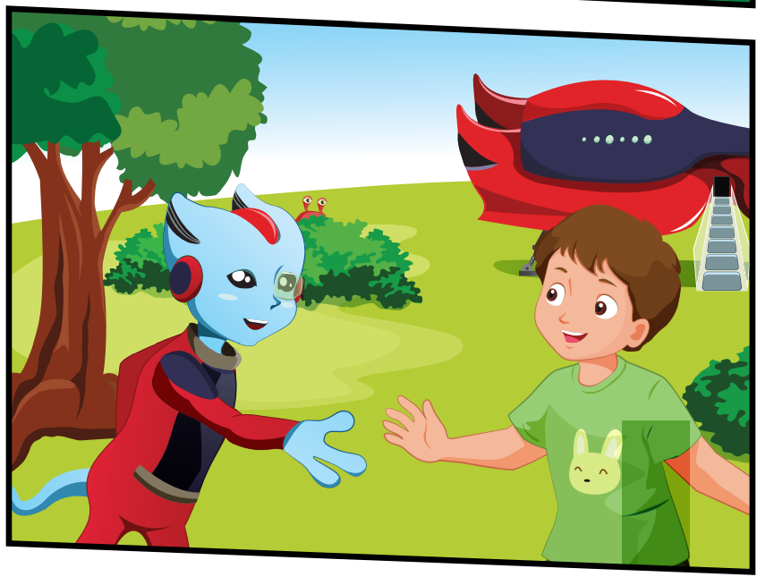
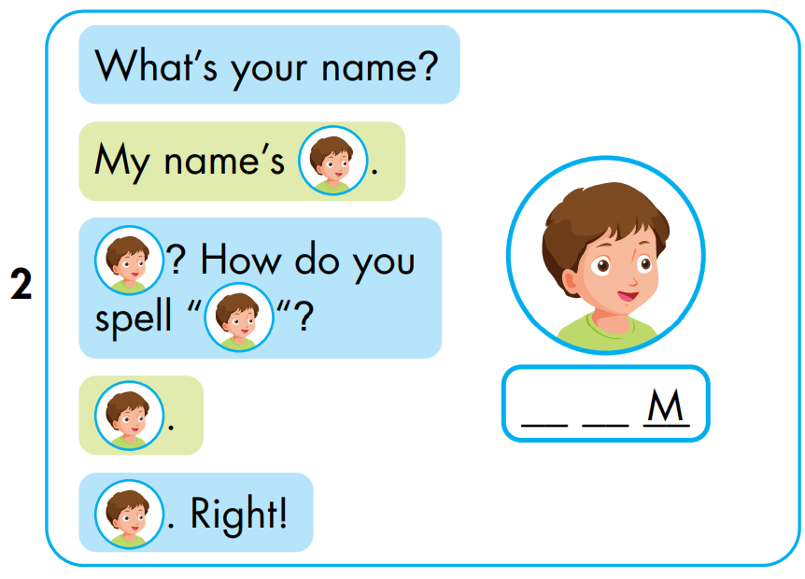


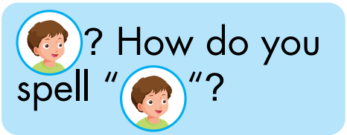

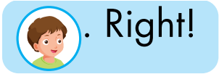
T
O
Notes:
Click the picture to hear the entire story
Click on the BIG PORTRAIT OF ALFIE to hear the CONVERSATION
Click on each sentence to hear the sound.
Click on THE SPACE (BACKGROUND) to reveal the answer.

Slide 8
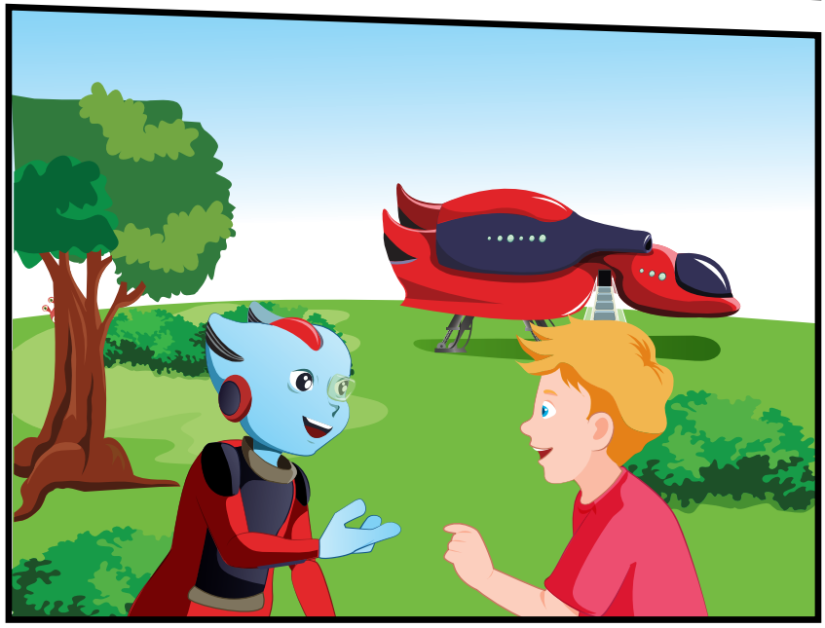
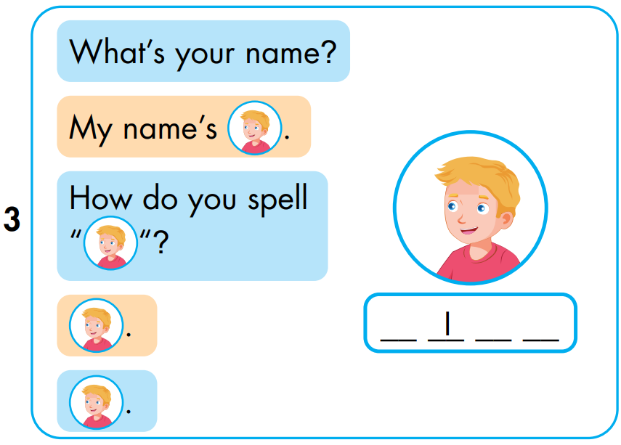


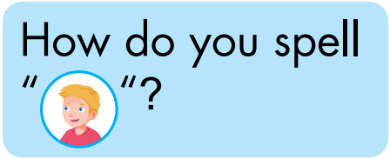
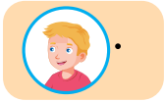

N
C
K
Notes:
Click the picture to hear the entire story
Click on the BIG PORTRAIT OF ALFIE to hear the CONVERSATION
Click on each sentence to hear the sound.
Click on THE SPACE (BACKGROUND) to reveal the answer.

Slide 9

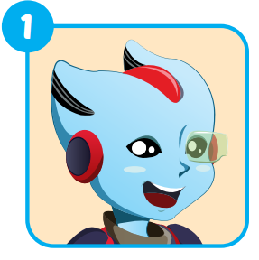
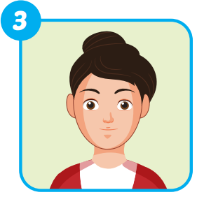
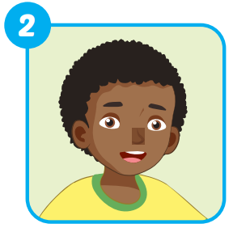
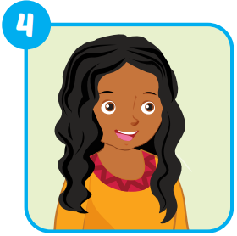
Extra 1 – WB p9
A _ _ _ _
ALFIE
_ _ _ _
MARY
_ _ _ _
HUGO
ELLA
_ _ _ _

Slide 10

Pop
-up

Slide 11
1
2
4
3
7
5
6
8
Notes:
Divide students into small group (2-3)
In turn, each team choose 1 option => a lot of letters automatically pop up => students have to say aloud at the same time. (speed can be adjusted)
Students in the team play one by one.
For example: Team A has 3 students. The 1st one tries and names all the letters correctly. The 2nd one cannot. They 3rd one cannot. => The whole team got 1 POINT.
Team B has 3 students. Two of whom name the letters correctly. The other one does not. => They got 2 POINTS.

Slide 13
q
c
y
z
r
READY
GO
n
e
a
g
i
o
p
f
Notes:
Click the Arrow to Replay
Click the House to come back the main theme.

Slide 15
q
z
m
d
r
READY
GO
p
b
k
g
i
o
L
f
Notes:
Click the Arrow to Replay
Click the House to come back the main theme.

Slide 17
L
z
e
s
r
READY
GO
p
c
h
g
i
o
t
f
Notes:
Click the Arrow to Replay
Click the House to come back the main theme.

Slide 19
k
q
a
s
b
READY
GO
n
z
h
o
m
s
t
f
Notes:
Click the Arrow to Replay
Click the House to come back the main theme.

Slide 21
k
L
c
f
b
READY
GO
w
s
r
o
n
v
t
g
Notes:
Click the Arrow to Replay
Click the House to come back the main theme.

Slide 23
d
f
a
i
p
READY
GO
q
t
r
m
n
w
v
h
Notes:
Click the Arrow to Replay
Click the House to come back the main theme.

Slide 25
o
u
a
e
y
READY
GO
a
g
r
s
t
p
v
h
Notes:
Click the Arrow to Replay
Click the House to come back the main theme.

Slide 27
o
i
a
f
y
READY
GO
n
b
x
g
d
r
w
t
Notes:
Click the Arrow to Replay
Click the House to come back the main theme.

