Slide 1

Unit 8: Food
Review & Practice 2
Page 123

Slide 2
Lesson Outline
Warm-up
Speaking
Consolidation
Wrap-up

Slide 3
Objectives
By the end of this lesson, students will be able to…
Vocabulary: review all vocabulary learned in Unit 8.
Speaking: practice asking and answering questions, playing a board game.

Slide 4

WARM UP

Slide 5
WHAT’S NEXT?
No__ __ __ __ __
Noodles
Cu__ __ __ __ __
Cupcake
Ba__ __ __ __
Banana
Ca__ __ __ __
Carrot
Do__ __ __
Donut

Slide 6
WHAT’S NEXT?
Pi__ __ __
Pizza
Ch__ __ __ __ __
Chicken
Ca__ __
Cake
Ap__ __ __
Apple
On__ __ __
Onion
To__ __ __ __
Tomato

Slide 7

It’s time to learn …

Slide 8

Speaking

Slide 9
PRE-SPEAKING
Rearrange these words to make a sentence.
bananas. are three There
There are three bananas.

Slide 10
PRE-SPEAKING
Rearrange these words to make a sentence.
like some Would pizza? you
Would you like some pizza?

Slide 11
PRE-SPEAKING
Rearrange these words to make a sentence.
carrots. are some Yes, there
Yes, there are some carrots.

Slide 12
PRE-SPEAKING
Rearrange these words to make a sentence.
there No, apples. are three
No, there are three apples.

Slide 13
PRE-SPEAKING
Rearrange these words to make a sentence.
a there potato? Is
Is there a potato?

Slide 14
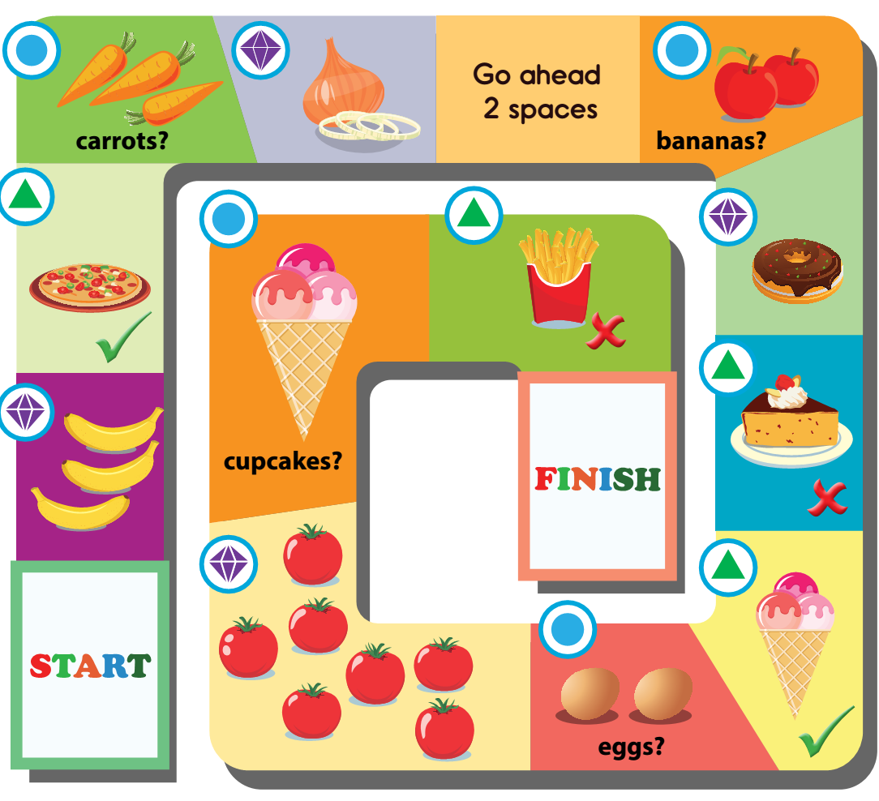
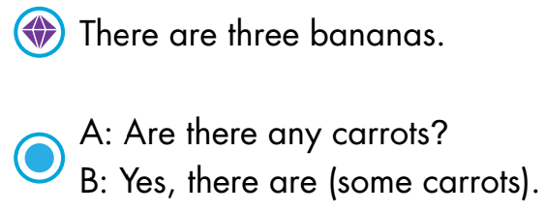
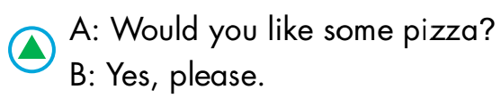
WHILE-SPEAKING
See the next slide to know how to play the game

Slide 15
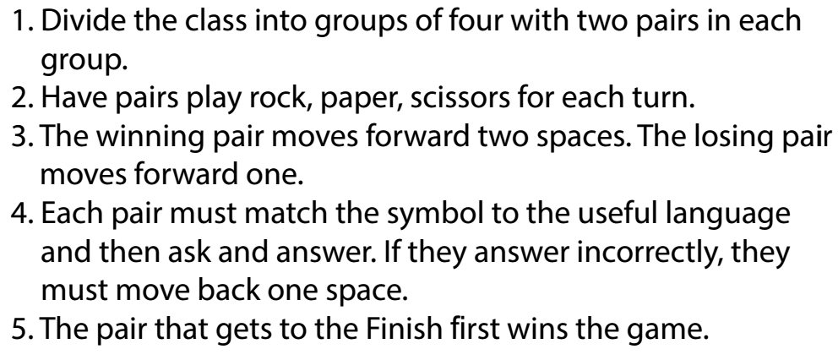
HOW TO PLAY

Slide 16
WHILE-SPEAKING

Slide 17


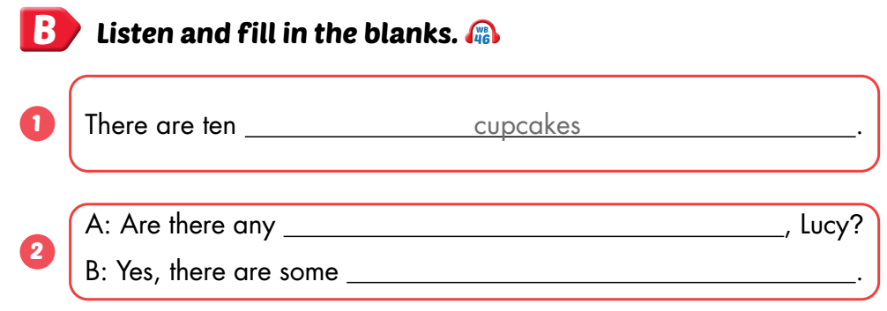
Workbook, p.87
POST-SPEAKING
eggs
eggs

Slide 18

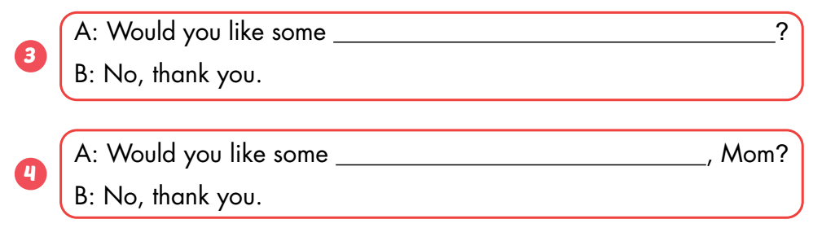
Workbook, p.87
cake
fries

Slide 19
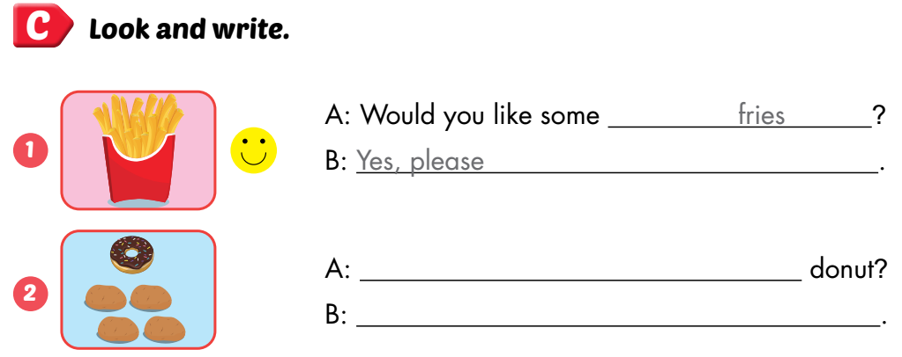
Workbook, p.87
Is there a
Yes, there is a donut

Slide 20

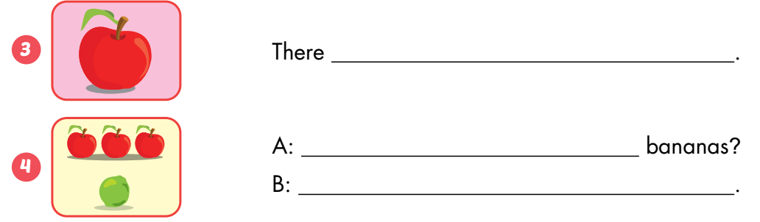
Workbook, p.87
is an apple
Are there any
No, there aren’t

Slide 21

CONSOLIDATION

Slide 22

WRAP-UP

Slide 23
Lesson 3
Today’s lesson
Vocabulary
Review all vocabulary learned in Unit 8
Speaking
Practice asking and answering questions by playing a board game

Slide 24
Lesson 3
Homework
Review the vocabularies, structures, and make sentences using them.
Do the exercises in Tiếng Anh 3 i-Learn Smart Start WB (page 87).
Do the exercises in Tiếng Anh 3 i-Learn Smart Start Notebook (page 57).
Prepare the next lesson (page 124 SB).
Play games in Tiếng Anh 3 i-Learn Smart Start DHA App on www.eduhome.com.vn

Slide 25

Have a nice day!

