Slide 1

Unit 8: Food
Lesson 3.1
Page 116

Slide 2
Lesson Outline
Warm-up
Vocabulary
Structure
Consolidation
Wrap-up

Slide 3
Objectives
By the end of this lesson, students will be able to…
Vocabulary: learn and practice fries, pizza, cake, ice cream, chicken, fish
Structure: learn and practice
Would you like some fries?
Yes, please./Sure, thanks!
No, thank you.

Slide 4

WARM UP

Slide 5


Notes:
Click đến khi lộ ra hình

Slide 6
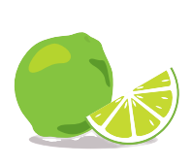
Notes:
Click đến khi lộ ra hình

Slide 7
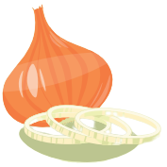
Notes:
Click đến khi lộ ra hình

Slide 8

Notes:
Click đến khi lộ ra hình

Slide 9
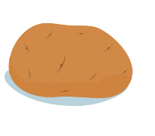
Notes:
Click đến khi lộ ra hình

Slide 10

It’s time to learn …

Slide 11

New words
fries, pizza, cake, ice cream, chicken, fish

Slide 12

Presentation

Slide 13


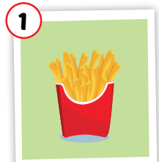
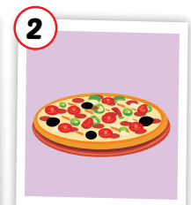
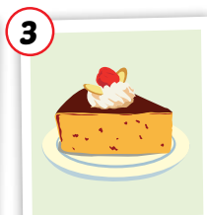
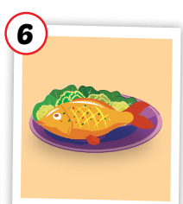
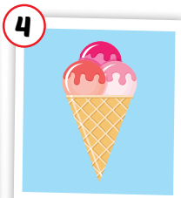
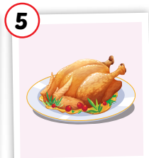
Click each icon to hear the sound
fries
pizza
cake
ice cream
chicken
fish
/fraɪz/
khoai tây chiên
/ˈpiːtsə/
Bánh pi-za
/keɪk/
bánh ngọt
/ˈaɪs kriːm/
kem
/ˈtʃɪkɪn/
thịt gà
/fɪʃ/
con cá, món cá
Notes:
Click chữ nghe đọc

Slide 14
Click the icon to hear the sound
fries
/fraɪz/
khoai tây chiên

Slide 15
Click the icon to hear the sound
pizza
/ˈpiːtsə/
Bánh pi-za

Slide 16
Click the icon to hear the sound
cake
/keɪk/
bánh ngọt

Slide 17
Click the icon to hear the sound
ice cream
/ˈaɪs kriːm/
kem

Slide 18
Click the icon to hear the sound
chicken
/ˈtʃɪkɪn/
thịt gà

Slide 19
Click the icon to hear the sound
fish
/fɪʃ/
con cá, món cá

Slide 20

Practice

Slide 21
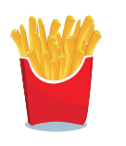
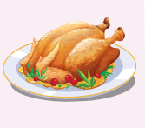


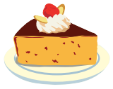
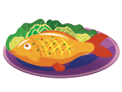
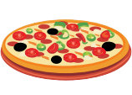
MEMORY GAME
1
2
3
4
5
6
7
8
9
10
11
12
13
14
15
16
17
18
Notes:
Bấm vào số để hiện hình, bấm vào mũi tên để giấu hình lại

Slide 22
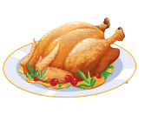
SLAP THE BOARD

Slide 23

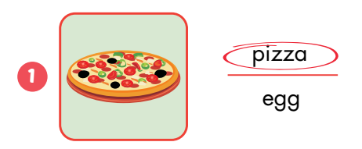
Extra Practice
WB, P. 82

Slide 24
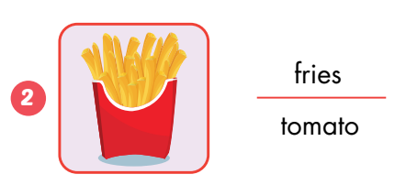
Extra Practice
WB, P. 82

Slide 25
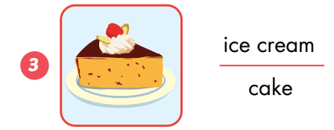
Extra Practice
WB, P. 82

Slide 26
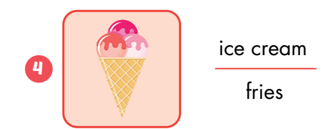
Extra Practice
WB, P. 82

Slide 27
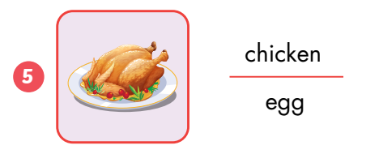
Extra Practice
WB, P. 82

Slide 28
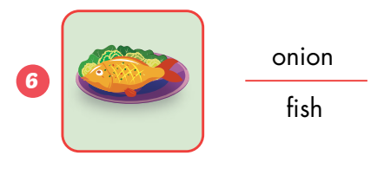
Extra Practice
WB, P. 82

Slide 29
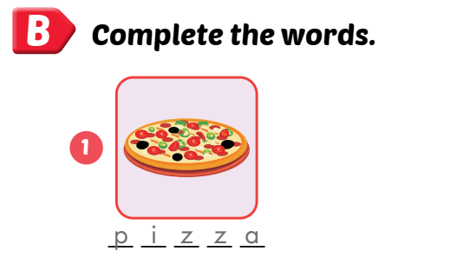
Extra Practice
WB, P. 82

Slide 30

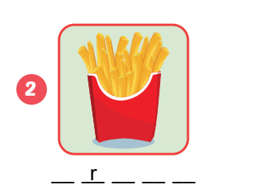
Extra Practice
WB, P. 82
fries

Slide 31
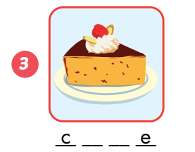
Extra Practice
WB, P. 82
cake

Slide 32
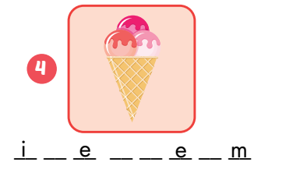
Extra Practice
WB, P. 82
ice cream

Slide 33
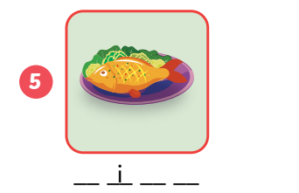
Extra Practice
WB, P. 82
fish

Slide 34
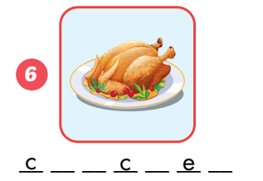
Extra Practice
WB, P. 82
chicken

Slide 35
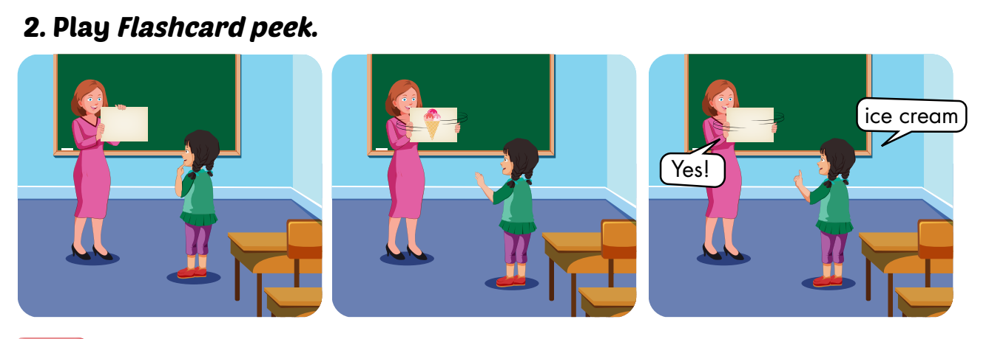

Slide 36
Structures
Would you like some fries?
- Yes, please. / Sure, thanks!
- No, thank you.

Slide 37

Presentation

Slide 38








Click on each sentence to listen
Would you like some fries?
Yes, please./Sure, thanks!
Would you like some cake?
No, thank you.
Notes:
Click vào câu để nghe

Slide 39

Practice

Slide 40
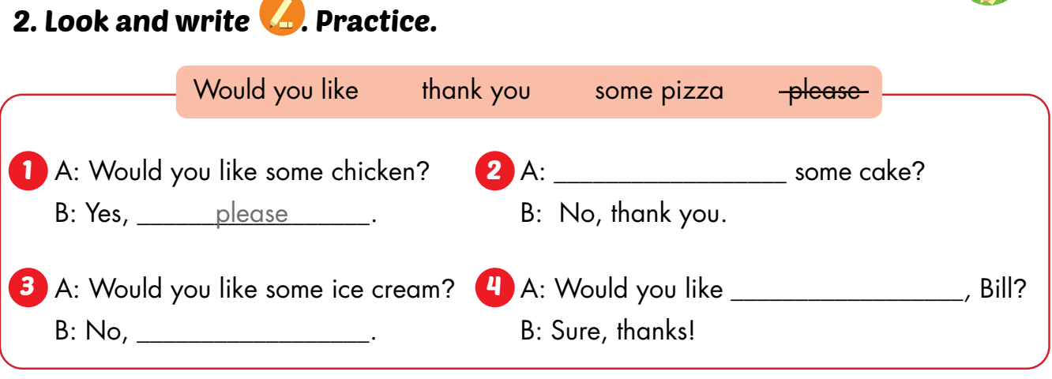
Would you like
some pizza
thank you

Slide 41
some chicken
Would you like ____________?
Yes, ________.
please

Slide 42
some ice cream
Would you like _______________?
No, ________.
thank you

Slide 43
some cake
Would you like ___________?
Yes, ________.
please

Slide 44
some fish
Would you like __________?
No, ________.
thank you

Slide 45
some fries
Would you like ____________?
Yes, ________.
please

Slide 46
some pizza
Would you like _________?
Yes, ________.
please

Slide 47

CONSOLIDATION

Slide 48
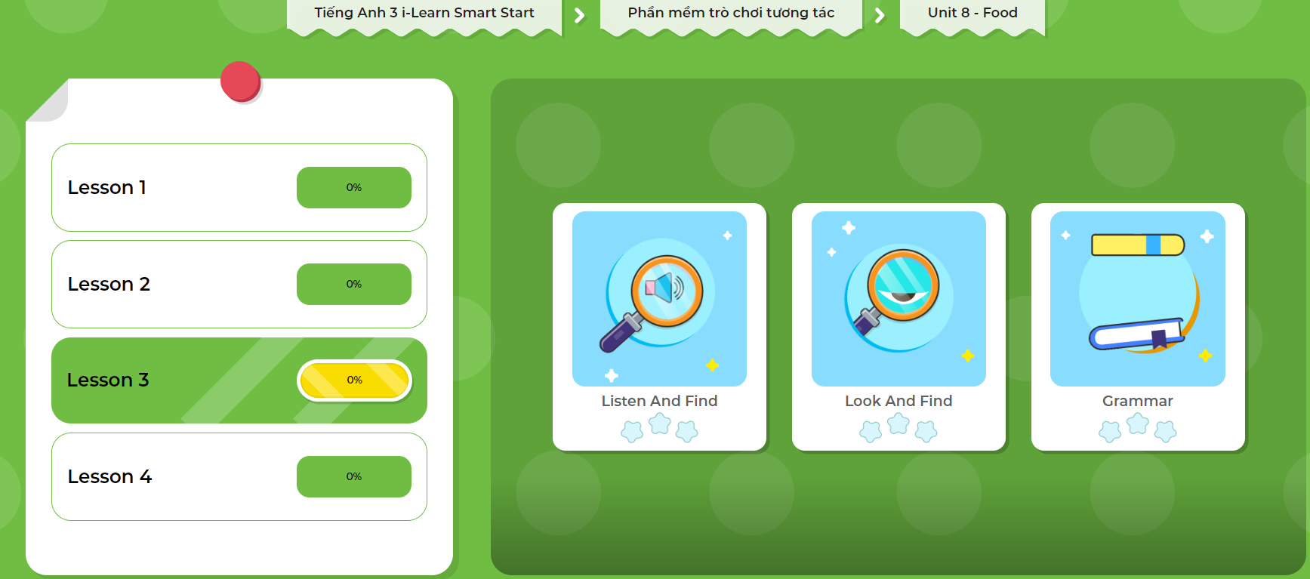
Extra Practice
DHA App
LET’S PLAY!
Click here to play the games

Slide 49

WRAP-UP

Slide 50
Today’s lesson
Vocabularies
fries, pizza, cake, ice cream, chicken, fish
Structures/ Sentence patterns
Would you like some fries?
Yes, please./Sure, thanks!
No, thank you.

Slide 51
Homework
Practice the vocabularies, structures, and make sentences using them.
Do the exercises in Tiếng Anh 3 i-Learn Smart Start WB (page 82).
Do the exercise in Tiếng Anh 3 i-Learn Smart Start DHA Notebook (page 54).
Prepare the next lesson (page 117 SB).
Play the consolidation games in Tiếng Anh 3 i-Learn Smart Start DHA App on www.eduhome.com.vn

Slide 52

Enjoy your day!

