Slide 1

Unit 8: Food
Lesson 1.1
Page 110

Slide 2
Lesson Outline
Warm-up
Vocabulary
Structure
Consolidation
Wrap-up

Slide 3
Objectives
By the end of this lesson, students will be able to…
Vocabulary: Pronounce and use the words related to the topic properly: apple, banana, carrot, cupcake, donut
Structure: Use There is an apple/There is a banana/There are eight cupcakes.

Slide 4

WARM UP

Slide 5

New words
apple
banana
carrot
cupcake
donut

Slide 6
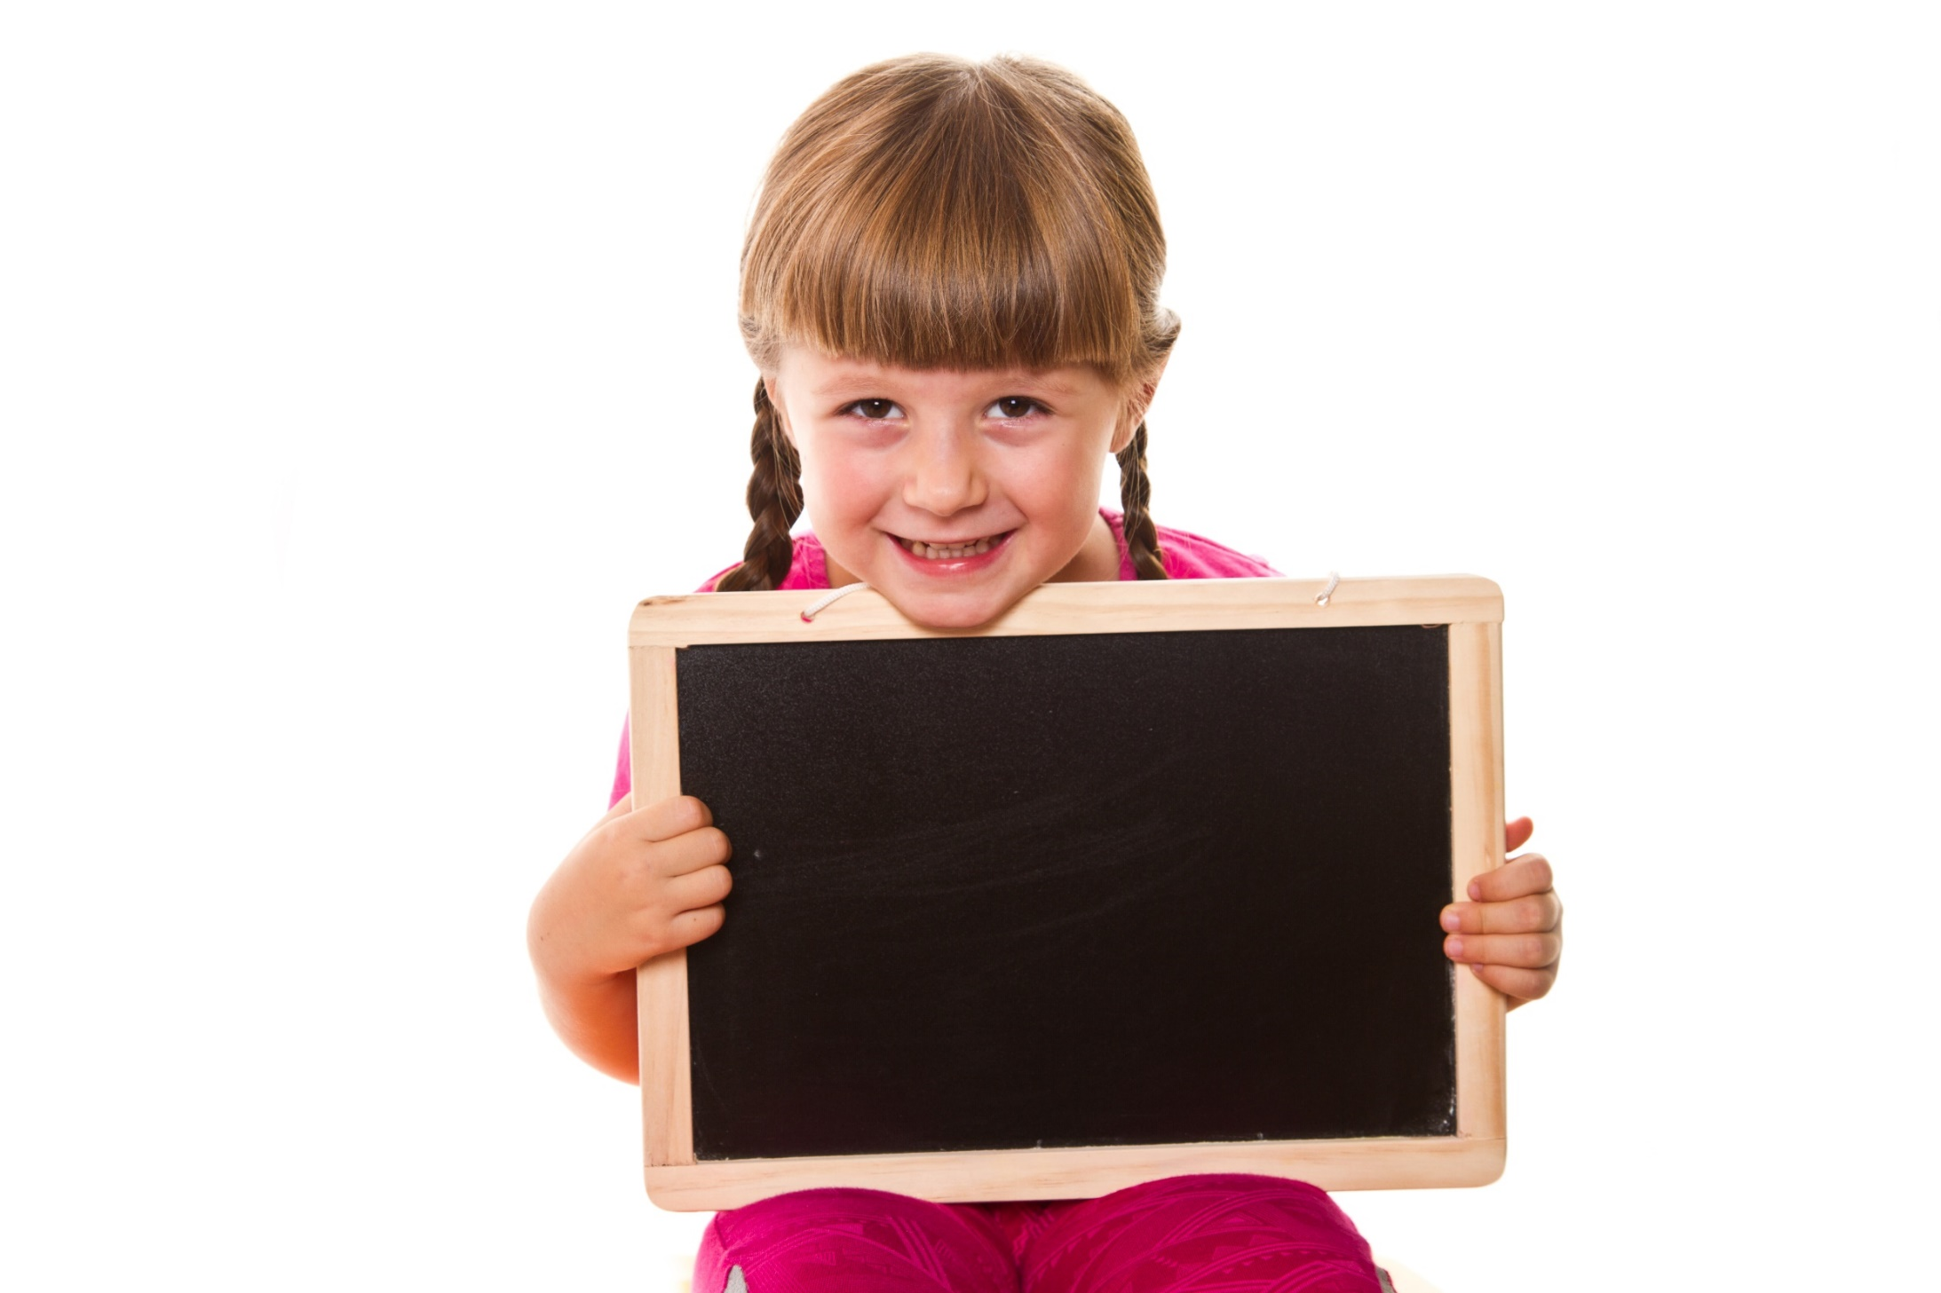
Presentation

Slide 7


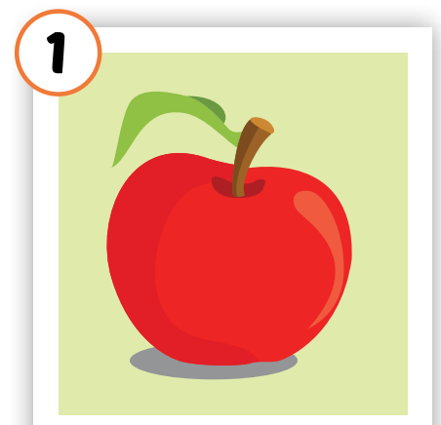
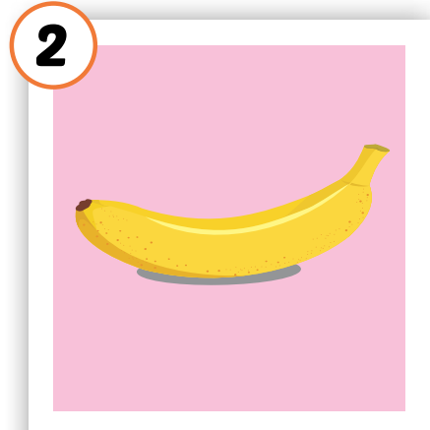
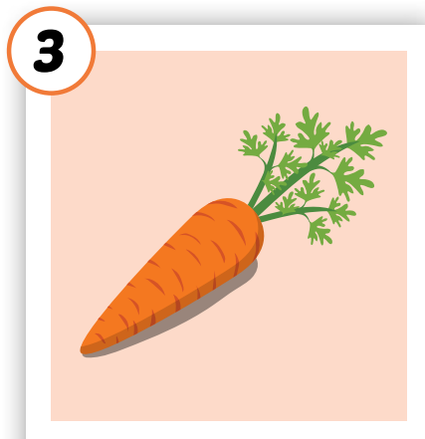
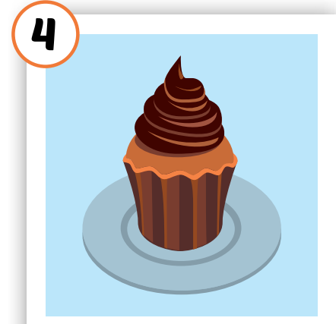
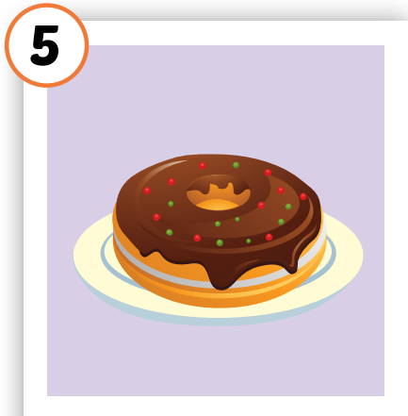





Click the icon to hear the sound
Notes:
Click vào hình A. 1. Listen and point. Repeat để cho cả audio full chạy

Slide 8
Click on each icon to hear the sound
/bəˈnænə/
quả chuối
/ˈkʌpkeɪk/
bánh nướng nhỏ
/ˈdoʊnʌt/
bánh vòng
/ˈæpl/
quả táo
/ˈkerət/
củ cà rốt

Slide 9
Click on the icon to hear the sound
/ˈæpl/
quả táo
Notes:
Click vô từng hình để nghe tiếng

Slide 10
Click on the icon to hear the sound
/bəˈnænə/
quả chuối
Notes:
Click vô từng hình để nghe tiếng

Slide 11
Click on the icon to hear the sound
/ˈkerət/
củ cà rốt
Notes:
Click vô từng hình để nghe tiếng

Slide 12
Click on the icon to hear the sound
/ˈkʌpkeɪk/
bánh nướng nhỏ
Notes:
Click vô từng hình để nghe tiếng

Slide 13
Click on the icon to hear the sound
/ˈdoʊnʌt/
bánh vòng
Notes:
Click vô từng hình để nghe tiếng

Slide 14
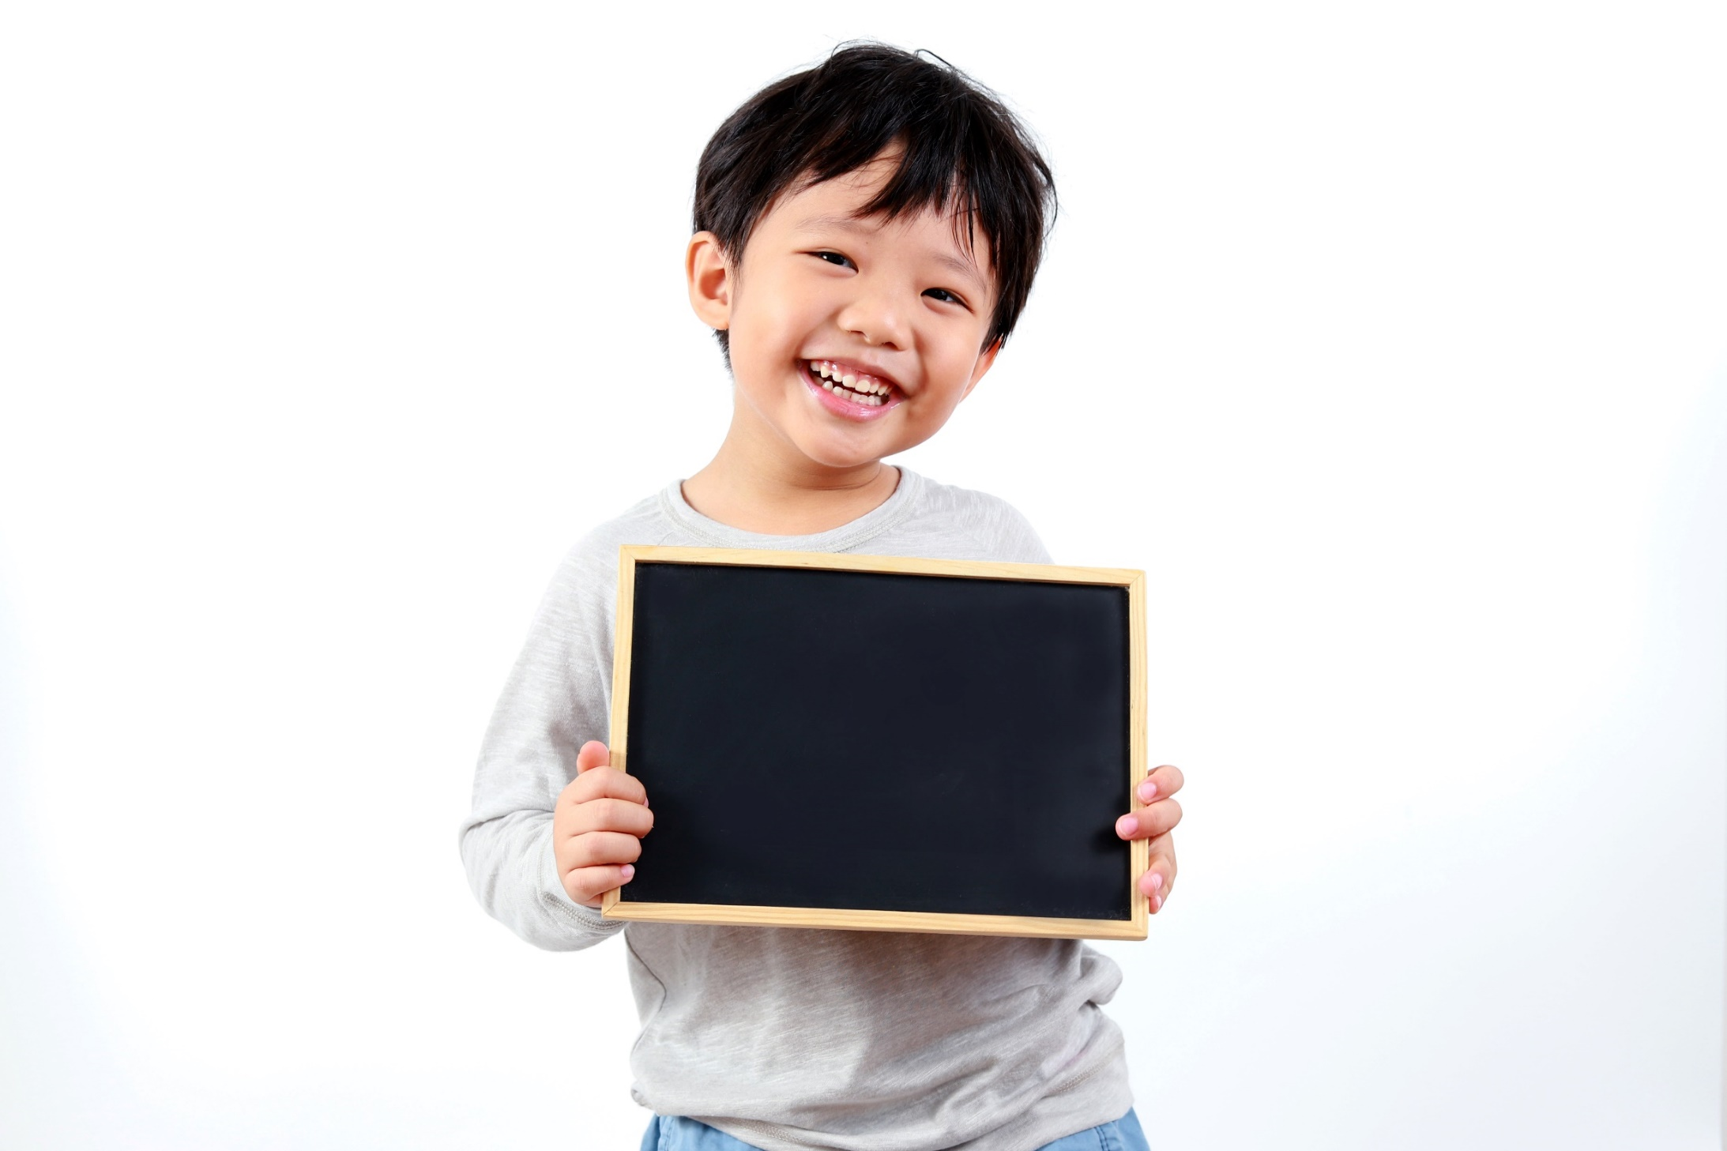
Practice

Slide 15
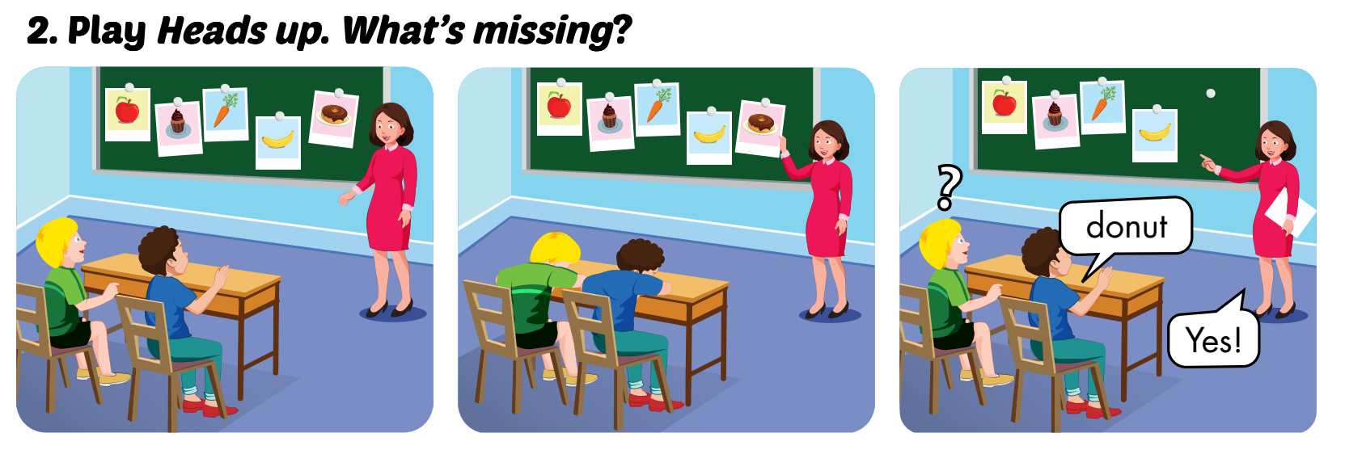

Slide 16
LOOK AND WRITE
o
carr_t
n
do_ut
e
appl_
b
_anana
c_pcake
u

Slide 17
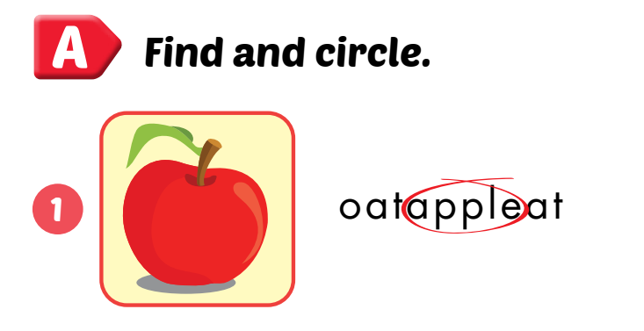
Extra Practice
WB, P. 78

Slide 18
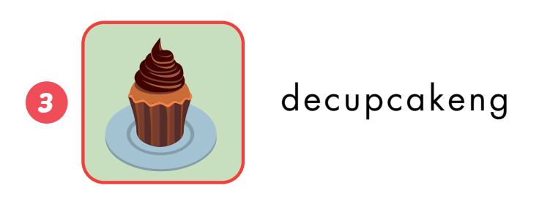
Extra Practice
WB, P. 78

Slide 19
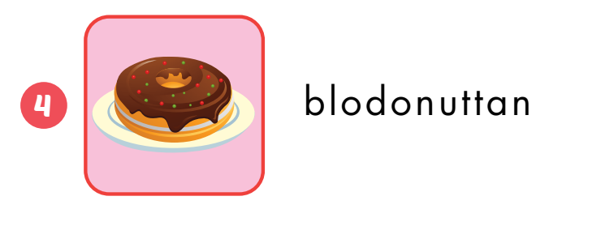
Extra Practice
WB, P. 78

Slide 20
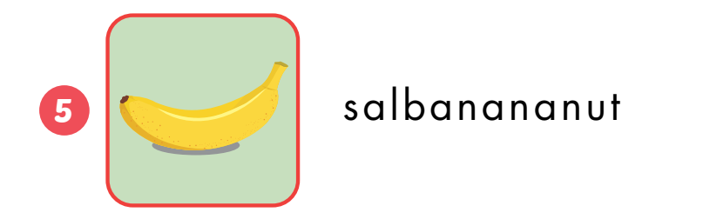
Extra Practice
WB, P. 78

Slide 21
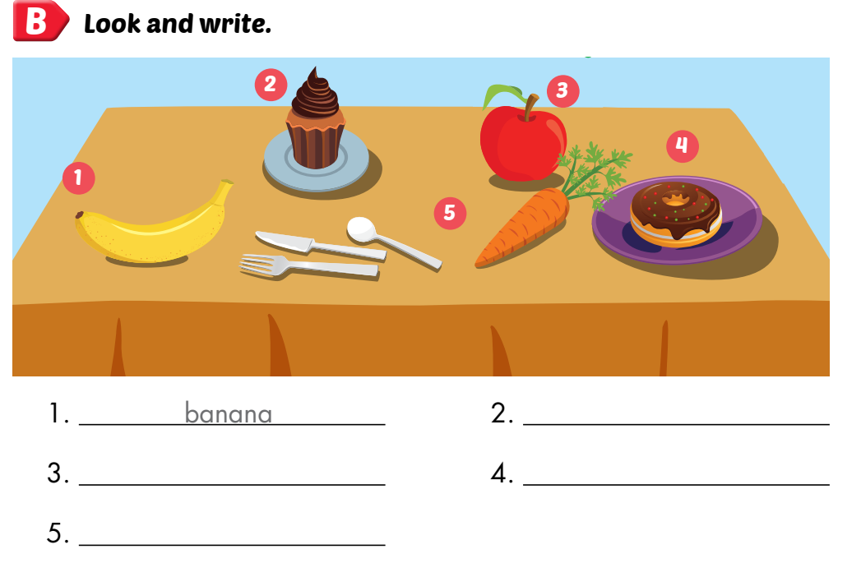
Extra Practice
WB, P. 78
cupcake
apple
donut
carrot

Slide 22
Let’s find
the food!
c
u
p
c
a
k
e
a
p
p
l
e
t
e
b
a
n
a
n
a
a
c
a
r
r
o
t
c
Click on the first letter of each word to see the name of food
d
o
n
u
t
u
u

Slide 23
Structures
There is an apple.
There is a banana. There are eight cupcakes.

Slide 24

Presentation

Slide 25


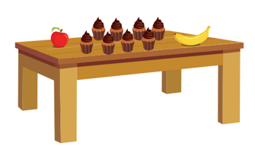

Click on each sentence to listen
There is an apple.
There is a banana.
There are eight cupcakes.

Slide 26
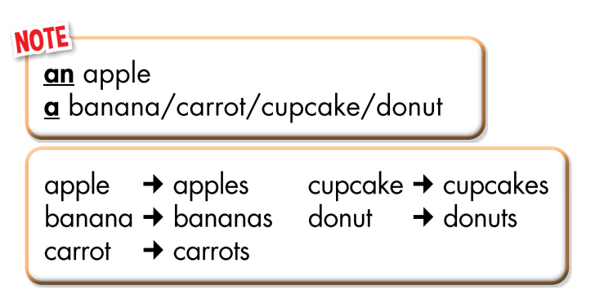

Slide 27
Practice

Slide 28
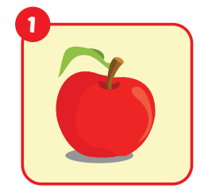
_______an apple.
There is

Slide 29
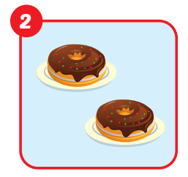
There are
_______two donuts.

Slide 30
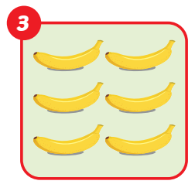
There are
_______six bananas.

Slide 31
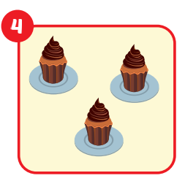
There are
_______ three cupcakes.

Slide 32
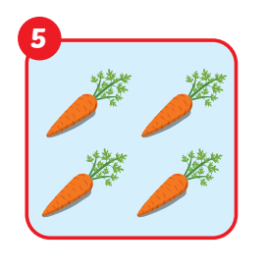
There are
_______ four carrots.

Slide 33
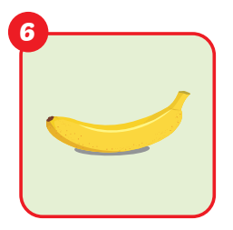
There is
_______ a banana.

Slide 34
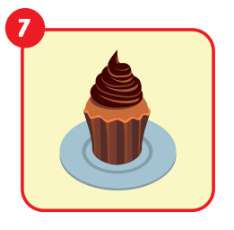
There is
_______ a cupcake.

Slide 35
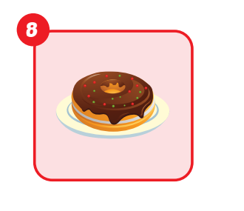
_______ a donut.
There is

Slide 36
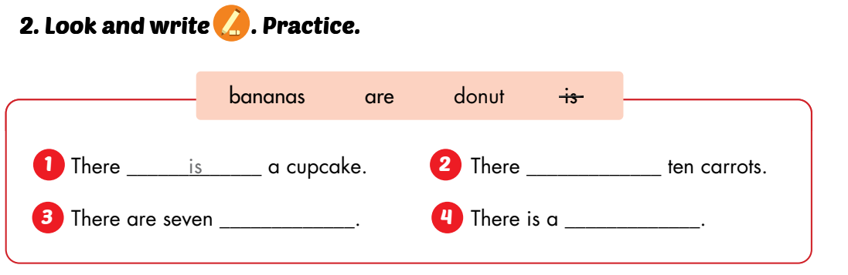
are
bananas
donut

Slide 37

CONSOLIDATION

Slide 38
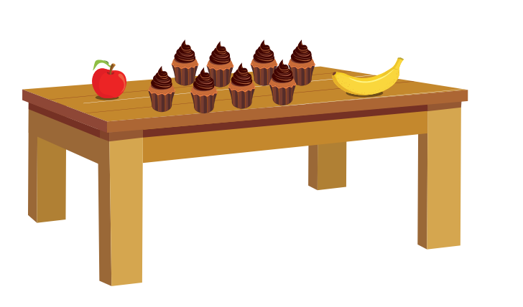
Describe the picture

Slide 39
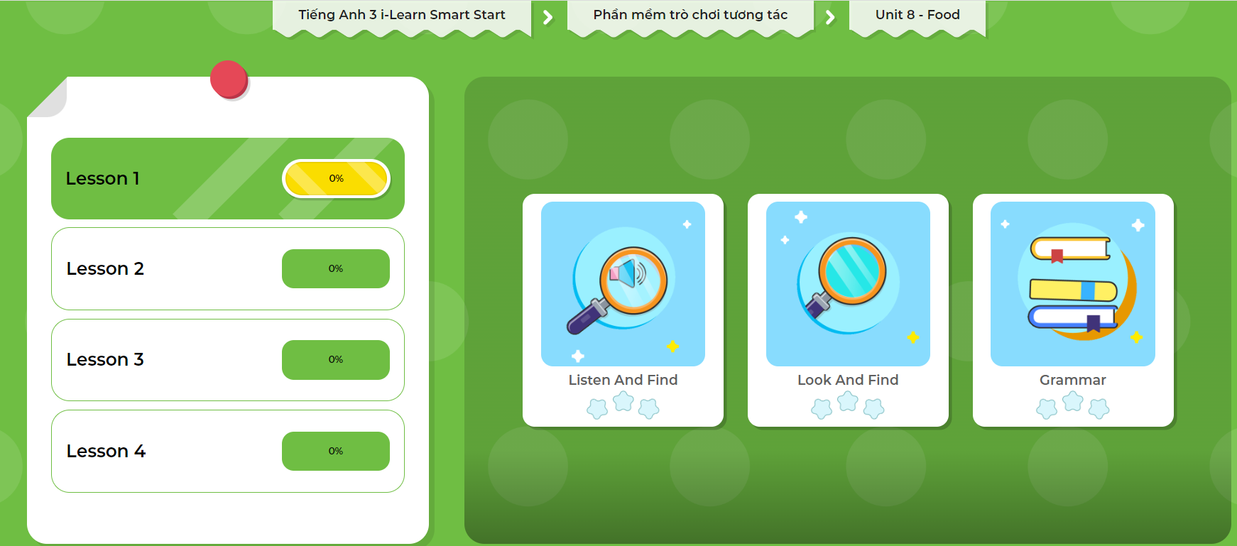
Extra Practice
DHA App
LET’S PLAY!
Click here to play the games

Slide 40
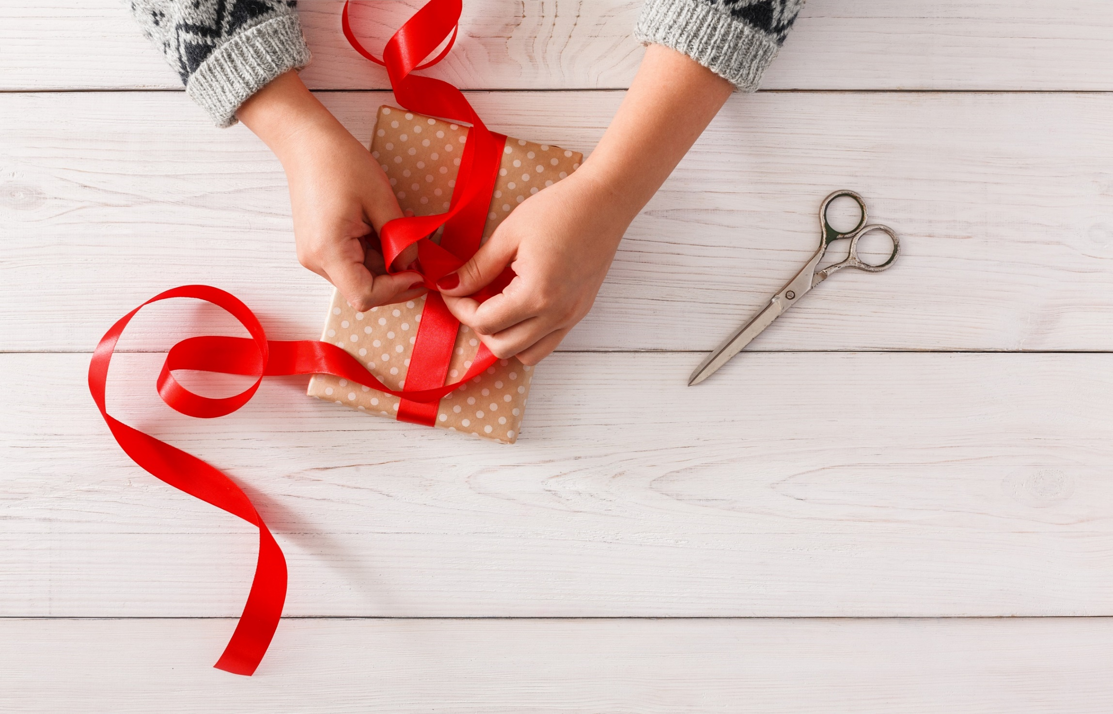
WRAP-UP

Slide 41
Lesson 3
Today’s lesson
Structures/ Sentence patterns
There is an apple/There is a banana/There are eight cupcakes.
Vocabulary
apple, banana, carrot, cupcake, donut

Slide 42
Lesson 3
Homework
Practice vocabularies, structures, and make sentences using them.
Practice the vocabulary and structure in Tiếng Anh 3 i-Learn Smart Start Notebook (page 52).
Do the exercises in Tiếng Anh 3 i-Learn Smart Start Workbook (page 78).
Prepare the next lesson (page 111).
Play the consolidation games in Tiếng Anh 3 i-Learn Smart Start DHA App on www.eduhome.com.vn

Slide 43
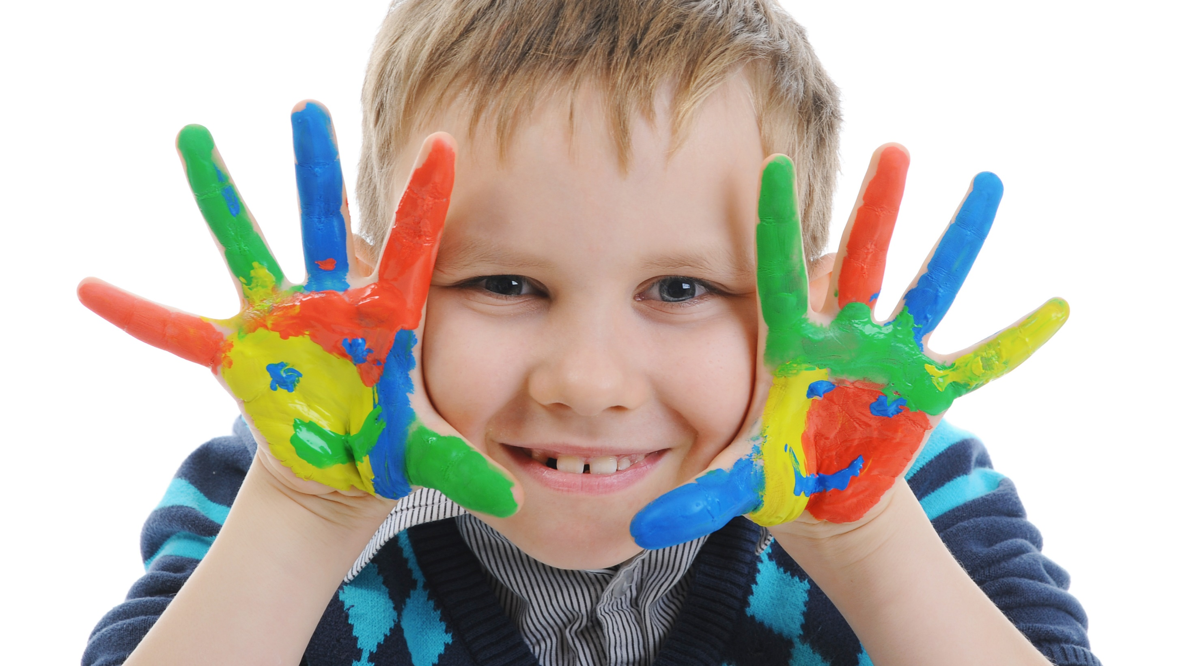
Enjoy your day!

