Slide 1

Unit 7: Toys
Review & Practice 2
Page 109

Slide 2
Lesson Outline
Warm-up
Speaking
Consolidation
Wrap-up

Slide 3
Objectives
By the end of this lesson, students will be able to…
Vocabulary: Review all vocabulary learned in Unit 7.
Speaking: Practice asking and answering questions, playing Connect Three game.

Slide 4

WARM UP

Slide 5






What’s next?
?
doll
robot

Slide 6




What’s next?
?
card
car

Slide 7



What’s next?
?
marble
block

Slide 8




What’s next?
?
card
car

Slide 9

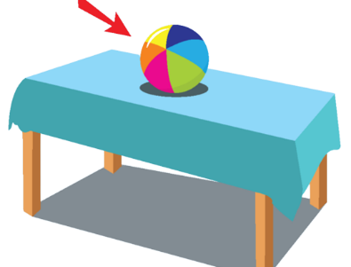
What’s next?
?
on
in

Slide 10




What’s next?
?
marble
block

Slide 11

It’s time to learn …

Slide 12

Speaking

Slide 13
PRE-SPEAKING
Rearrange these words to make a sentence.
blocks How do many have ? you
How many blocks do you have?

Slide 14
PRE-SPEAKING
Rearrange these words to make a sentence.
ten have I blocks.
I have ten blocks.

Slide 15
PRE-SPEAKING
Rearrange these words to make a sentence.
see? you can What
What can you see?

Slide 16
PRE-SPEAKING
Rearrange these words to make a sentence.
big see I car. a can
I can see a big car.

Slide 17
PRE-SPEAKING
Rearrange these words to make a sentence.
the in Put the box. toy robot
Put the robot in the toy box.

Slide 18
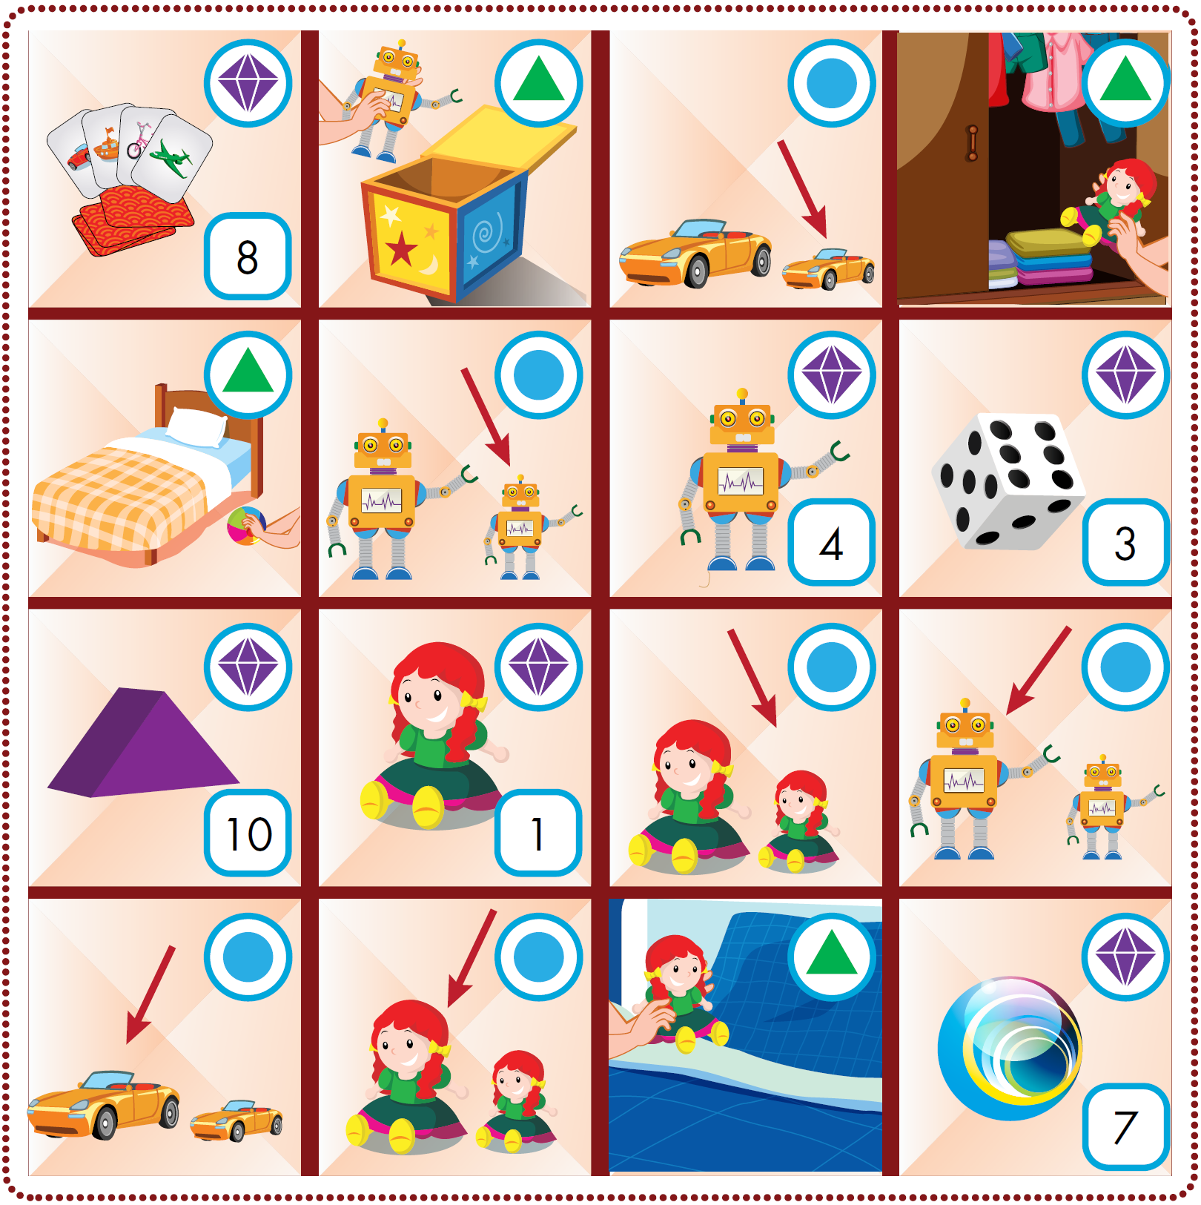

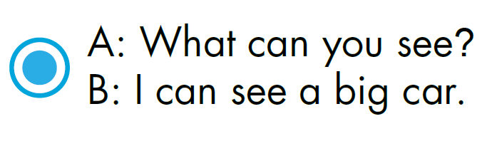

WHILE-SPEAKING
See the next slide to know how to play the game

Slide 19
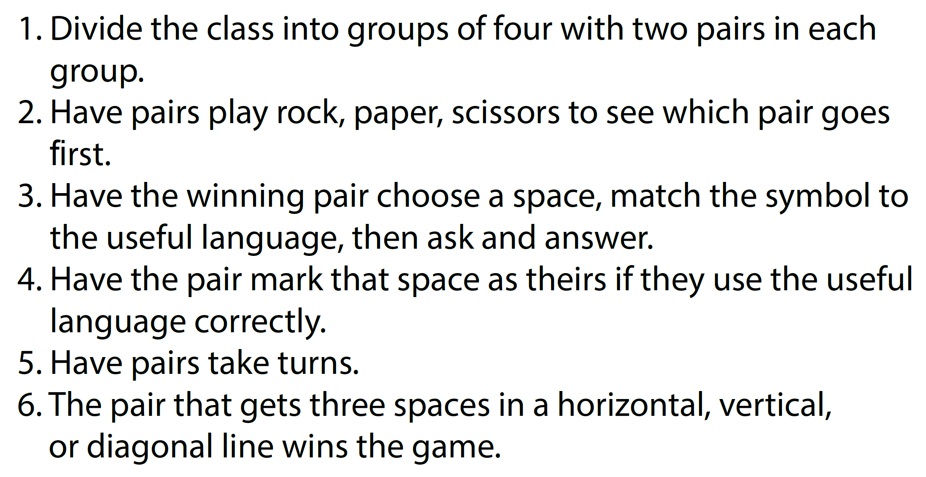
HOW TO PLAY

Slide 20
WHILE-SPEAKING

Slide 21

CONSOLIDATION

Slide 22
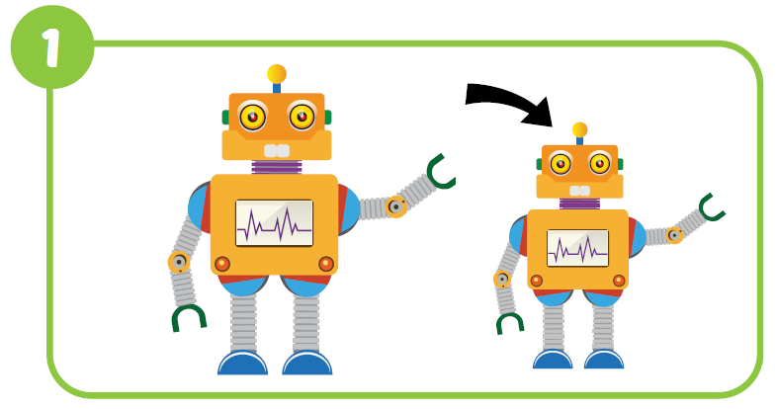


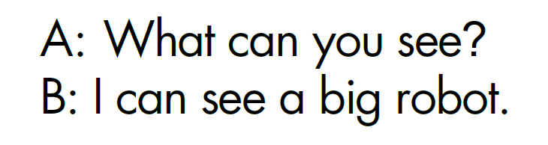
Workbook - P.76
Notes:
Click vào ô vuông để hiện đáp án

Slide 23
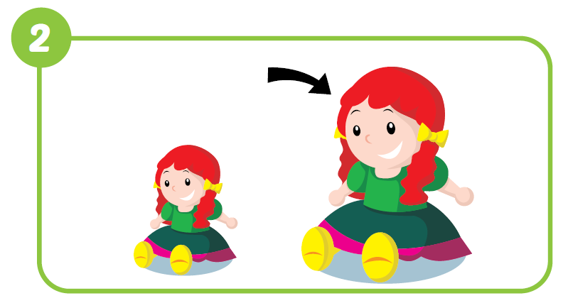

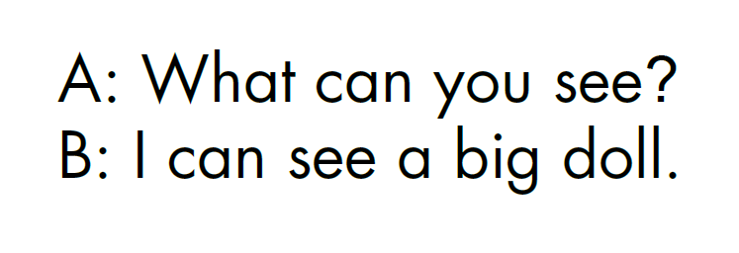
Workbook - P.76
Notes:
Workbook - P.77

Slide 24

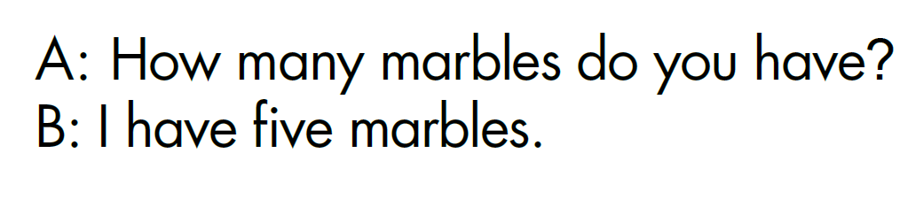
Workbook - P.76
Notes:
Workbook - P.77

Slide 25

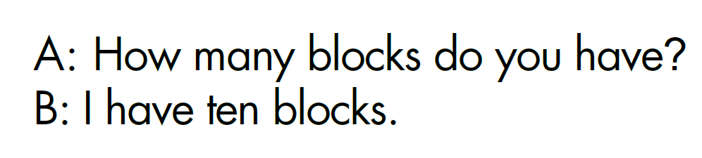
Workbook - P.76
Notes:
Workbook - P.77

Slide 26
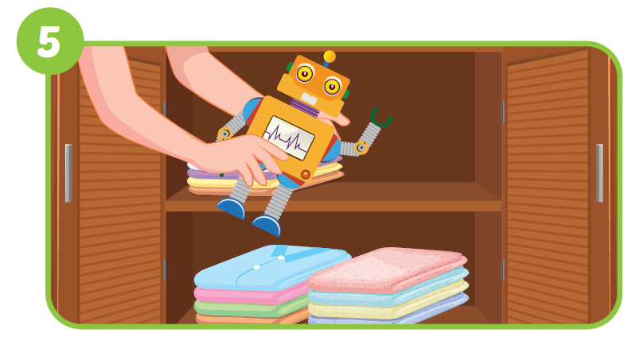
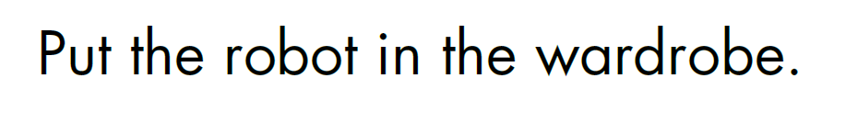
Workbook, p.76
Notes:
Workbook - P.77

Slide 27
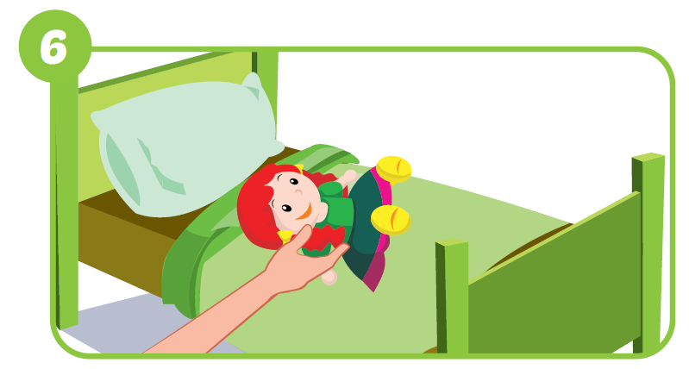

Workbook - P.76
Notes:
Workbook - P.77

Slide 28
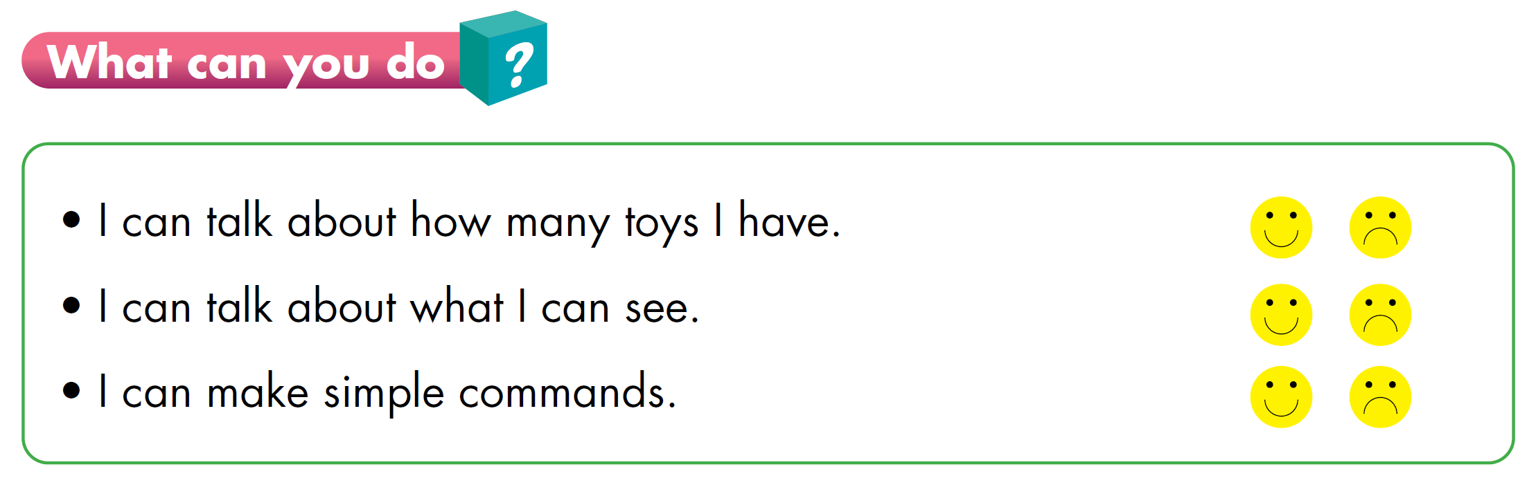

Slide 29
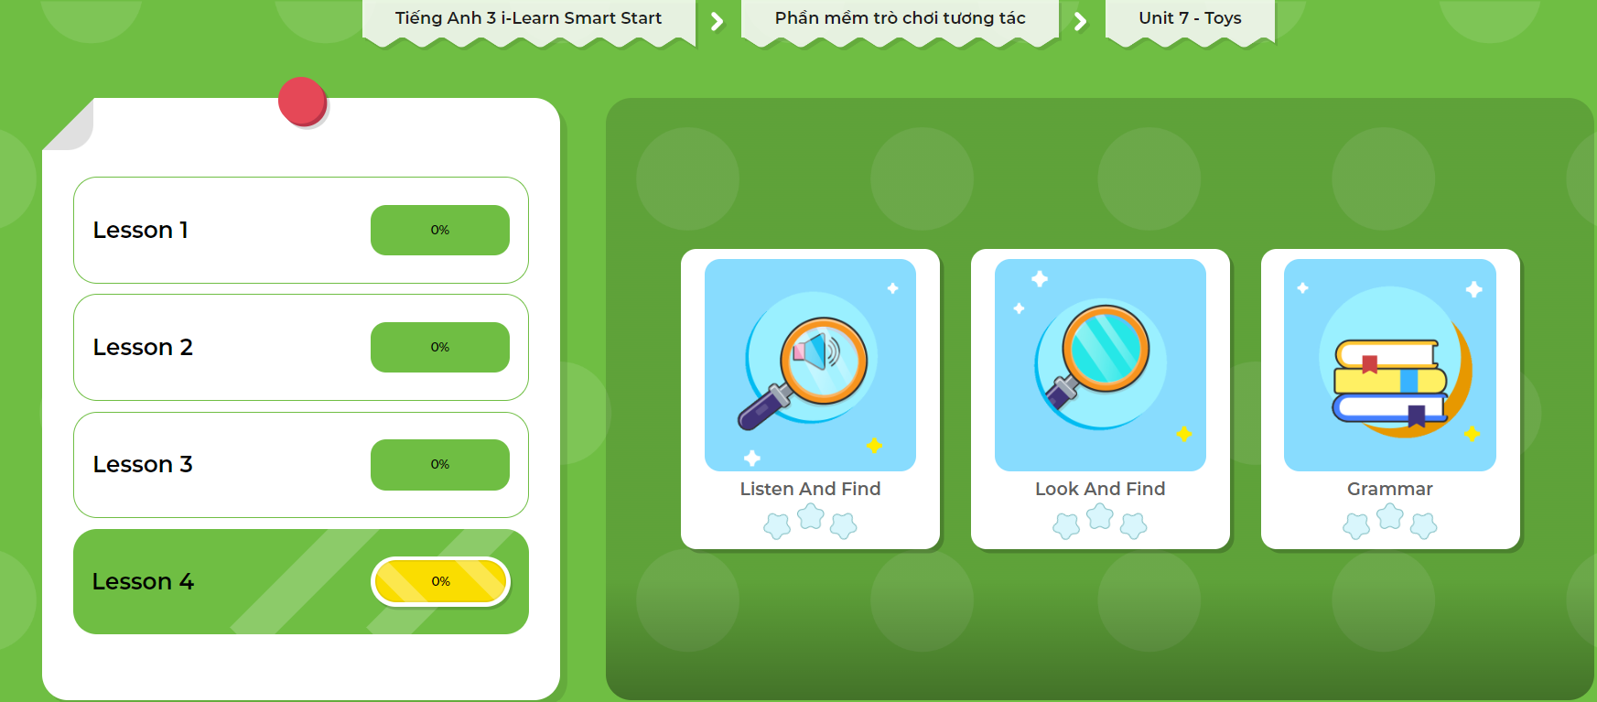
Extra Practice
DHA on Eduhome
LET’S PLAY!
Click here to play the games.

Slide 30

WRAP-UP

Slide 31
Today’s lesson
Vocabulary
Review all vocabulary learned in Unit 7
Speaking
Practice asking and answering questions by playing connect three game

Slide 32
Homework
Review the vocabularies, structures, and make sentences using them.
Do the exercises in Tiếng Anh 3 i-Learn Smart Start WB (page 76).
Do the exercises in Tiếng Anh 3 i-Learn Smart Start Notebook (page 51).
Prepare the next lesson (page 110 SB).
Play games in Tiếng Anh 3 i-Learn Smart Start DHA App on www.eduhome.com.vn

Slide 33

Have a nice day!

