Slide 1
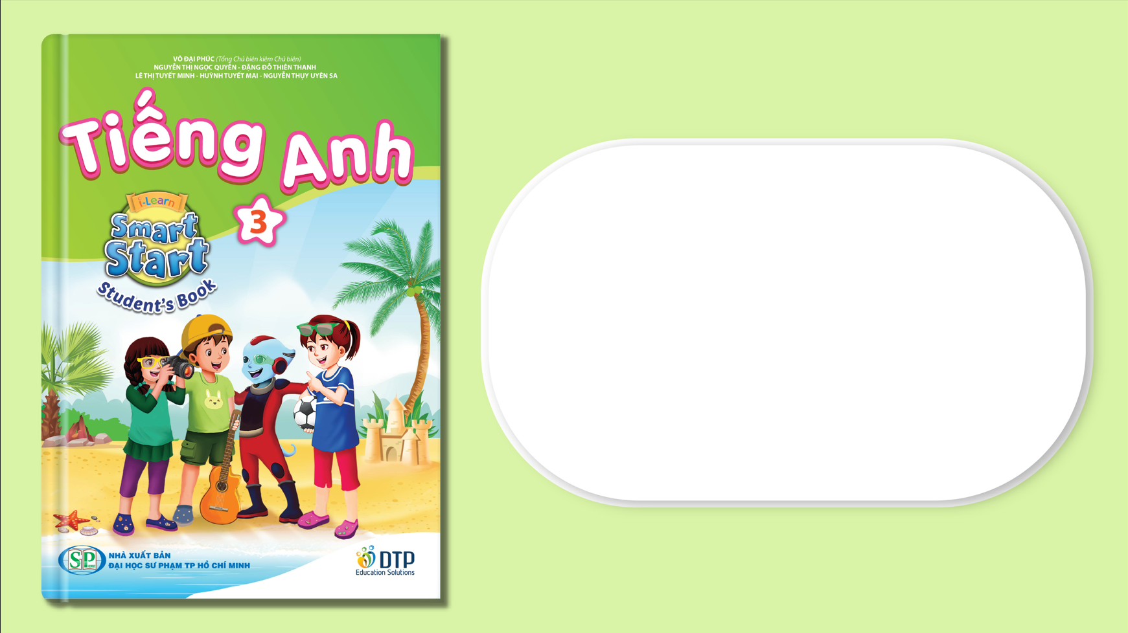
Unit 7: Toys
Lesson 2.3
Page 101

Slide 2
Lesson Outline
Warm-up
Practice
Speaking
Consolidation
Wrap-up

Slide 3
Objectives
By the end of this lesson, students will be able to…
Vocabulary: Practice vocabulary learned earlier in the lesson.
Structure: Practice structures:
How many ...... do you have?
I have ........

Slide 4

WARM UP

Slide 5
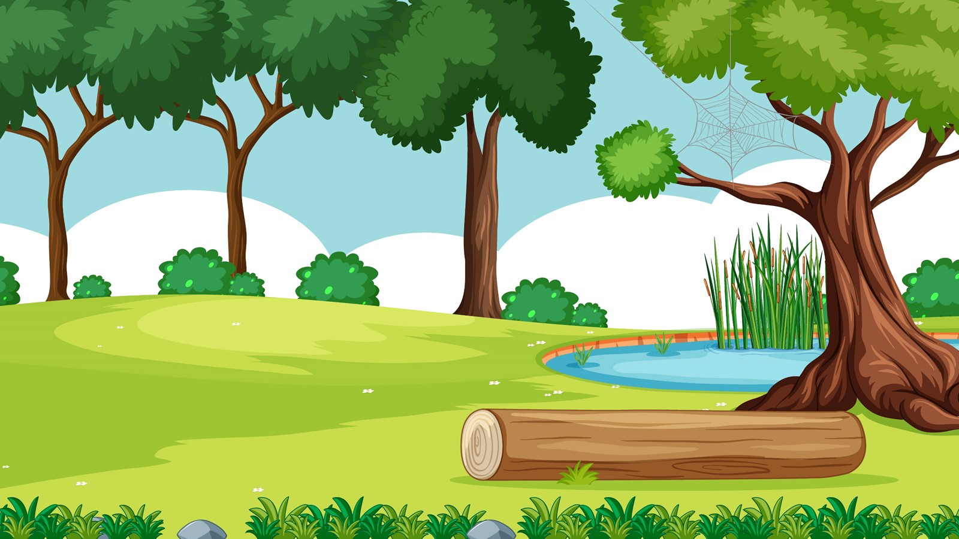
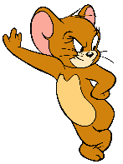
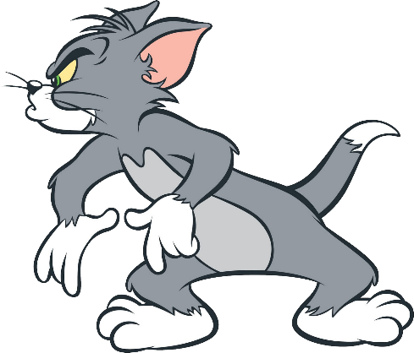
JERRY’S
QUESTIONS
Start
Divide class into 2 teams: TOM and JERRY
TOM has to choose the right opition.
If Tom’s answer is correct, the BOMB WILL MOVE TO JERRY AND EXPLODE.
If Tom’s answer is incorrect, THE BOMB WILL MOVE TO TOM AND EXPLODE.

Slide 6




next
marble
dice

Slide 7
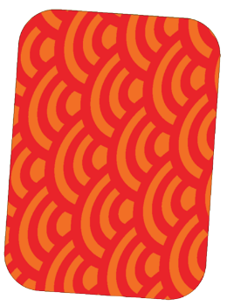
next
card
dice

Slide 8
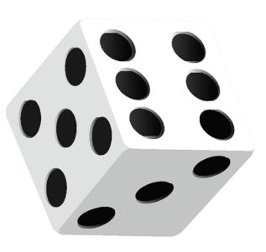
next
marble
dice

Slide 9

next
block
card

Slide 10

Goodbye!!!

Slide 11

It’s time to learn …

Slide 12

Pre-Speaking
Look and write
How many marbles
______ _______ _______ do you have?
seven marbles
I have _____ ________.

Slide 13
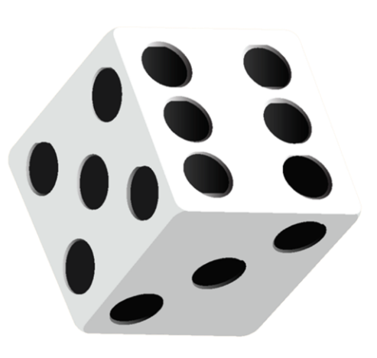
Pre-Speaking
Look and write
How many dice
______ _______ _______ do you have?
five dice
I have _____ ________.

Slide 14
Pre-Speaking
Look and write
_____ _____ _____ _____ ____ _____?
How many dice do you have
_ ____ ___ _______.
I have five dice

Slide 15

Structures
How many marbles do you have?
- I have five marbles.

Slide 16

Practice

Slide 17
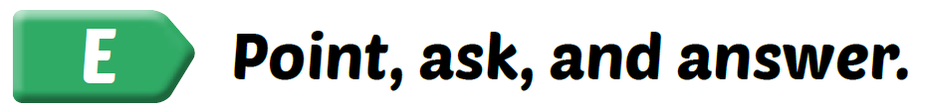
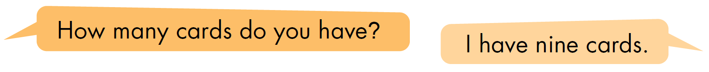
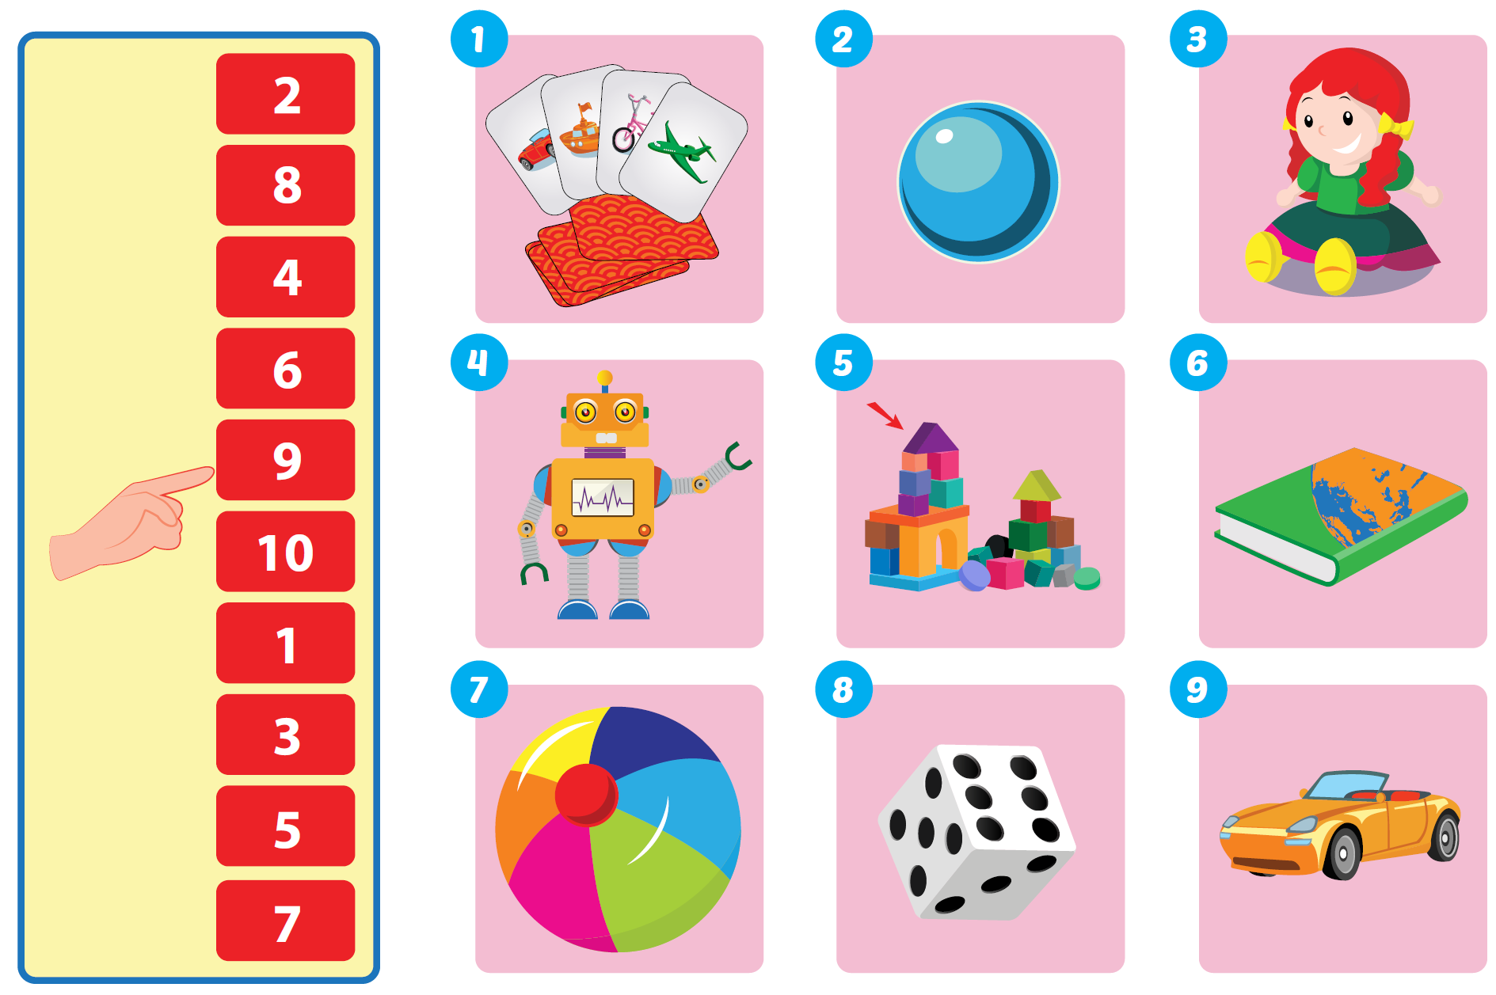

Slide 18
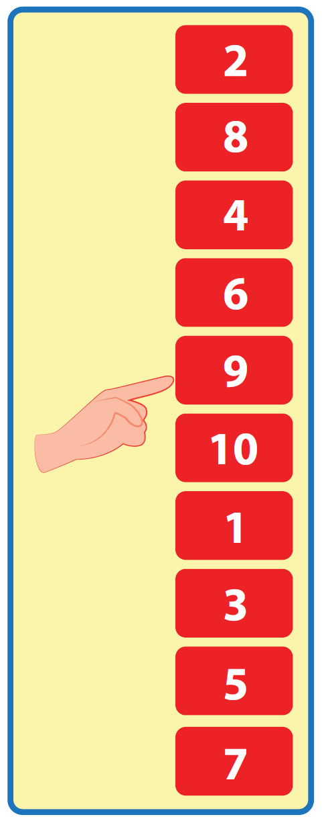


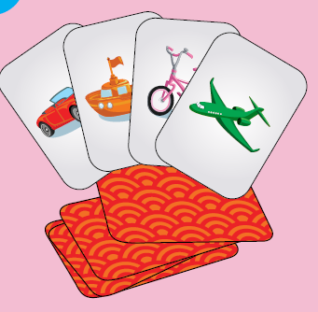


1
I have nine cards.
How many cards do you have?

Slide 19
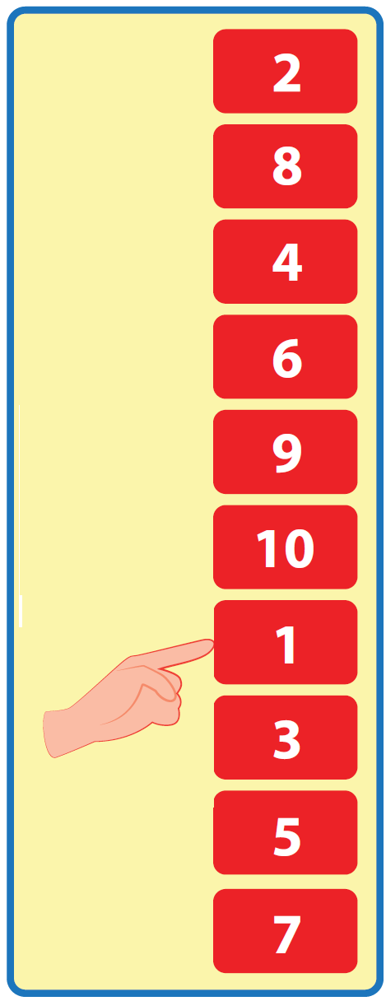
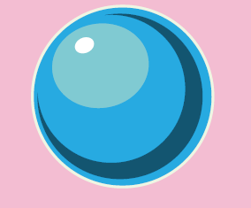
2
I have one marble.
How many marbles do you have?

Slide 20
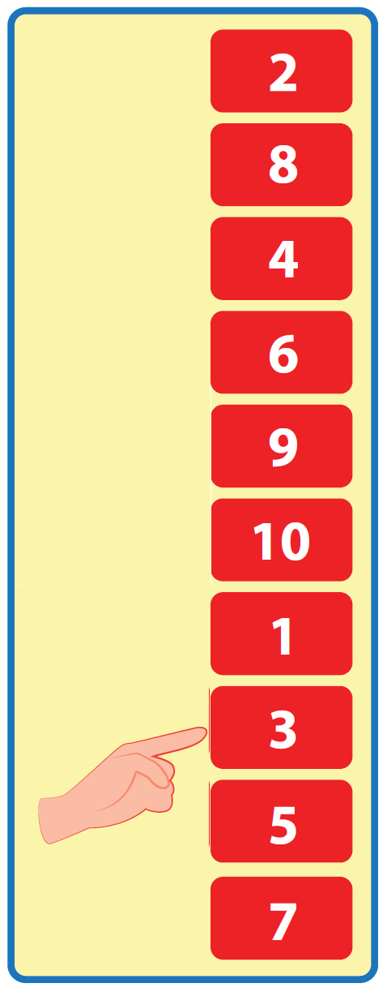
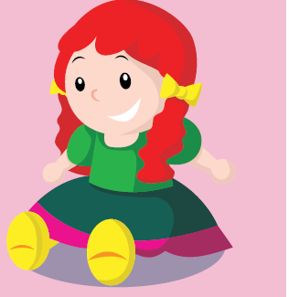
3
I have three dolls.
How many dolls do you have?

Slide 21
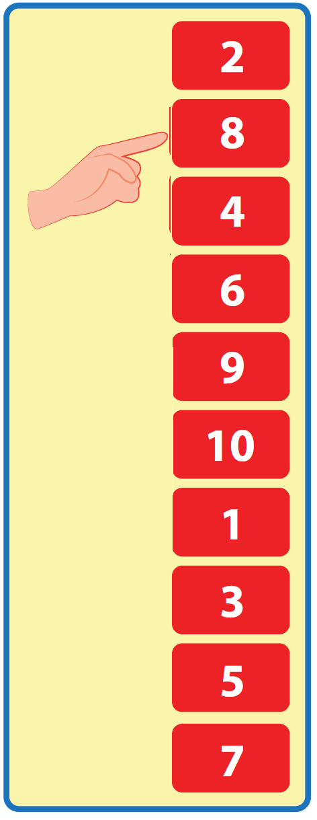
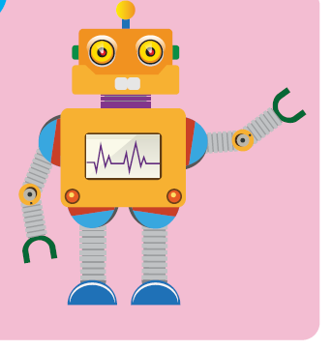
4
I have eight robots.
How many robots do you have?

Slide 22
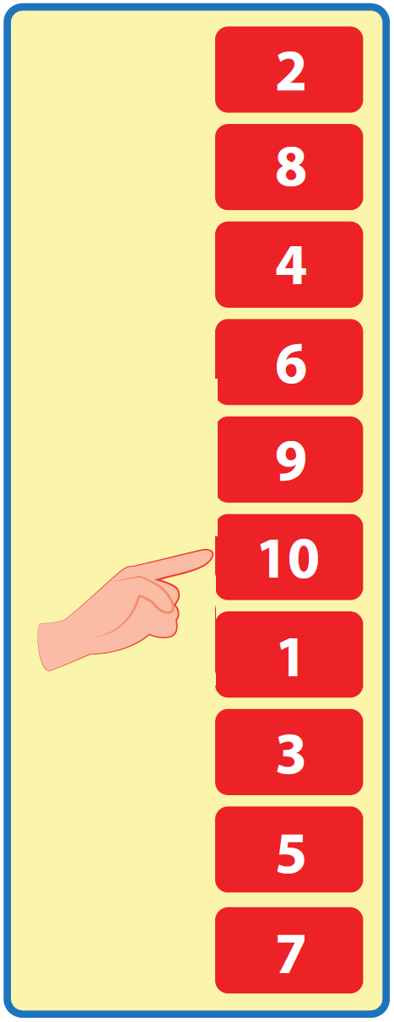
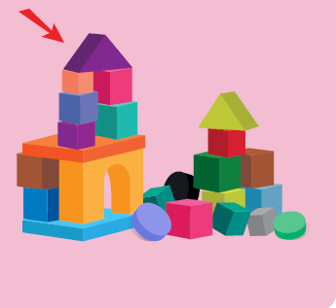
5
I have ten blocks.
How many blocks do you have?

Slide 23
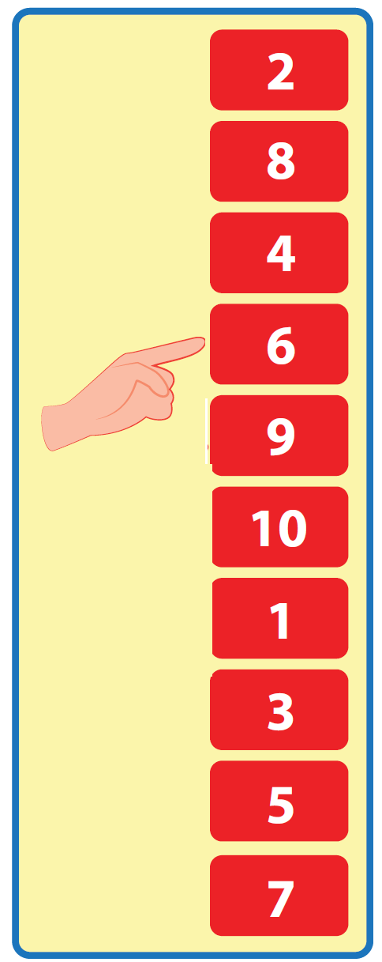
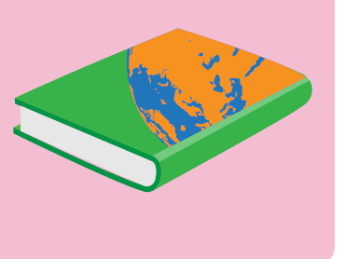
6
I have six books.
How many books do you have?

Slide 24
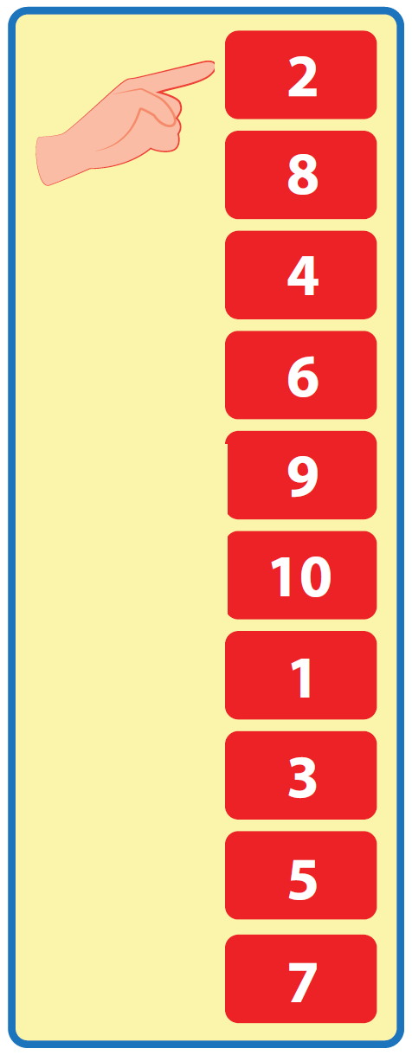
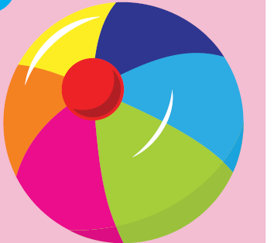
7
I have two balls.
How many balls do you have?

Slide 25
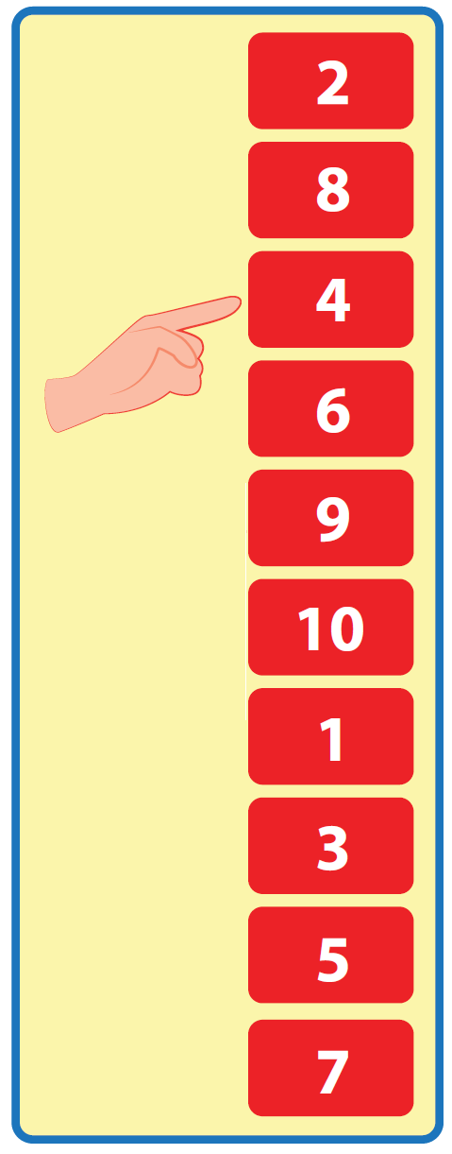
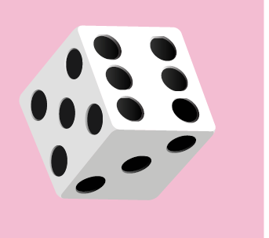
8
I have four dice.
How many dice do you have?

Slide 26
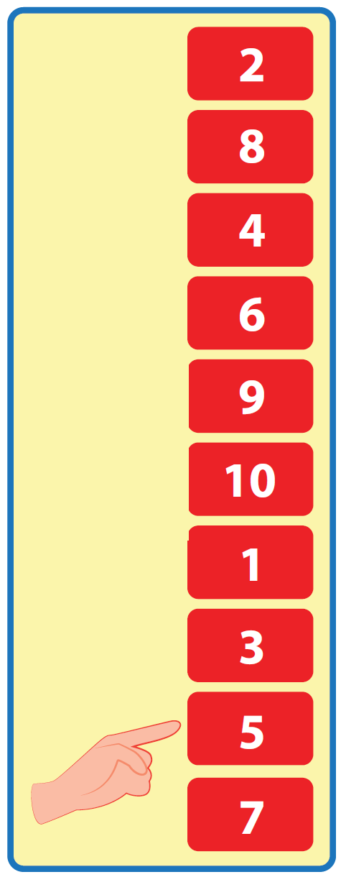
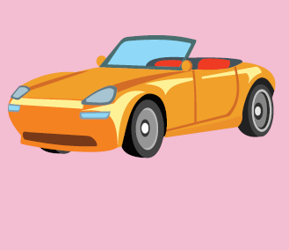
9
I have five cars.
How many cars do you have?

Slide 27

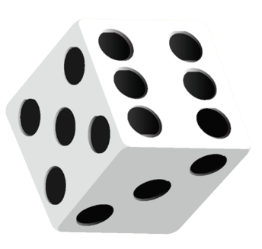
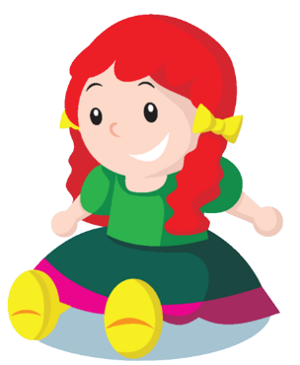
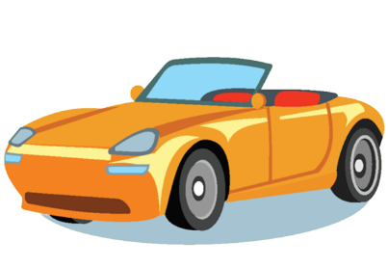


Post speaking
Guess the toys by asking questions.
One student will stand in front of the class. The teacher gives the student a picture of toys. The other students will ask the questions to guess the toys in the picture.

Slide 28

CONSOLIDATION

Slide 29
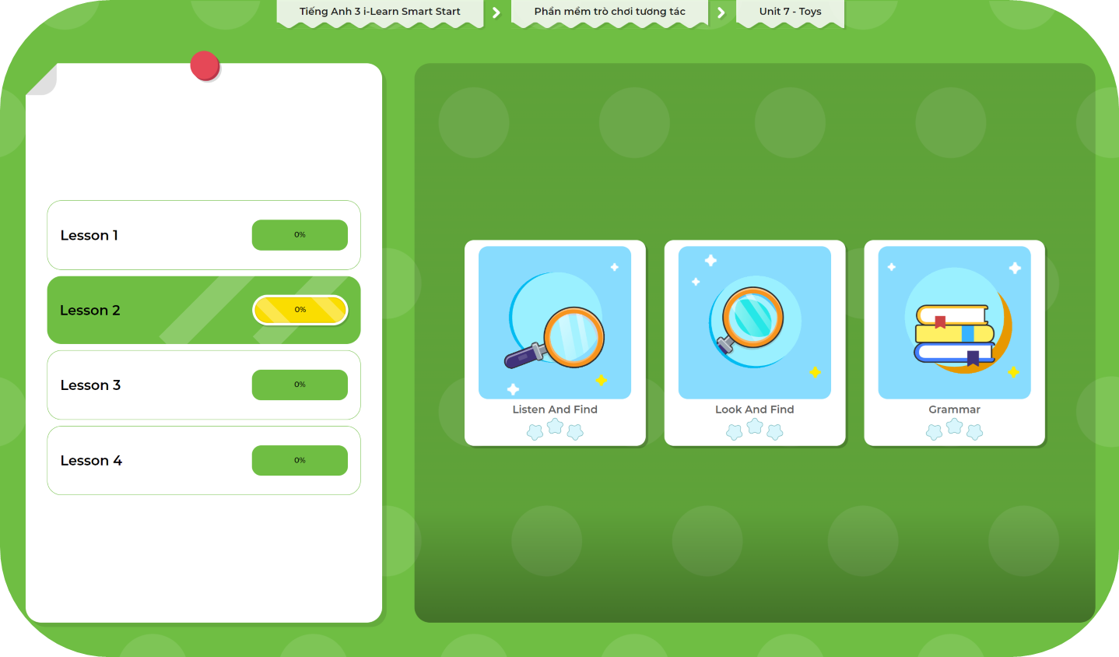
Extra Practice
DHA App
LET’S PLAY!
Click here to play the games

Slide 30

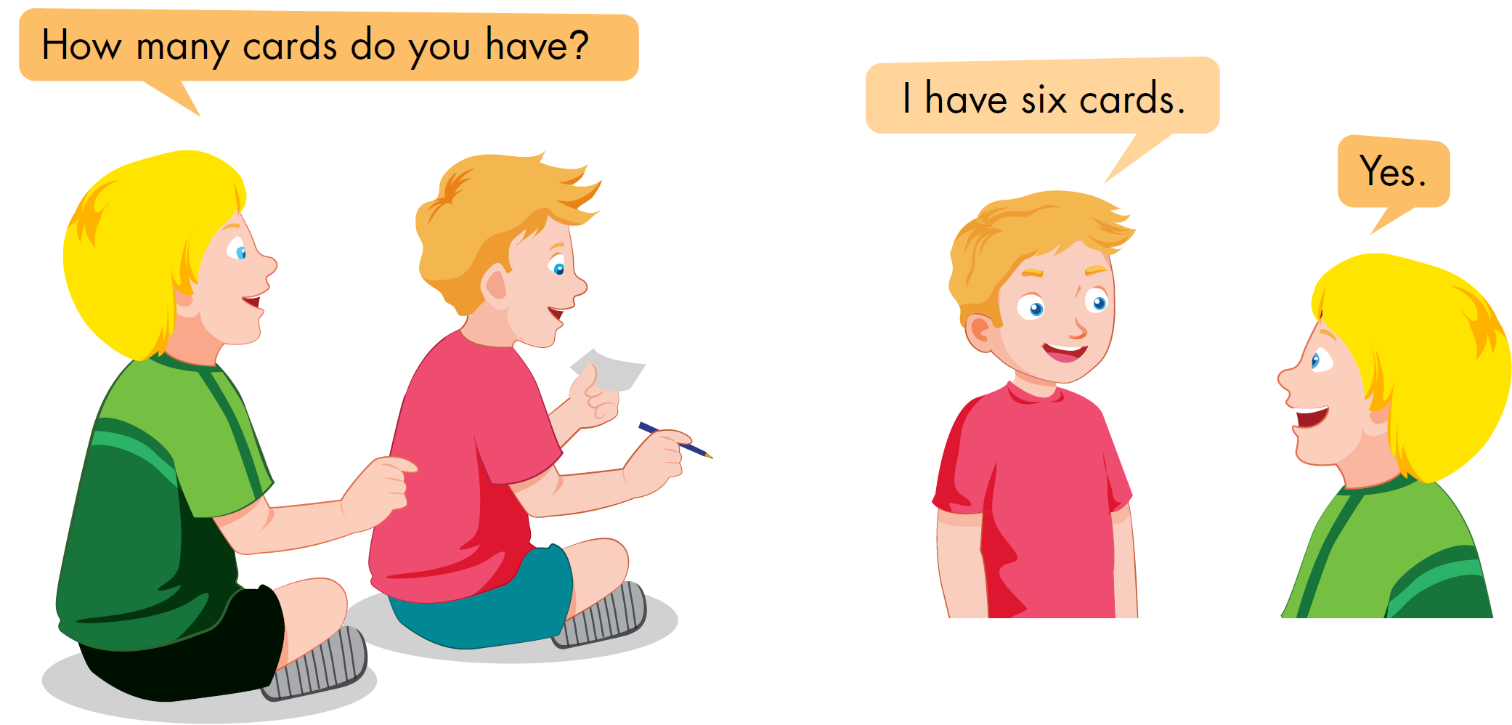

Slide 31
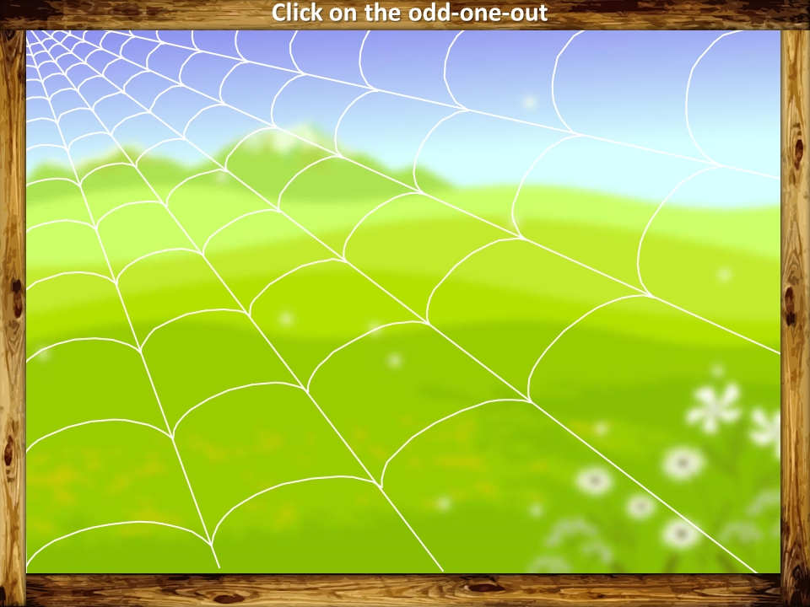
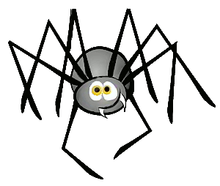

VOCABULARY REVIEW
PLAY

Slide 32

sit down
listen
car
Why?
CHECK
Because it is a kind of toy.
NEXT

Slide 33
doll
robot
father
Why?
CHECK
Because it is not a toy.
NEXT

Slide 34
father
mother
dice
Why?
CHECK
NEXT
Because it is not a family member.

Slide 35
block
card
goodbye
Why?
CHECK
NEXT
Because it is not a toy.

Slide 36
car
sister
marble
Why?
CHECK
NEXT
Because it is a family member.

Slide 37
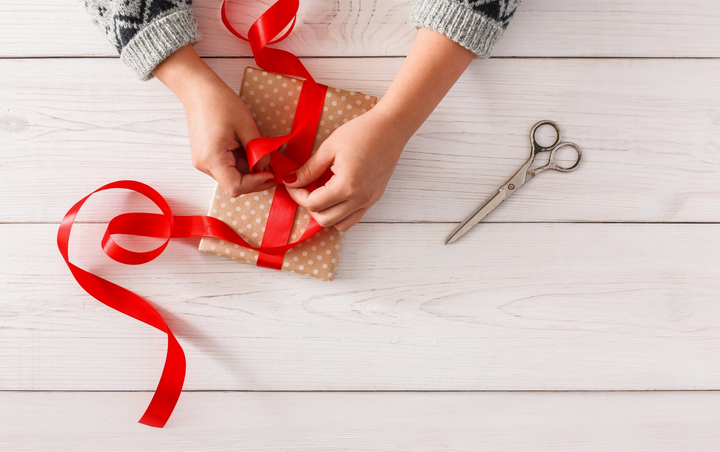
WRAP-UP

Slide 38
Today’s lesson
Vocabulary:
Review: robot, car, doll, marble, dice, block, card
Structures/ Sentence patterns
How many ...... do you have?
I have ........

Slide 39
Homework
Practice the vocabulary, structures, and make sentences using them.
Do the exercises in Tiếng Anh 3 i-Learn Smart Start WB (page 72).
Do the exercises in Tiếng Anh 3 i-Learn Smart Start Notebook (page 47).
Prepare the next lesson (page 102 SB).
Play the consolidation games in Tiếng Anh 3 i-Learn Smart Start DHA App on www.eduhome.com.vn

Slide 40
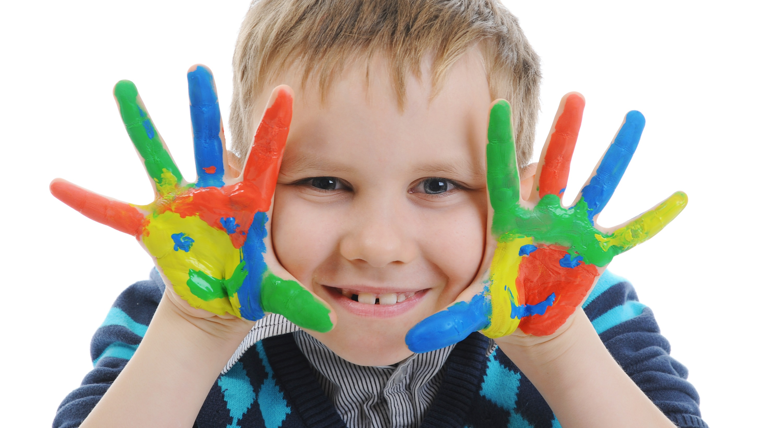
Enjoy your day!

