Slide 1

Unit 5: Sports and hobbies
P.E. Lesson 4.3
Page 79

Slide 2
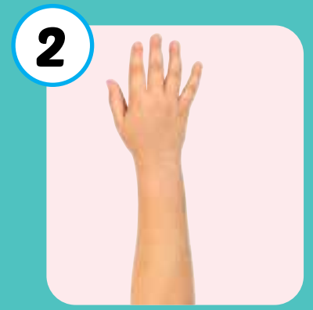
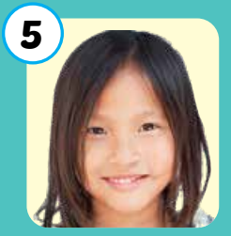
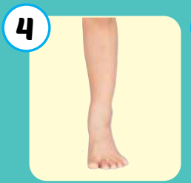
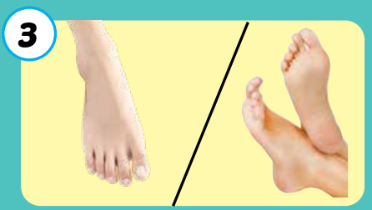
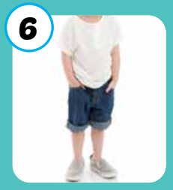
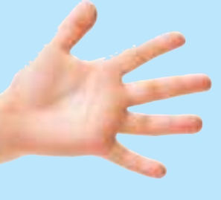
1
2
3
4
Click on the square to see the picture
5
6
7
8
Click on the button to close the picture
9
10
11
12

Slide 3
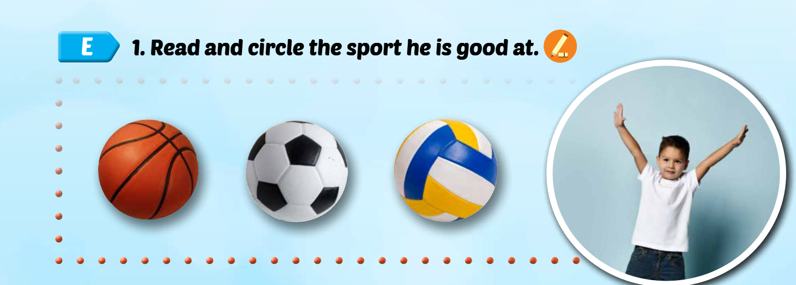
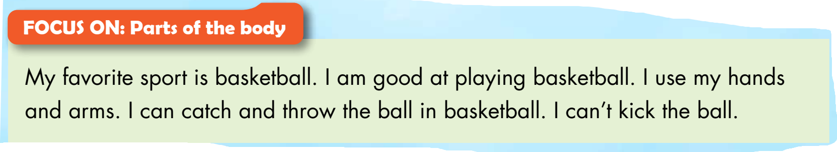
My favorite sport is basketball. I am good at playing basketball. I use my hands and arms. I can catch and throw the ball in basketball. I can’t kick the ball.

Slide 4
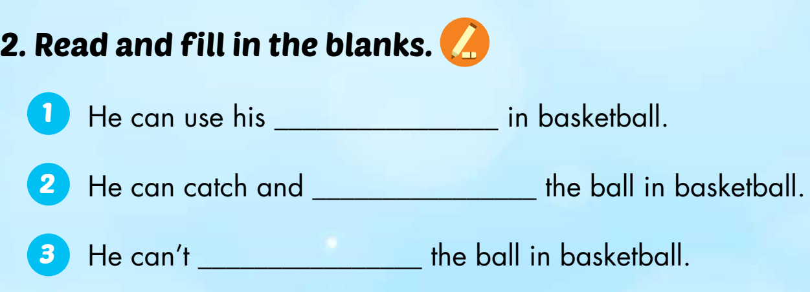
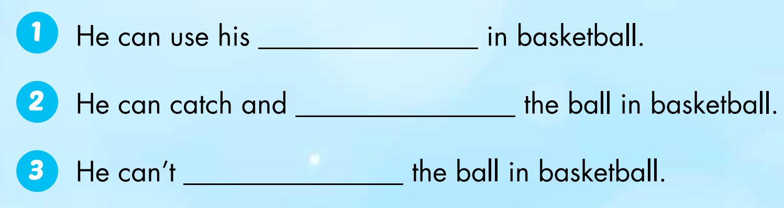
hands and arms
throw
kick

Slide 5
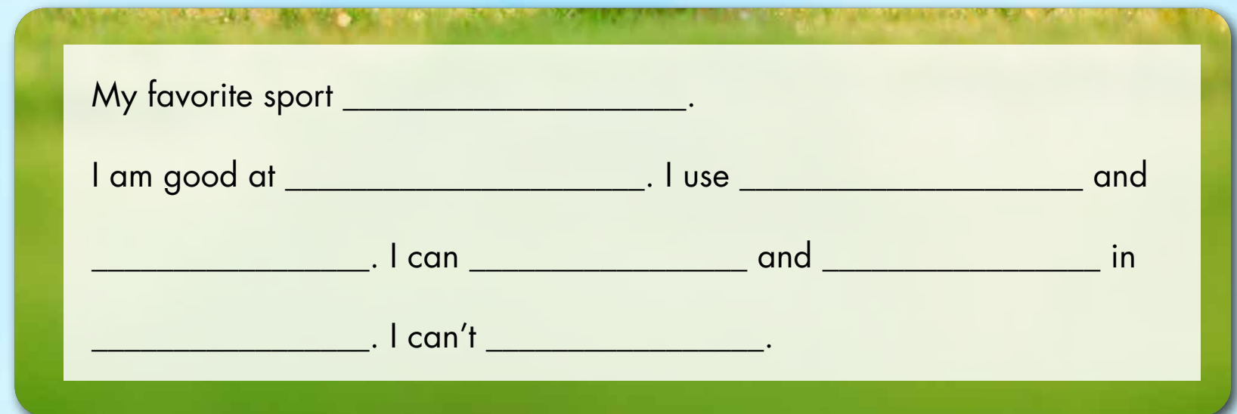

Slide 6
1. Divide the class into fours.
2. Have students read their sentences to their group.
3. Afterwards, have some students read their sentences in front of the class.

Slide 7

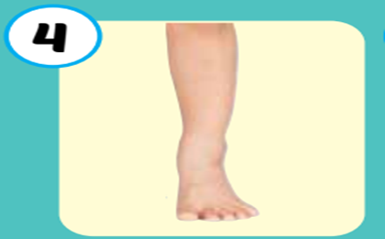

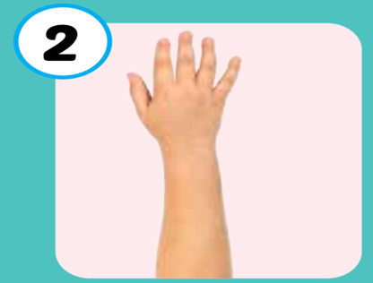


Practice writing sentences.
I use my ____in ____.
6
1
SPIN
5
2
4
3

Slide 8

CONSOLIDATION

Slide 9
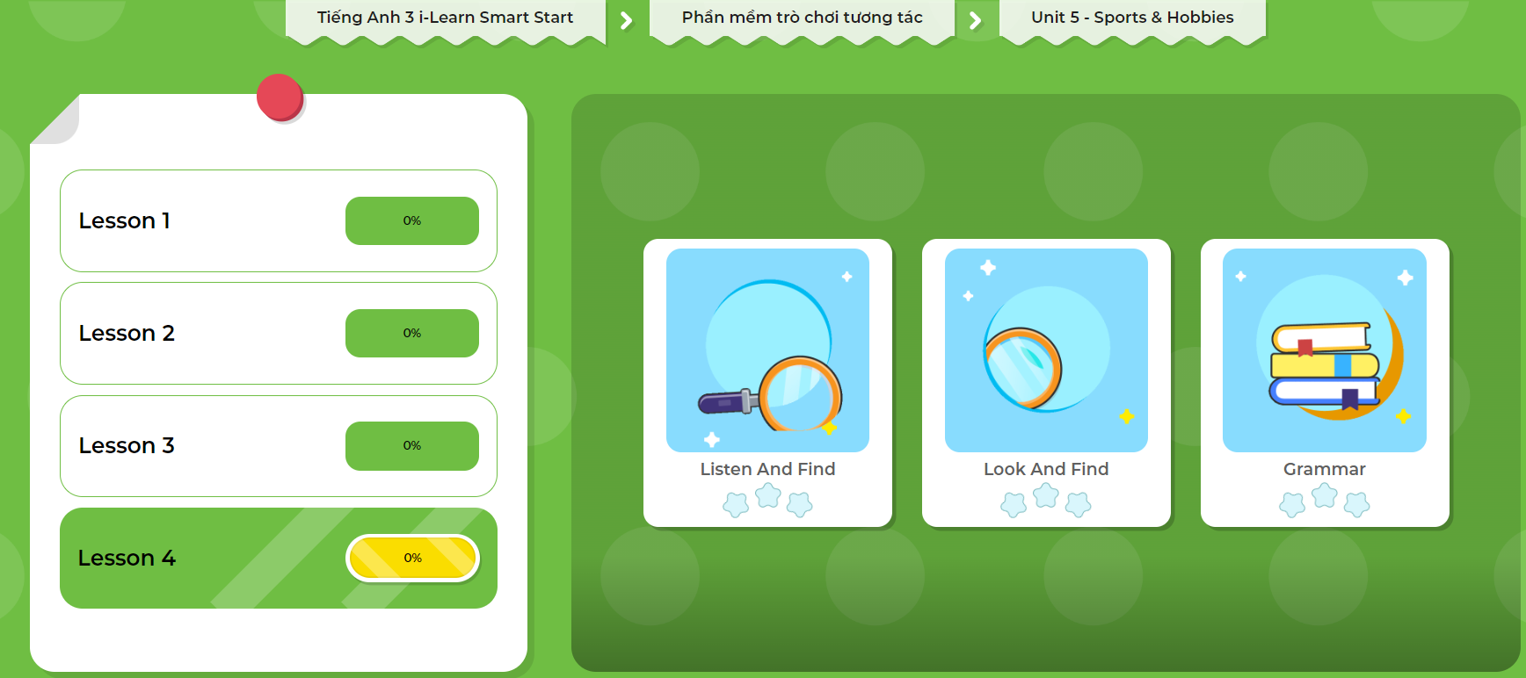
LET’S PLAY!
Click here to play the games.

Slide 10
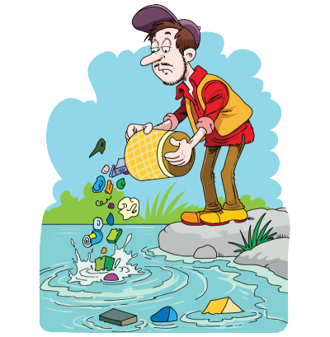
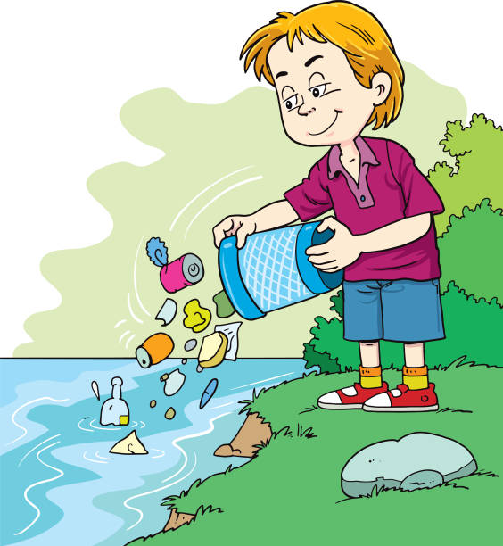
Clean up trash by answering questions correctly ☺

Slide 11





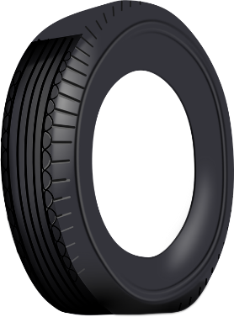




Clean up
the ocean

Slide 12







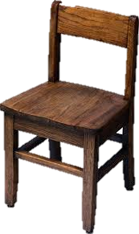


1
Click the trash after completing the question.
end
3
4
2
Rewrite the sentences
Click the number to show the sentence.
6
8
5
7

Slide 13


favorite/ My/ is/ soccer./ sport
My favorite sport is soccer.
Back

Slide 14
good/ am/ at/ basketball./ I/ playing
I am good at playing basketball.
Back

Slide 15
my/ use/ and/ I/ hands/ arms.
I use my hands
and arms.
Back

Slide 16
throw/ can/ I/ basketball./ catch/ the ball/ and/ in
I can catch and throw the ball in basketball.
Back

Slide 17
can’t/ I/ the ball./ kick
I can’t kick the ball.
Back

Slide 18
you/ Can/ your/ use/ head/ volleyball?/ in
Can you use your head in volleyball?
Back

Slide 19
can/ You/ the ball/ soccer./ kick/ in
You can kick the ball in soccer.
Back

Slide 20
legs/ You/ use/ and/ your/ feet in/ soccer.
You use your legs and feet in soccer.
Back

Slide 21
Today’s lesson
Vocabularies
hand
arm
foot/feet
leg
body
head
Structures/Sentence patterns
I use my legs and feet in soccer.
I can kick the ball in soccer.
I can't kick the ball in basketball.

