Slide 1

Unit 5: Sports and hobbies
Review & Practice 1
Page 80

Slide 2


Swap positions

Slide 3
How to play
The students stand in a circle (or sit on a circle of chairs), except for one student (or the teacher), who stands in the middle. Each student must have a fixed position.
The person in the middle says a sentence that starts with Change positions if you… and ends with some condition (e.g. …have curly hair).
If that condition is true for a student, they have to stand up and find a new position as quickly as possible.
Students who can't find swap positions will be penalized.

Slide 4
6. Change positions if the first letter of your name is D.
7. Change positions if the last letter of your name is G.
8. Change positions if you can play tennis.
9. Change positions if you have long hair.
10. Change positions if you love your teacher.

Slide 5


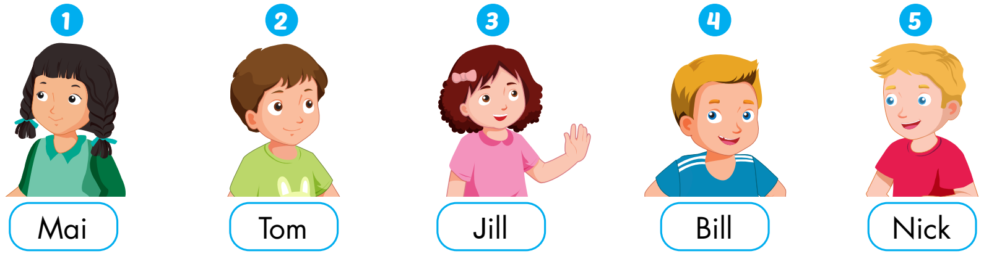

Slide 6
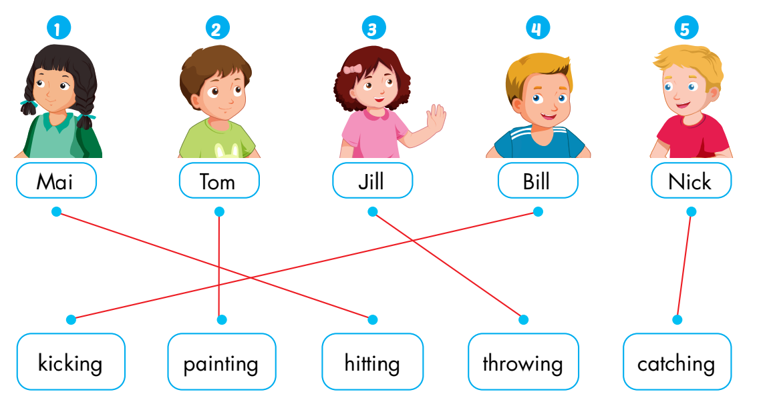
1. James: What are you good at, Mai?
Mai: I'm good at hitting the ball. Watch me!
Listen again
2. James: What about you, Tom? What are you good at?
Tom: I don't really like sports. I'm good at painting.
3. James: Next, what are you good at, Jill?
Jill: I'm good at throwing.
4. James: And...what are you good at, Bill?
Bill: I'm good at kicking.
5. James: What are you good at, Nick?
Nick: I'm good at catching. Let's play

Slide 7
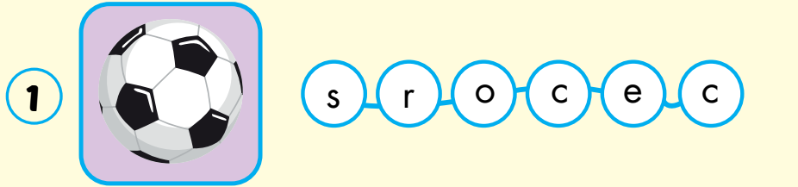
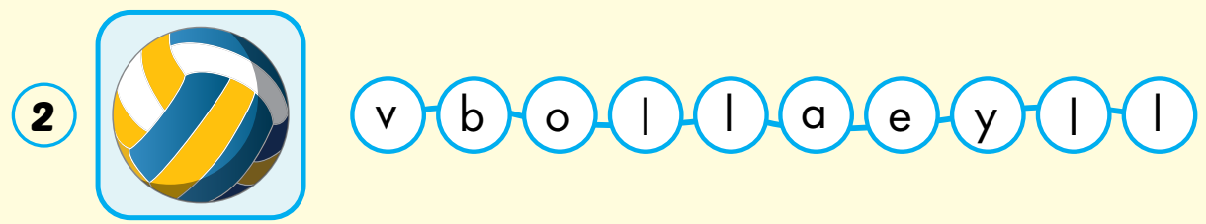
soccer
volleyball

Slide 8
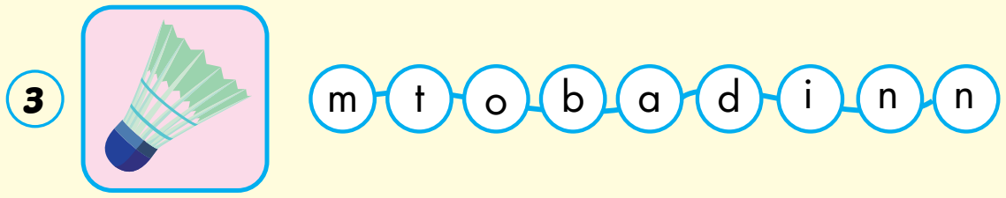
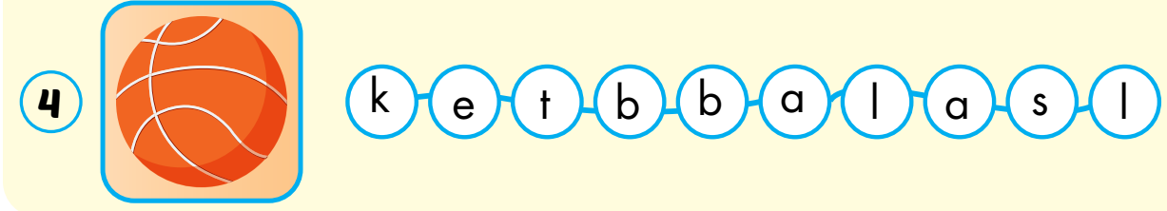
badminton
basketball

Slide 9

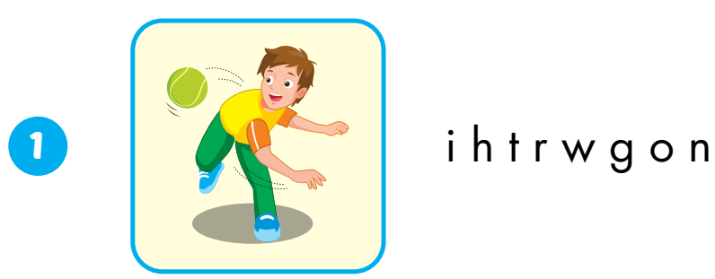

Extra Practice
WB, page 56.
throwing
kicking

Slide 10


Extra Practice
WB, page 56.
watch TV
go out

Slide 11
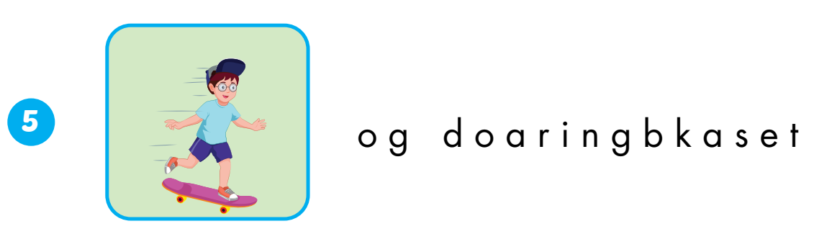

Extra Practice
WB, page 56.
go skateboarding
catching

Slide 13





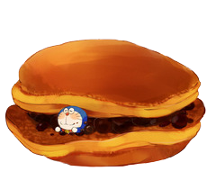

Please help me find the correct answers.

Slide 14
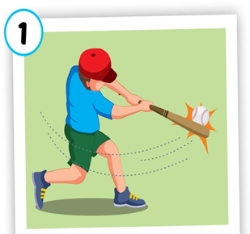

h_ _ _ _ _ _
hitting

Slide 15
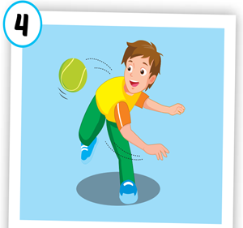
_h_ _ _ _ _ _
throwing

Slide 16
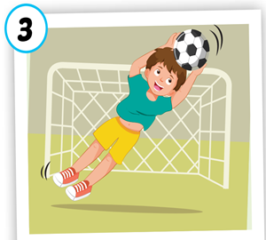
c _ _ _ _ _ _ _
catching

Slide 17
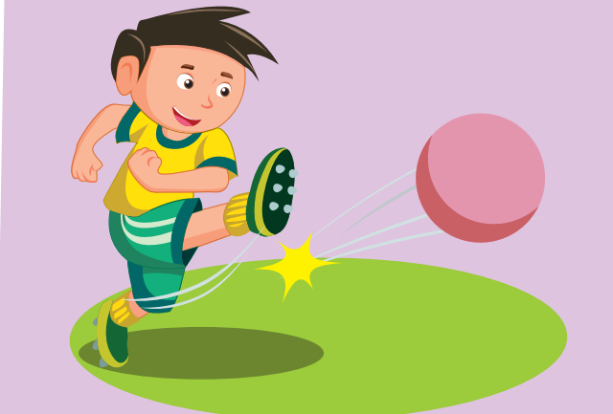
_ _ _ k _ _ _
kicking

Slide 18
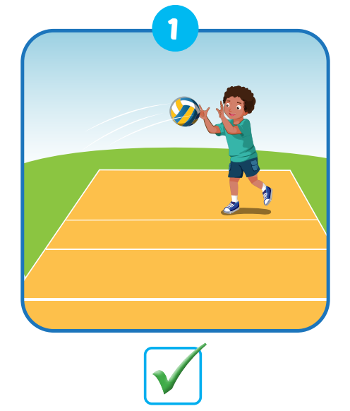
llovyelalb
volleyball

Slide 19
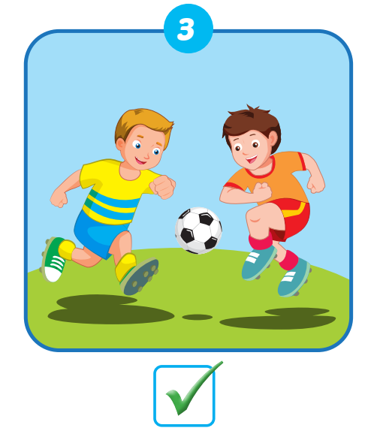
csorec
soccer

Slide 20
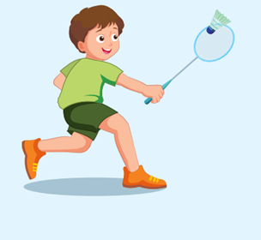
imnntoadb
badminton

Slide 21
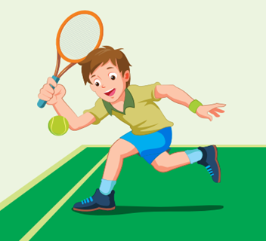
entins
tennis

Slide 22
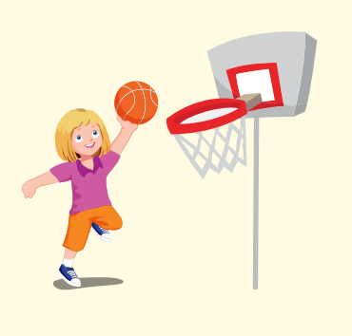
skbatllabe
basketball

