Slide 1

Unit 5: Sports and hobbies
Lesson 3.2
Page 75

Slide 2
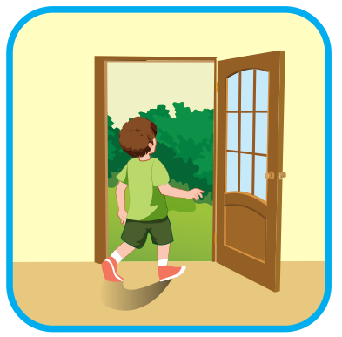
go out
SHOW

Slide 3
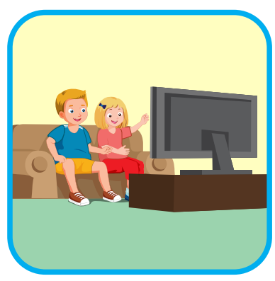
watch TV
SHOW

Slide 4
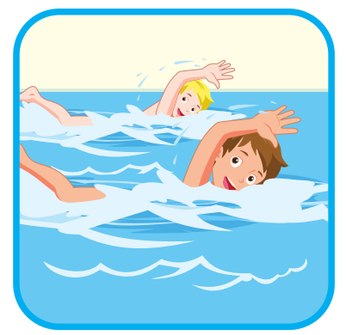
go swimming
SHOW

Slide 5
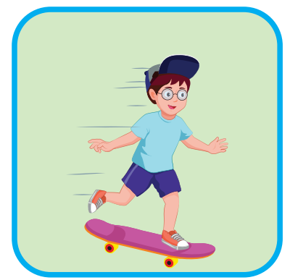
go skateboarding
SHOW

Slide 6

Phonics
/tʃ/

Slide 7

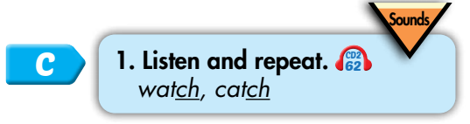

/tʃ/
watch
catch

Slide 8


/tʃ/, /tʃ/, /tʃ/,
/tʃ/, /tʃ/, /tʃ/,
watch, catch,
/tʃ/, /tʃ/, /tʃ/.
/tʃ/, /tʃ/, /tʃ/,
/tʃ/, /tʃ/, /tʃ/,
watch, catch,
/tʃ/, /tʃ/, /tʃ/.
Click to follow the lyrics.
Click one more to follow the second one.

Slide 9
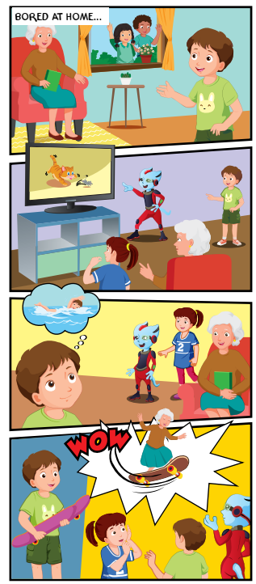

1
Where are the kids?
2
Who is with them?
3
What is Grandma doing?
4

Slide 10

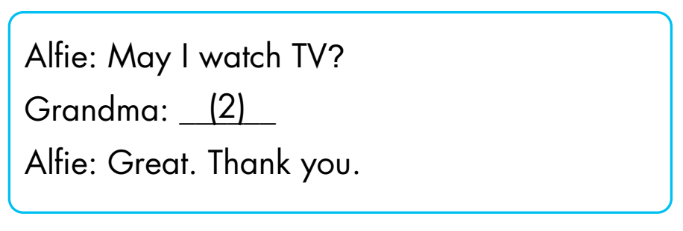
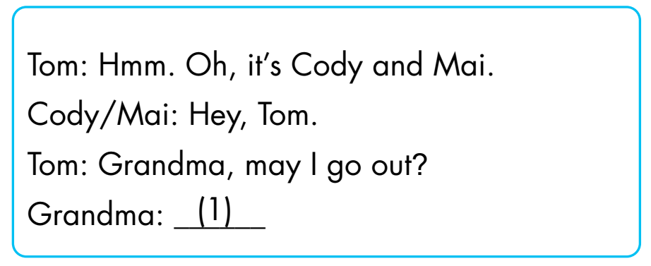
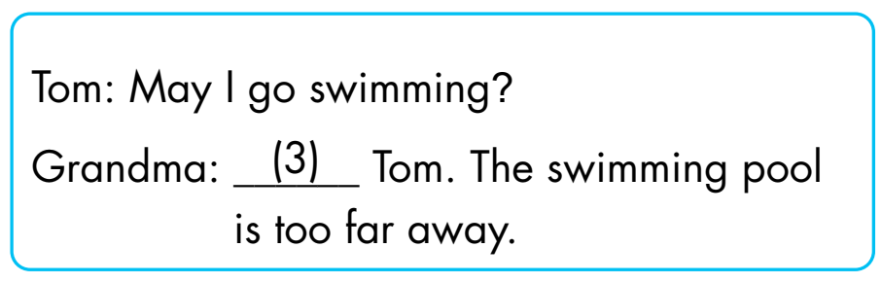
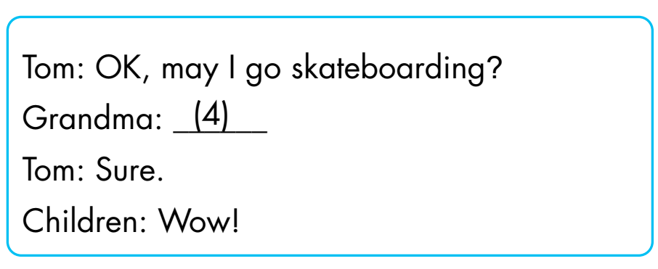
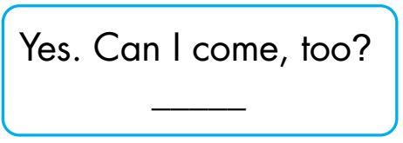
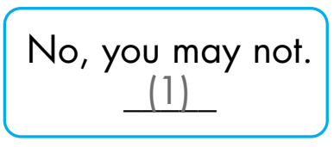
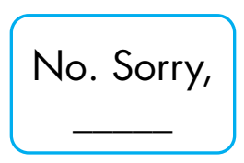
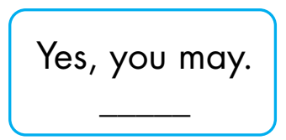
(4)
(3)
(2)

Slide 11
Extra Practice
WB, page 53.
1
2
3
4
May I go
skateboarding?
May I watch TV?
May I go out?
May I go swimming?
❌
✓
❌
✓
Click on the number to hear the sound.

Slide 12
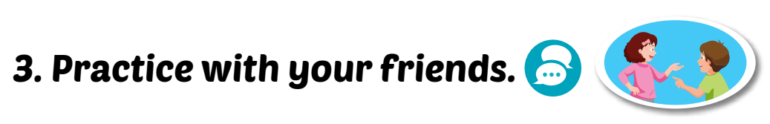
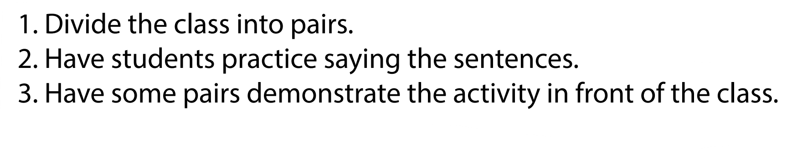
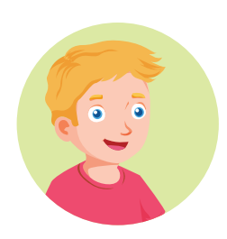

Yes, you may./ No, you may not.
May I watch TV?

Slide 13

THE SLAP GAME 🙌🏽

Slide 14
May I go out?
Yes, you may
Yes, I may

Slide 15
May I go skateboarding?
No, you may not
Yes, I may

Slide 16
May I …TV?
go
watch

Slide 17
May I go …?
swimming
swiming

Slide 18
… go out?
I may
May I

Slide 19
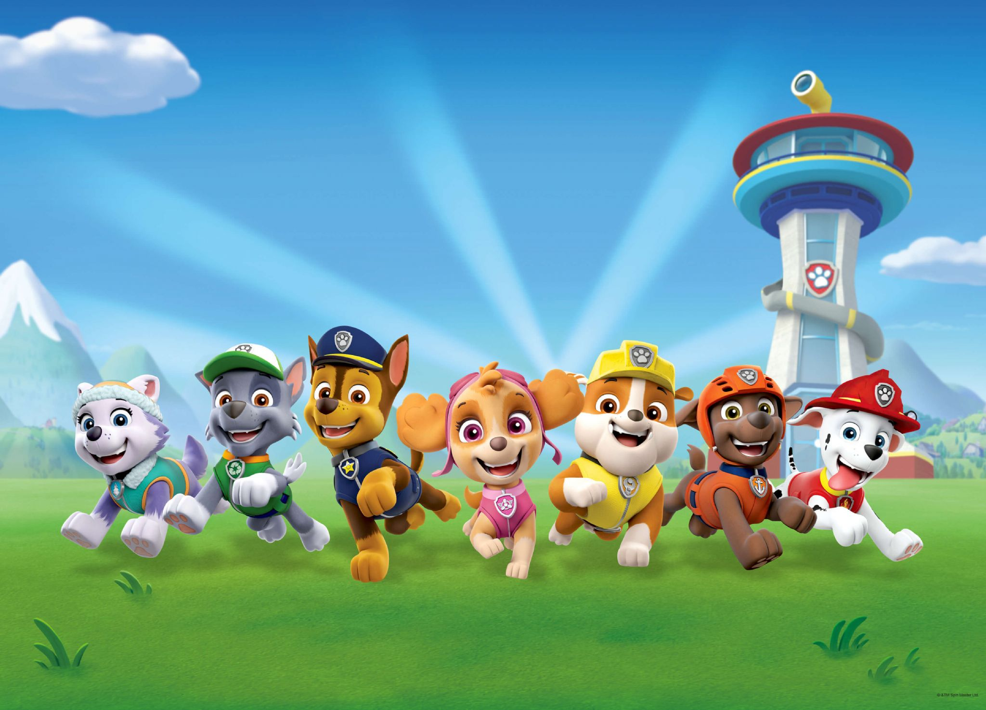
Let’s play

Slide 20

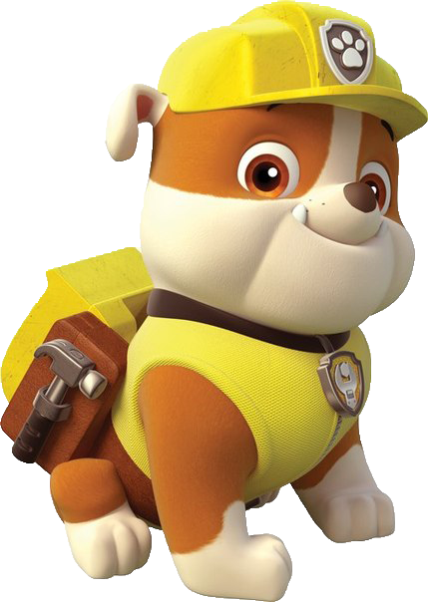
How to play
. Listen to a sound
. Choose the correct answer

Slide 21

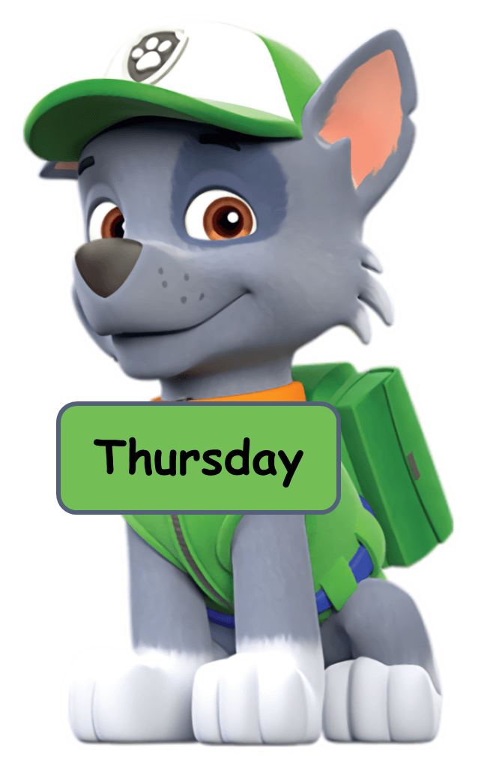
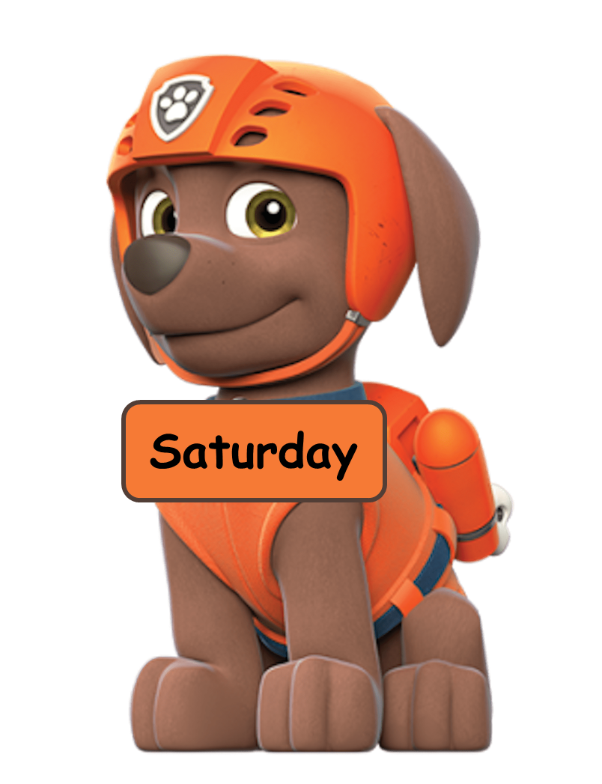


Click the dog having the correct answer.
Click here
Wat TV
Watch VT
Wach TV
Watch TV

Slide 22
Click the dog having the correct answer.
Click here
go swim
go swiming
go swimming
swimming

Slide 23
Click the dog having the correct answer.
Click here
skateboarding
go
skateboarding
go skateboading
go skate

Slide 24


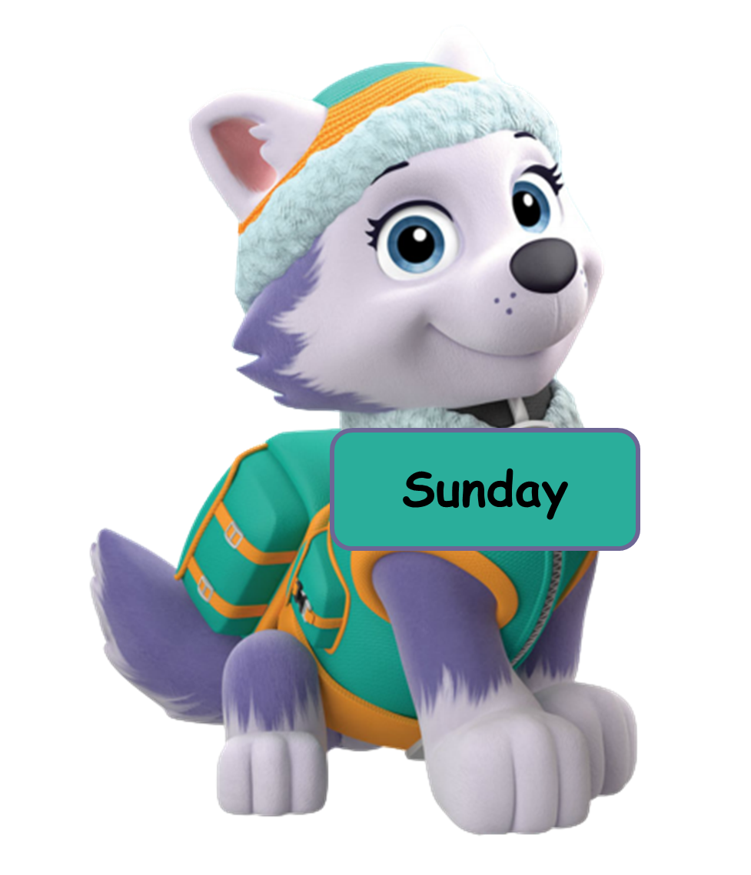
Click the dog having the correct answer.
Click here
going out
go out
out
go ou

Slide 25
Click the dog having the correct answer.
Click here
Answer the question you hear.
No, you may.
Yes, I may.
Yes, you may.
Yes, you may not.

