Slide 1

Unit 5: Sports and hobbies
Lesson 2.1
Page 71

Slide 2
How to play
The students stand in a circle (or sit on a circle of chairs), except for one student (or the teacher), who stands in the middle. Each student must have a fixed position.
The person in the middle says a sentence that starts with Change positions if you… and ends with some condition (e.g. …have curly hair).
If that condition is true for a student, they have to stand up and find a new position as quickly as possible.
Students who can't find swap positions will be penalized.

Slide 3
1. Change positions if you’re wearing black shoes.
2. Change positions if you have short hair.
3. Change positions if you’re wearing a watch.
4. Change positions if you have curly hair.
5. Change positions if you’re wearing glasses.

Slide 4

New words
hitting
kicking
catching
throwing

Slide 5


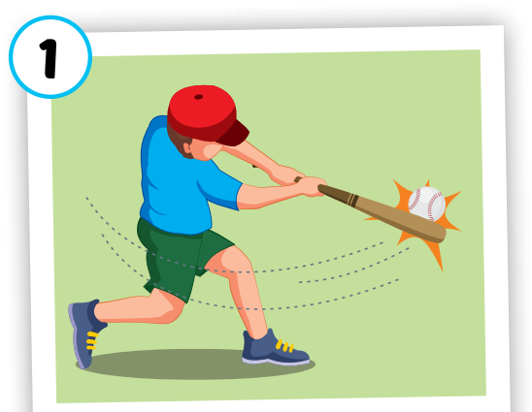
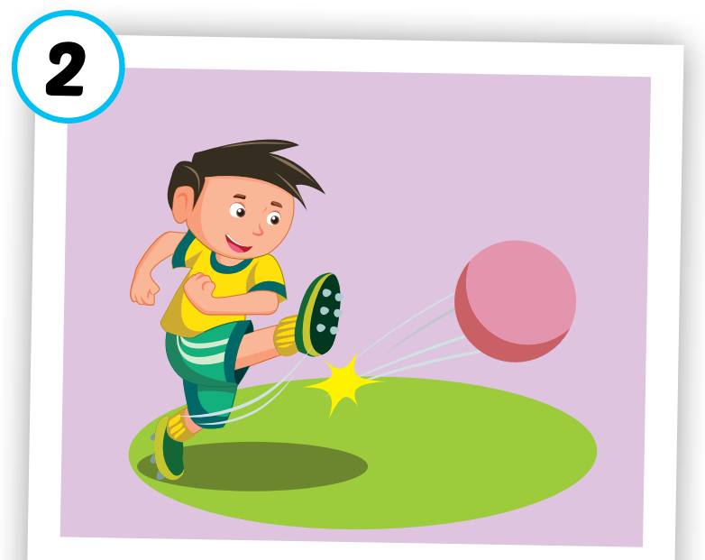
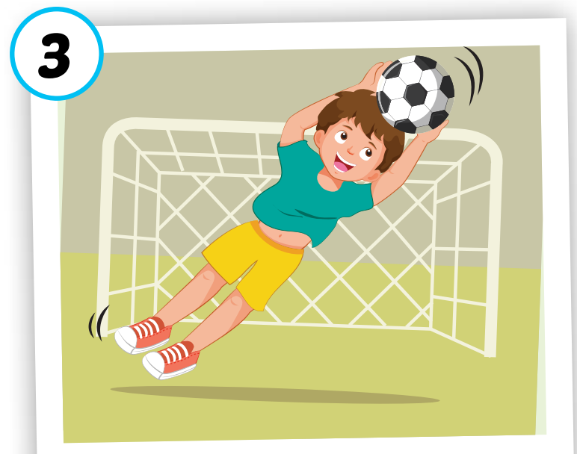
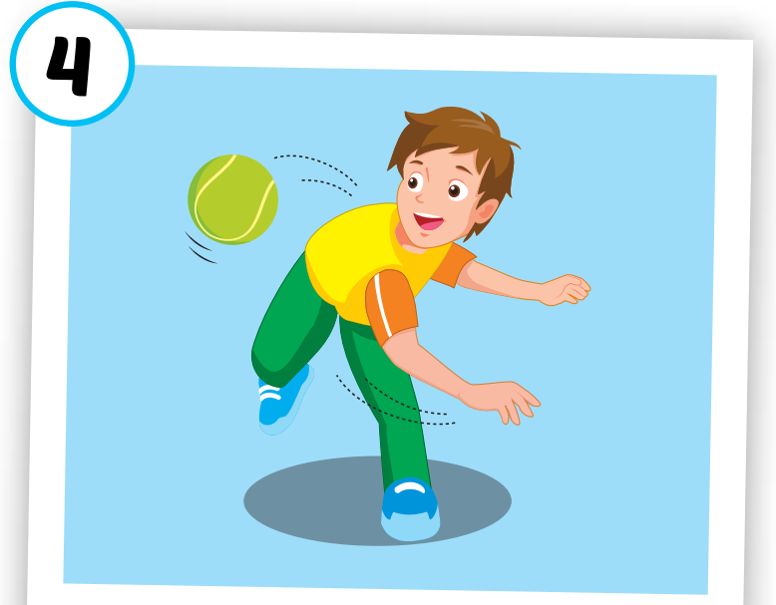
hitting
kicking
catching
throwing
/ˈhɪtɪŋ/
đánh
/ˈkɪkɪŋ/
đá
/ˈkætʃɪŋ/
bắt
/ˈθroʊɪŋ/
ném
Click on each word to hear the sound.

Slide 6
1
2
3
4
5
6
7
8
Choose the same pictures.
Click on the square to see the picture
Click on to close the picture.

Slide 7

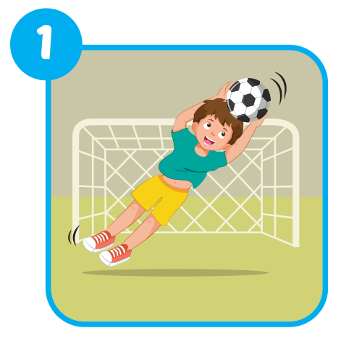
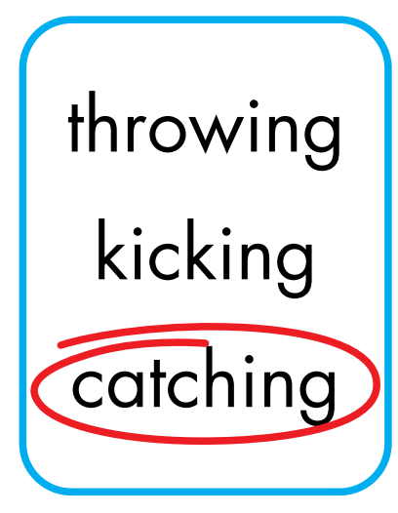
Extra Practice
WB, page 50.

Slide 8
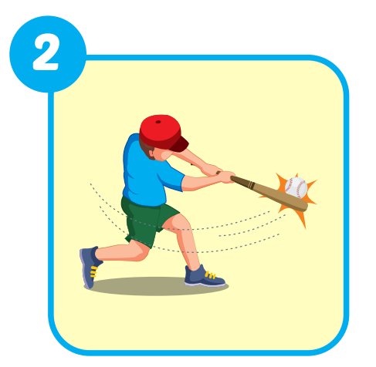
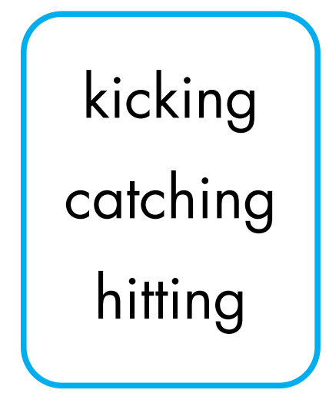
Extra Practice
WB, page 50.

Slide 9
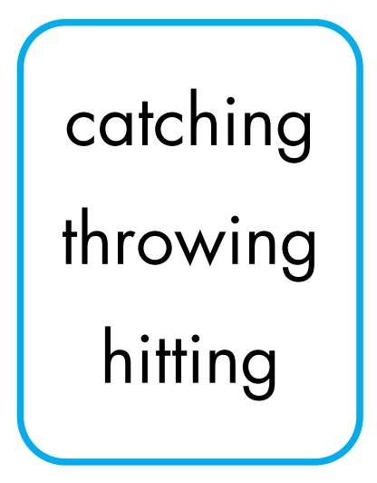
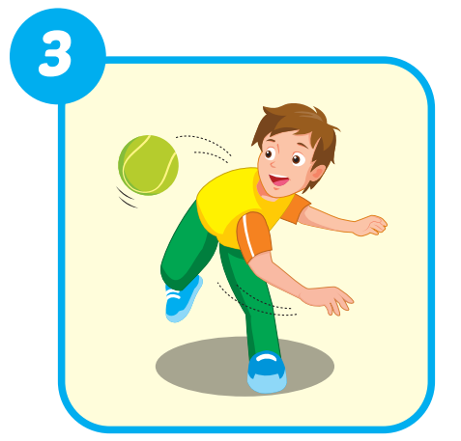
Extra Practice
WB, page 50.

Slide 10
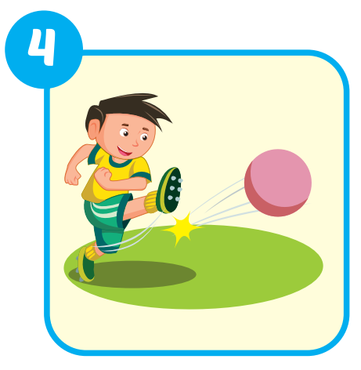
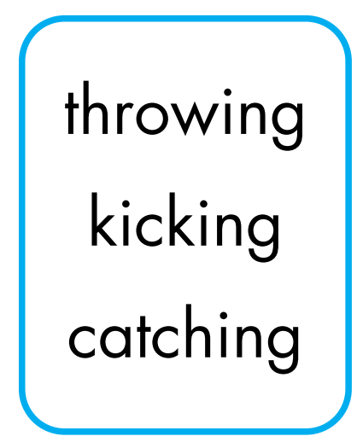
Extra Practice
WB, page 50.

Slide 11

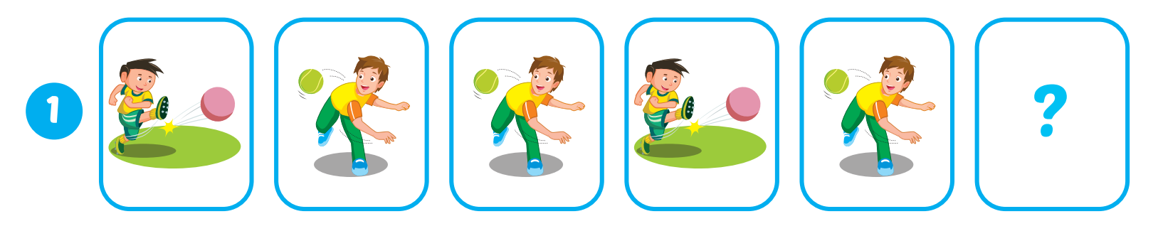

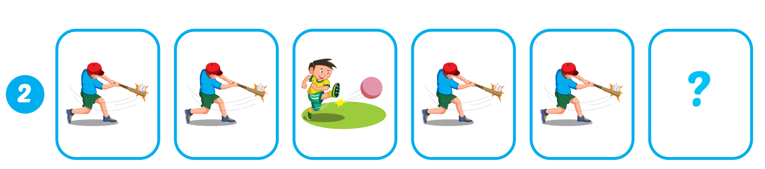
Extra Practice
WB, page 50.
kicking

Slide 12
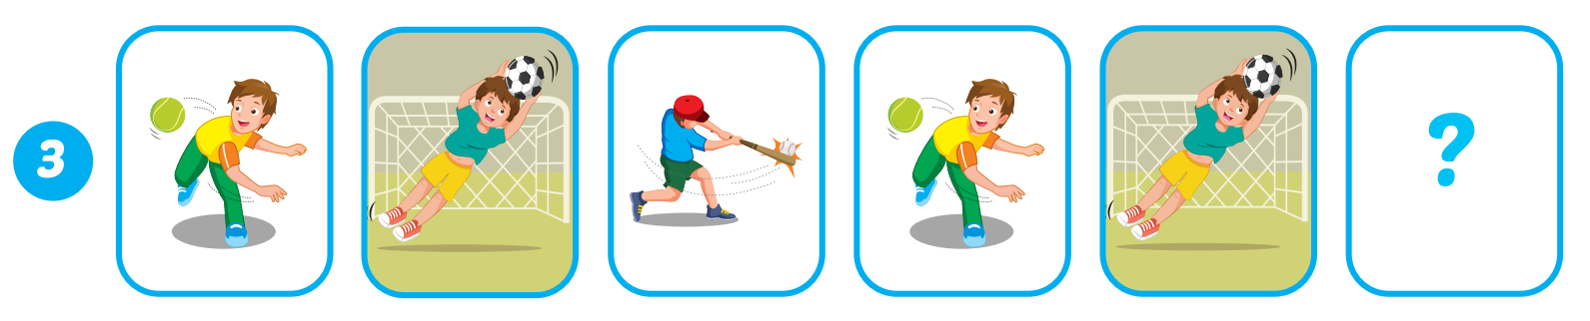
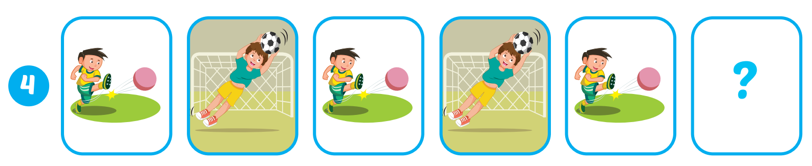
Extra Practice
WB, page 50.
hitting
catching

Slide 13
Structures
What are you good at?
- I'm good at kicking.

Slide 14

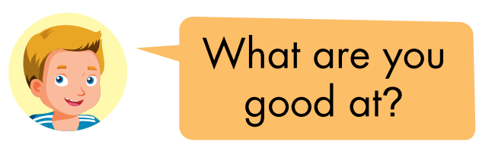
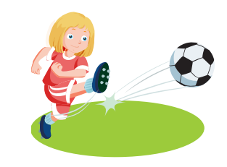
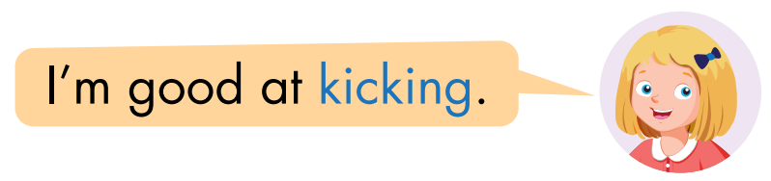

Slide 15

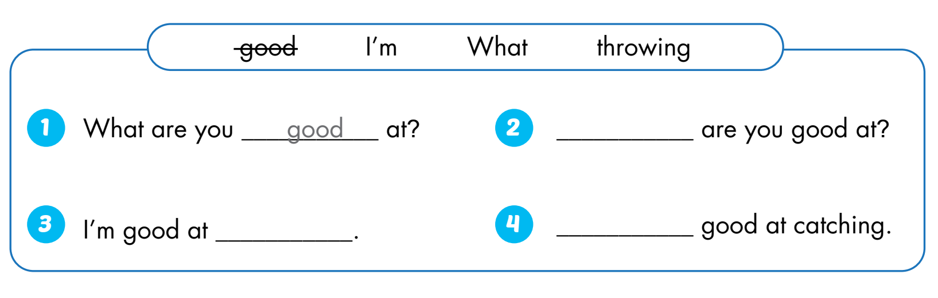
What
throwing
I’m

Slide 16





Who is faster?

Slide 17





How to play
Divide students into 2 groups.
The group with the correct answer will move on. The group with the wrong answer will be lost turn.
The group across the river first will win.
Group A
Group B

Slide 18






End
Congratulations
Congratulations
Click on the avatar of the group to move the level.
Click the log to show question.

Slide 19


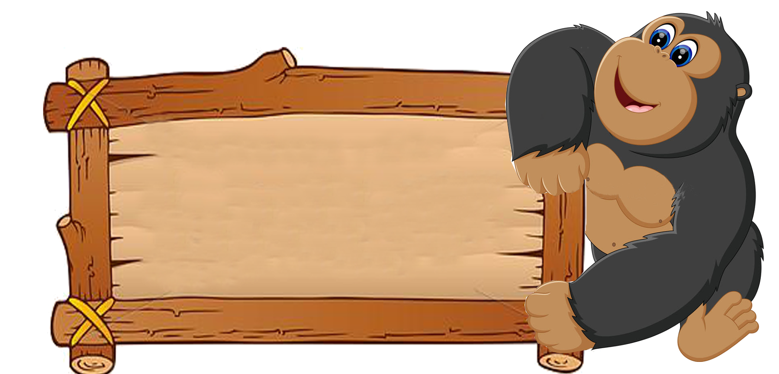
Back
Hitting

Slide 20
Back
Throwing

Slide 21
Back
I'm good at…
What are you good at?

Slide 22
Back
A. Kicking
Choose the correct word.
Kicking B. Caching
C. Thowing D. Hiting

Slide 23
Back
Catching
Rewrite the word:
iccgthna

Slide 24


Back
I'm good at …
What are you good at?

Slide 25
Back
Kicking

Slide 26
Back
Hitting
Rewrite the word:
ihtgint

Slide 27
Back
Catching

Slide 28
Back
C. Throwing
Choose the correct word.
A. Kiking B. Hiting
C. Throwing D. Caching

