Slide 1

Unit 5: Sports and hobbies
Lesson 1.1
Page 68

Slide 2
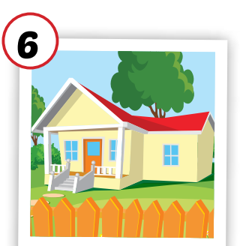
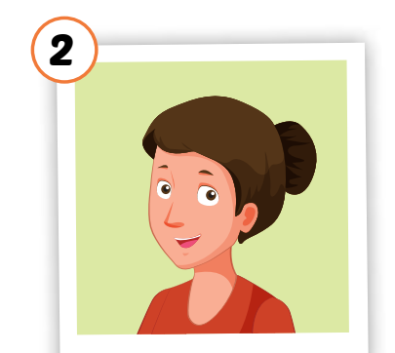

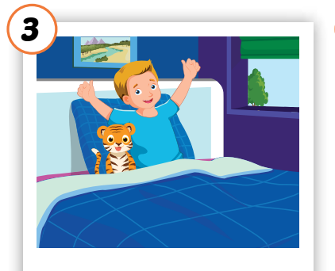
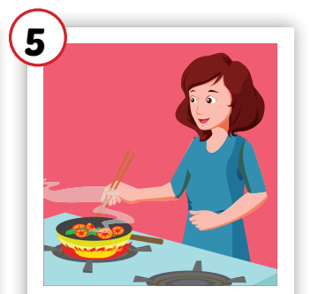
Crossword Puzzle
1
H | O | U | S | E
Click the boxes to show the answer.
2
W | A | K | E | U | P
3
C | O | O | K | I | N | G
4
M | O | T | H | E | R
5
N | O | T | E | B | O | O | K
Double click on the number to open the hint.
Click again on the number to close the hint.
KEYWORD

Slide 3

New words
badminton
tennis
volleyball
basketball
soccer

Slide 4
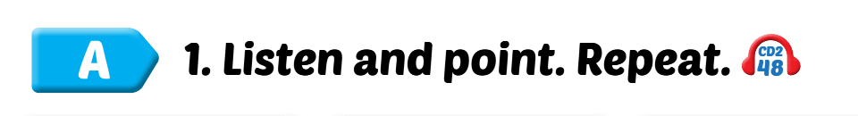

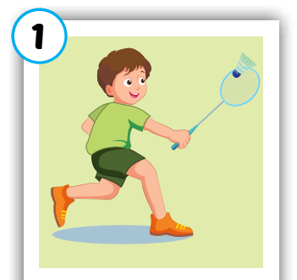
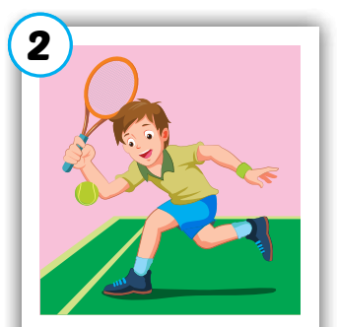
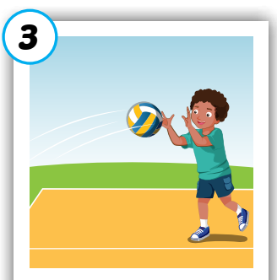
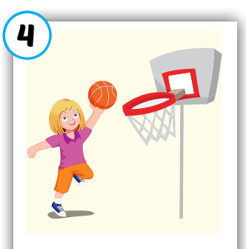
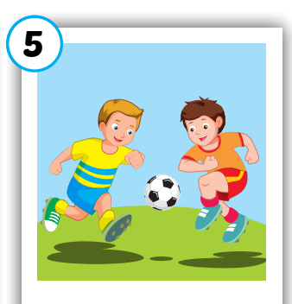
Click on each word to hear the sound.
badminton
tennis
volleyball
basketball
soccer
/ˈbædmɪntən/
cầu lông
/ˈtenɪs/
quần vợt
/ˈvɑːlibɑːl/
bóng chuyền
/ˈbæskətbɑːl/
bóng rổ
/ˈsɑːkər/
bóng đá

Slide 5

1
2
3
4
Click on the square to see the picture
6
7
8
Click on the button to close the picture
5
9
10
11
12
Notes:
Memory game. GV nhấn vào ô để mở, nếu HS chọn 2 hình không giống nhau, GV nhấn vào hình tròn để đóng hình lại, HS phải nhớ những hình đã mở.

Slide 6

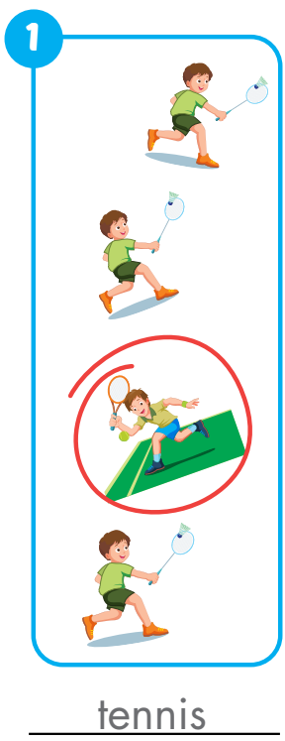
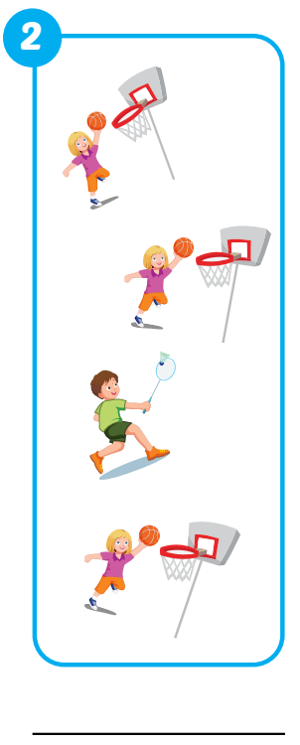
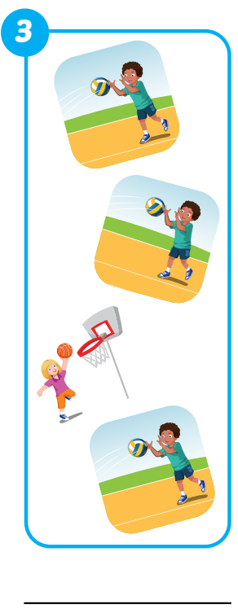
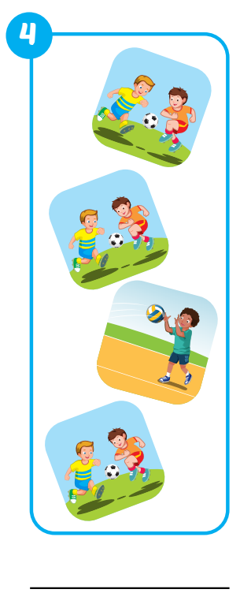
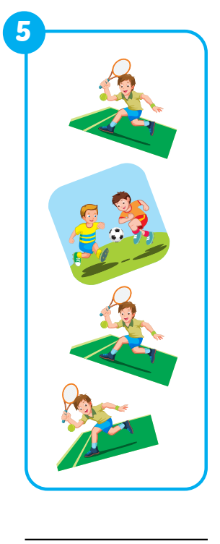
Extra Practice
WB, page 48.
badminton
basketball
volleyball
soccer

Slide 7

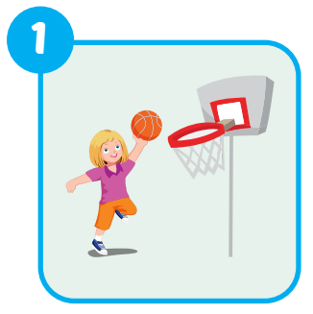
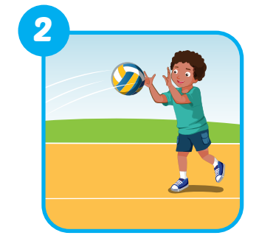
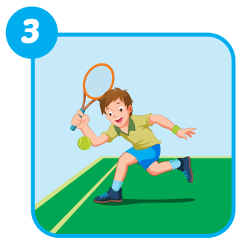
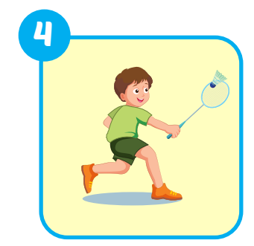
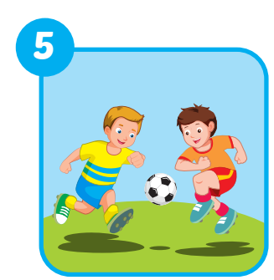

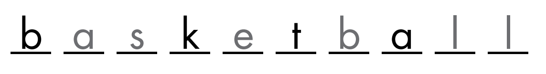



Extra Practice
WB, page 48.
3
e n i s
1
2
o l e b a l
5
S c c r
4
b a m i n o

Slide 8
Structures
Can you play soccer?
-Yes, I can./No, I can't.

Slide 9


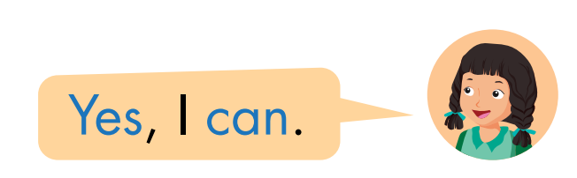
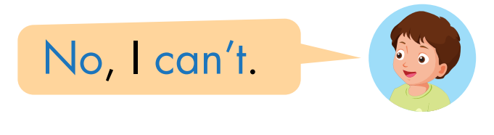

Slide 10

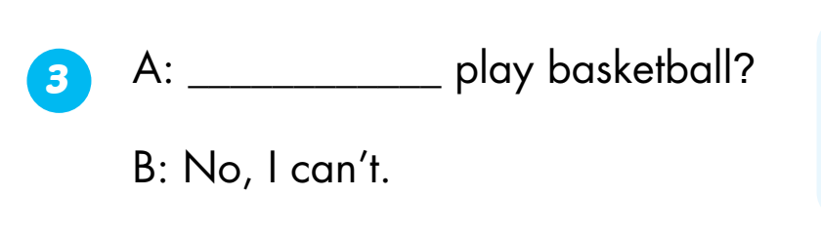
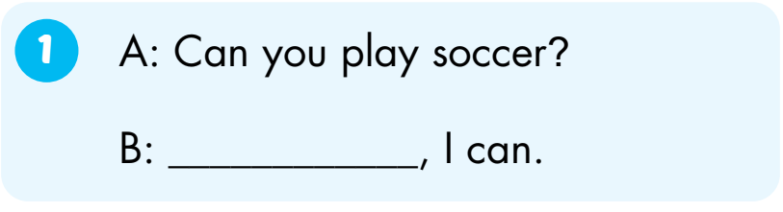
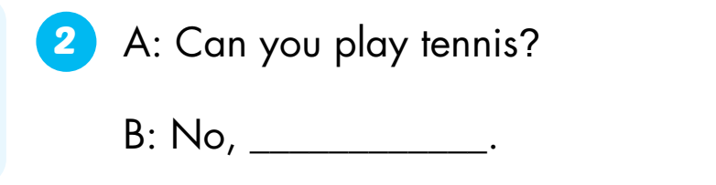
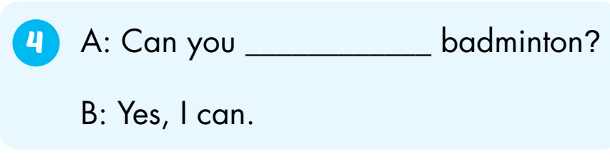
Can you
Yes
play
I can’t

Slide 11

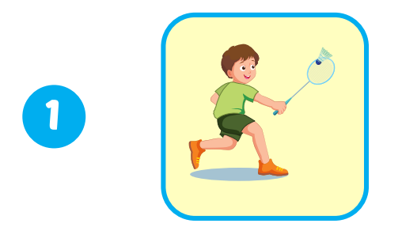
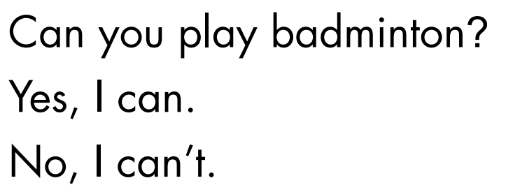
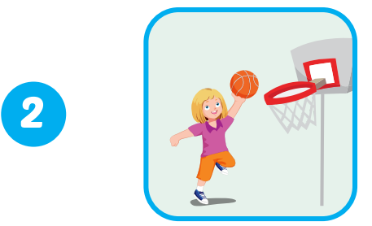
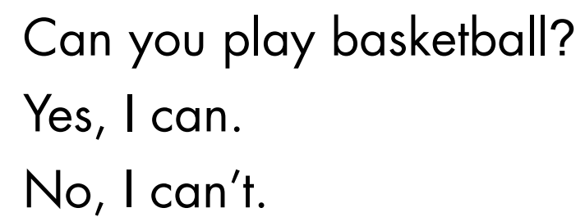
Extra Practice
WB, page 49.
1
✓
✓
2
Click on the number to hear the sound.

Slide 12
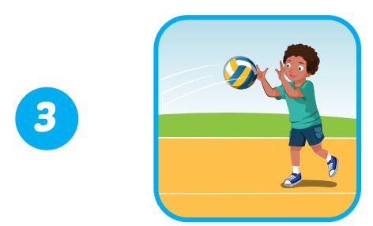
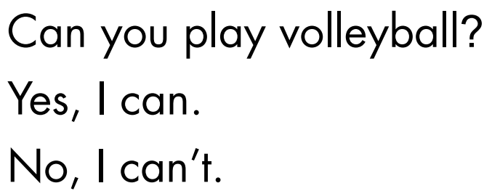
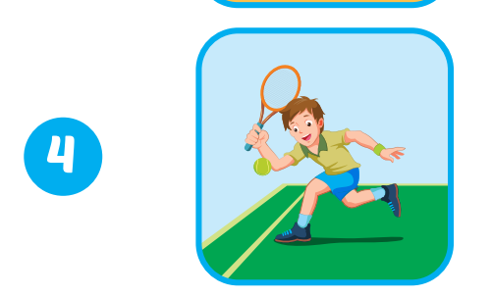
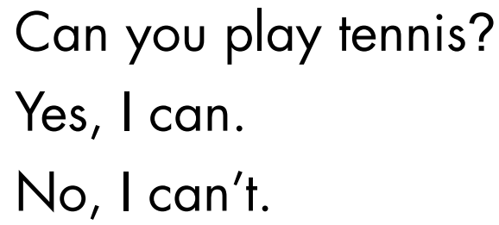
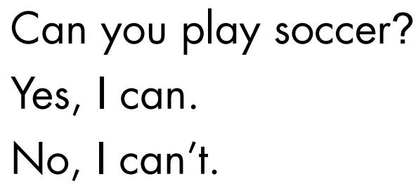
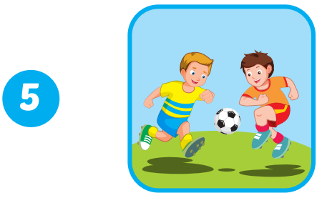
3
✓
✓
4
5
✓
Click on the number to hear the sound.

Slide 13

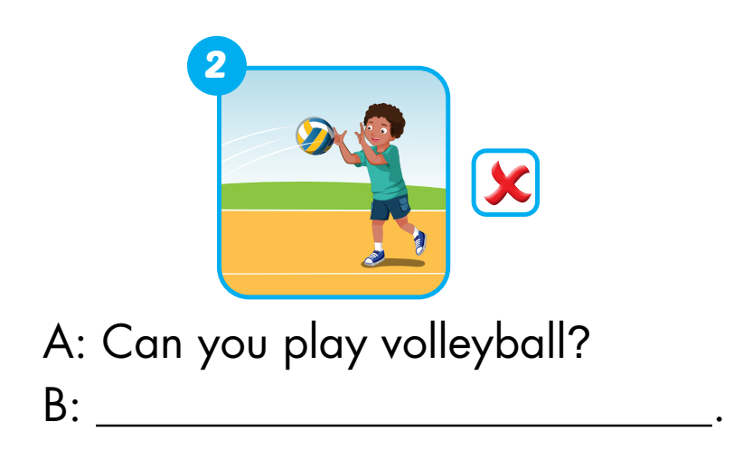
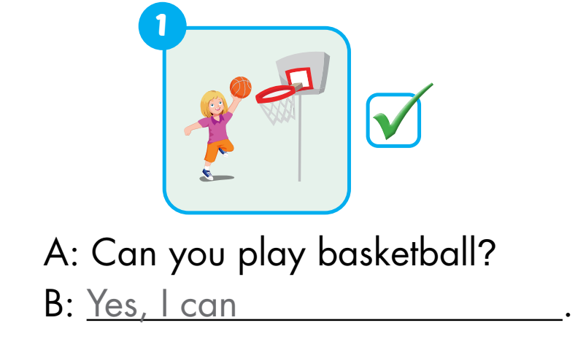
Extra Practice
WB, page 49.
No, I can’t

Slide 14
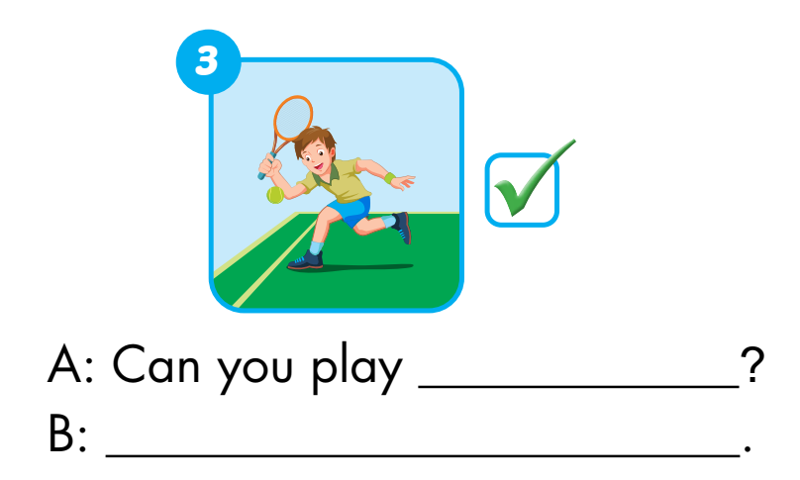
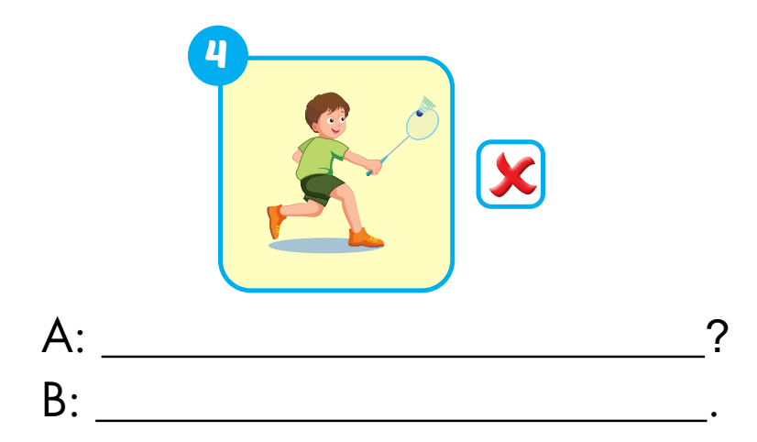
tennis
Can you play badminton
Yes, I can
No, I can’t

