Slide 1

Unit 1: My friends
Lesson 2.1
Page 13

Slide 2

Vocab
the USA, the UK, Italy, India, Japan, Alpha

Slide 3




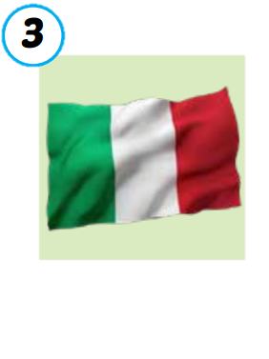
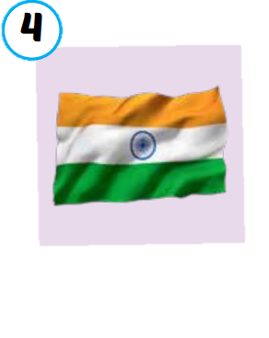

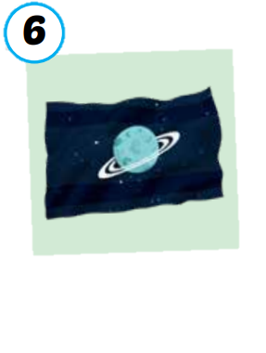
the USA
the UK
Italy
India
Japan
Alpha
/ðə ˌjuː es ˈeɪ/
nước Mỹ,
Hoa Kỳ
/ðə ˌjuː ˈkeɪ/
Vương quốc Anh
/ˈɪtəli/
nước Ý
/ˈɪndiə/
nước Ấn Độ
/dʒəˈpæn/
Nước Nhật
/ˈælfə/
Hành tinh Alpha

Slide 4






SLAP THE BOARD
Japan
The USA
The UK
Alpha
Italy
India
Notes:
Divide students into 2-3 groups. Make lines.
Teacher show picture one by one. One students of each team quickly SLAP THE BOARD and SAY ALOUD THE ANSWER at the same time.
The fastest and most correctly is the winner.
(there are 6 rounds)

Slide 5


Listen and match.
a
b
c
d
e
f
Notes:
Show listening option one by one.
Then show pictures and ask students to guess the answer.
Click on the STARS A/B/C/... To hear the sound.
Click on the background to reveal the line answers.

Slide 6
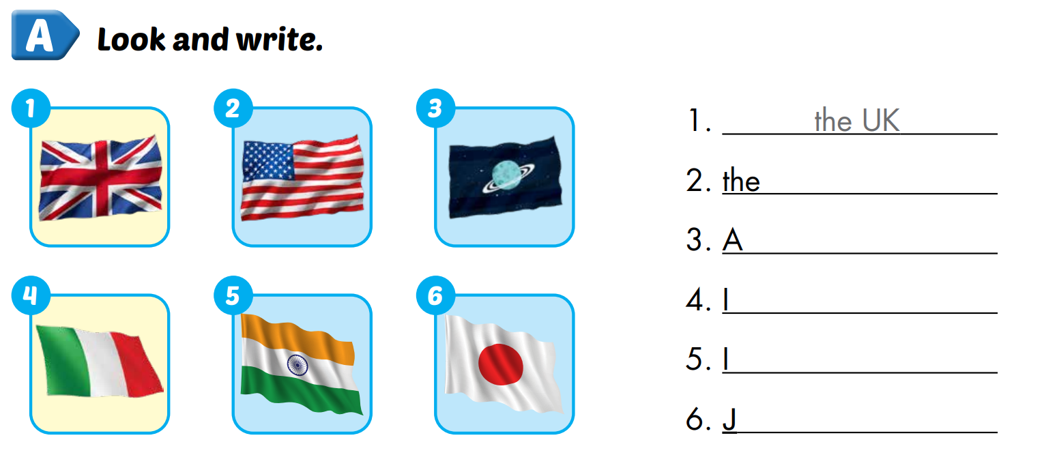
Extra 1 – WB P.10
USA
lpha
taly
ndia
apan

Slide 7
Structure
Where are you from?
I’m from ...

Slide 8




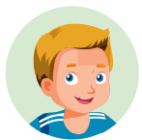

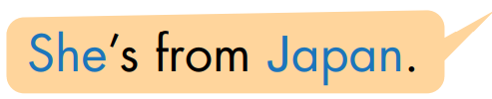

Notes:
Click on each sentence to hear the sound.
Click on the headphone CD1 19 to hear the entire audio.

Slide 9

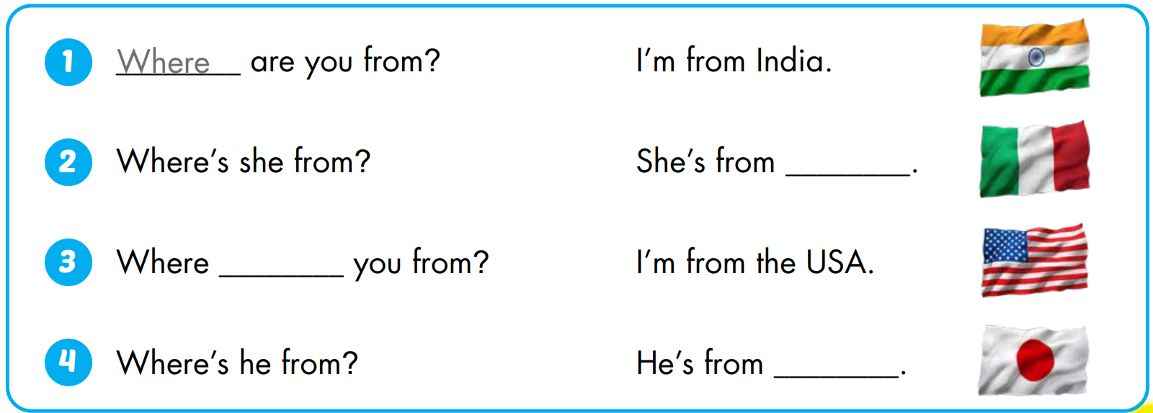
Italy
are
Japan

Slide 10

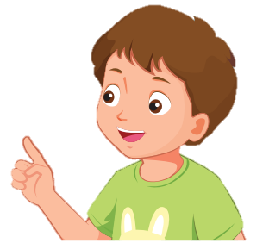
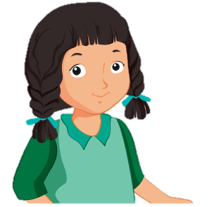






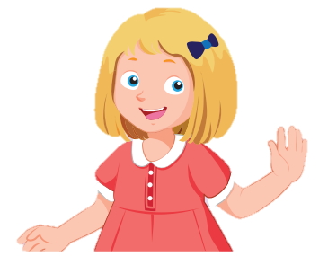
2
4
WHEEL OF POINT
3
6
1
5
֎
3
6
4
5
2
1
Where are you from?
I’m from ...
Where is he from?
He’s from ...
Where is she from?
She’s from ...
Notes:
Divide students into 2 teams. Tiktoktoe to find the winner, the loser asks, the winner answers.
The winner SPIN THE WHEEL to get points. (click on the arrow to move to the wheel)
(there are 12 rounds)
Click on the wheel to go to WHEEL SLIDE

Slide 11
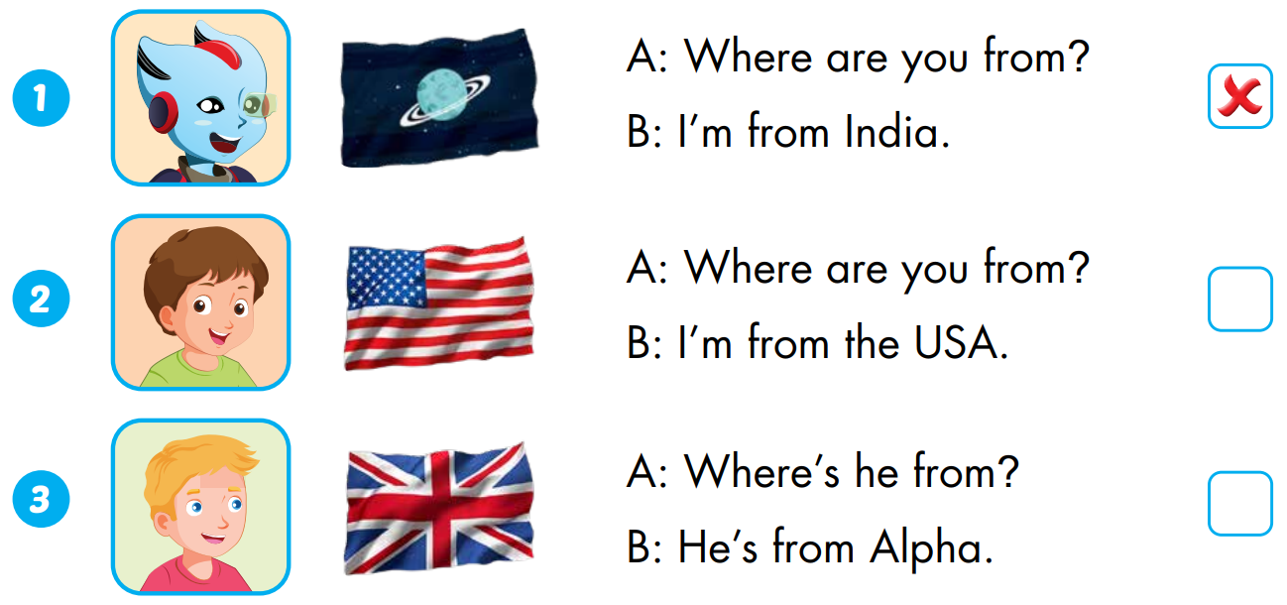


Extra 1 – WB P.10
Alpha
the UK

Slide 12
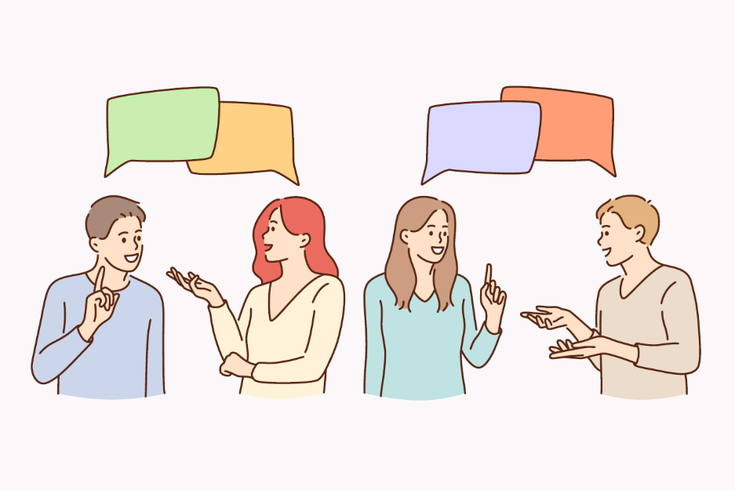
Sarah: Hello. What’s your name?
Dylan: Hi. My name’s Dylan.
Sarah: How can you spell “Dylan”?
Dylan: It’s D-Y-L-A-N. What’s your name?
Sarah: My name’s Sarah.
Dylan: How can your spell “Sarah”?
Sarah: It’s S-A-R-A-H.
Dylan: Where are your from?
Sarah: I’m from the USA. What about you?
Dylan: I’m from Italy. Nice to meet you.
Sarah: Nice to meet you, too.
Dylan: My friend’s name is Alfie.
Sarah: Where is he from?
Dylan: He’s from Alpha.
Play roles. Make the similar conversation.
Notes:
- Work in pairs, play roles and make the similar conversation.

