Slide 1
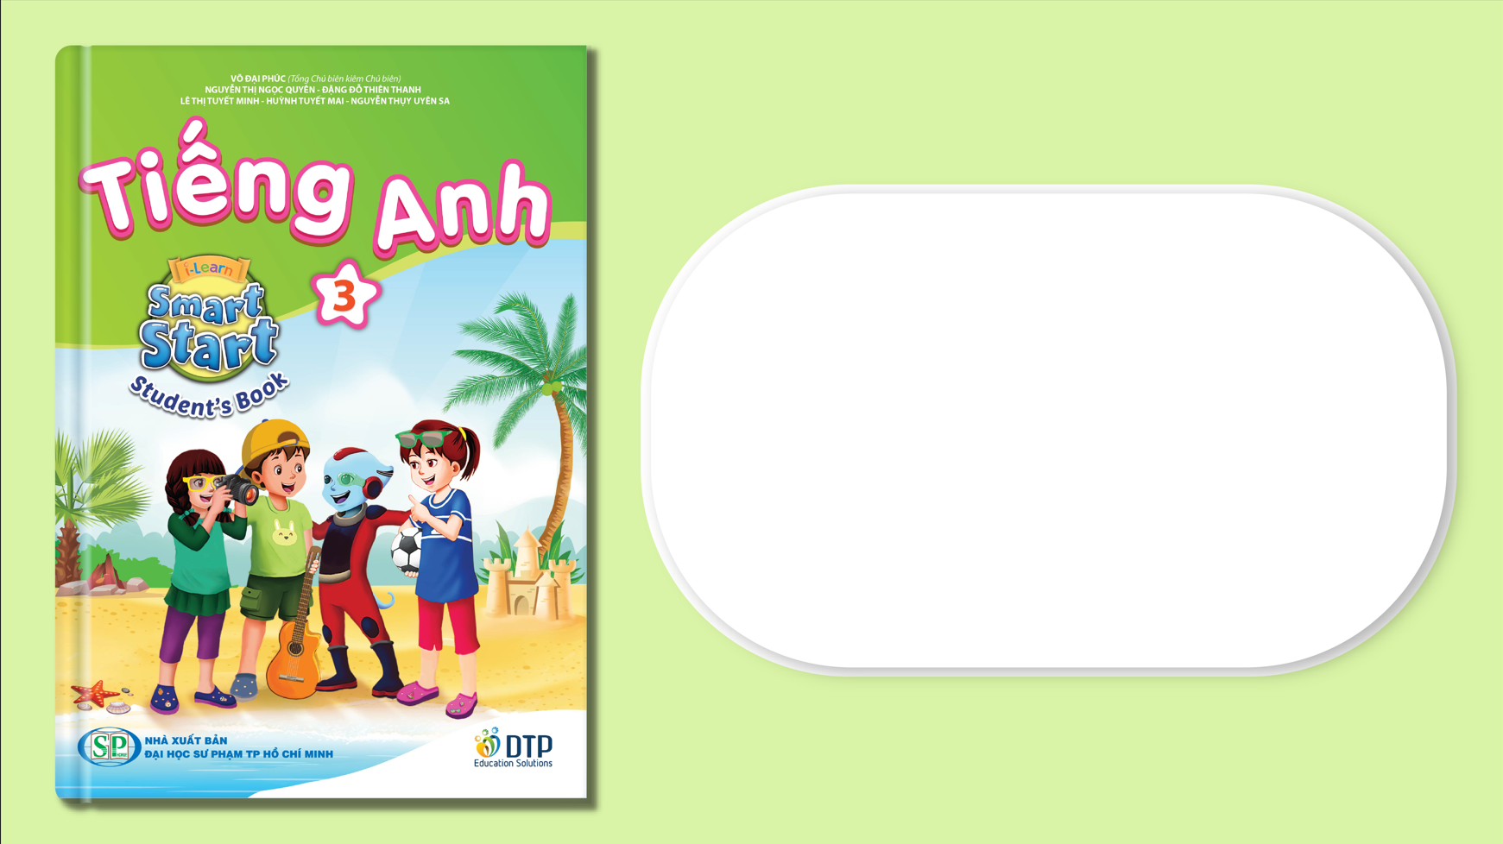
Unit 1: My friends
Lesson 1.1
Page 10

Slide 2

New words
The alphabet
A B C...

Slide 3

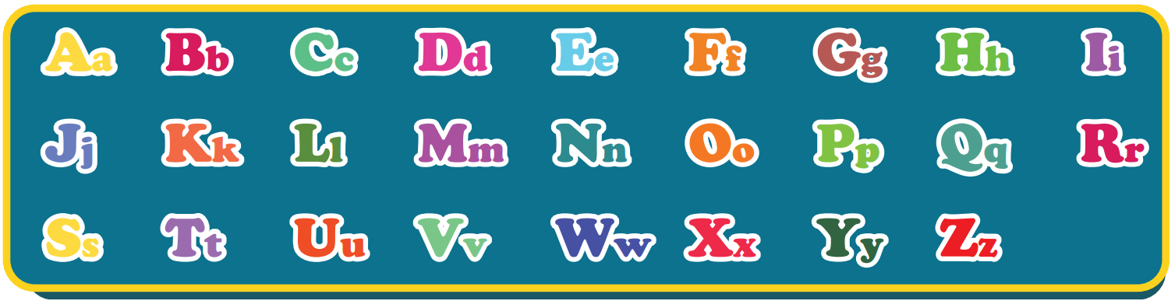
Click on the picture of the Alphabet song to hear the sound
The Alphabet song
Notes:
Click on the picture to listen to the Alphabet song.
For the first time, the arrow icon automatically appears in group of two-three letters along with the music.
For the second time, guider has to point every single letter for students.

Slide 4
Act1. Heads up. What’s missing?
Aa
Bb
Cc
Dd
Ee
Ff
Gg
Hh
Ii
Jj
Kk
Ll
Mm
Nn
Oo
Pp
Qq
Rr
Ss
Tt
Uu
Vv
Ww
Xx
Yy
Zz
Notes:
Review
Heads down on the table. When hearing guider’s command, heads up guess the missing letter (letters)
10 turns (1 missing letter -> 2 missing letters -> 3 missing letters)

Slide 5
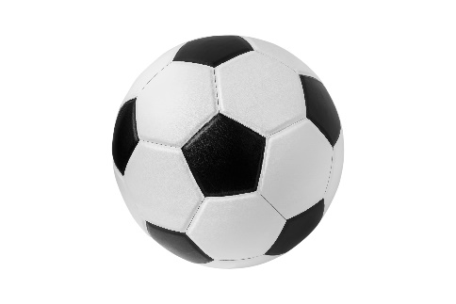
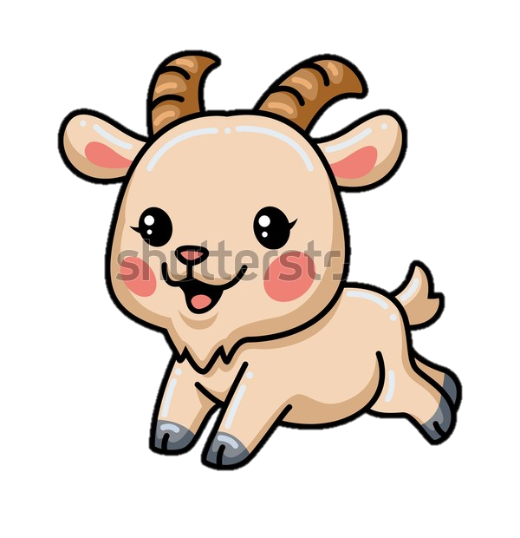

Act2. Look and write.
Aa
Bb
Cc
Dd
Ee
Ff
Gg
Cat
_all
_at
Ball
Apple
Dog
_lephant
Fish
_oat
_pple
_og
Elephant
_ish
Goat
Notes:
Goat: 2008803551

Slide 6
Structures
How do you spell “Alfie”?
A-L-F-I-E.

Slide 7

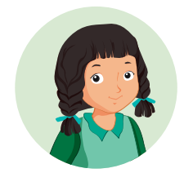
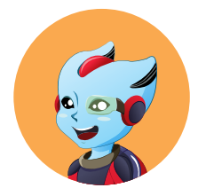
Click on the bubbles to hear the sound
How do you spell “Alfie”?
A-L-F-I-E.
Mai
Alfie
Notes:
- Click on the WORDS to hear the SOUND

Slide 8
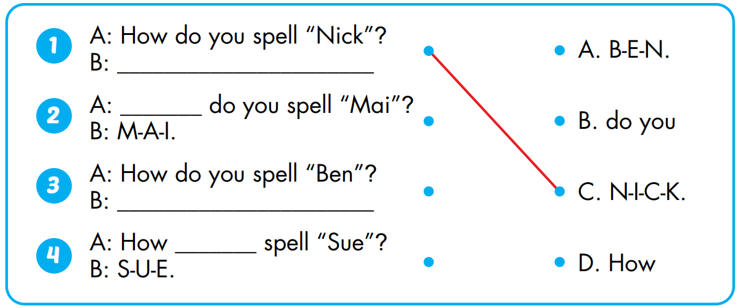
Act1. Look and match. Practice.

Slide 9
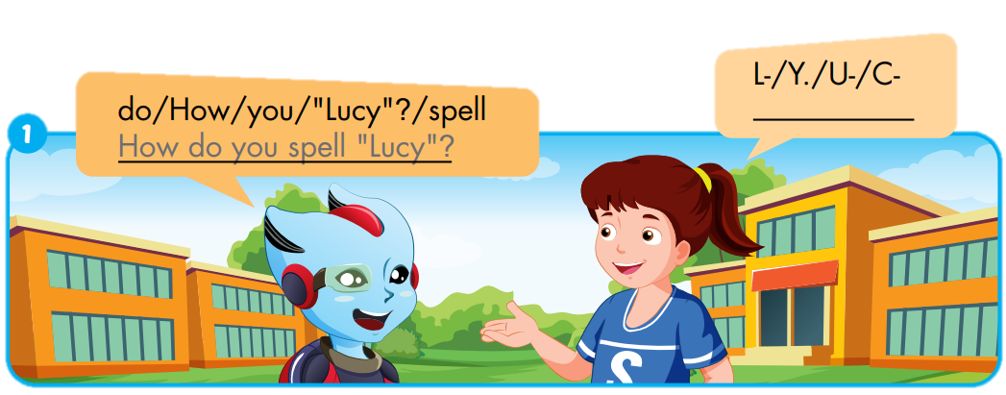
Extra-Act1 - WBp8. Unscramble and write.
L-
U-
C-
Y.

Slide 10
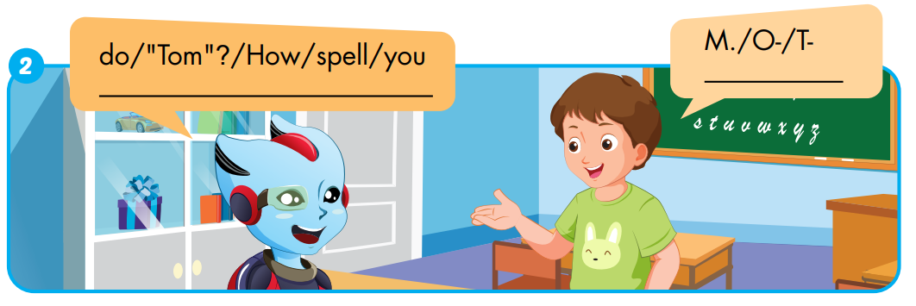
Extra-Act1 - WBp8. Unscramble and write.
T-
O-
M.
How
do
you
spell
“Tom”?

Slide 11
Act1. Sing the Alphabet song.
The Alphabet Song
Notes:
- Click on the picture to hear the sound.

