Slide 1

Unit 7: Toys
Lesson 3.1
Page 102

Slide 2
Objectives
By the end of this lesson, students will be able to…
Vocabulary: Pronounce and use the words related to the topic properly: under, on, in, toy box, wardrobe
Structure: Instruct someone to put an item somewhere else by using:
Put the ball on the chair.

Slide 3





GAME WITH
DORAEMON
Start

Slide 4



HOW TO PLAY
There are 4 quizzes in the game.
You will have 10 seconds to give the answer to each question.
To answer the question, raise a card of the same color as the answer.
Orange
Blue
Green
Red
You have 1 minute to prepare your card!

Slide 5







Yeahhh,
That’s right!
Huhu,
That is wrong.
Try your best
How many dolls?
Seven dolls.
Ten dolls.
Eight dolls.
Nine dolls.

Slide 6


Yeahhh,
That’s right!
Huhu,
That is wrong.
Try your best
.
How many robots?
Eight robots.
Nine robots.
Six robot.
Ten robots.

Slide 7

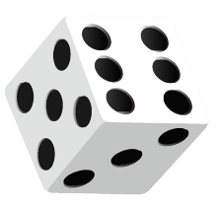
Yeahhh,
That’s right
Huhu,
That is wrong.
Try your best
How many dice?
Seven dice.
Ten dice.
Nine dice.
Eight dice.

Slide 8


Yeahhh,
That’s right
Huhu,
That is wrong.
Try your best
How many cars?
Five cars.
Seven cars.
Six cars.
Eight cars.

Slide 9






GAME WITH
DORAEMON
THANK YOU
SO MUCH!

Slide 10

New words
under
on
in
toy box
wardrobe

Slide 11


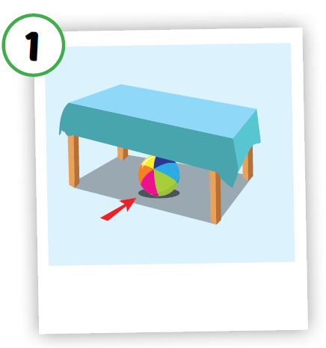
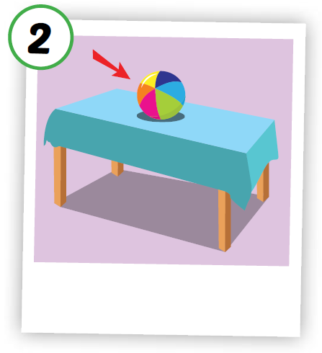
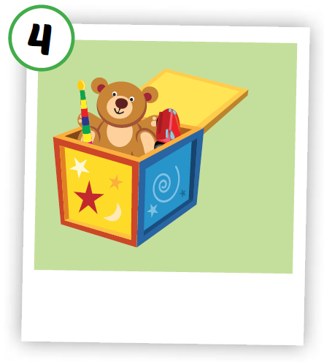
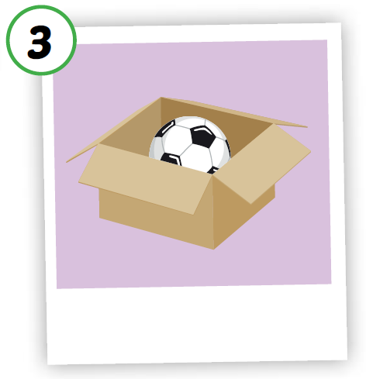
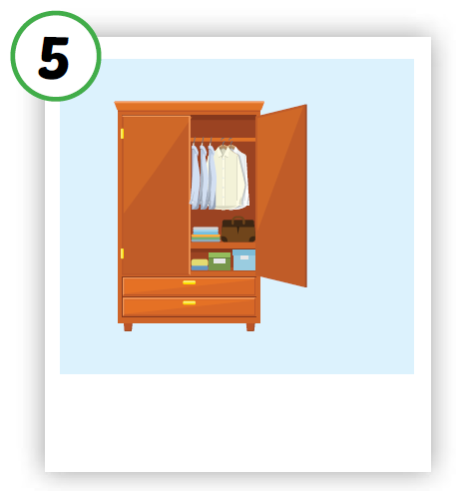





Click on each icon to hear the sound
/ˈwɔːrdroʊb/
tủ đồ,
tủ quần áo
/ˈʌndər/
ở dưới
/ɑːn/
ở trên
/ɪn/
ở trong
/tɔɪ bɑːks/
hộp đồ chơi
Notes:
Click vô hình để nghe

Slide 12
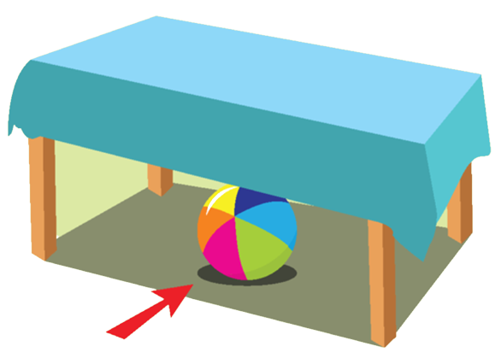
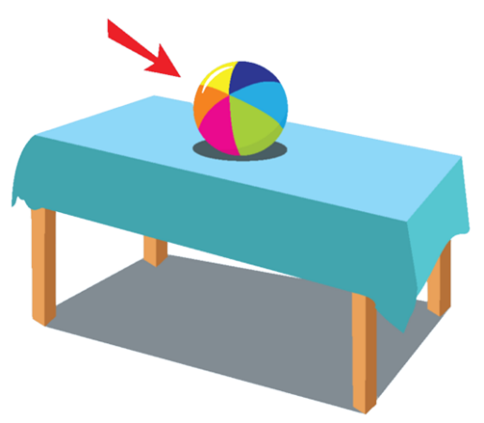









1
2
3
4
5
a
b
c
d
e
Notes:
Click vào thẻ số và thẻ chữ, tìm hình và từ tương ứng nhau

Slide 13
Structures
Put the ball on the chair.

Slide 14




Click on the icon to listen

Slide 15
Put the ball on the table.
Practice

Slide 16
Put the ball in the box.
Practice

