Slide 1

Unit 2
Review and Practice
Page 36

Slide 2
Lesson Outline
Warm-up
Listening
Reading
Consolidation
Wrap-up

Slide 3
Objectives
By the end of this lesson, students will be able to review introducing family members, asking who someone is, and following simple instructions.
Vocabulary:
friend, cousin, uncle, grandfather, aunt, homework, clean, wake up
Structures:
Who’s he/she?/ This is my…/ What’s his/her name?/ Clean your room.

Slide 4

WARM UP

Slide 5


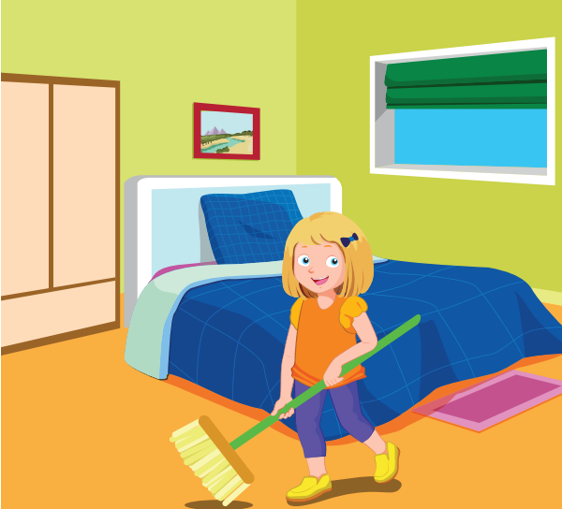
Listen and circle.
A
B
Keys

Slide 6

Listen and circle.
A
B
Keys

Slide 7
Listen and circle.
A
B
Keys

Slide 8

Listen and circle.
A
B
Keys

Slide 9
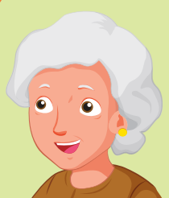
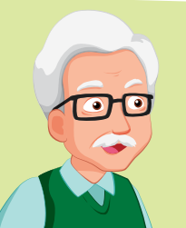



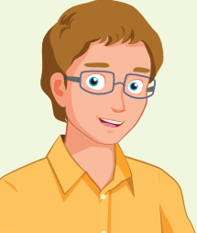
Memory Game
1
2
3
uncle
4
5
6
sister
grandfather
7
8
9
cousin
10
11
12
grandmother
aunt

Slide 10

It’s time to learn …

Slide 11

Listening

Slide 12
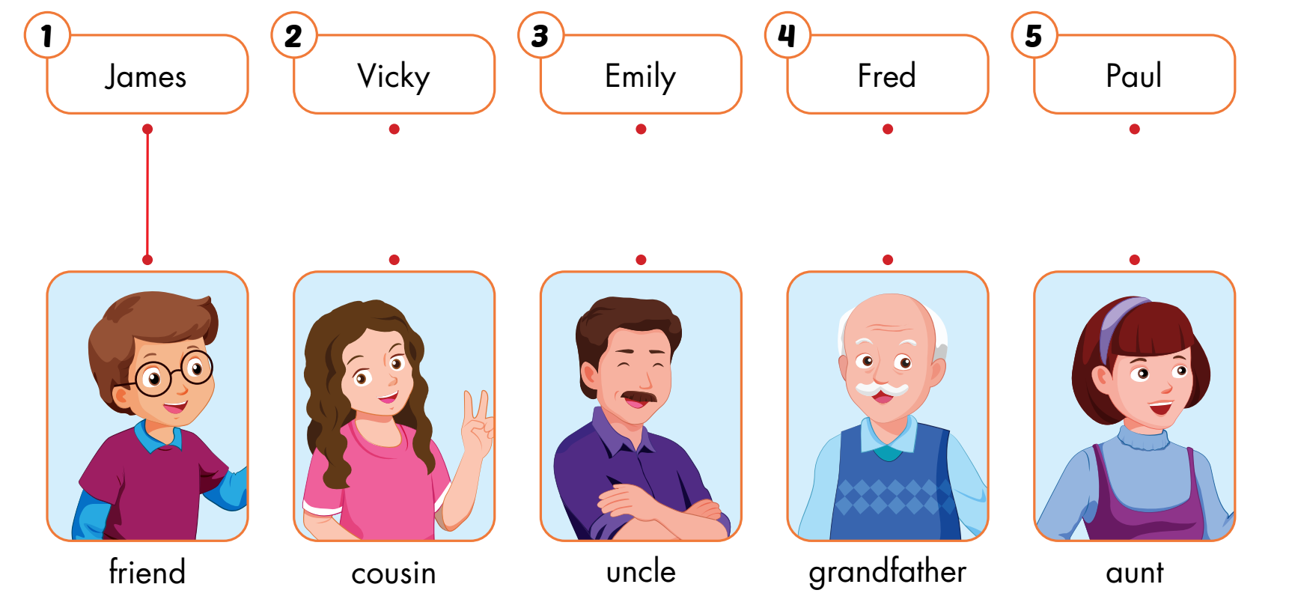
A
Listen and draw lines. (CD1 Track 57)
Keys

Slide 13
Audio scripts
Track 57
Narrator: Look at the pictures. Listen. There is one example.
1. G: This is my friend.
B1: Hi, I'm James.
B2: Hi, James.
Narrator: Can you see the line? This is an example.
Now, listen and draw lines.
2. B: Who's she?
G: She's my aunt.
B: What's her name?
G: Her name's Vicky.
3. B: This is my cousin.
G: What's her name?
B: Her name's Emily.
G: Hi, Emily.
4. B: This is my grandfather.
M: Hi, I'm Fred.
G: Hi, Fred.
5. G: Who's he?
B: He's my uncle.
G: What's his name?
B: His name's Paul.
Narrator: Now, listen again.

Slide 14

Reading

Slide 15

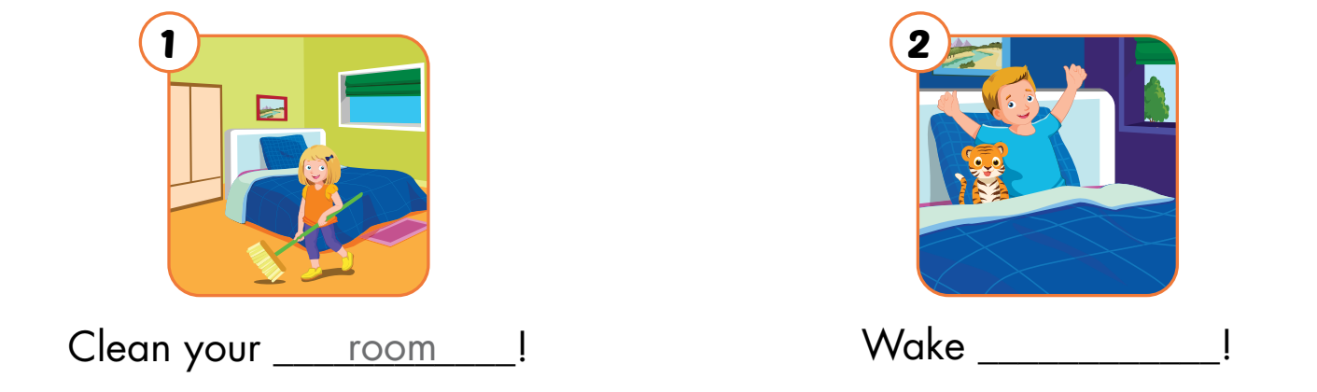
B
Read the sentences. Choose a word from the box. Fill in the blanks.
up

Slide 16
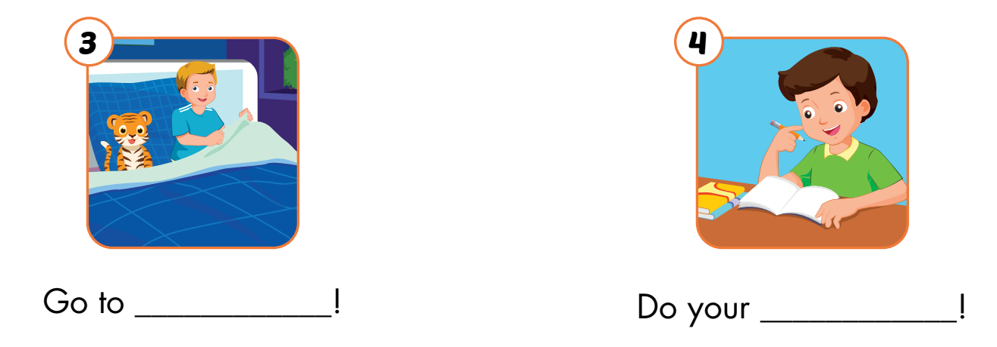
B
Read the sentences. Choose a word from the box. Fill in the blanks.
bed
homework

Slide 17

Extra Practice

Slide 18
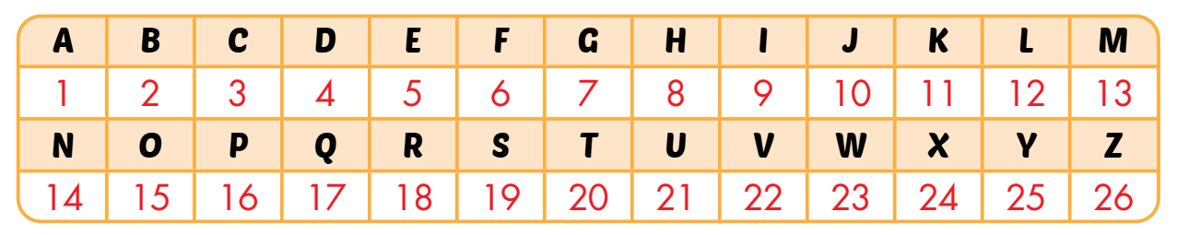
A
Look at the table and pictures. Look at the numbers. Write the words and draw lines.

Slide 19
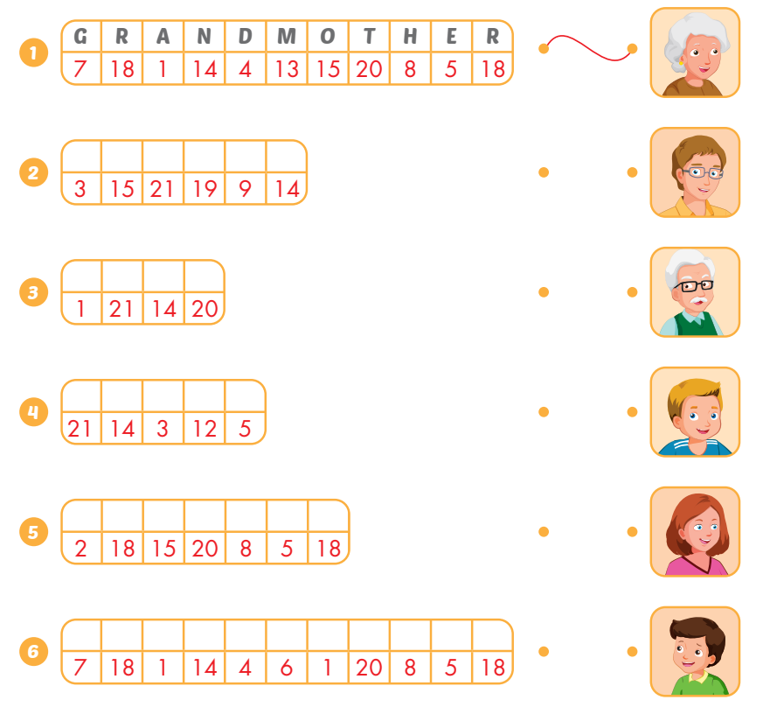
A
Look at the table and pictures. Look at the numbers. Write the words and draw lines.
c
o
u
s
i
n
a
u
n
t
u
n
c
l
e
b
r
o
t
h
e
r
g
r
a
n
d
f
a
t
h
e
r

Slide 20

Consolidation

Slide 21



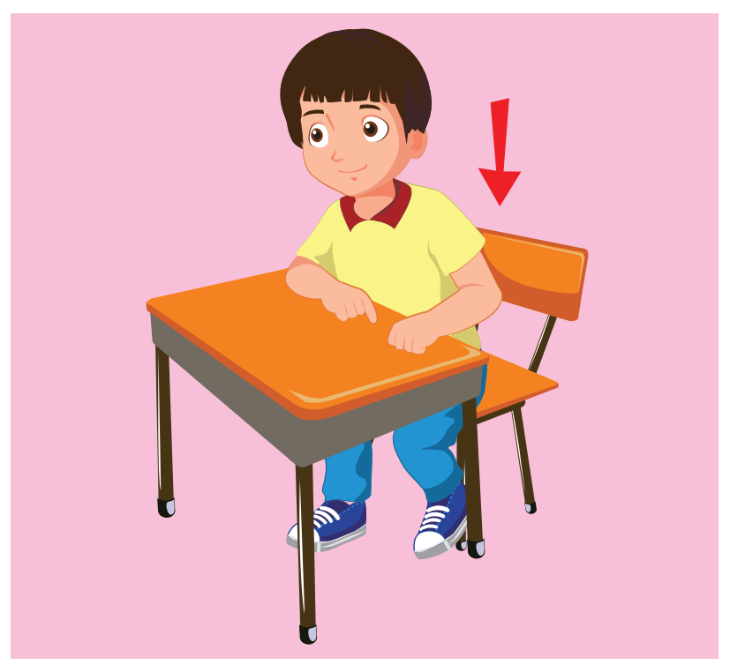
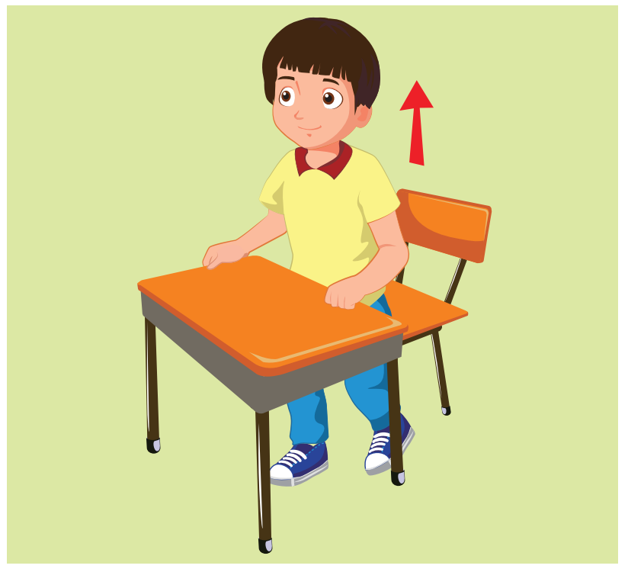



What’s missing?
1
2
3
4
5
6
7
8

Slide 22

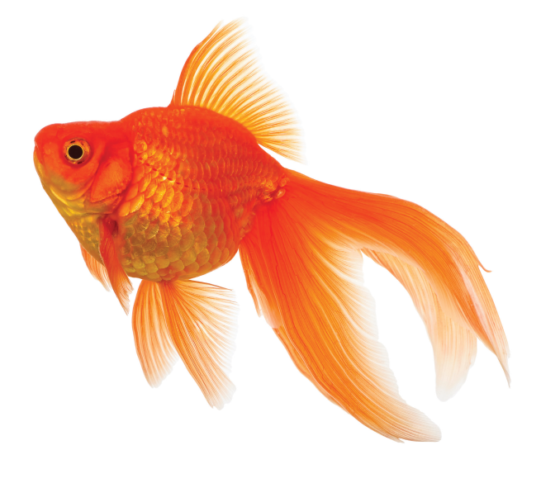


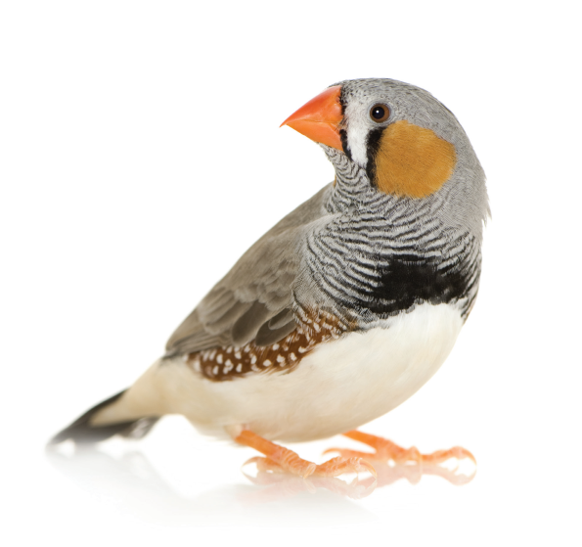
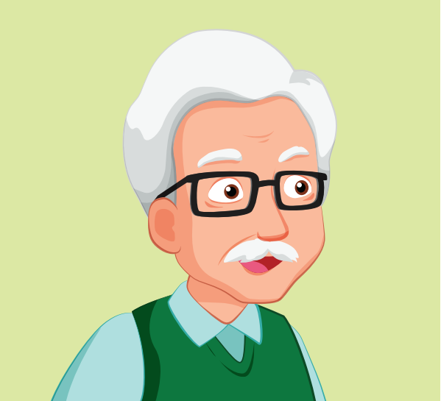


What’s missing?
1
2
3
4
5
6
7
8

Slide 23

WRAP-UP

Slide 24
Today’s lesson
Vocabulary:
friend, cousin, uncle, grandfather, aunt, homework, clean, wake up
Structures:
Who’s he/she?/ This is my…/ What’s his/her name?/ Clean your room.

Slide 25
Homework
Practice vocabularies and structure. Make sentences using them.
Do the exercises in Tiếng Anh 3 i-Learn Smart Start Workbook (page 26).
Practice the vocabulary and structure in Tiếng Anh 3 i-Learn Smart Start Notebook (page 19).
Play the consolidation games in Tiếng Anh 3 i-Learn Smart Start DHA App on www.eduhome.com.vn
Prepare the next lesson (page 37).

Slide 26

Enjoy your day!

