Slide 1

Unit 2
Culture Lesson
Page 35

Slide 2
Lesson Outline
Warm-up
Reading
Writing
Speaking
Consolidation
Wrap-up

Slide 3
Objectives
By the end of this lesson, students will be able to talk about the family pet.
Vocabulary:
mother, father, brother, family, pet, black, white, dog, cat, fish, bird, pig, goat, duck, cow, rabbit
Structures:
My family pet is a cat./ I love my cat.

Slide 4

WARM UP

Slide 5
Read and match.
1. My family pet
A. nine years old.
2. I love my
B. is Linh.
3. She is
C. cat.
4. My name
D. is a cat.
Keys

Slide 6

It’s time to learn …

Slide 7

Reading

Slide 8
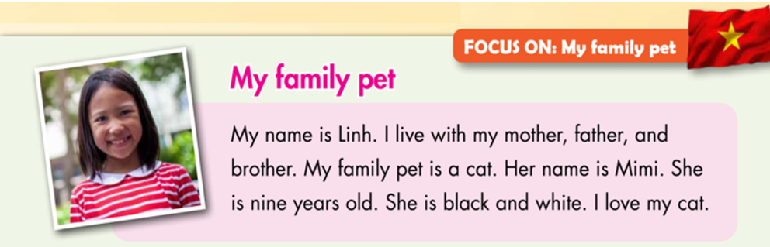
E
1. Read and circle True or False.

Slide 9
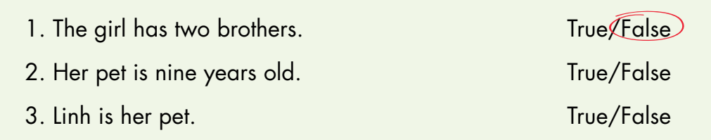
E
1. Read and circle True or False.

Slide 10
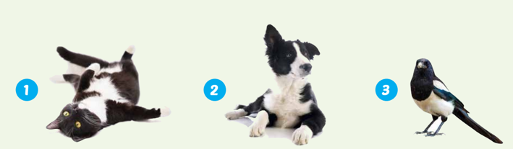
E
2. Circle Linh’s pet.

Slide 11

Writing

Slide 12
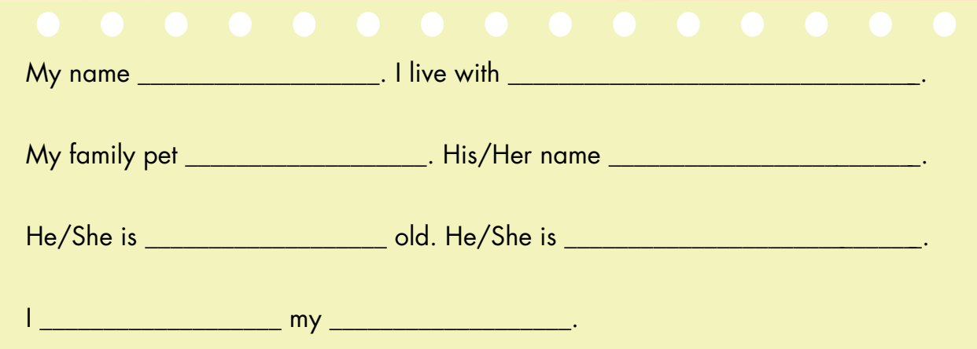
F
Look at E. Write about your pet.
is Minh
my mother and father
is a rabbit
is Park
2 years
black and white
love
rabbit

Slide 13
Speaking

Slide 14
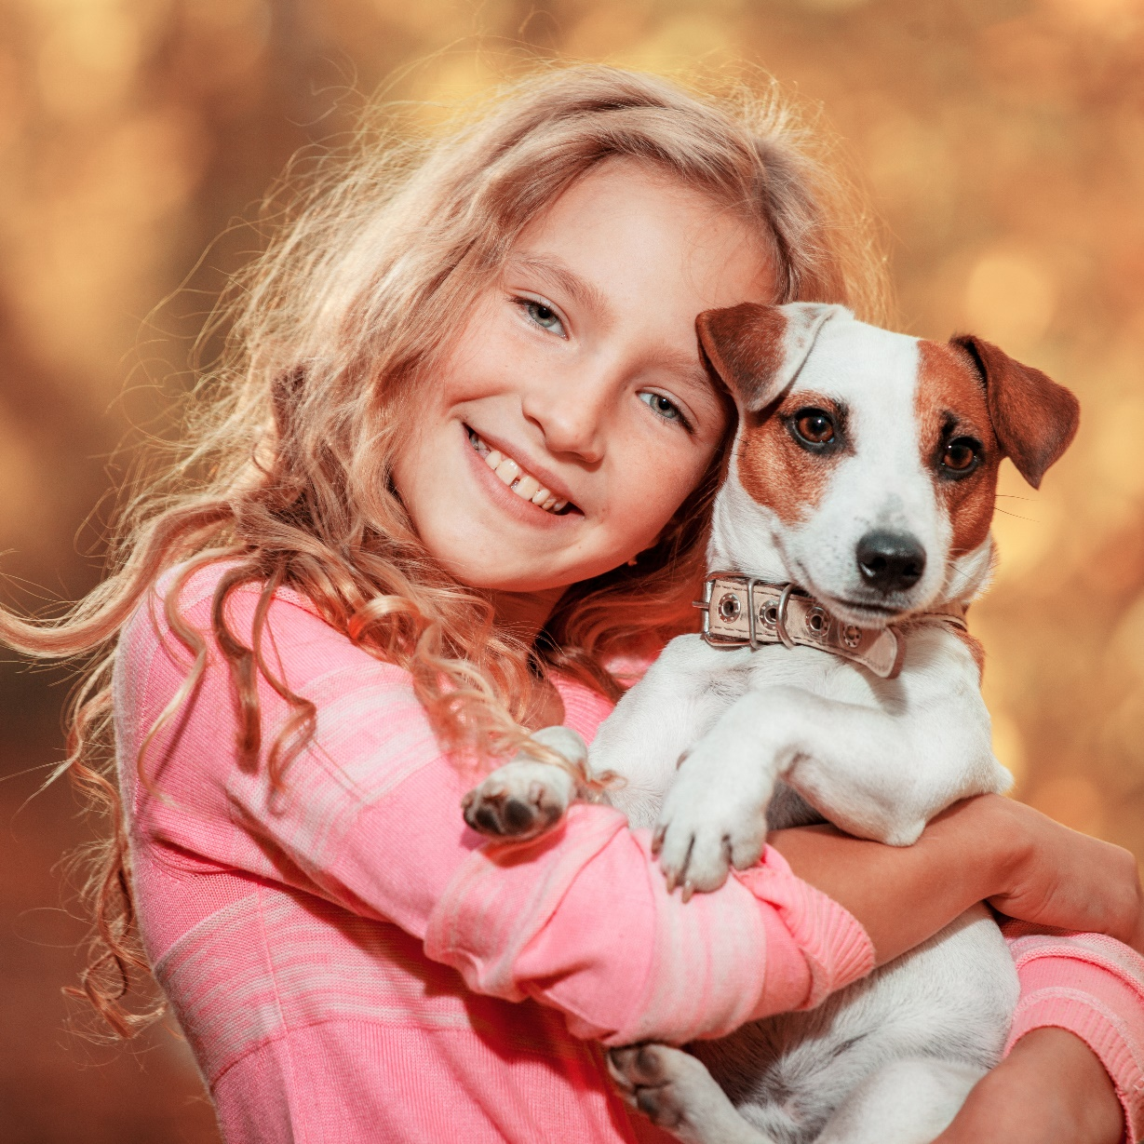
G
Talk about your pet.

Slide 15

Further Practice

Slide 16
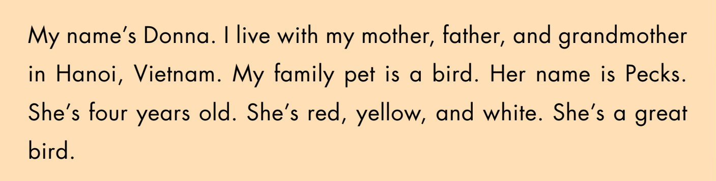
B
Read and circle True or False.

Slide 17
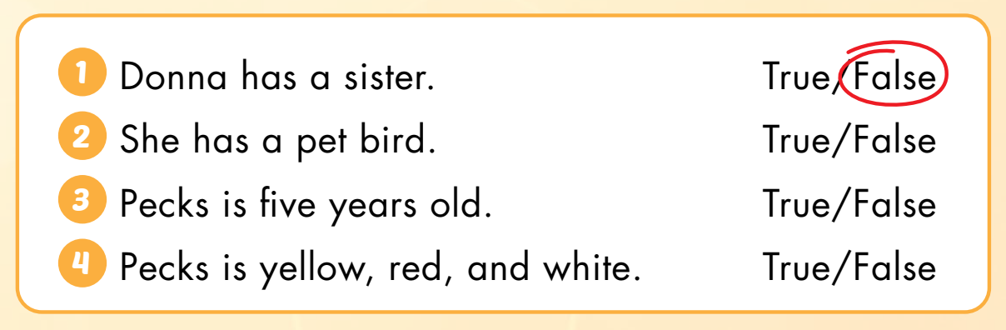
B
Read and circle True or False.

Slide 18

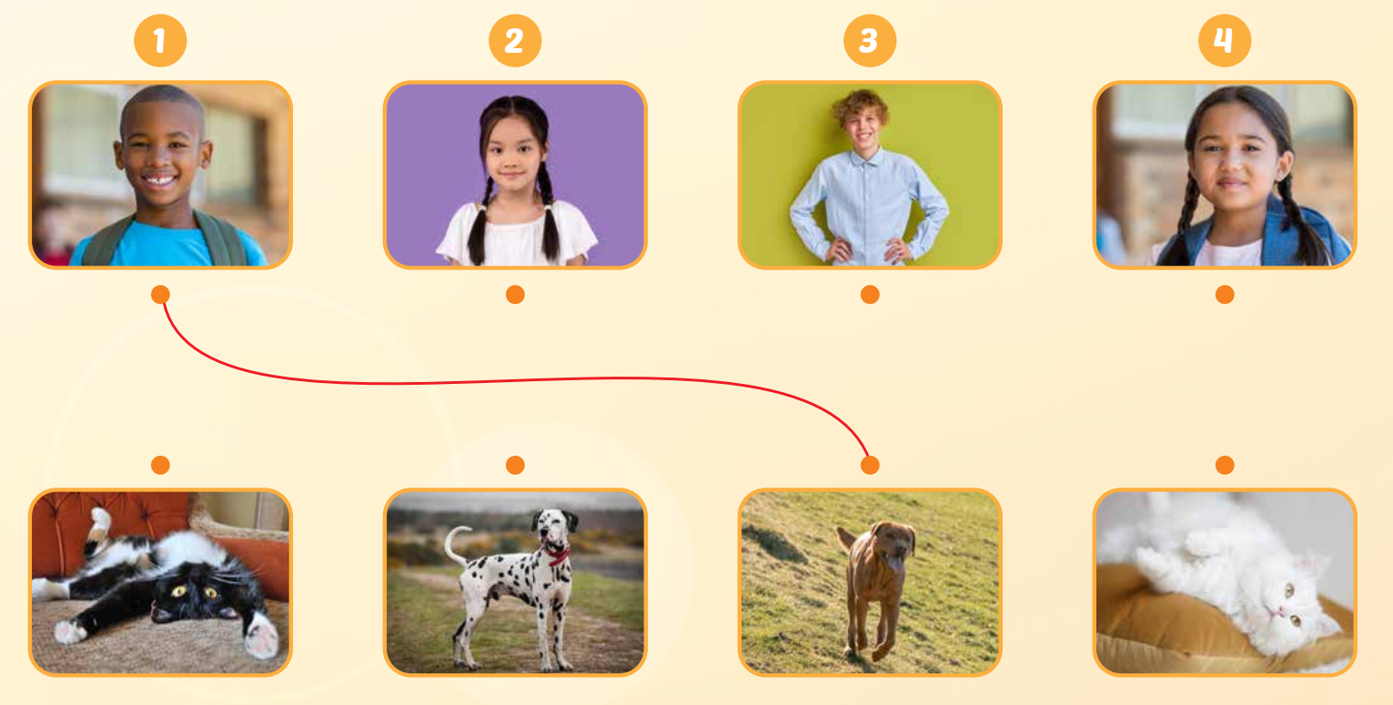
C
Listen and draw lines. (WB Track 15)
Keys

Slide 19
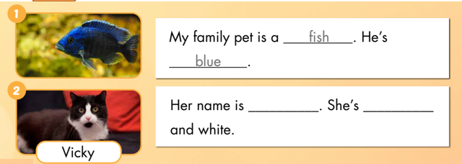
D
Look and write.
Vicky
black

Slide 20
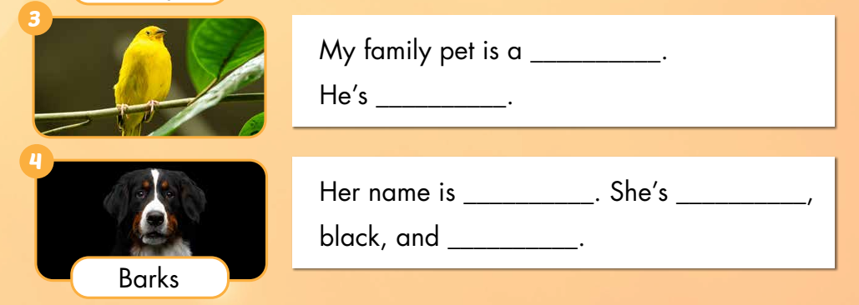
D
Look and write.
bird
yellow
Barks
white
brown

Slide 21

Consolidation

Slide 22
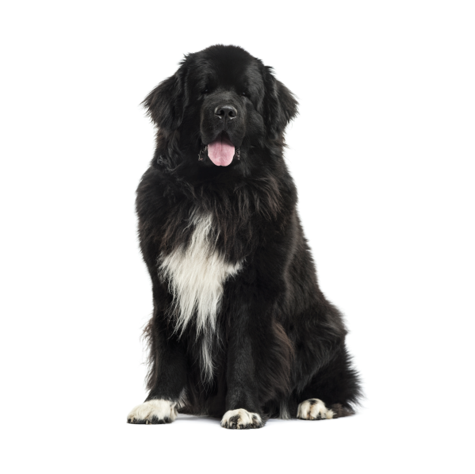
My family pet is a ______.
dog

Slide 23
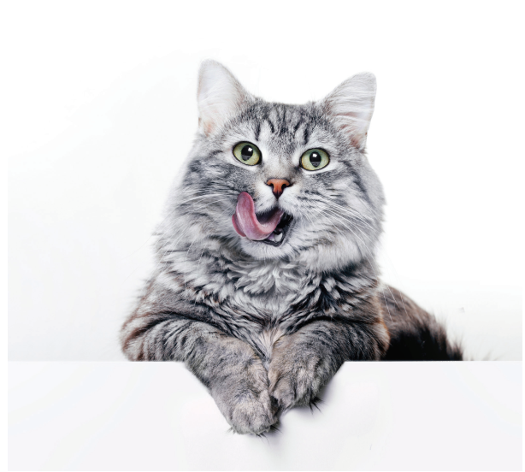
I love my ______.
cat

Slide 24
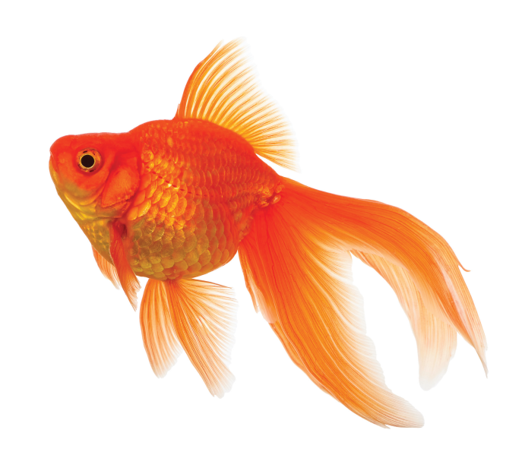
fish
My family pet is a ______.

Slide 25
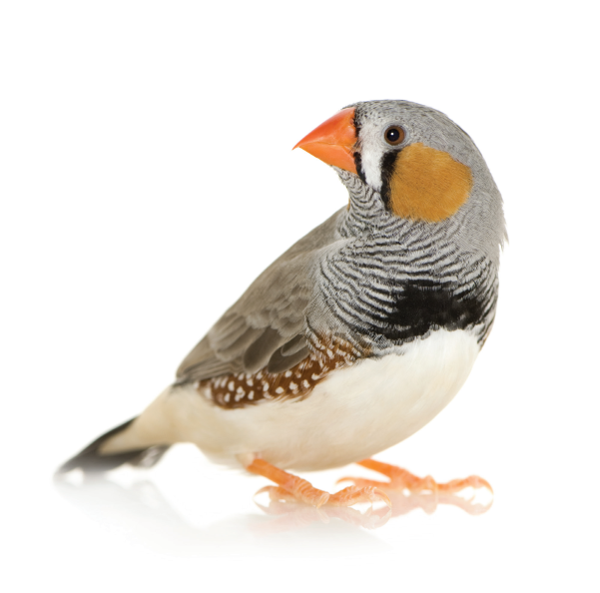
bird
My family pet is a ______.
My family pet is a ______.

Slide 26
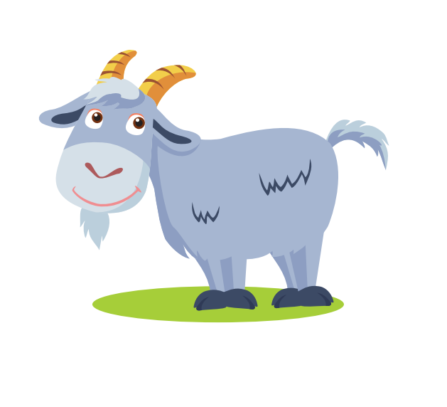
goat
My family pet is a ______.

Slide 27
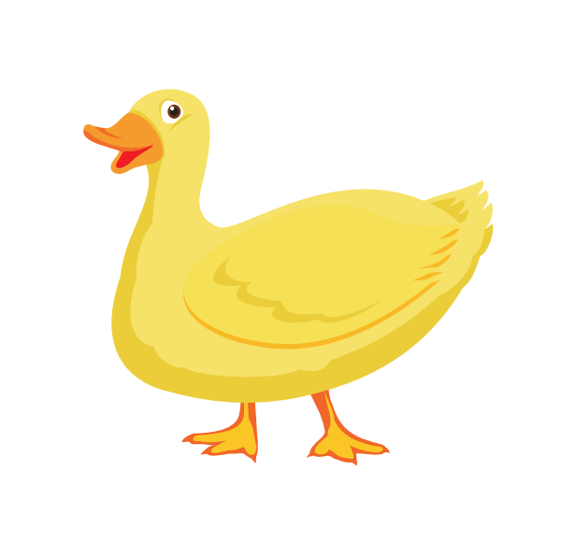
duck
I love my ______.

Slide 28
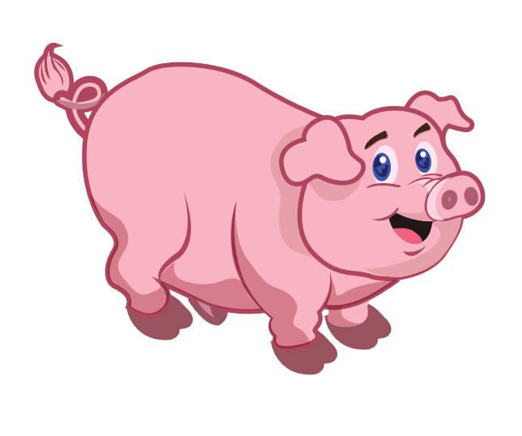
pig
I love my ______.

Slide 29

rabbit
My family pet is a ______.

Slide 30
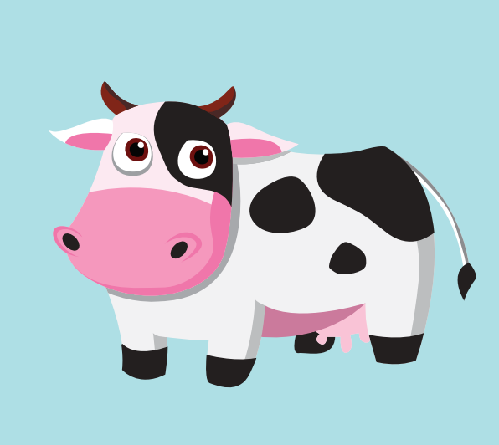
cow
I love my ______.

Slide 31

WRAP-UP

Slide 32
Today’s lesson
Vocabulary Revision:
mother, father, brother, family, pet, black, white, dog, cat, fish, bird, pig, goat, duck, cow, rabbit
Structures:
My family pet is a cat./ I love my cat.

Slide 33
Homework
Practice vocabularies and structure. Make sentences using them.
Practice the vocabulary and structure in Tiếng Anh 3 i-Learn Smart Start Notebook (page 19).
Play the consolidation games in Tiếng Anh 3 i-Learn Smart Start DHA App on www.eduhome.com.vn
Prepare the next lesson (page 36).

Slide 34

Enjoy your day!

