Slide 1

UNIT 1: MY FRIENDS
Review & Practice 1

Slide 2
Lesson Outline
Warm-up
Listening
Consolidation
Wrap-up

Slide 3
Objectives
By the end of this lesson, ﻿students will be able to:
review spelling names.
review where people are from.
review what their friends like doing.

Slide 4

WARM UP

Slide 5



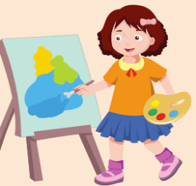












Activity 1
Tic-tac-toe. Then choose the pictures and spell the words.
Alfie
The UK
Italy
Painting
Tom
The USA
Dancing
Japan
India
Singing
Reading
Mai
Nick
Alpha
Drawing
Ben
Notes:
Print the handout
Steps:
+ Divide ss into groups of 3 or 4
+ Ask them to cut out all the pictures
+ Let ss tic-tac-toe. The winner will choose the picture and spell the word. If spelling correctly, that person can keep the paper for him/herself. If not, tic-tac-toe again
+ Continue until the last piece
+ The students with the most papers will be the winner

Slide 6

Activity 2
“Change the chair” game
Change the chair if you have “India”
Change the chair if you have “The USA”
Change the chair if you have “The UK”
Change the chair if you have “dancing”
Change the chair if you have “reading”
Change the chair if you have “Japan”
Change the chair if you have “Nick”
Smiley
Change the chair if you have “Tom”
Change the chair if you have “Alpha”
Change the chair if you have “Alfie”
Change the chair if you have “singing”
Notes:
Prepare chairs or draw places for each student
Set context: Smiley will say something, and you must follow. After showing the sentence, students will have 3s to change the chair.
Rules:
+ Students use the paper of the last game to play
+ If they have the word that Smiley said, they must change the chair with each other within 3s. If not, they will be out.
+ Teacher can raise the level of difficulty by joining the game. While students are finding the chair to change, teacher can replace 1 place, so that there will be an odd student who can’t change the place.
+ Once students finish change their chairs, teacher can ask question relates to the answer.
For example: Students have the paper “India”. They change their chairs. After that, teacher can ask: “where are you from?” => ss answer: “I’m from India”

Slide 7

It’s time to practice …

Slide 8

Listening

Slide 9


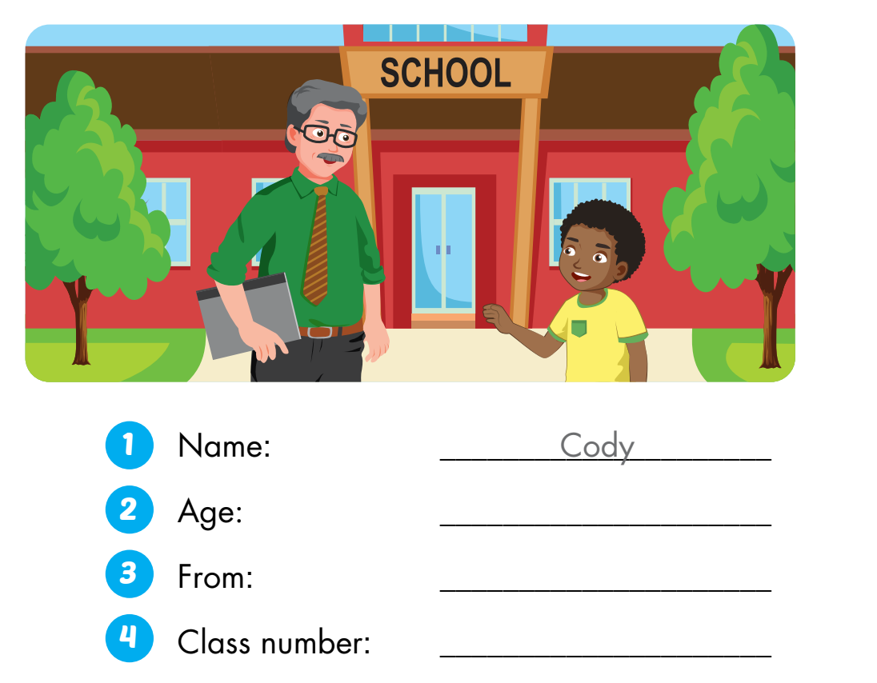
Activity 1
Click here to play the audio.
eight (8)
Italy
three (3)
Notes:
Elicit the picture. Ask ss guess the answer. Listen and check

Slide 10
Activity 2
Complete the note. Then introduce yourself.
Name:
Age:
From:
Class number:
1. Hello, my name’s Cody. It’s C-O-D-Y.
Cody
8
2. I’m eight.
Italy
3. I’m from Italy.
3
4. I’m in class three.
Notes:
Let ss complete the note 1st. Then, invite ss come in front of the class and introduce themselves.

Slide 11
Activity 3
Write the introduction in the notebook.
Name:
Age:
From:
Class number:
1. Hello, my name’s Cody. It’s C-O-D-Y.
Cody
8
2. I’m eight.
Italy
3. I’m from Italy.
3
4. I’m in class three.
Notes:
Ask ss to write the introduction inside the notebook.

Slide 12
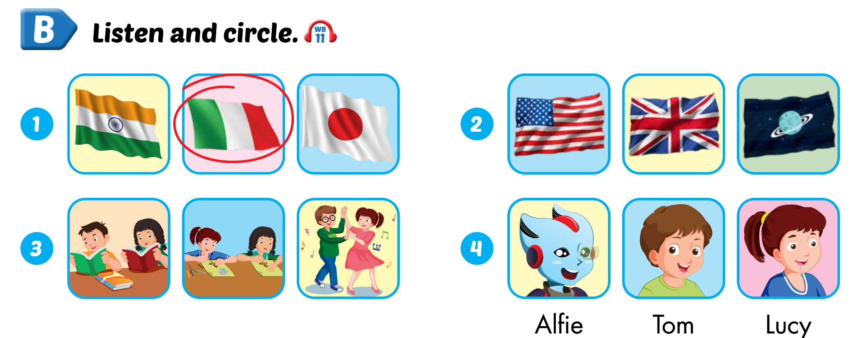
Extra Activity 1 WB p. 17
Click here to play the audio.
Notes:
Ask ss to look at each pictures. Elicit all the names and activities, including spelling
Ask ss to guess
Then listen and check

Slide 13
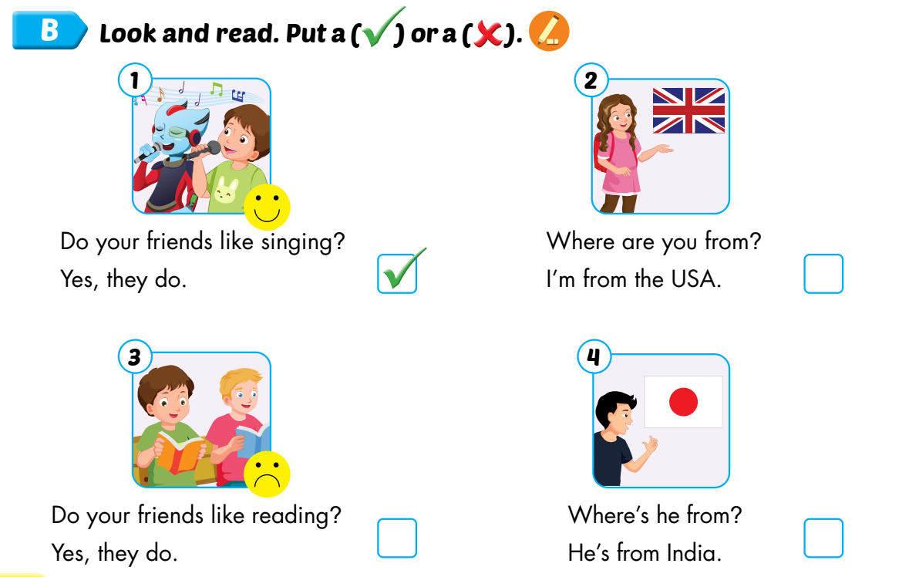
Extra Activity 1 SB p. 22
✘
✘
✘

Slide 14

CONSOLIDATION

Slide 15
Activity 1
Match the questions with the correct answers.
1. Where are you from? |  | a. My name’s Alfie.
2. How do you spell “Nick”? |  | b. He’s from Japan.
3. Do your friends like singing? |  | c. She’s from the USA.
4. What’s your name? |  | d. Yes, they do.
5. Where’s he from? |  | e. “N-I-C-K”.
6. Where’s she from? |  | f. I’m from the UK.

Slide 16
Activity 2
Answer the question.
1. What’s your name?
My name’s … .
2. How do you spell it?
It’s … .
3. How are you?
I’m … , thank you.
4. How old are you?
I’m … years old.
5. Where are you from?
I’m from … .
6. Do you like dancing?
Yes/ No, … .
7. It’s nice to meet you.
It’s nice to meet you, too.
Notes:
Let ss work in pairs
Ss take turn to ask and answer
T shows sample answers if necessary

Slide 17
Activity 3
Write your own answers into the notebook.
1. What’s your name?
2. How do you spell it?
3. How are you?
4. How old are you?
5. Where are you from?
6. Do you like dancing?
7. It’s nice to meet you.
Notes:
Ss write their own answers with their information down on their notebooks.
T helps ss in need

Slide 18

WRAP-UP

Slide 19
Today’s lesson
review spelling names
review where people are from
review what their friends like doing.

Slide 20
Homework
Review the vocabularies and structure. Make sentences using them.
Do the exercises in Tiếng Anh 3 i-Learn Smart Start Workbook (page 17)
Practice the vocabulary and structure in Tiếng Anh 3 i-Learn Smart Start Notebook (page 14)
Play the consolidation games in Tiếng Anh 3 i-Learn Smart Start DHA App on www.eduhome.com.vn
Prepare the next lesson (page 23)

Slide 21

Enjoy your day!

