Slide 1
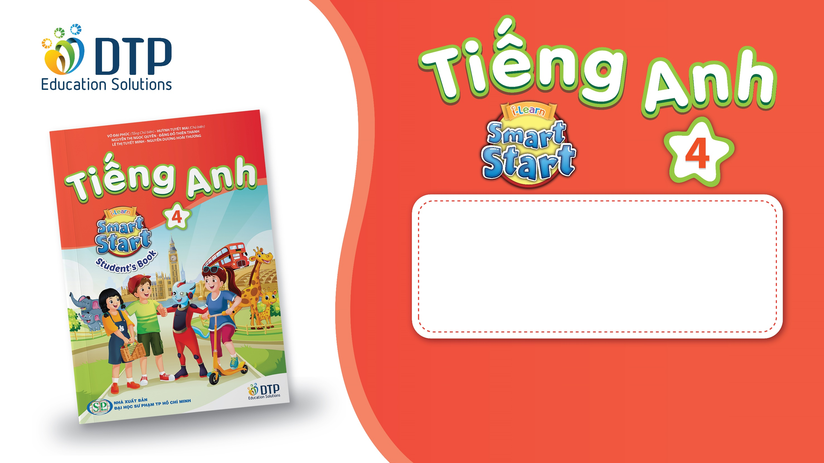
Unit 4: ACTIVITIES
Review and Practice
Page 61

Slide 2
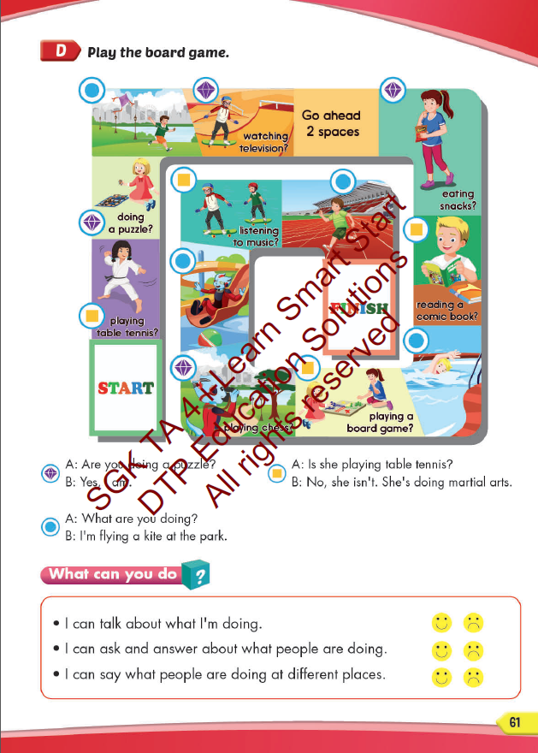
Lesson Outline
Warm-up
Speaking
Consolidation
Wrap-up

Slide 3
Objectives
By the end of this lesson, students will be able to say what they or other people are doing an activity at some different places.
Vocabulary:
Activities: listen to music, watch television, play table tennis, do martial arts, skate, play chess, play a board game, do a puzzle, read a comic book, eat snacks, take photos, play video games.
Places: library, stadium, park, water park, market, swimming pool. studio, soccer field, arcade, skate park, coffee shop.
Structure:
What are you doing? What are they doing?
I’m swimming at the pool. They’re swimming at the pool.
What is he/she doing?
He/she swimming at the pool.

Slide 4

WARM UP

Slide 5
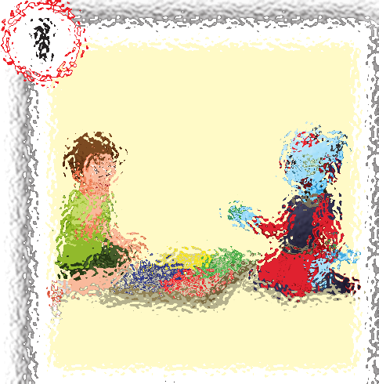
REVIEW VOCABULAY
Guess the picture.
play a board game

Slide 6
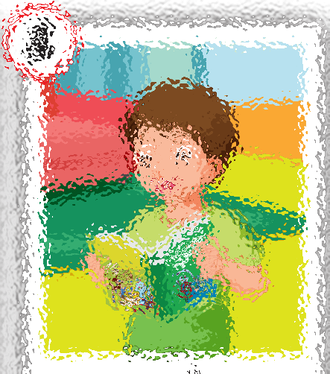
REVIEW VOCABULAY
Guess the picture.
read a comic book

Slide 7
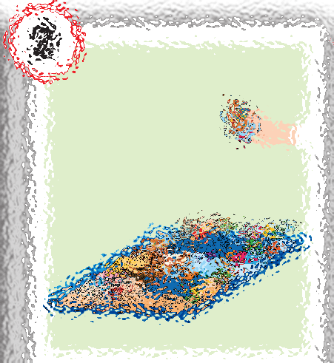
REVIEW VOCABULAY
Guess the picture.
do puzzle

Slide 8
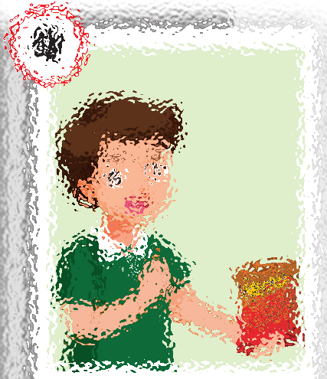
REVIEW VOCABULAY
Guess the picture.
eat snacks

Slide 9
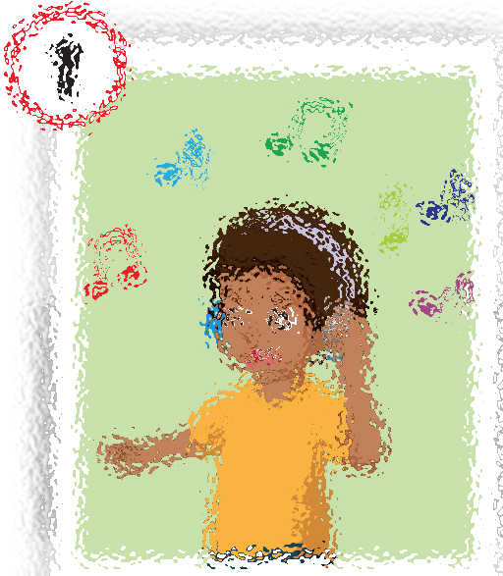
REVIEW VOCABULAY
Guess the picture.
listen to music

Slide 10
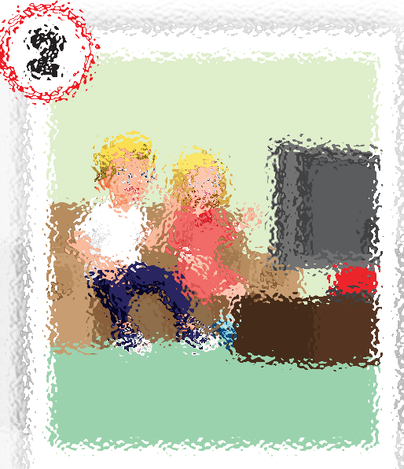
REVIEW VOCABULAY
Guess the picture.
watch television

Slide 11
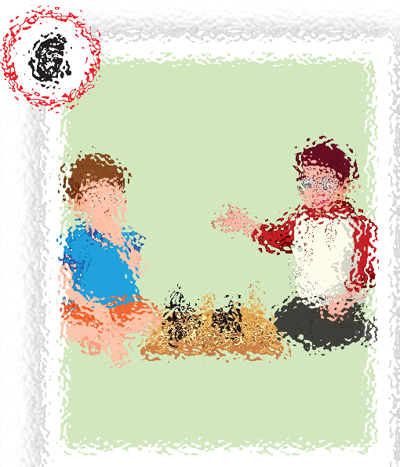
REVIEW VOCABULAY
Guess the picture.
play chess

Slide 12

It’s time to learn …

Slide 13

Speaking

Slide 14
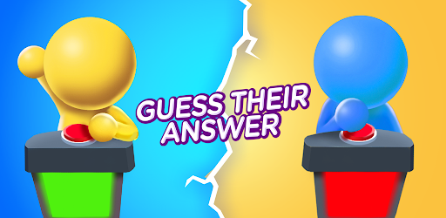
REVIEW STRUCTURE

Slide 15

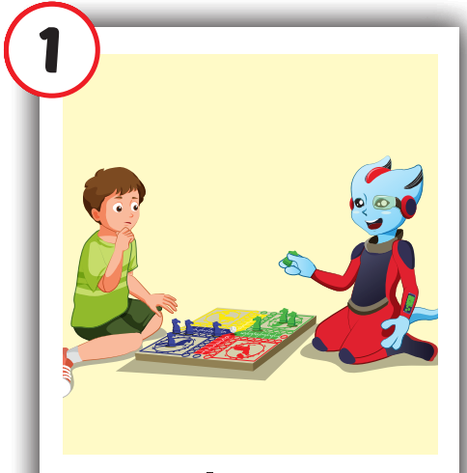
Are you playing a board game?
a. Yes, I am.
b. No, I am not.
Notes:
- To go back to the sea animals slide, click the whale
- To show the scores, click the pearl.

Slide 16

Are you doing a puzzle?
a. Yes, I am.
b. No, I am not.
Notes:
- To go back to the sea animals slide, click the whale
- To show the scores, click the pearl.

Slide 17

Are you watching television?
a. Yes, I am.
b. No, I am not.
Notes:
- To go back to the sea animals slide, click the whale
- To show the scores, click the pearl.

Slide 18

Are you doing a puzzle?
a. Yes, I am.
b. No, I am not.
Notes:
- To go back to the sea animals slide, click the whale
- To show the scores, click the pearl.

Slide 19
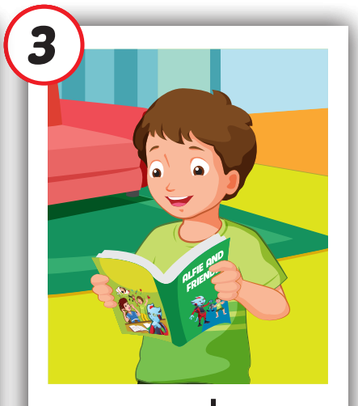
Are you eating snacks?
a. Yes, I am.
b. No, I am not.
Notes:
- To go back to the sea animals slide, click the whale
- To show the scores, click the pearl.

Slide 20
Are you playing chess?
a. Yes, we are.
b. No, I am not.
Notes:
- To go back to the sea animals slide, click the whale
- To show the scores, click the pearl.

Slide 21
Are you playing chess?
a. Yes, I am.
b. No, I am not.
Notes:
- To go back to the sea animals slide, click the whale
- To show the scores, click the pearl.

Slide 22

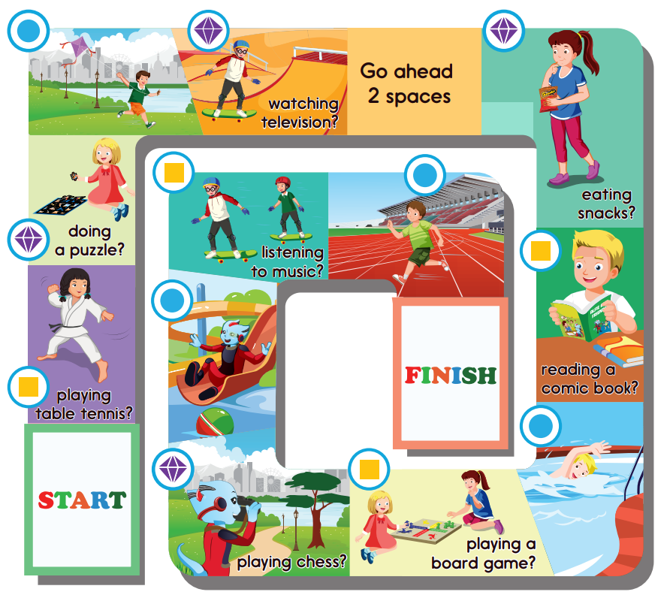
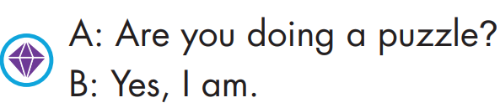
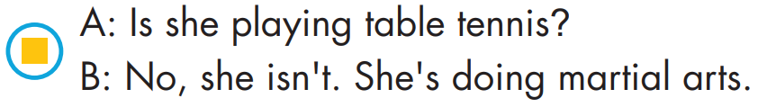
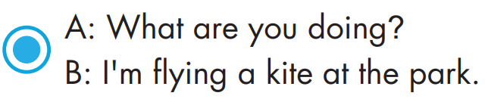

Slide 23

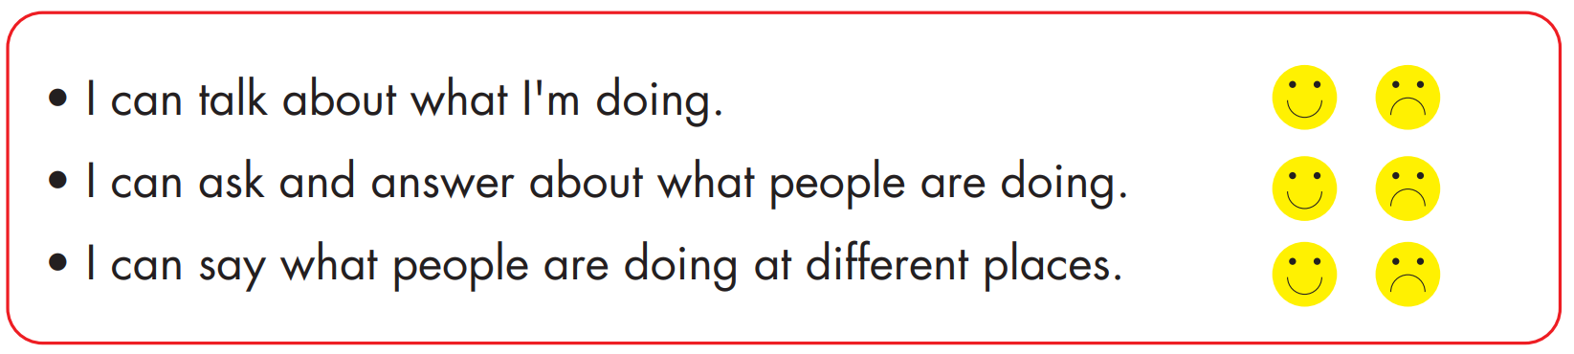

Slide 24

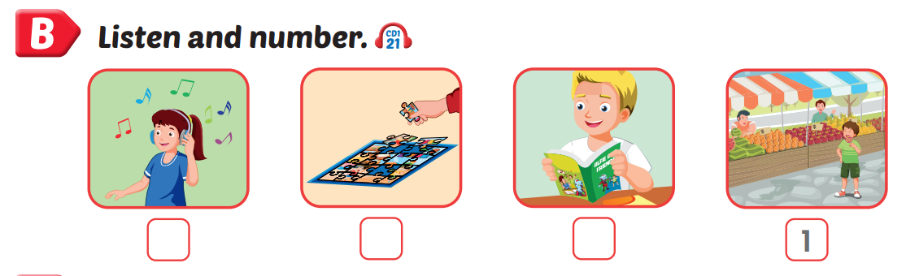
Extra practice
Ex. B, WB, p.41
2
4
3

Slide 25
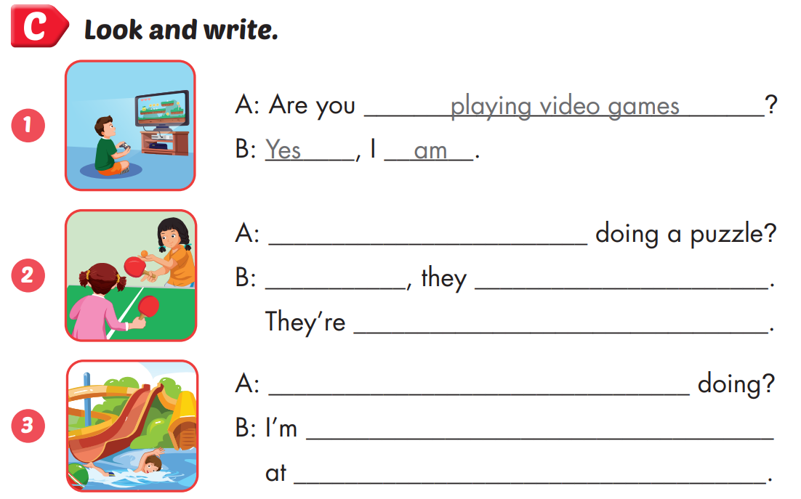
Extra practice
Ex. C, WB, p.41
Are they
No
aren’t
playing table tennis
What are you
swimming
the Swimming pool

Slide 26
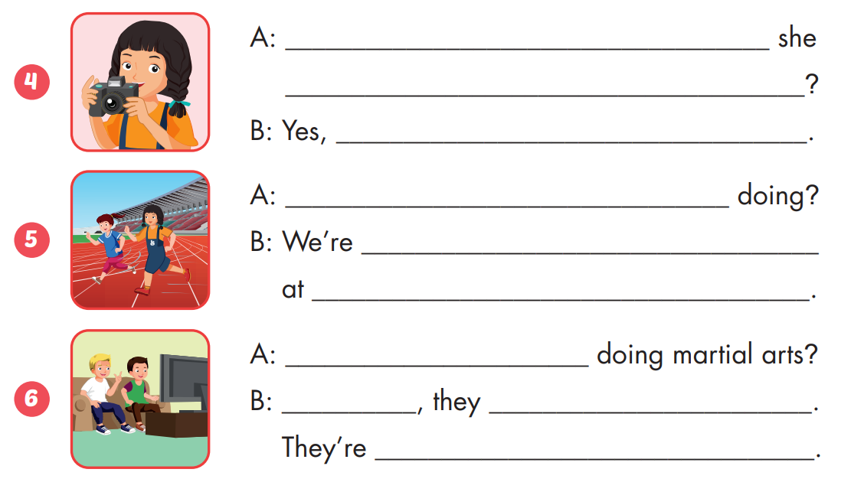
Extra practice
Ex. C, WB, p.41
Is
taking photos
she is
What are
running
the stadium
Are they
No
aren’t
watching television

Slide 27

CONSOLIDATION

Slide 28
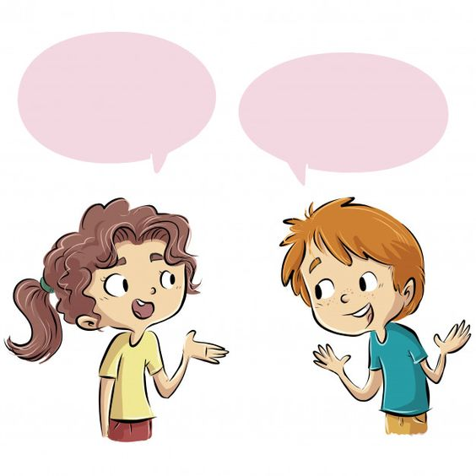
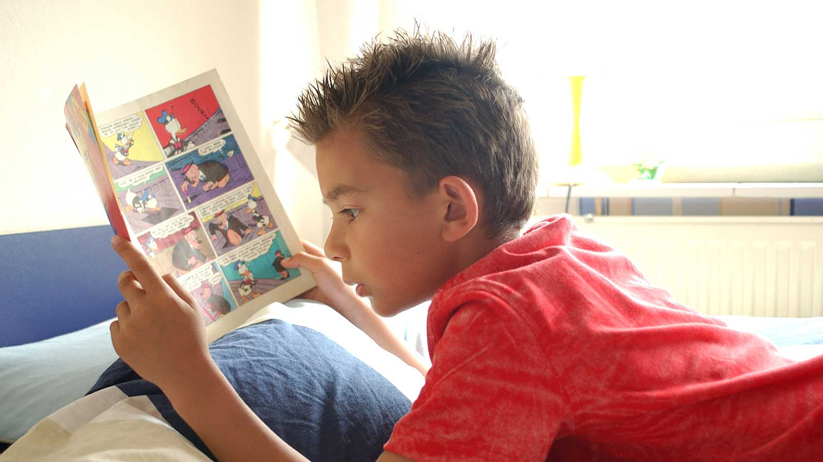
What is he doing?
He’s reading a comic book.

Slide 29
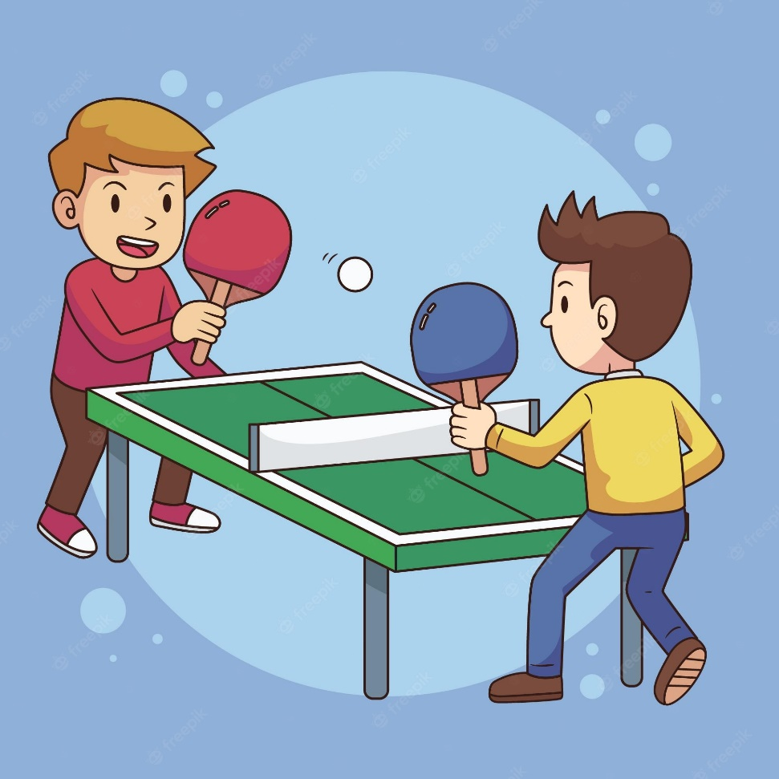
What are they doing?
They’re playing table tennis.

Slide 30
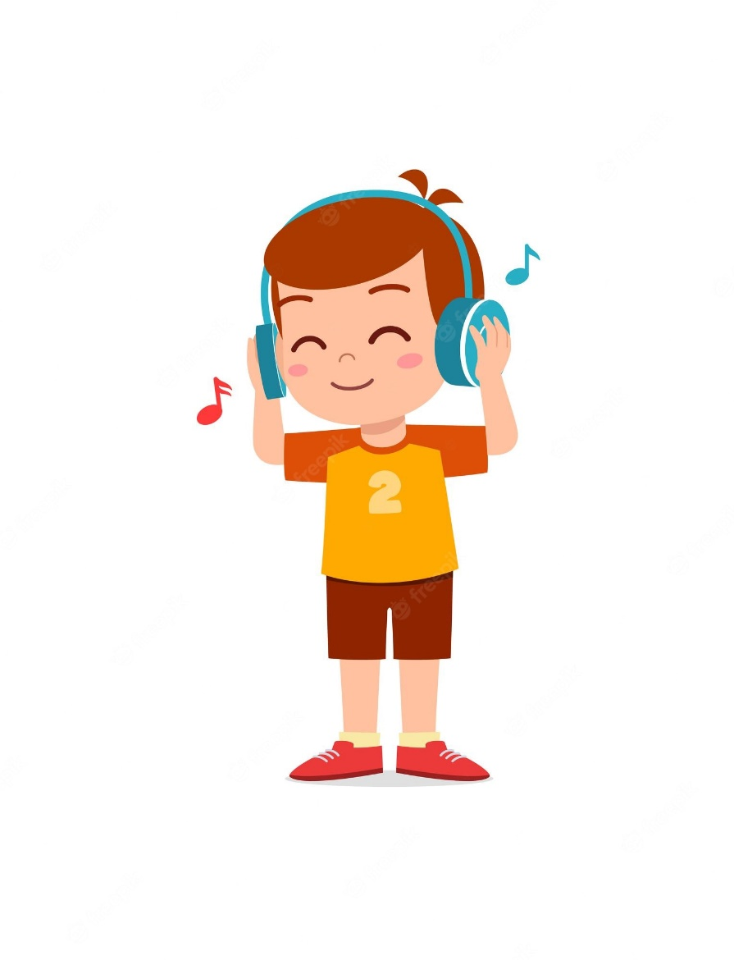
Is he listening to music?
Yes, he is.

Slide 31
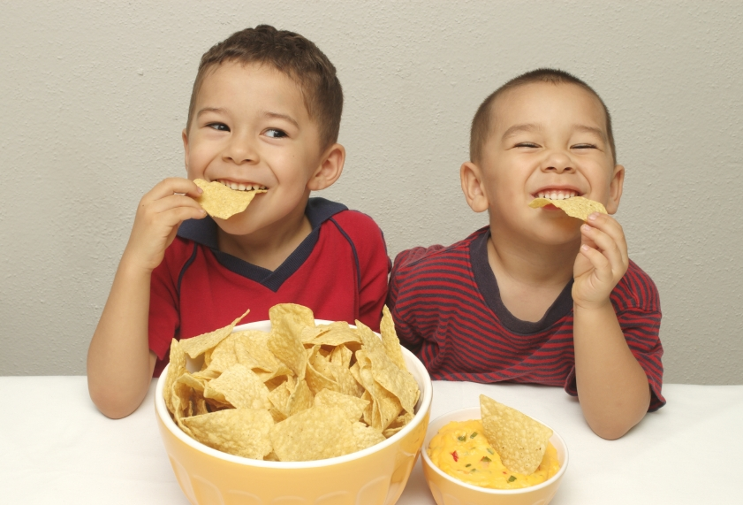
What are they doing?
They’re eating snacks.

Slide 32
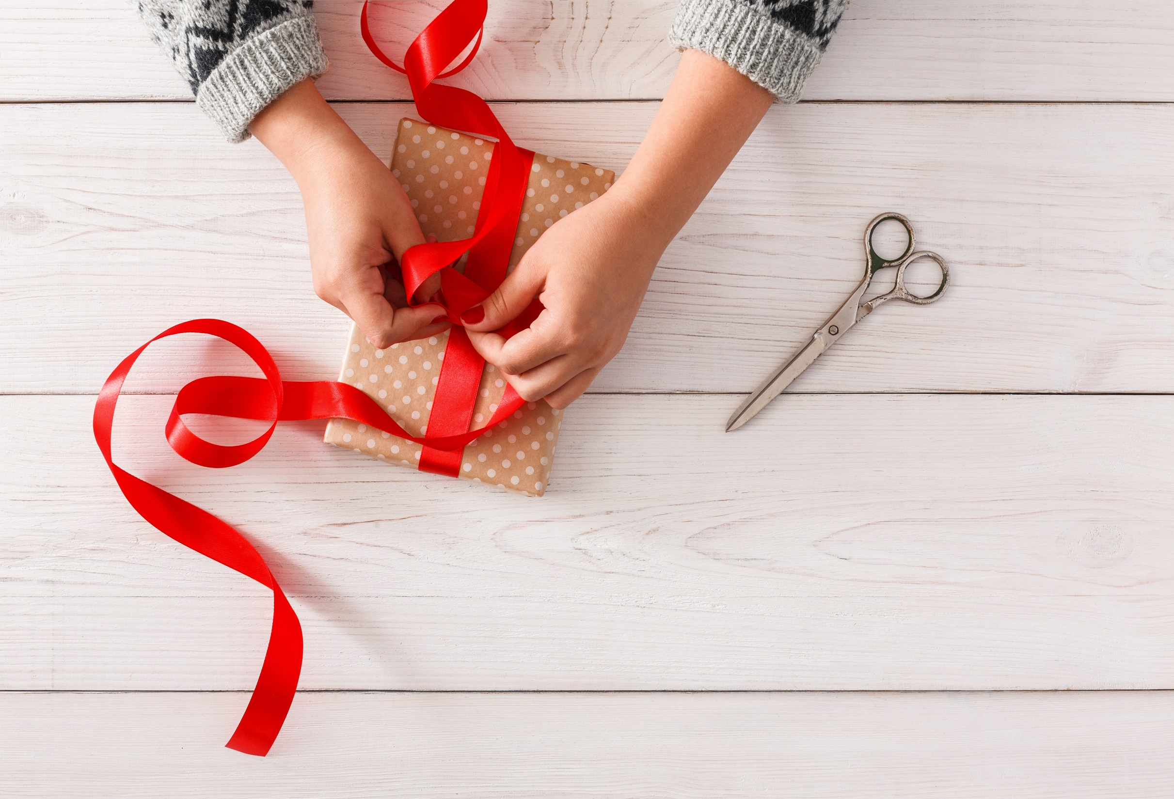
WRAP-UP

Slide 33
Today’s lesson
Vocabularies
do a puzzle, watch television, eat snacks, read a comic book, play a board game, play chess, play table tennis.
Structures/ Sentence patterns
Are you doing a puzzle?
- Yes, I am.
Is she playing table tennis?
- No, she isn’t. She’s doing martial arts.
What are you doing?
- I’m flying a kite at the park.

Slide 34
Homework
Practice the vocabularies and structure; and make sentences using them.
Do the exercises in Tiếng Anh 4 i-Learn Smart Start WB (page 40)
Do the exercises in Tiếng Anh 4 i-Learn Smart Start Notebook (page 27).
Do the exercises in Tiếng Anh 4 i-Learn Smart Start SB (page 62)
Play the consolidation games in Tiếng Anh 4 i-Learn Smart Start DHA App on www.eduhome.com.vn

