Slide 1

Unit 4: ACTIVITIES
Lesson 4
Page 59

Slide 2
Objectives
By the end of this lesson, students will be able to read hobbies in Vietnam, write and talk about their hobbies.
Vocabulary: studio, soccer field, arcade, skate park, bookstore.
Structure:
What's she doing?
She's dancing at the studio.
What are they doing?
They're playing soccer at the soccer field.

Slide 3

WARM UP

Slide 4

REVIEW 1
Look and say.

Slide 5

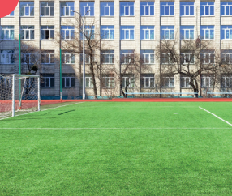
REVIEW 1
Look and say.
START
CHECK
soccer field

Slide 6

REVIEW 1
Look and say.
START
CHECK
skate park

Slide 7

REVIEW 1
Look and say.
START
CHECK
skate park

Slide 8

REVIEW 1
Look and say.
START
CHECK
skate park

Slide 9
REVIEW 2
Look and complete.
1
I’m skating at the __________.
skate park
studio

Slide 10
REVIEW 2
Look and complete.
2
He’s playing games at the __________.
library
arcade

Slide 11
REVIEW 2
Look and complete.
3
I’m flying kite at __________.
soccer field
arcade

Slide 12
REVIEW 2
Look and complete.
4
They’re reading at the __________.
skate park
bookstore

Slide 13

It’s time to learn …

Slide 14

Reading

Slide 15



Underline keywords in each statement.
Read the text carefully and find information.

Slide 16

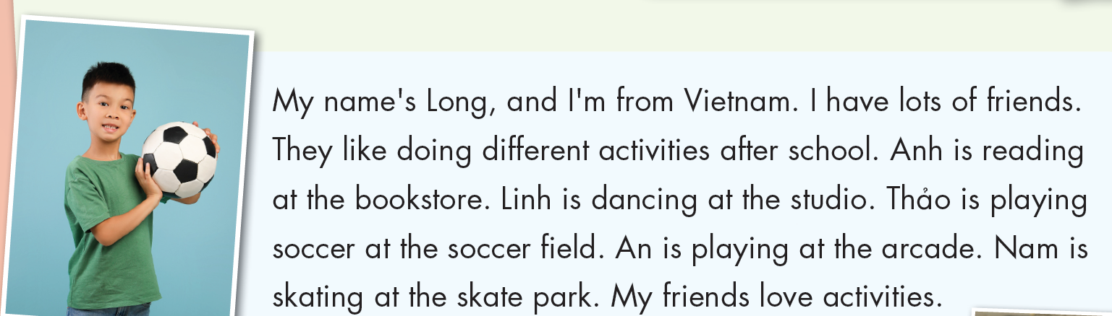

Slide 17

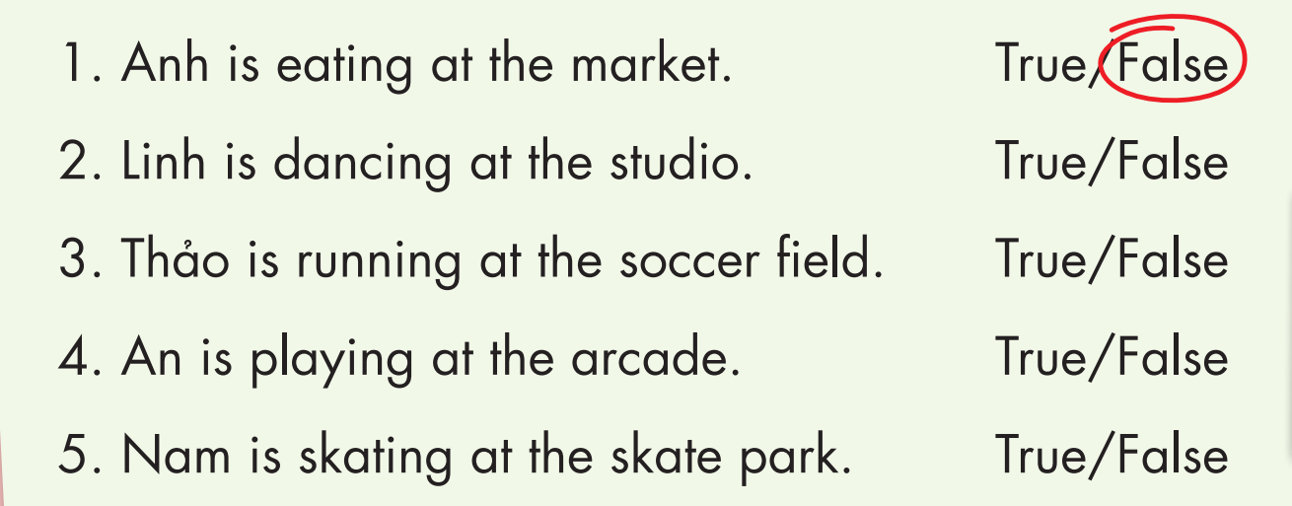

Slide 19



Slide 20
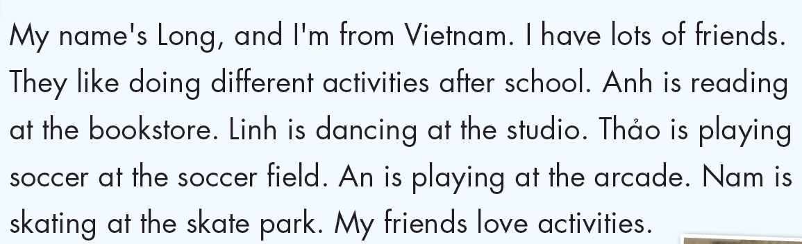
READ AND COMPLETE
Long
Vietnam
friends
doing
reading
bookstore
studio
soccer field
arcade
skate park

Slide 21
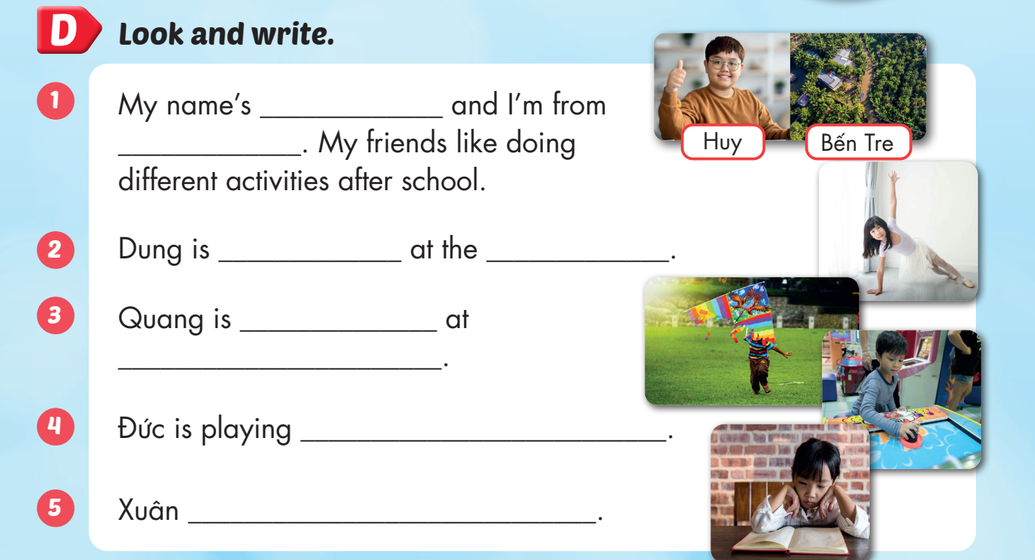
Huy
Bến Tre
dancing
studio
flying a kite
soccer field
games at the arcade
is reading at home

Slide 22

Production

Slide 23
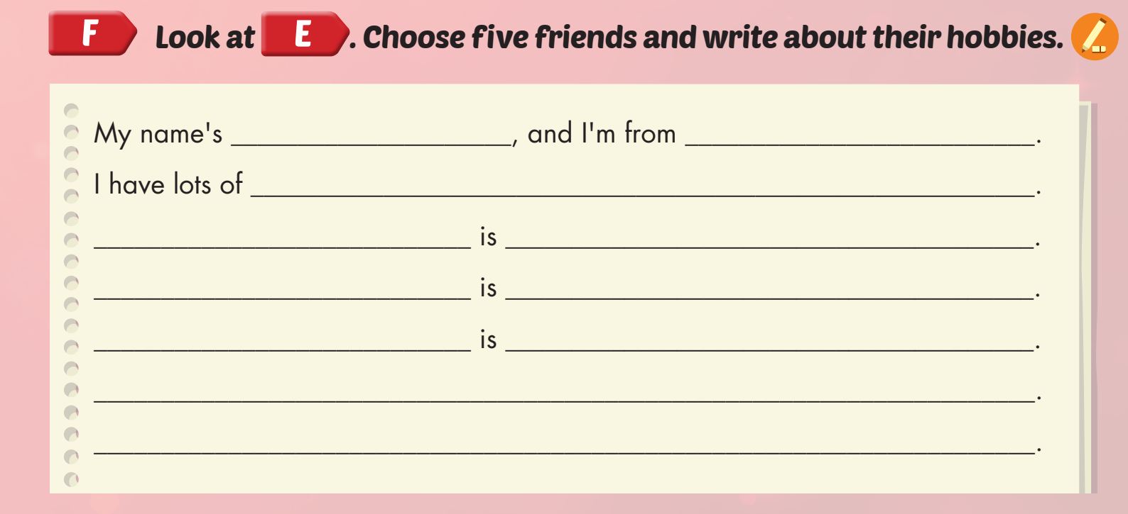

Slide 24

CONSOLIDATION

Slide 25



Slide 26

WRAP-UP

Slide 27
Today’s lesson
Vocabularies
studio, soccer field, arcade, skate park, bookstore.
Structures/ Sentence patterns
What is she doing?
She’s dancing at the studio.
What are they doing?
They are playing soccer at the soccer field.

Slide 28
Homework
Practice the vocabularies and structure; and make sentences using them.
Do the exercises in Tiếng Anh 4 i-Learn Smart Start WB (page 39)
Do the exercises in Tiếng Anh 4 i-Learn Smart Start Notebook (page 25).
Prepare the next lesson (page 60 SB)
Play the consolidation games in Tiếng Anh 4 i-Learn Smart Start DHA App on www.eduhome.com.vn

