Slide 1

Unit 4: ACTIVITIES
Lesson 4
Page 58

Slide 2
Objectives
By the end of this lesson, students will be able to read and listen about where people do some different activities that are popular in their culture.
Vocabulary: studio, soccer field, arcade, skate park, bookstore.
Structure:
What's she doing?
She's dancing at the studio.
What are they doing?
They're playing soccer at the soccer field.

Slide 3

WARM UP

Slide 4

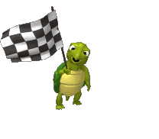



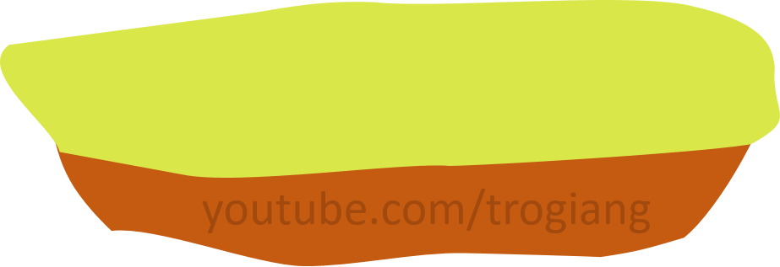

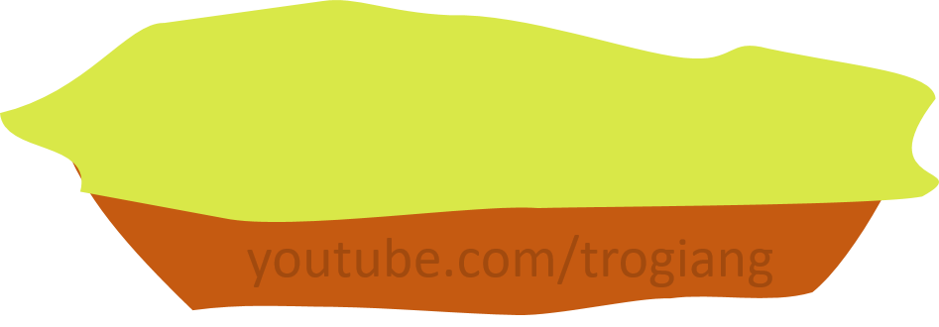






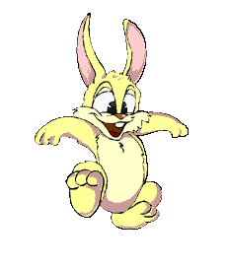




5
CONGRATULATIONS TIGER TEAM
5
CONGRATULATIONS RABBIT TEAM
4
4
3
3
2
2
overtop
1
1
Notes:
T divides Ss into 2 teams.
Each team has a leader.
Team leaders have to play Rock, Scissors, Paper for each question.
The winner will get a turn to answer the question.
Ss can step once for a correct answer.

Slide 5

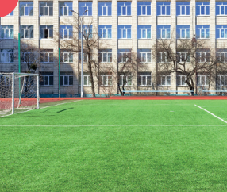

Click on each sentence to check the correct answer.
What are they doing?
1
play soccer
A
They playing soccer at the soccer field.
B
They’re playing soccer at the soccer field.
C
They’re play soccer at the soccer field.

Slide 6
Click on each sentence to check the correct answer.
What are they doing?
2
read
A
They’re reading at the bookstore.
B
They’re chatting the bookstore.
C
They’re read at the bookstore.

Slide 7
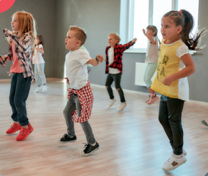
Click on each sentence to check the correct answer.
What are they doing?
3
dance
A
They’s dancing at the studio.
B
They dance at the studio.
C
They’re dancing at the studio.

Slide 8
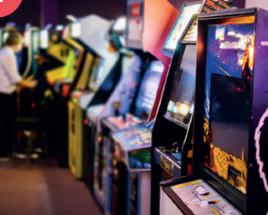
Click on each sentence to check the correct answer.
What is he doing?
4
playing
A
He’s play at the arcade.
B
He’s playing at the arcade.
C
He’s playing at the arcade.

Slide 9
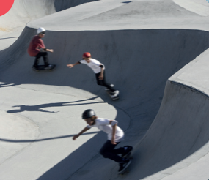
Click on each sentence to check the correct answer.
What are the doing?
5
A
They’re skating at the skate park.
B
They are skate at the skate park.
C
They skating at the skate park.

Slide 10

It’s time to learn …

Slide 11

Reading

Slide 12
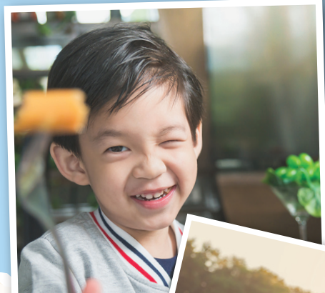


Underline key words in each statement.
Read the text carefully and find information.

Slide 13
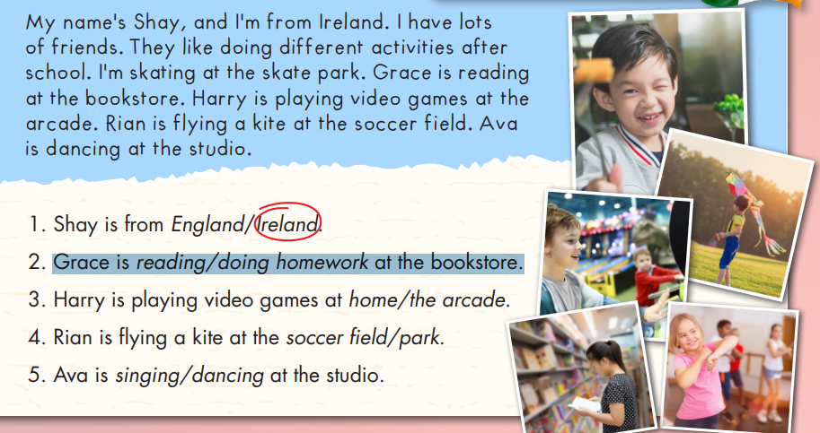

Slide 14
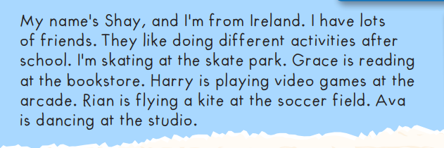
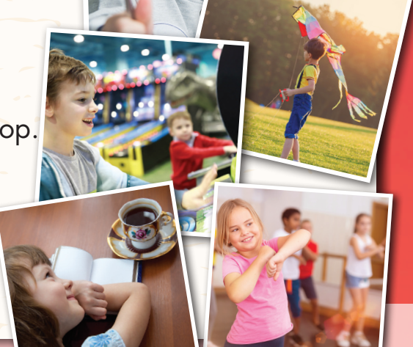
1. Shay is from England/ Ireland.
2. Grace is reading/doing homework at the coffee shop.
3. Harry is playing video games at home/the arcade.
4. Rian is playing a kite at the soccer field/park.
5. Ava is singing/dancing at the studio.

Slide 15



Slide 16
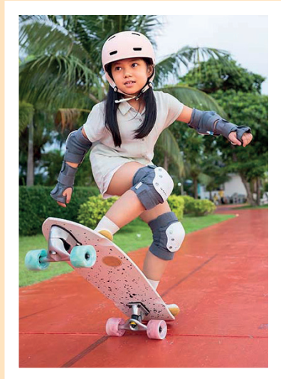
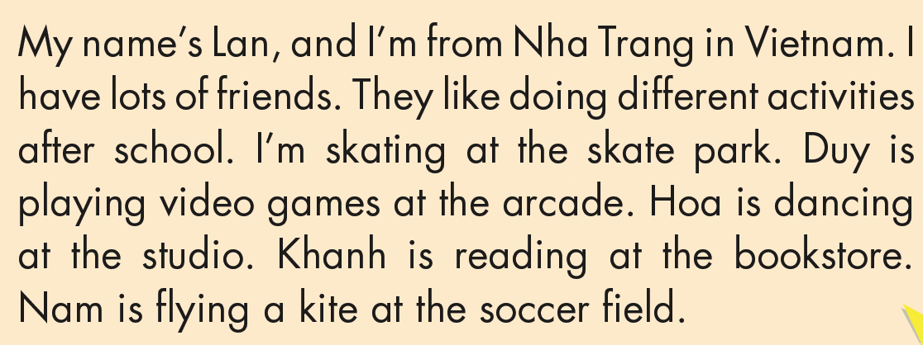
3. Read and complete.
skating
arcade
dancing
soccer field
skating
arcade
dancing
soccer field

Slide 17

Listening

Slide 18

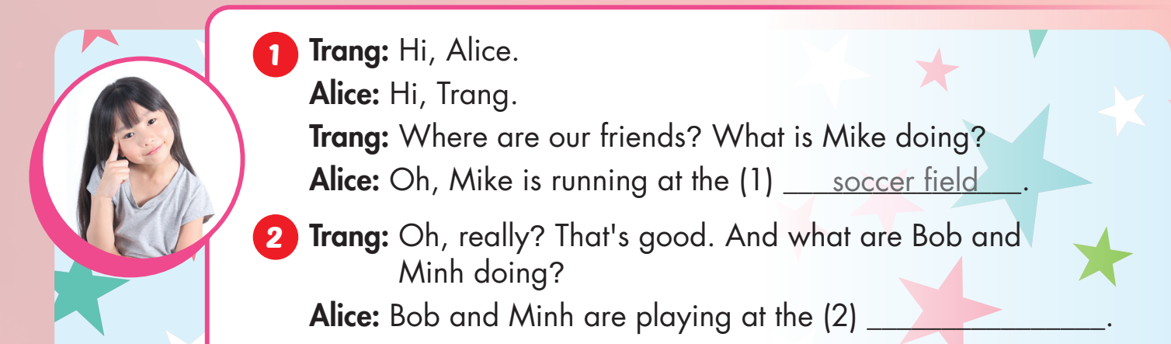

Slide 19
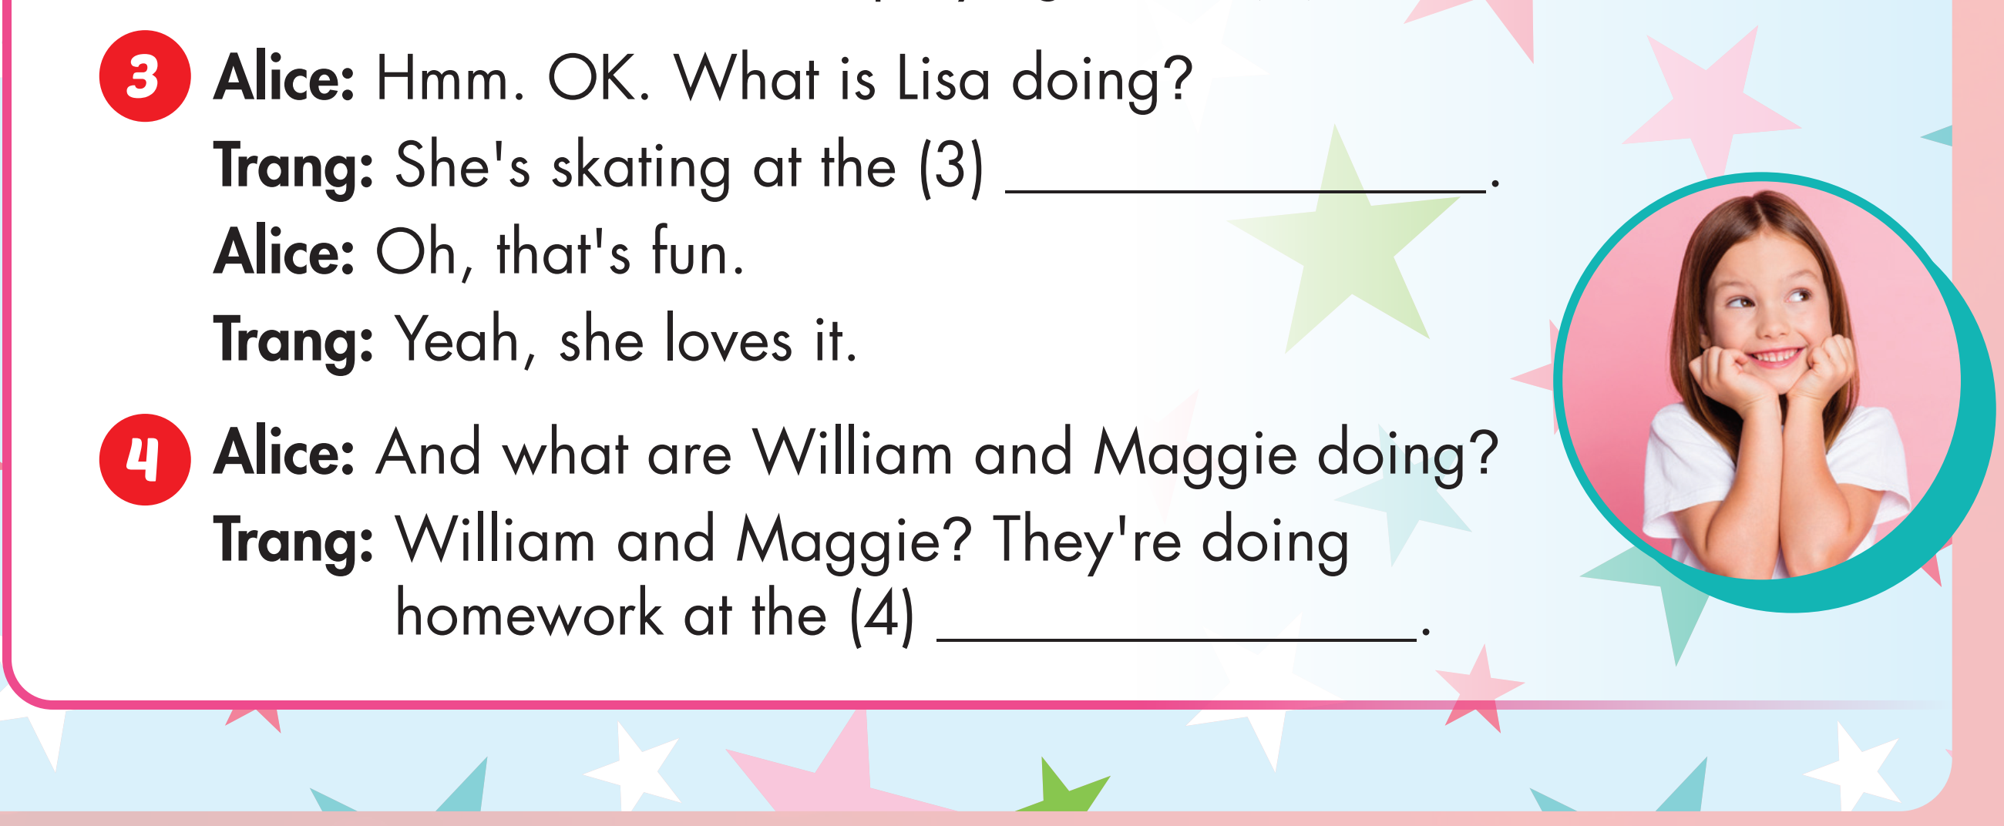

Slide 20
arcade

Slide 21
Skate park
bookstore

Slide 22

Production

Slide 23
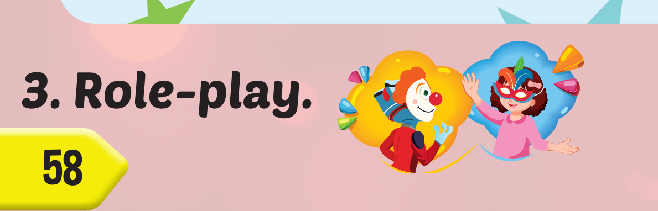

Slide 24

CONSOLIDATION

Slide 25

WRAP-UP

Slide 26
Today’s lesson
Vocabularies
studio, soccer field, arcade, skate park, bookstore.
Structures/ Sentence patterns
What is she doing?
She’s dancing at the studio.
What are they doing?
They are playing soccer at the soccer field.

Slide 27
Homework
Practice the vocabularies and structure; and make sentences using them.
Do the exercises in Tiếng Anh 4 i-Learn Smart Start WB (page 39)
Do the exercises in Tiếng Anh 4 i-Learn Smart Start Notebook (page 25).
Prepare the next lesson (page 51 SB)
Play the consolidation games in Tiếng Anh 4 i-Learn Smart Start DHA App on www.eduhome.com.vn

