Slide 1






















Slide 2
Unit 9. Places in town
Lesson 3. Task 1, 2, 3

Slide 3

1
http://yyoutube.com/watch?v=e_04ZrNroTo
Warm Up

Slide 4
2
Presentation

Slide 5

Turn left

Slide 6
Turn right

Slide 7



Go straight

Slide 8

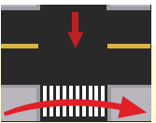
Cross the road

Slide 9
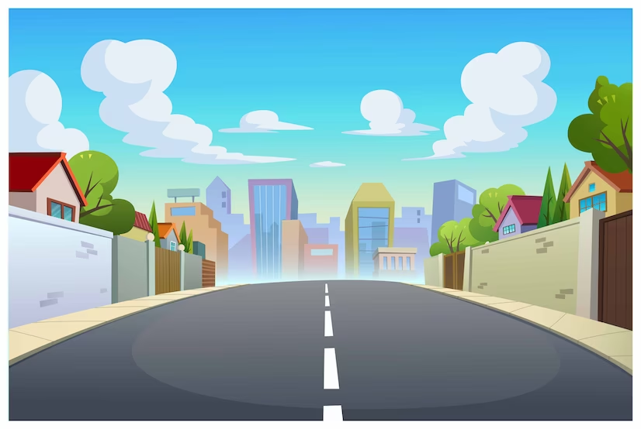

VOCABULARY CHECKING

Slide 10

WHERE´S THE FIRE?
START
Drive the fire engine to the fire

Slide 11

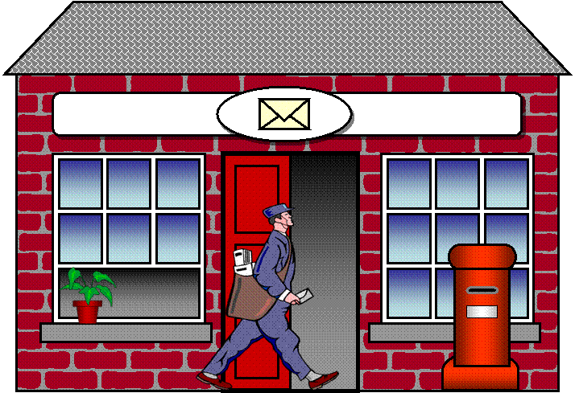
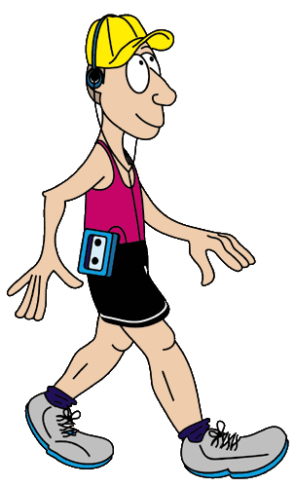
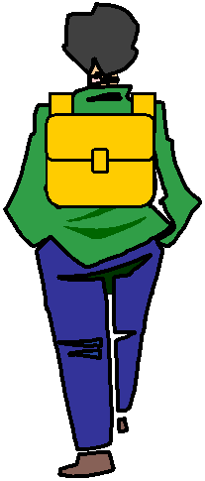


GPS
TURN RIGHT
Click on the arrows
Click on the arrows

Slide 12
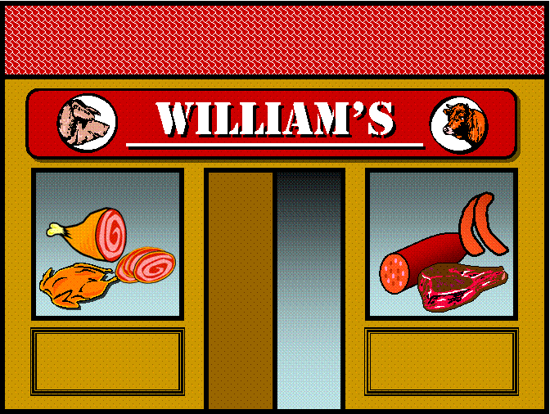
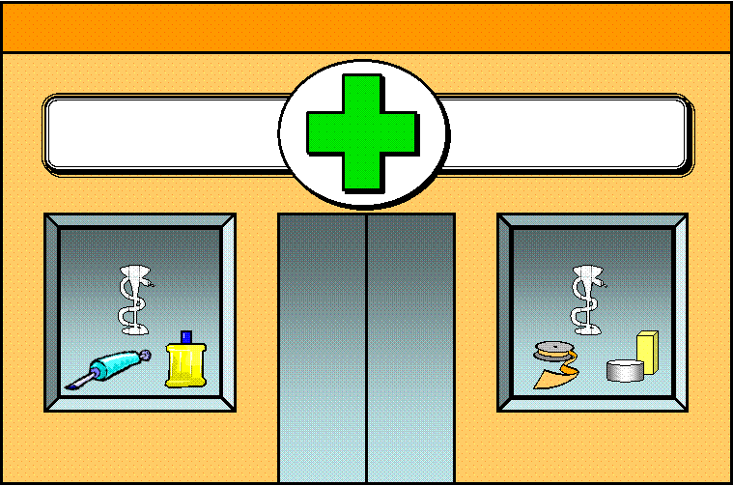


GPS
GO STRAIGHT
Click on the arrows

Slide 13




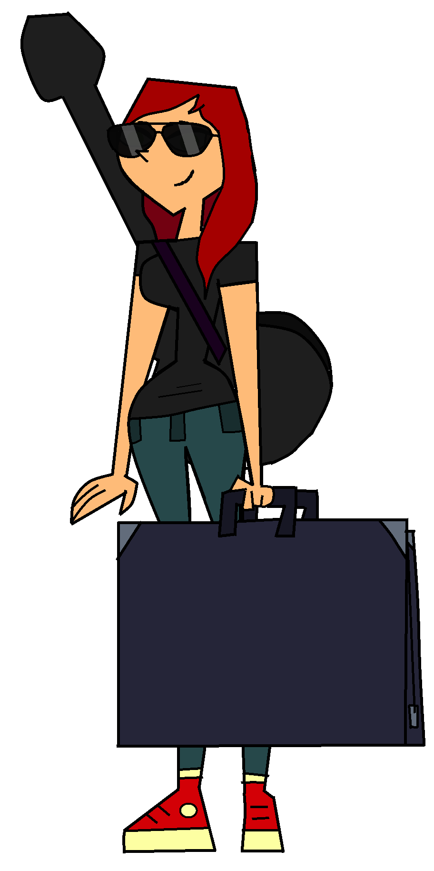
GPS
TURN LEFT
Click on the arrows

Slide 14

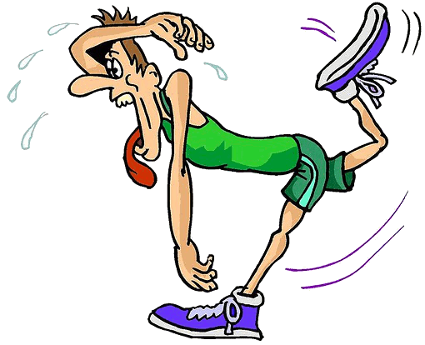
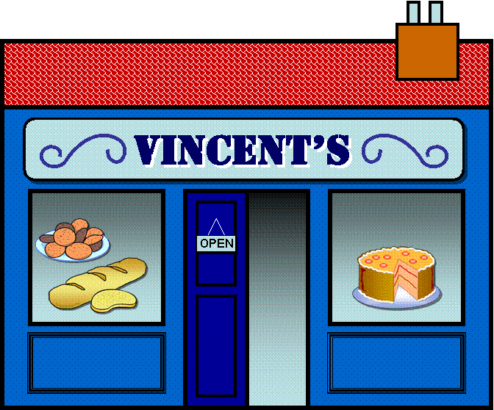
GPS
TURN RIGHT
Click on the arrows

Slide 15


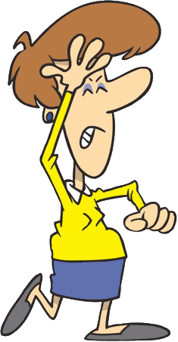

GPS
HERE WE ARE!

Slide 16
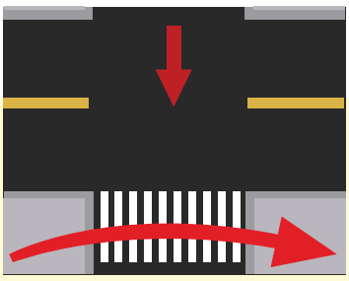



1 Listen and point. Repeat.
Cross the road
Go straight
Turn left
Turn right

Slide 17
3
Practice

Slide 18


Let’s cross the road here. We go straight on high street and then turn right. The cinema is opposite the school.
Great !
How do we go to the cinema now , Anika ?

Slide 19
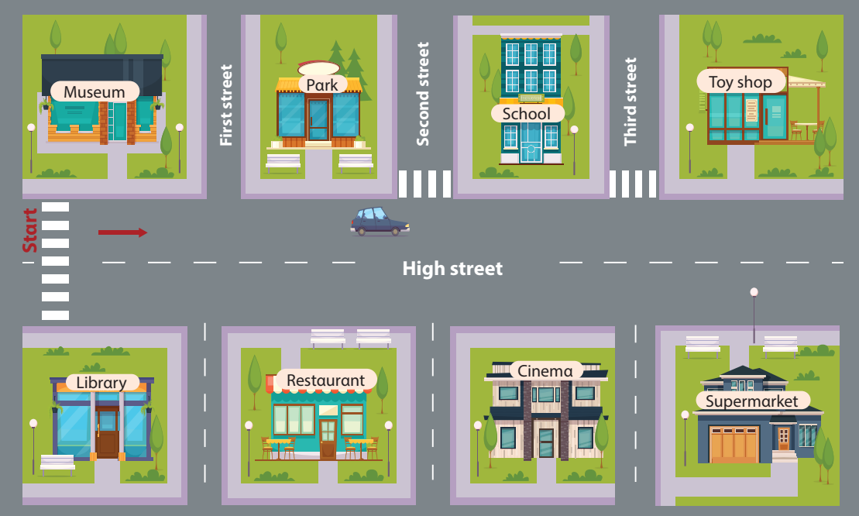
2 Listen and write
opposite
The cinema is…………………………… the school.

Slide 20




Slide 21


Notes:
NHẤN BÓNG ĐỂ CHỌN CÂU HỎI . SAU KHI TRẢ LỜI NHẤN VÀO BÓNG ĐỂ KHÁM PHÁ SỐ ĐIỂM NHẬN ĐƯỢC.

Slide 22




3 Look αnd sαy. Use the mαp in 2
Where is the museum?
Go strαight on High street.
The museum is opposite the librαry.

Slide 23

3 Look αnd sαy. Use the mαp in 2
Where is the restaurant?
Go strαight on High street.
The restaurant is opposite the park.

Slide 24

3 Look αnd sαy. Use the mαp in 2
Where is the library?
Go strαight on High street. The library is opposite the museum.

Slide 25

3 Look αnd sαy. Use the mαp in 2
Where is the supermarket?
Go strαight on High street.
The supermarket is opposite the toy shop.

Slide 26
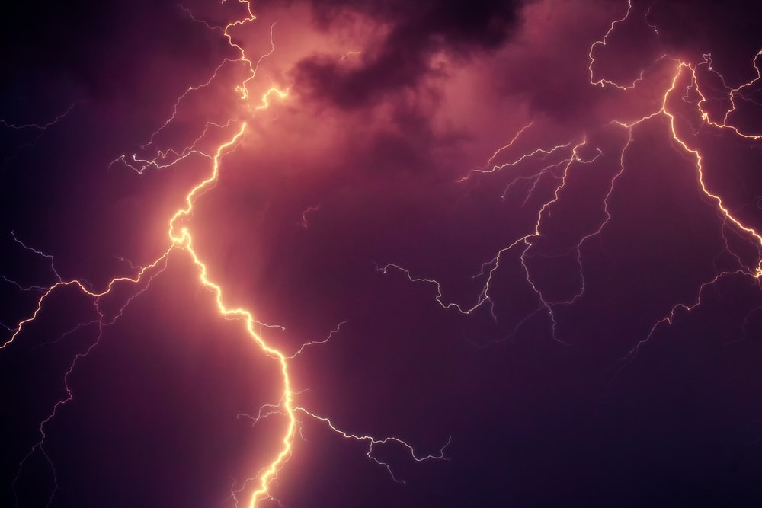






Slide 27



Slide 28
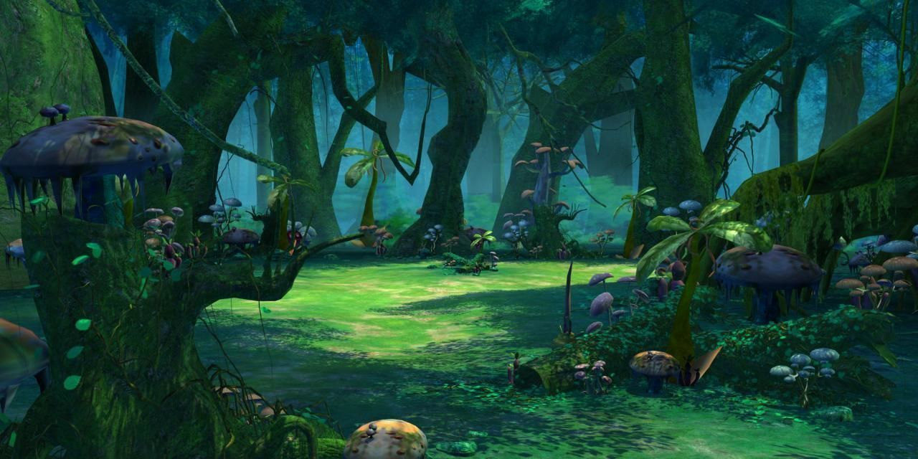


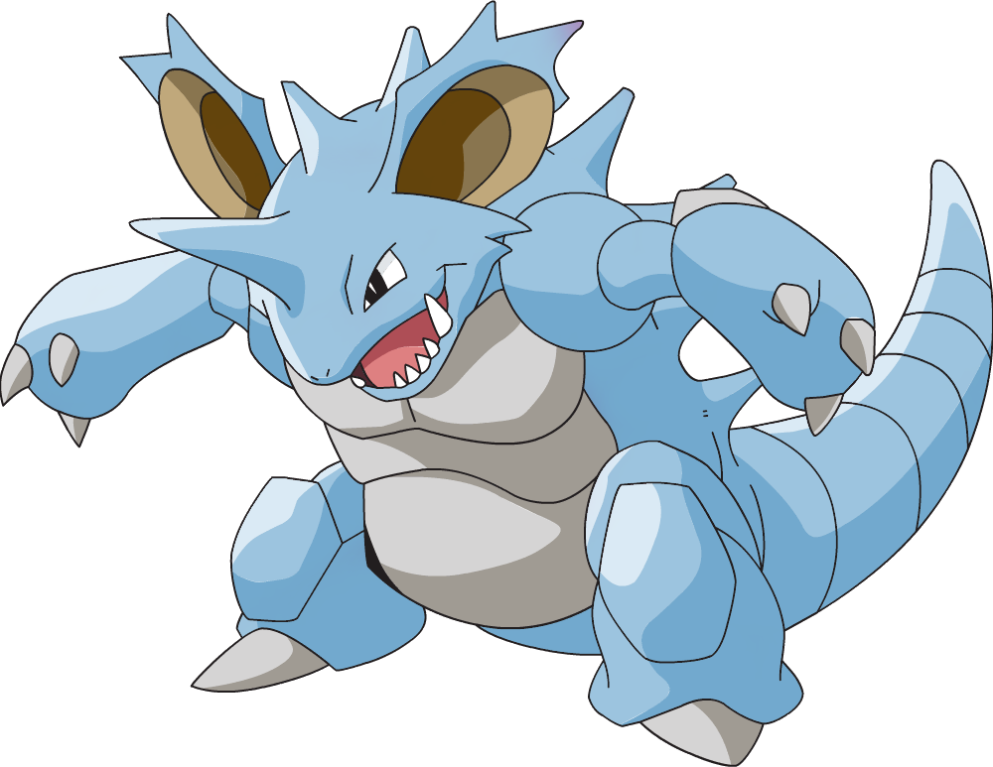

Slide 29
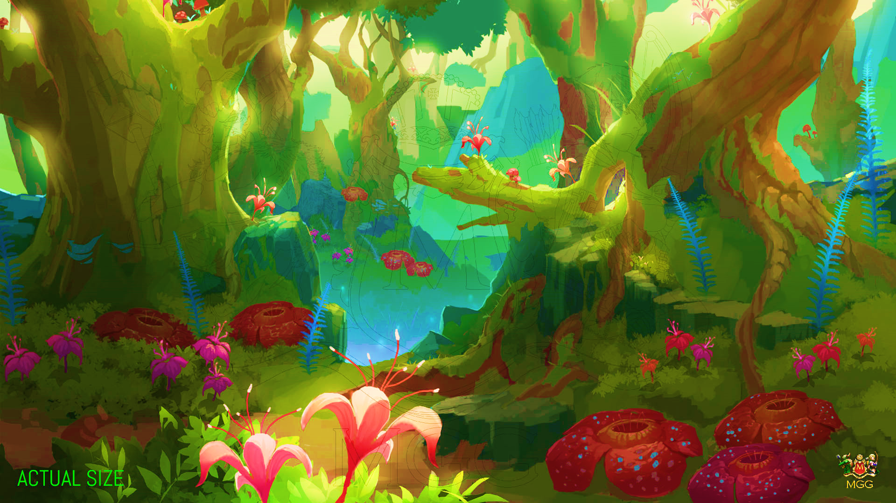


Slide 30
4
Production

Slide 31
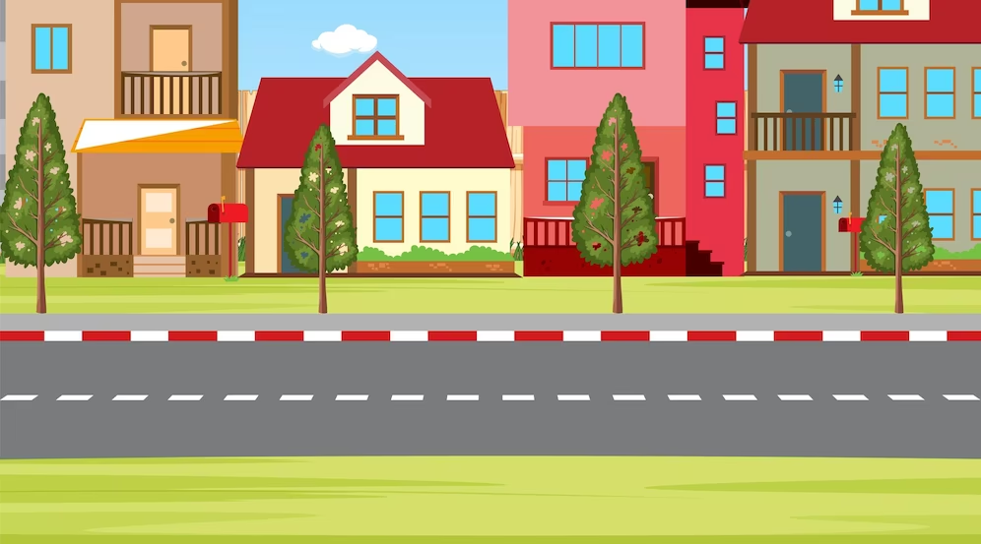
Where is the museum?
Go strαight on High street.
The museum is opposite the librαry.
Notes:
Ask

Slide 32
5
Assessment

Slide 33
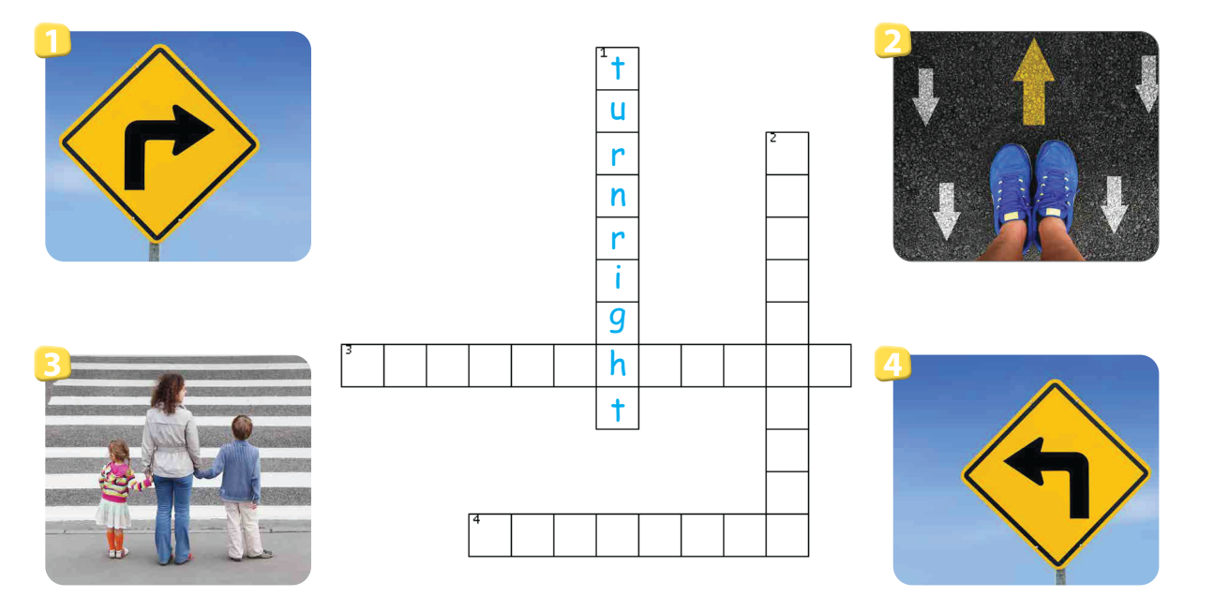
Do the crossword
g
o
s
t
r
c
r
o
s
s
t
e
r
o
a
d
i
g
h
t
u
r
n
l
e
f
t

Slide 34
VOCABULARY
Cross the road, go straight, turn left, turn right
STRUCTURE
The cinema is opposite the school.

Slide 35

THANK YOU
& GOODBYE!

