Slide 1





















Slide 2





Unit 8: Technology
Lesson 2 – Period 1

Slide 3


Warm up
Matching Game

Slide 4


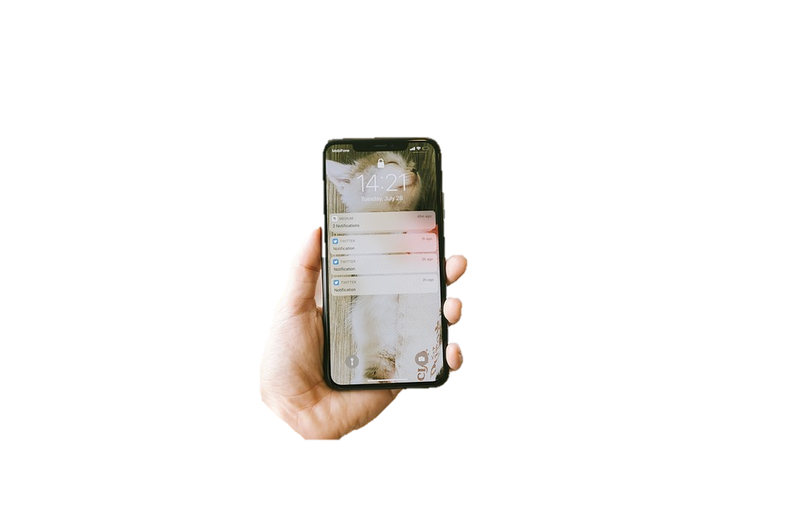


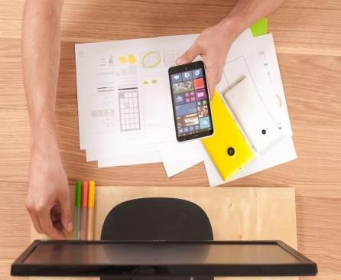

Smart
phone
make videos
write emails
robot

Slide 5

Presentation
1
Listen and point. Repeat.

Slide 6




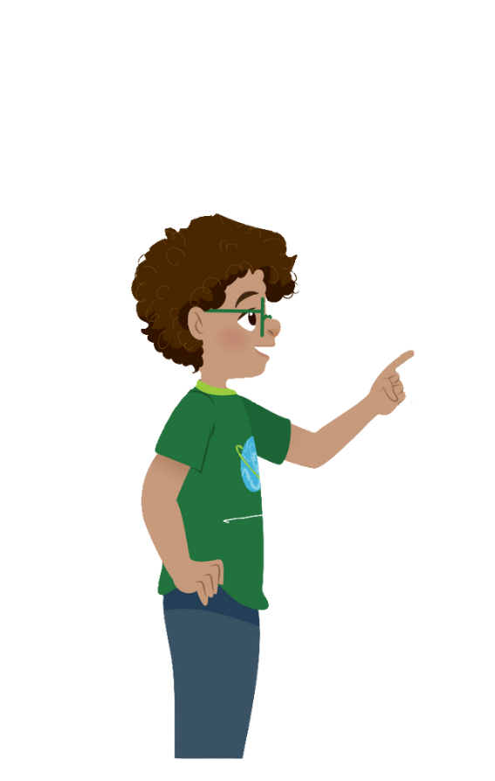


1
Listen and point. Repeat.
Surf the Internet
Use the tablet
Work in pairs
Work in groups

Slide 7

Practice
2
Listen and read. Tick

Slide 8



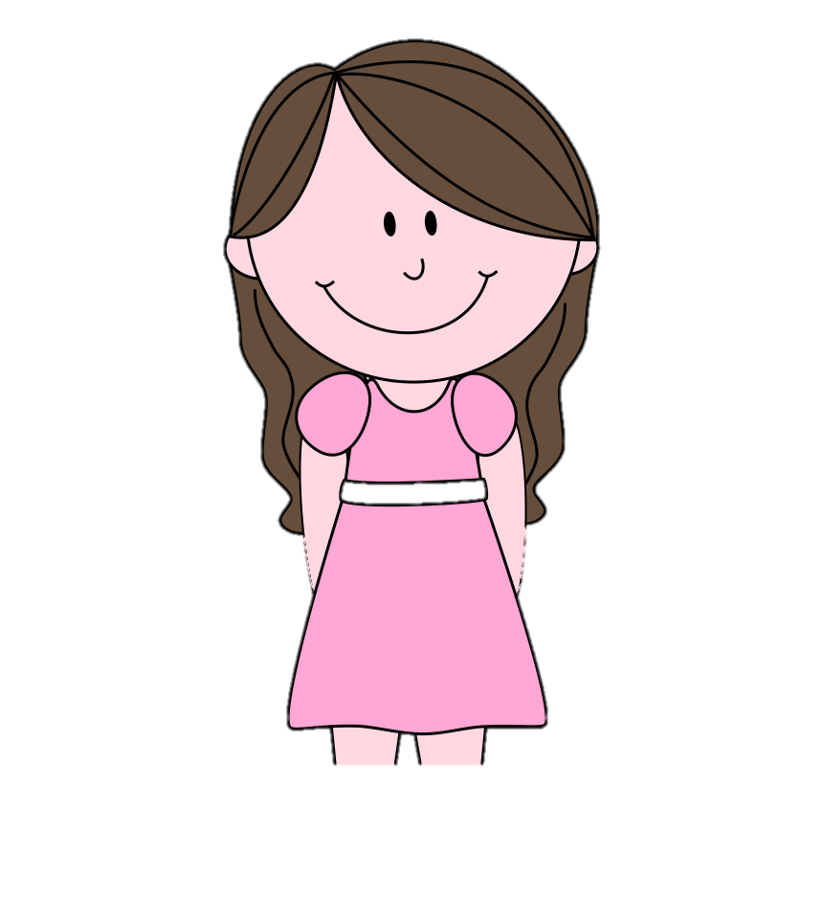
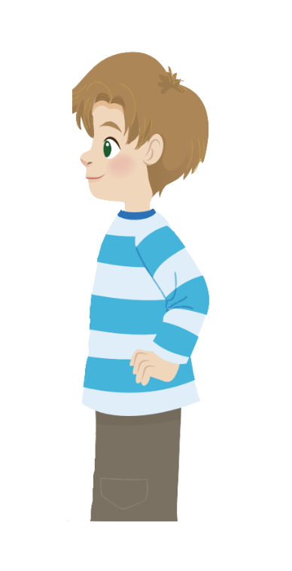
2
Listen and read.Tick.
No, you can’t. But you can open your book and look at the word list.
Robert
Teacher
Yes, teacher.
Now, let’s work in pairs and answer question 1 to 5.
I can see some new words. Teacher, can we use the tablet?

Slide 9
2
Listen and repeat.Tick.
Now, let’s work in pairs and answer question 1 to 5.
Teacher
Robert
I can see some new words. Teacher, can we use the tablet?
The teacher wants her students to work in
✓
pairs.
groups.

Slide 10

2
Listen and repeat.Tick.
2. Students can use
their tablets
their books.
✓
Teacher
Robert
No, you can’t. But you can open your book and look at the word list.
Yes, teacher.

Slide 11
Practice
3
Look and say.

Slide 12




1. Students _____ work in pairs in class.
A. never
B. always
C. sometimes
D. often
Back

Slide 13

Reorder the words to make correct sentence
2. She/ uses/ the/ sometimes/ tablets.
2. She sometimes uses the tablets.
Back

Slide 14
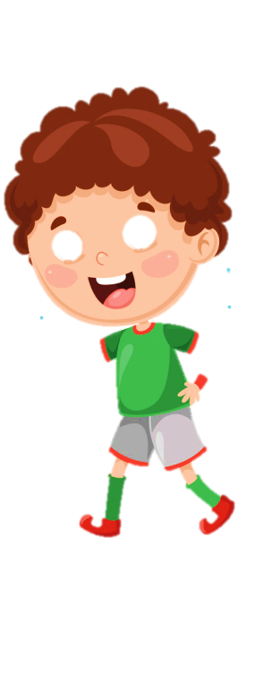


3. They always work ____________.
A. in groups
B. individually
C. in pairs
D. group
Back

Slide 15




4. She sometimes surfs the Internet.
1. | 2 | 3 | 4
Picture 4
Back

Slide 16

Production

Slide 17

Assessment

Slide 18






Look and read. Put tick (✓) or cross (✗) in the box.
1. We work in pairs.
2. She sometimes uses the tablet.
3. My mother always make phone calls.
Notes:
HOẠT ĐỘNG TƯƠNG TÁC

Slide 19


6 Wrap up

Slide 20
REMEMBER
VOCABULARY:
Surf the Internet
Work in pairs
Work in groups
Use the tablet
STRUCTURE:
I/We/ They sometimes/always + V
He/She sometimes/always + Vs/es

