Slide 1







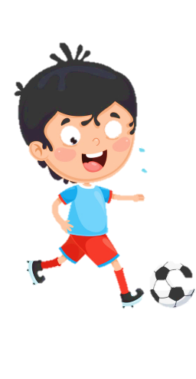











Slide 2




Unit 8 - Lesson 1– Period 2

Slide 3


1. Warm up

Slide 4

Do a crossword in red?
7
7
M
A
K
E
1
E
N
G
L
I
S
H
2
W
R
I
T
E
3
S
M
A
R
T
P
H
O
N
E
4
P
L
A
Y
G
A
M
E
S
5
6
R
O
B
O
T
S
Notes:
Hs chọn số để nhìn hình, trả lời từ còn thiếu và điền vào chỗ trống
Click số 7 để hiện key của crossword

Slide 5
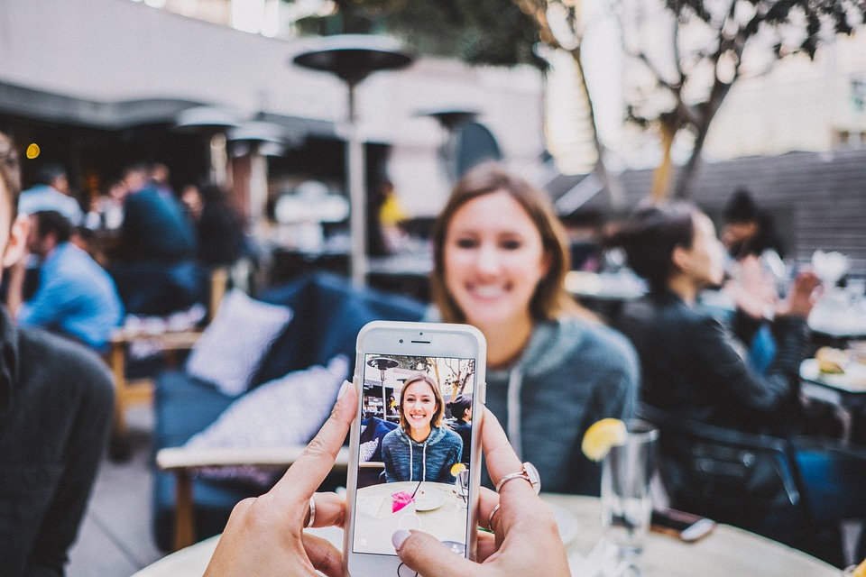
We can _____ videos on a smart phone.
HOME

Slide 6
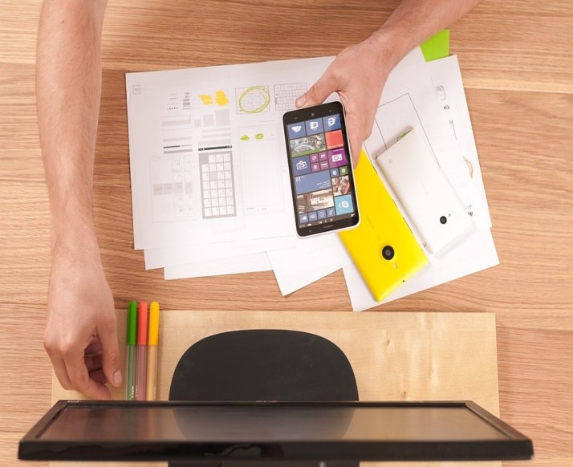
I can learn _________.
HOME

Slide 7

We can ______
emails on the
smart phone.
HOME

Slide 8
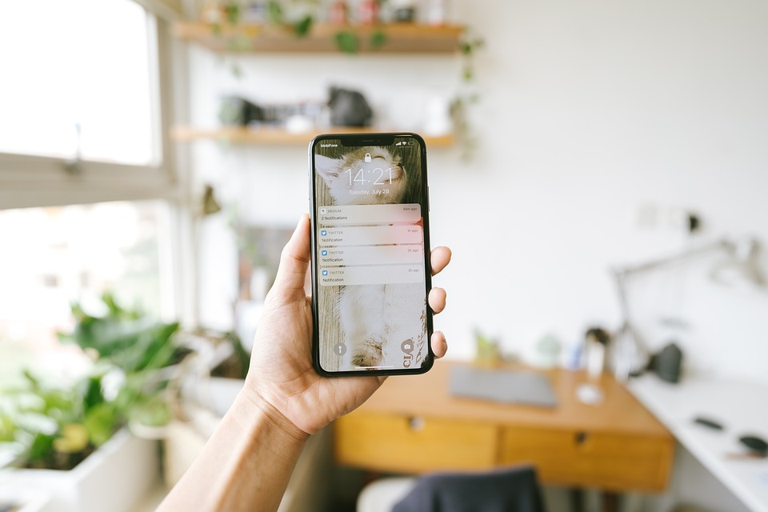
It’s a __________.
HOME

Slide 9
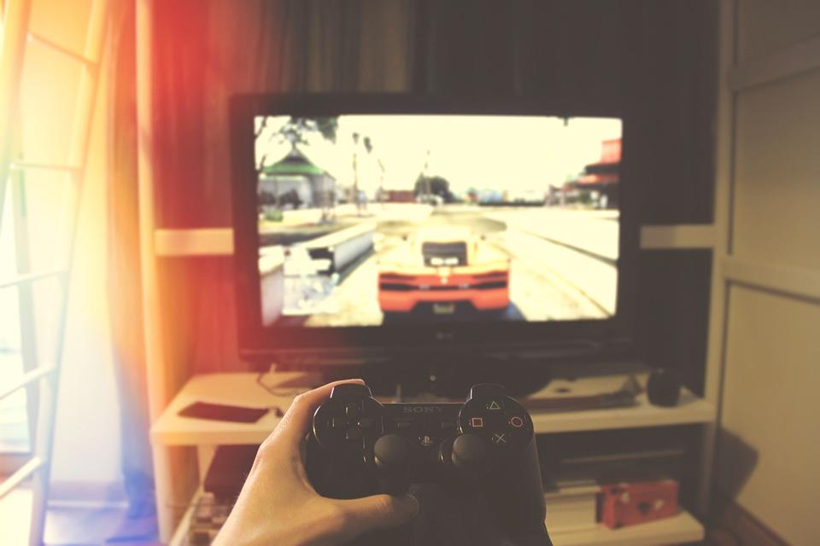
He can ___________.
HOME

Slide 10



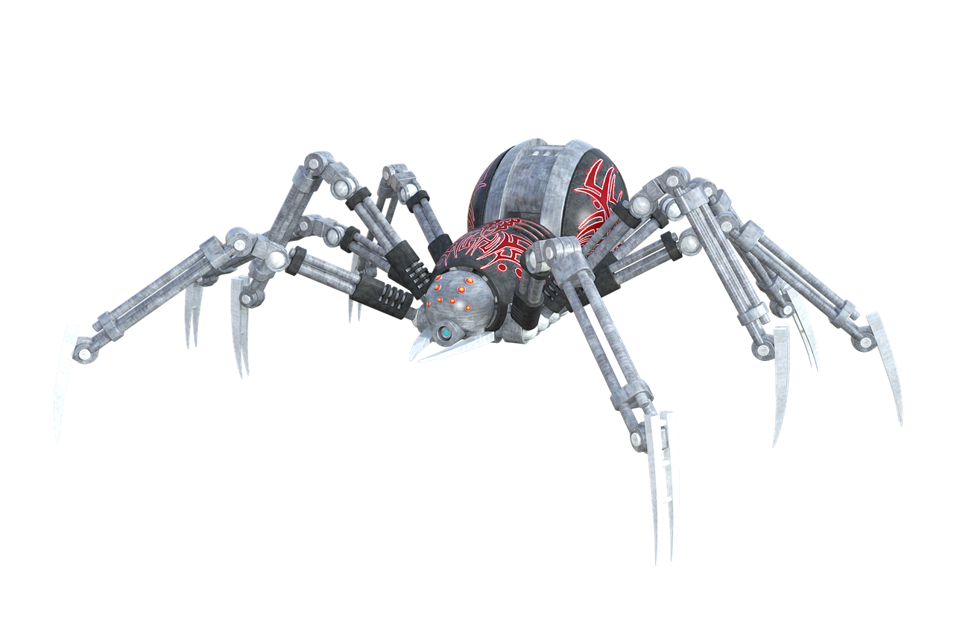
They are ______.
HOME

Slide 11

Presentation
4
Listen and repeat.

Slide 12

Frequency Adverbs
Always
Sometimes

Slide 13

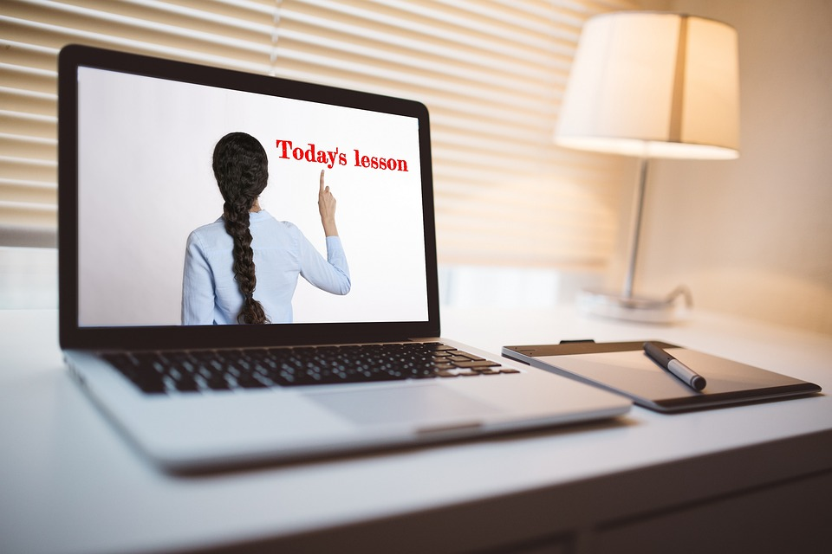
Choose correct answer
1
What can she do?
2
He ____ learns English.
A. She can make videos.
A. sometimes
B. She can write emails.
B. never
C. She can learn English.
C. always

Slide 14



4
Listen and repeat.
1
She sometimes makes videos on her smartphone.

Slide 15

2
He always learns English on his computer.

Slide 16

Practice
5
Look and say.

Slide 17


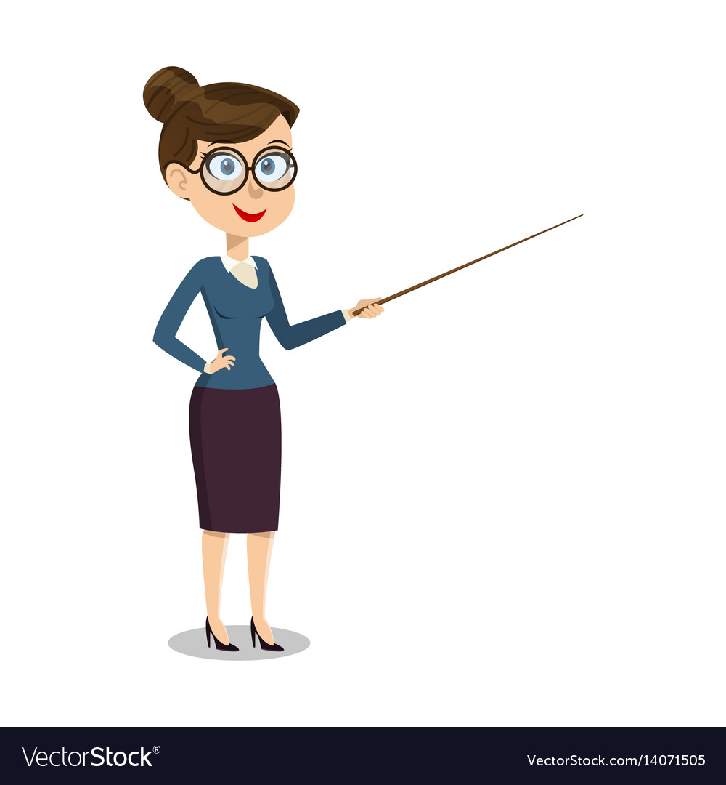


5
Look and say.
Linda/write emails
Linda sometimes writes emails on her computer.

Slide 18

My brother/ make videos
My brother always makes videos on his computer.

Slide 19
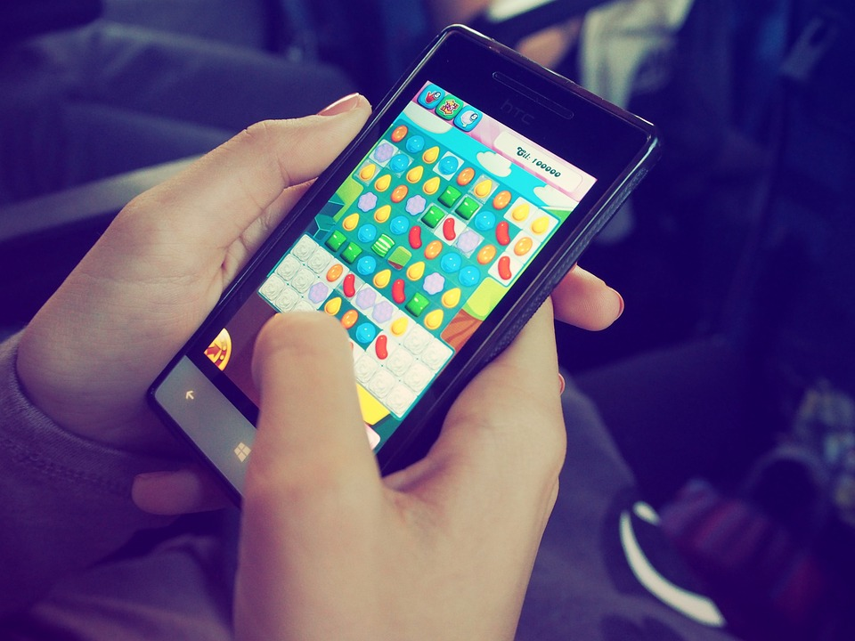

Richard/ play games
Richard sometimes plays games on his smartphone.

Slide 20
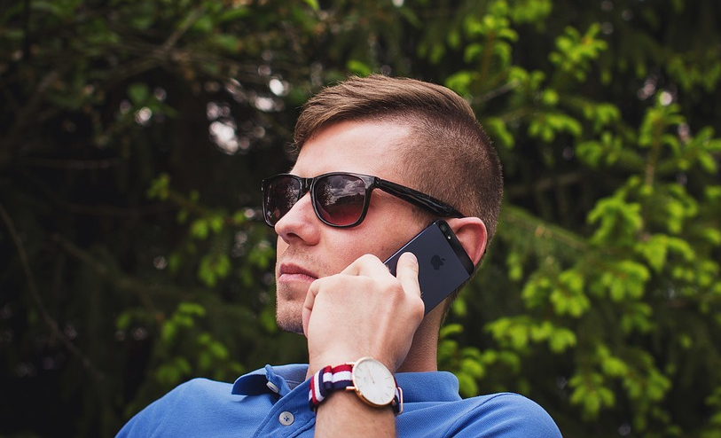
Uncle Mark/
make phone calls
Uncle Mark sometimes makes phone calls on his smartphone.

Slide 21
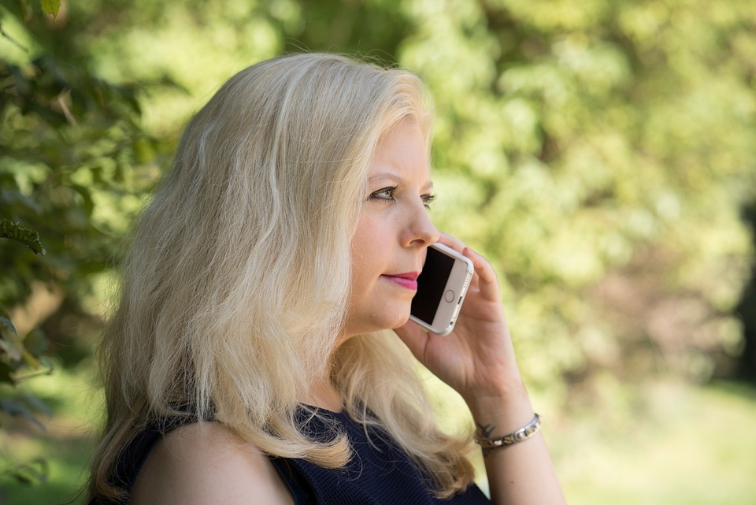

Frequency adverbs practice
always
usually
often
sometimes
never

Slide 22

Production
6
Let’s talk.

Slide 23

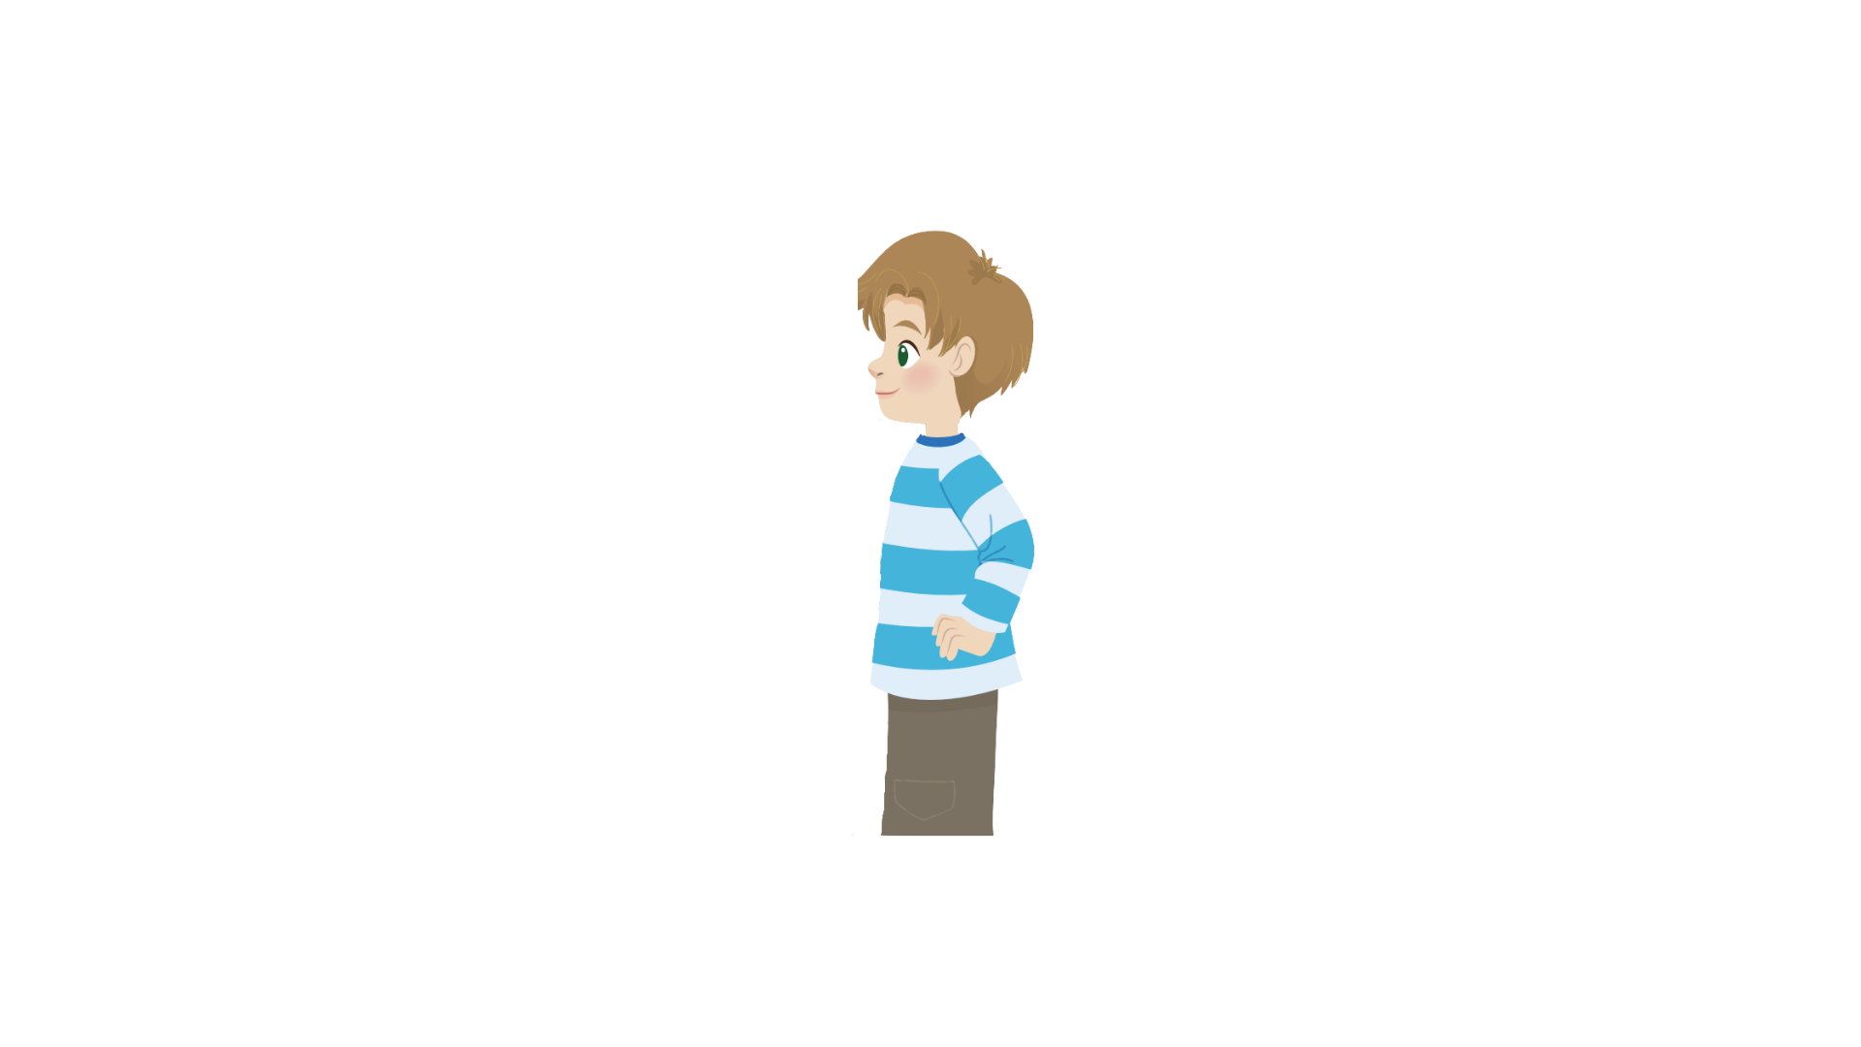
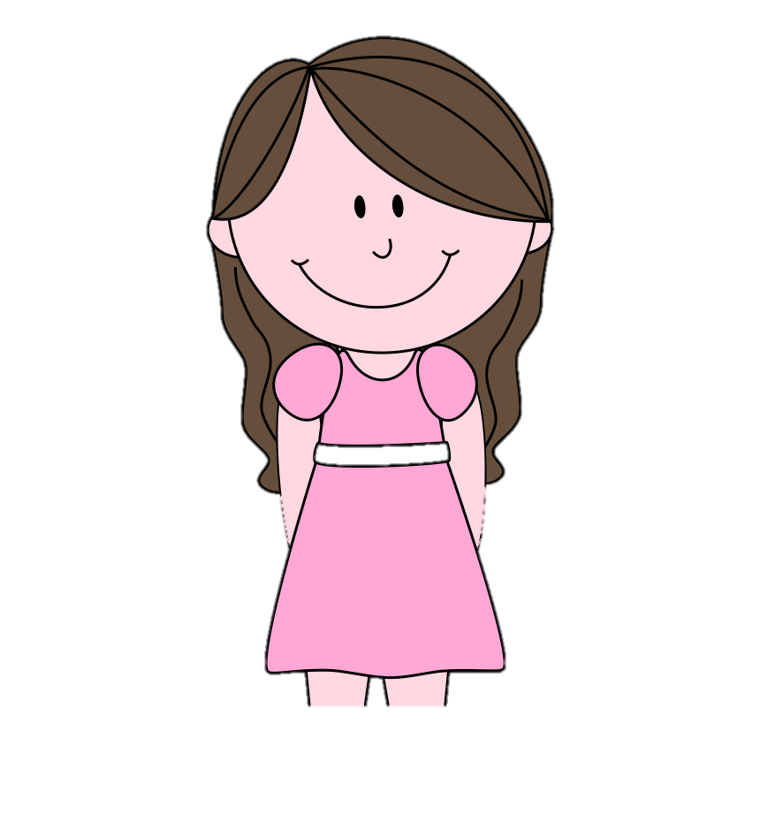
6
Let’s talk
I always learn English on my smartphone.
That’s cool! I sometimes play video games on my smart phone.
Sam
Andy

Slide 24
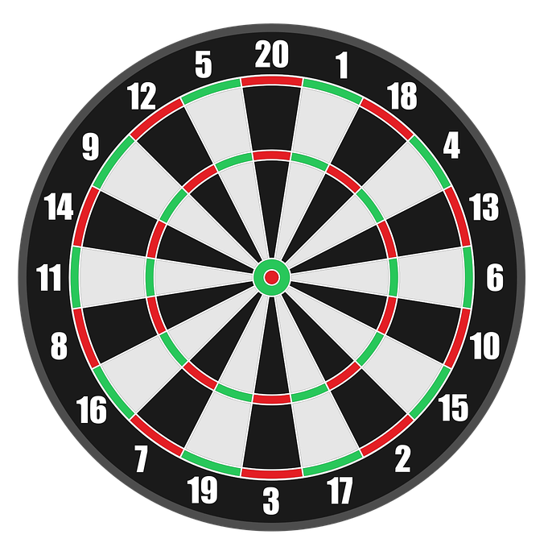


Game :Dart Board
Look and answer
1
3
5
2
4
Next

Slide 25




+ 3
I sometimes write emails.
Back
I always write emails.
Abc.xyz789

Slide 26


We ____ learn English
on our computers.
+5
always
sometimes
Back
Abc.xyz789

Slide 27


3
I _______ make phone calls on my _______.
+8
Sometimes/ smartphone
Sometimes/
computer
Back
Abc.xyz789

Slide 28

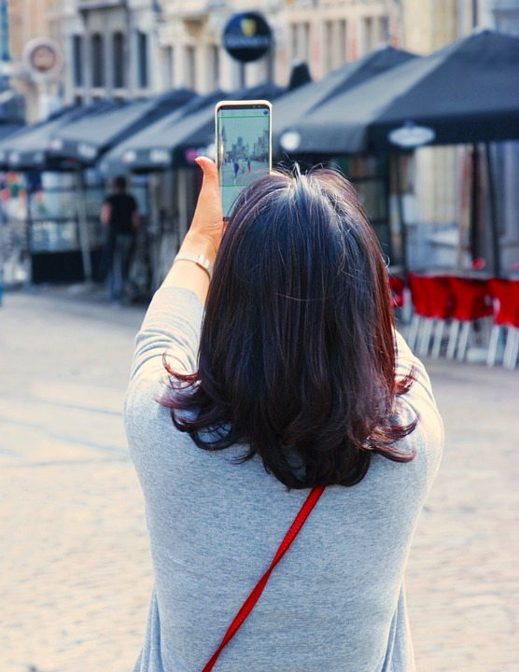

+ 6
I always take photos.
Back
I sometimes take photos.
Abc.xyz789

Slide 29


That’s cool! I ____ make videos on my computer.
+4
never
always
Back
Abc.xyz789

Slide 30

Assessment

Slide 31

Choose the correct answers.
1. I ______ learn English on my smartphone.
A. always
B. alway
C. allways
D. awway
2. They can ________emails on their computer.
A. eat
B. hit
C. leave
D. write
3. What can you do on your _______?
A. I
B. we
C. phone
D. he
4. Aunt Trang sometimes ____ phone calls.
A. made
B. makes
C. make
D. makees
Notes:
HOẠT ĐỘNG TƯƠNG TÁC

Slide 32


Wrap up

Slide 33


REMEMBER
VOCABULARY:
Sometimes: đôi khi
Always: luôn luôn
STRUCTURE:
I/We/ They sometimes/always + V
He/She sometimes/always + Vs/es

Slide 34




Thank you & goodbye!

