Slide 1








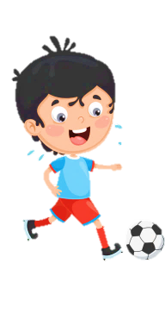













Slide 2
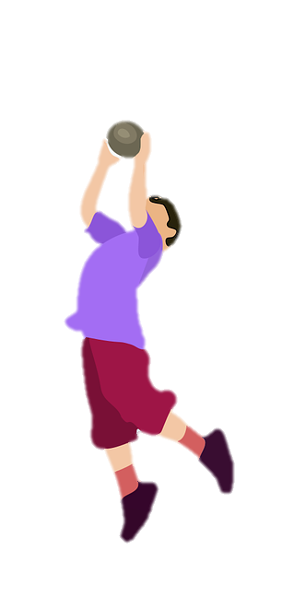
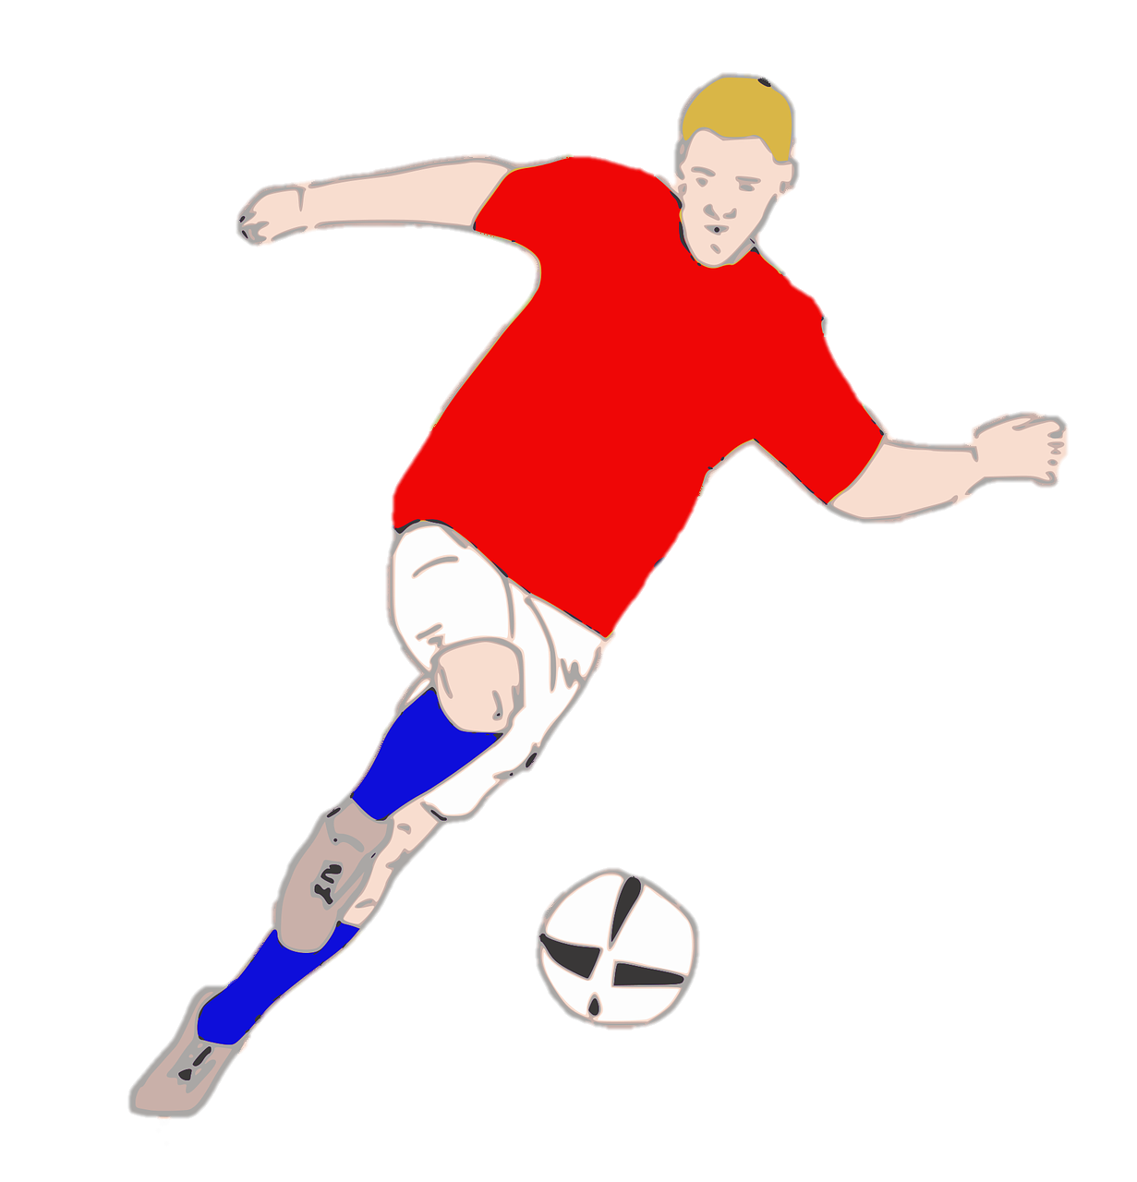
Unit 7:
SPORTS
Lesson 2 – Part 1, 2, 3

Slide 3





Table of contents
01
02
Warm-up
Presentation
04
05
Wrap-up &
Assessment
Production
03
Practice

Slide 4


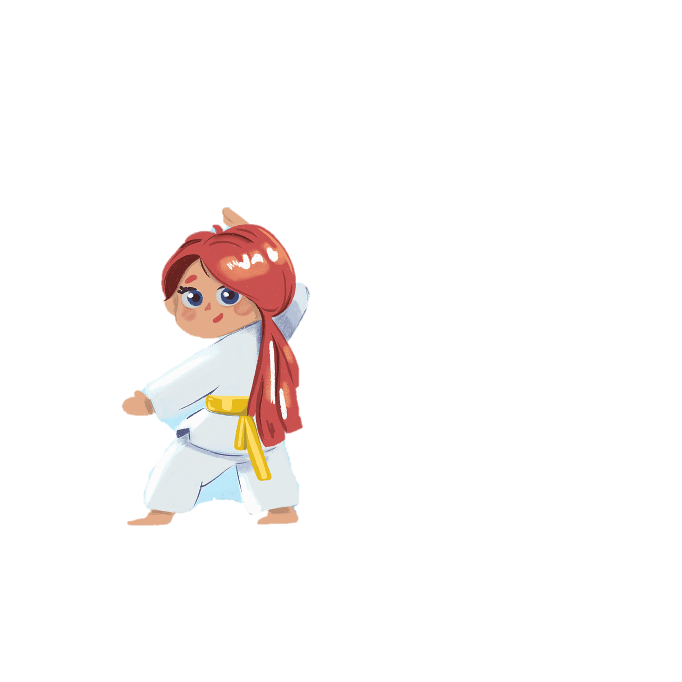
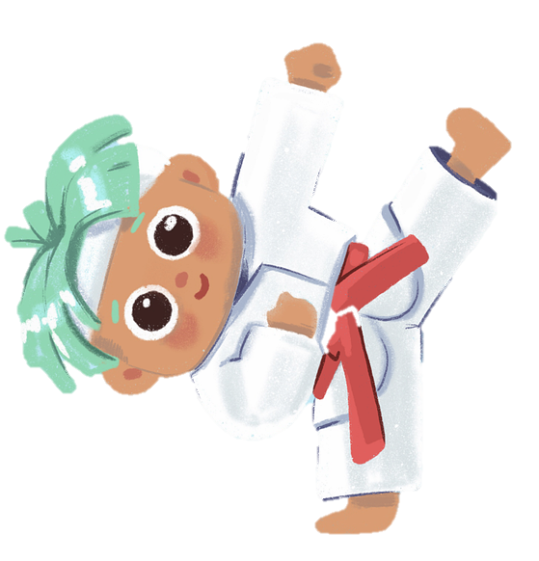
1
Warm-up

Slide 5

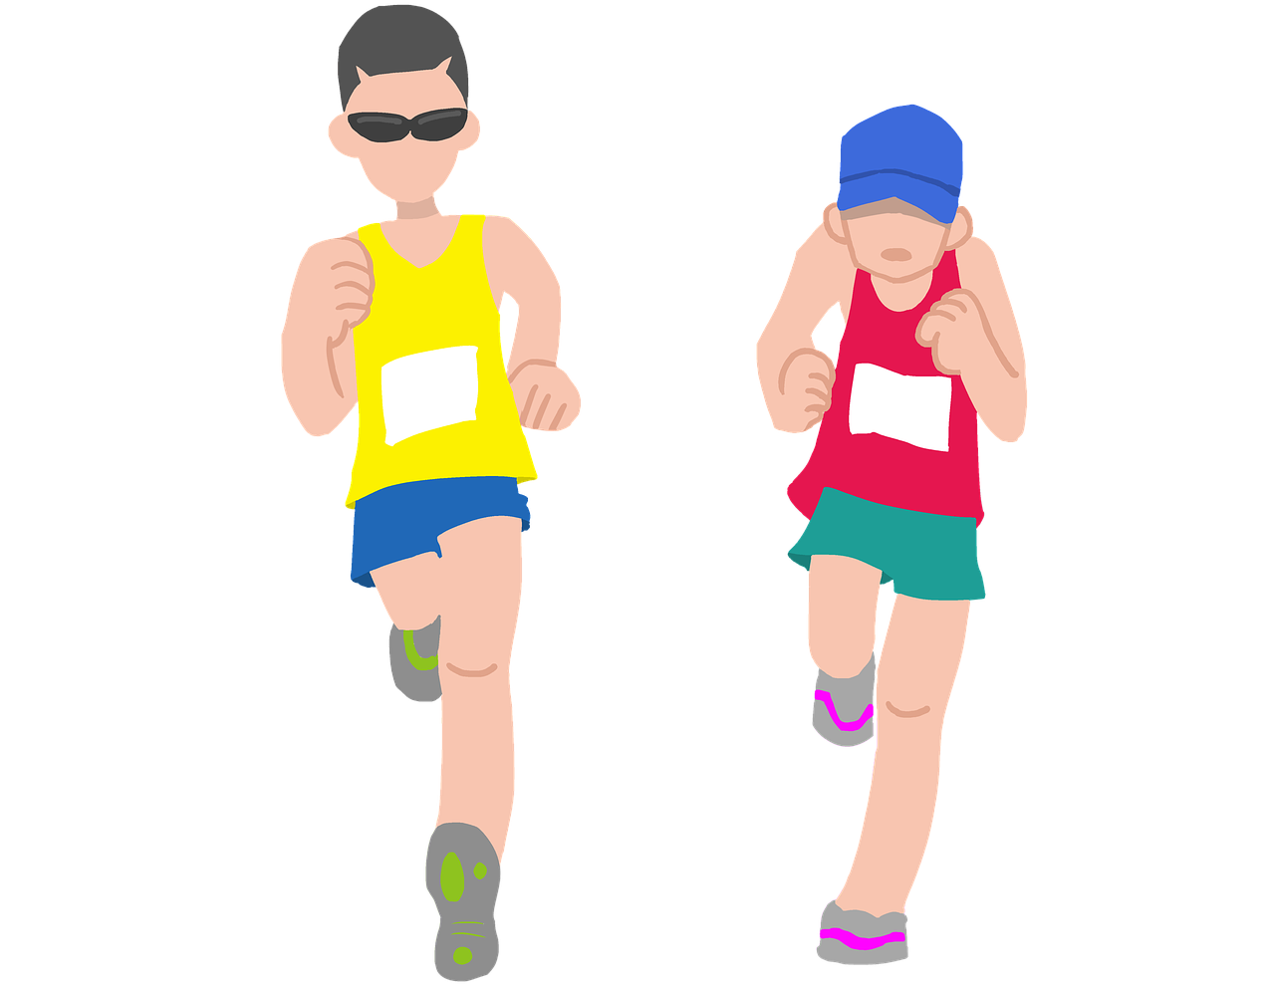
Reorder the words to make a meaningful sentence.
am/jogging/with/I/my/brother
=> I am jogging with my brother.

Slide 6

Reorder the words to make a meaningful sentence.
reading/at/is/the/moment/she/books
=> She is reading books at the moment.

Slide 7
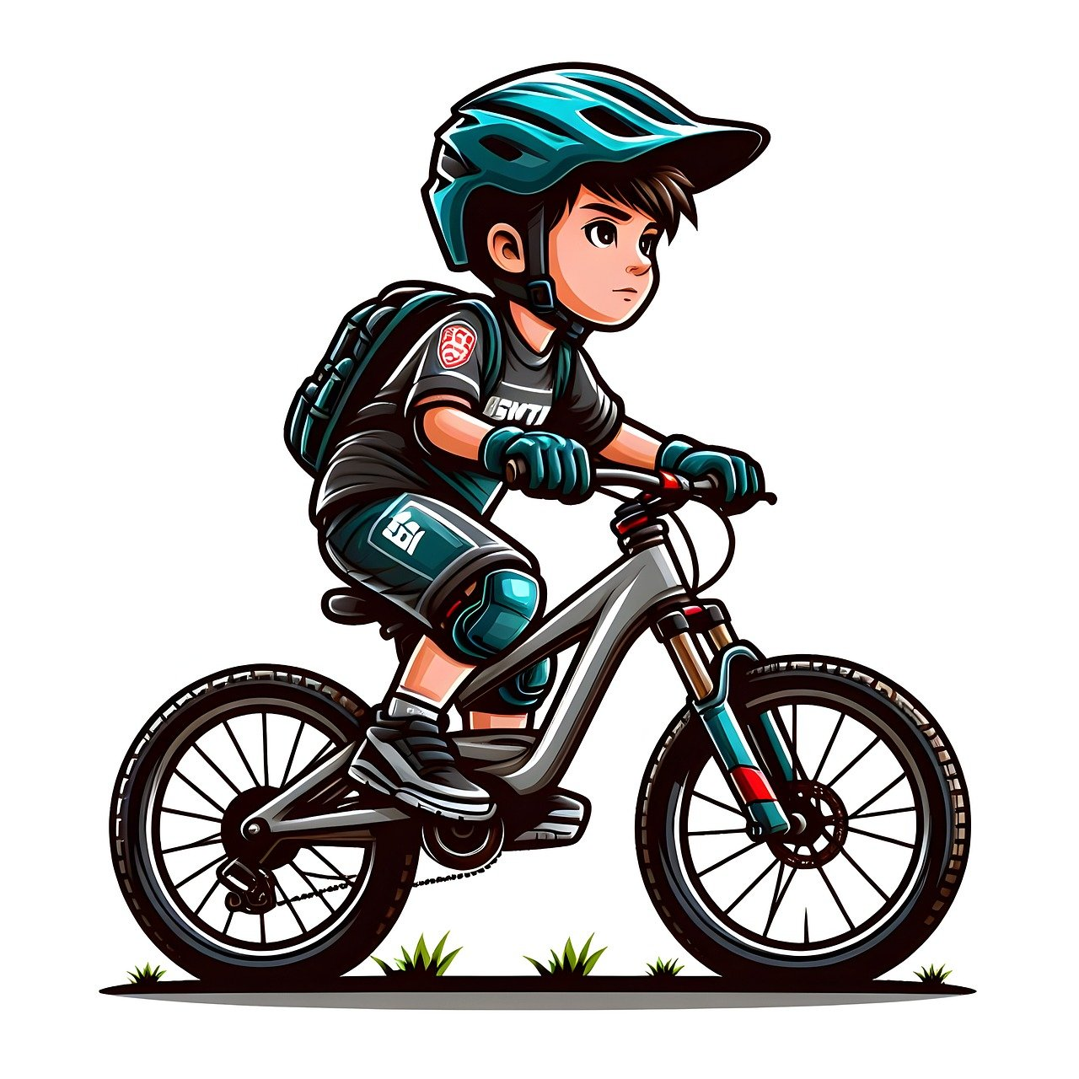
Reorder the words to make a meaningful sentence.
John/his/riding/to/bike/is/school
=> John is riding his bike to school.

Slide 8

Reorder the words to make a meaningful sentence.
are/photos/we/amusement/taking/is/park/the/at
=> We are taking photos at the amusement park.

Slide 9
2
Presentation

Slide 10
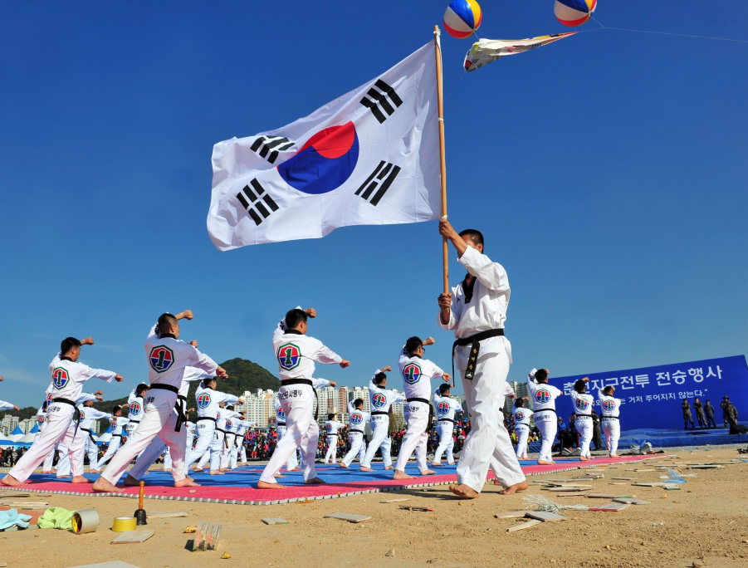

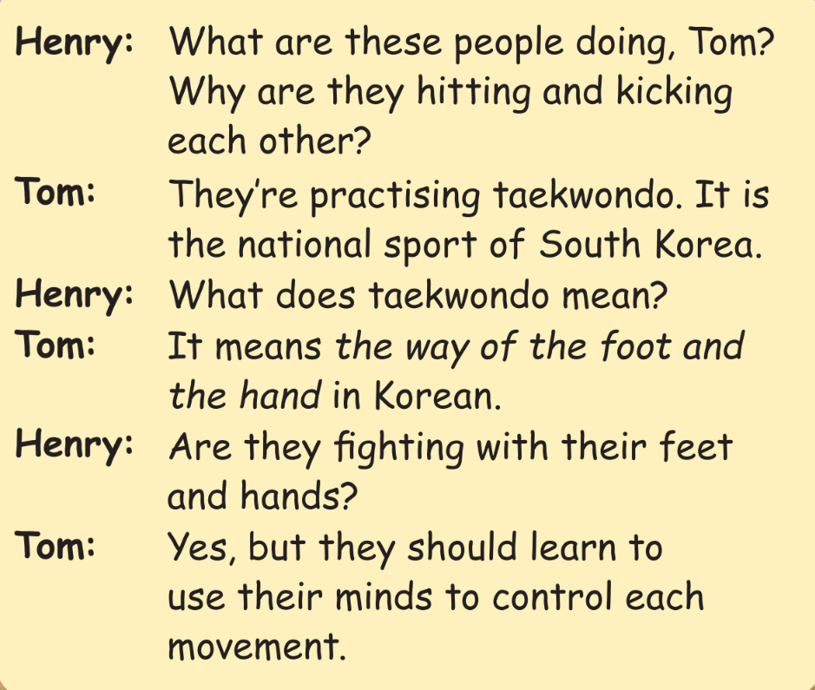

Slide 11
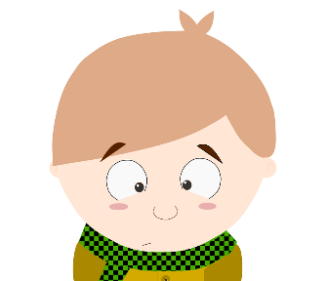
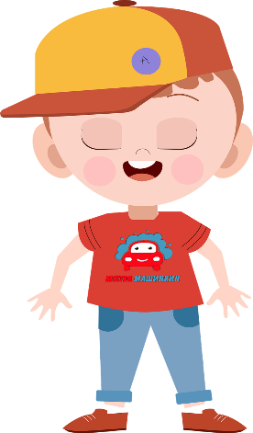
What are these people doing, Tom? Why are they hitting and kicking each other?
They’re practising taekwondo. It is the national sport of South Korea.
It means the way of the foot and the hand in Korean.
What does taekwondo mean?
Yes, but they should learn to use their minds to control each movement.
Are they fighting with their feet and hands?

Slide 12


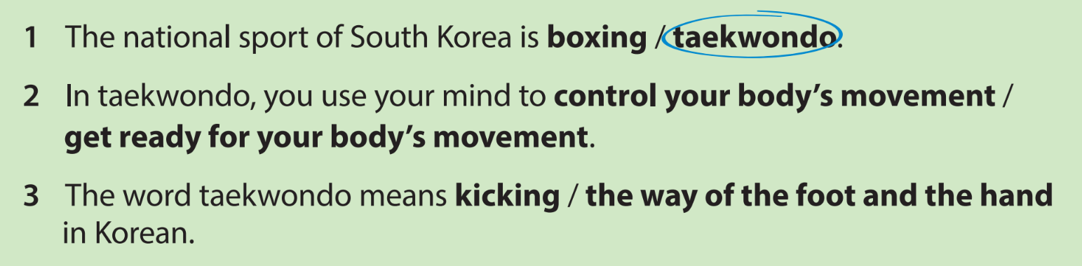
Circle the correct words
What are these people doing, Tom? Why are they hitting and kicking each other?
They’re practising taekwondo. It is the national sport of South Korea.
It means the way of the foot and the hand in Korean.
What does taekwondo mean?
Yes, but they should learn to use their minds to control each movement.
Are they fighting with their feet and hands?

Slide 13


control
/kənˈtrəʊl/

Slide 14
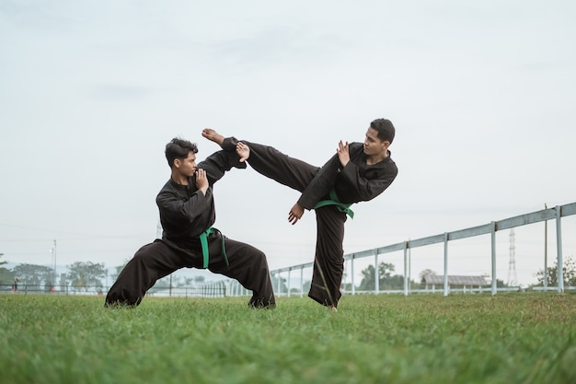
fight
/faɪt/

Slide 15
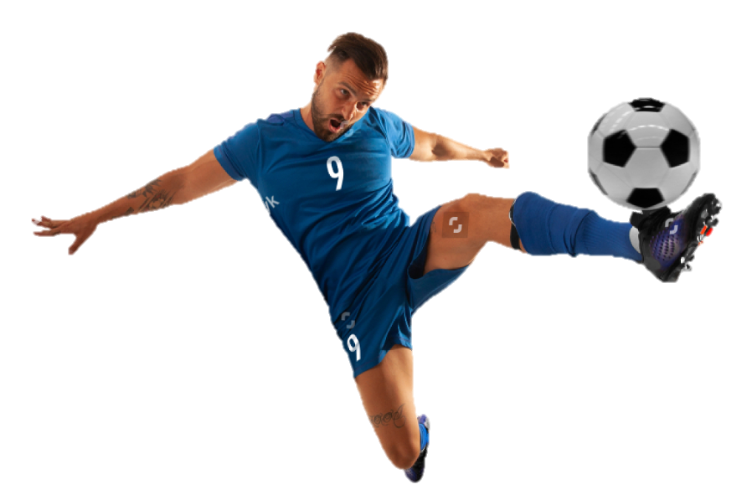
kick
/kɪk/

Slide 16

mind
/maɪnd/

Slide 17
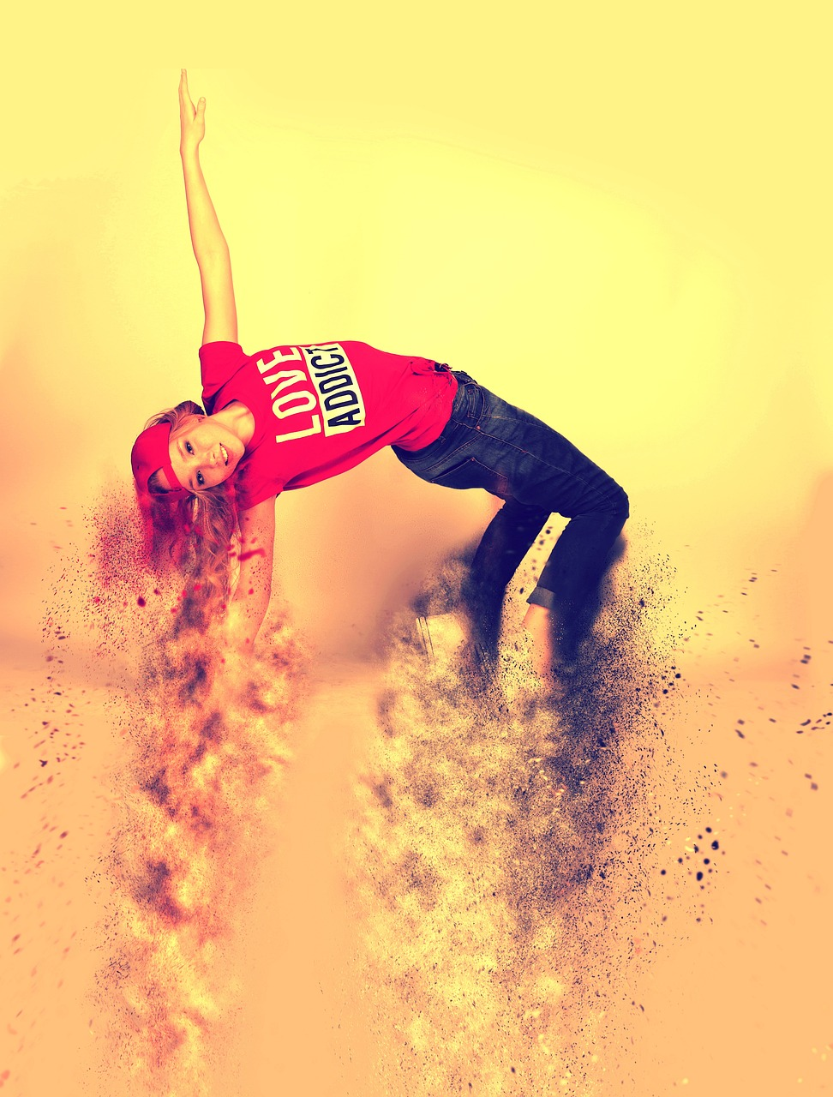
movement
/ˈmuːv.mənt/

Slide 18




Slide 19
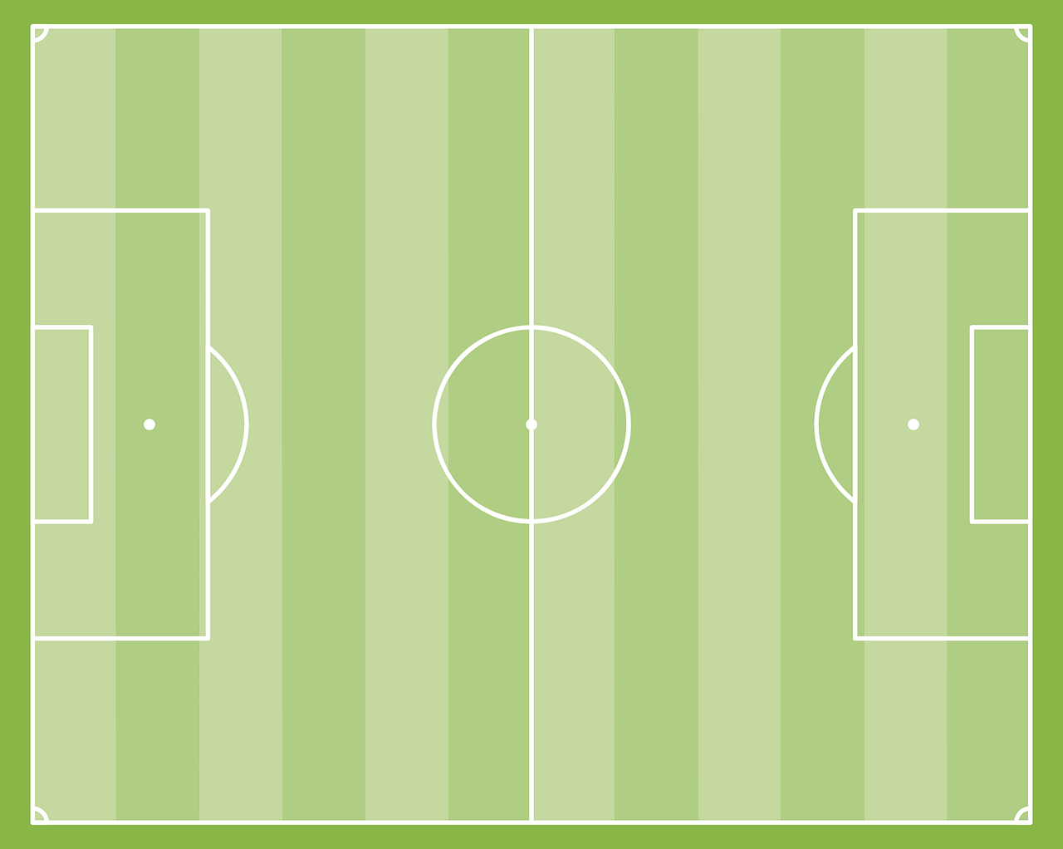
Look and say.
movement

Slide 20
Look and say.
mind

Slide 21
Look and say.
control

Slide 22
Look and say.
kick

Slide 23
Look and say.
mind

Slide 24
3
Practice

Slide 25

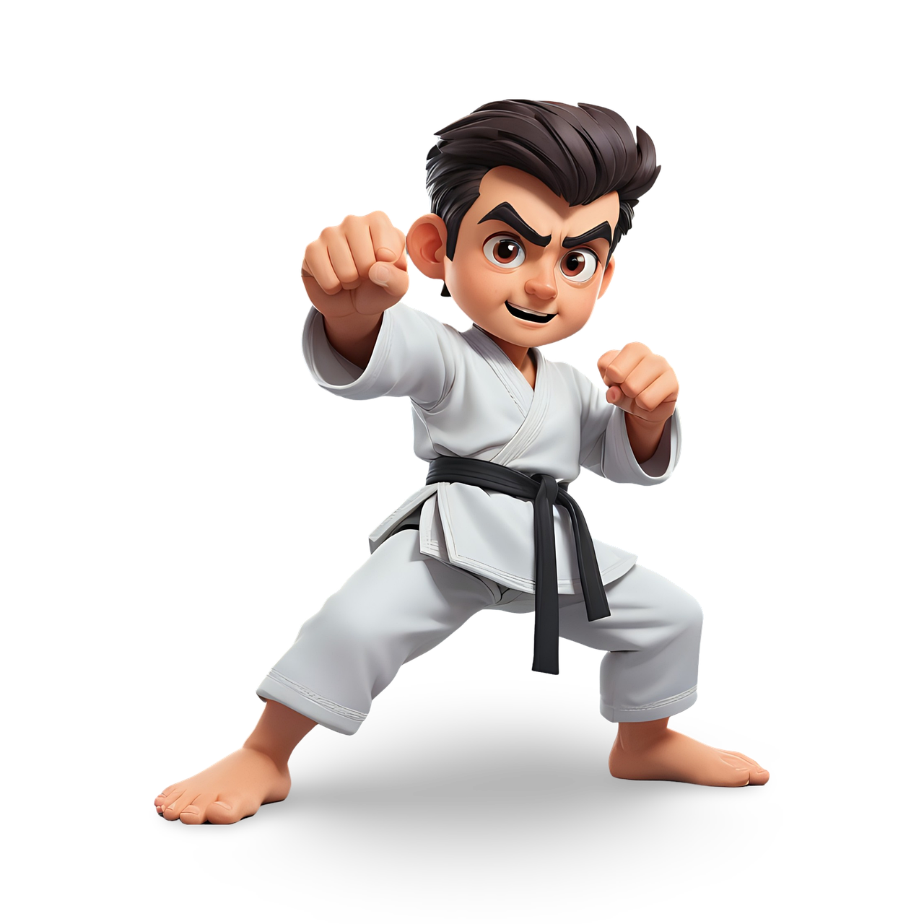
Quiz:
What do you know about Taekwondo?

Slide 26
What does ‘taekwondo’ mean?
a. The way of the foot and the hand in Korean.
b. The way of the feet and the arms in Korean.
c. The way of the foot and the hand in English.
d. The way of the feet and the arms in Korean.

Slide 27
2. Taekwondo is the national sport of …..
North Korea
b. South Korea
red
c. West Korea
d. East Korea

Slide 28
3. What is the highest belt rank in taekwondo?
red
b. dark red
red
c. brown
d. black

Slide 29
4. What is not a belt colour in taekwondo?
a. green
b. blue
c. pink
d. yellow

Slide 30
5. In taekwondo, you use your mind to….
control your body’s language
control your body’s movement
control your feet’s movement
control your competitor’s body’s movement

Slide 31
6. What is not one of the benefits of taekwondo?
It’s good for our health.
It helps us protect ourselves.
It helps us be more creative.
It helps us make more friends.

Slide 32
4
Production

Slide 33


Let’s make a mind map about Taekwondo!

Slide 34

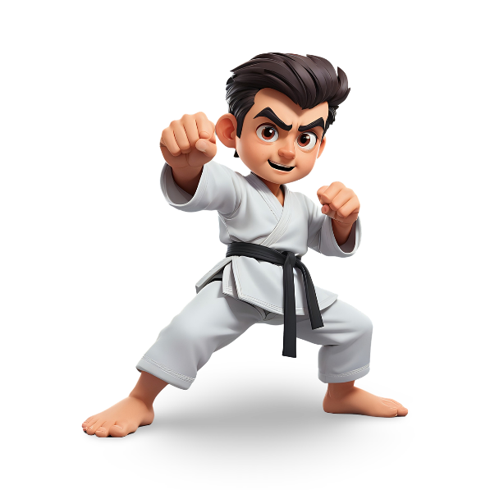


Comes from South Korean
National sport of South Korea
Good for health
Use the feet and the hands
Taekwondo
benefits
white
Use mind to control body’s movement
yellow
6 basic belt colours
Protect ourselves & others
green
blue
black
(strongest)
red

Slide 35
5
Wrap-up &
Assessment

Slide 36
Look and circle the words.
dradcontrolahdwllz
lkwasrufightas
askickawrdfg

Slide 37
Look and circle the words.
swminmindahdwllz
ovemtenmovementmov

Slide 38


Wrap-up
Unit 7: Sports
Lesson 2 – Part 1,2,3
What have we learnt today?
Vocabulary: control, mind, movement, kick, fight

Slide 39

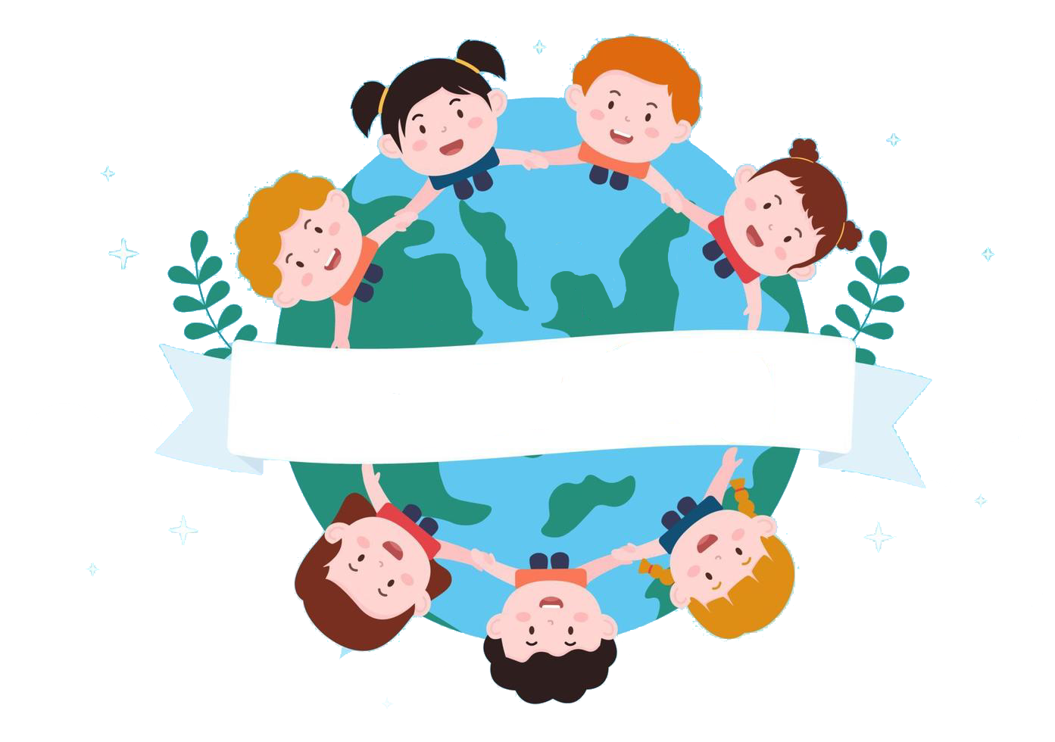
Thank you
& goodbye!

