Slide 1





















Notes:
Để nguyên trang bìa như này, chỉ thay đổi tên bài trong quá trình làm. Logo của sách Wonderful World

Slide 2



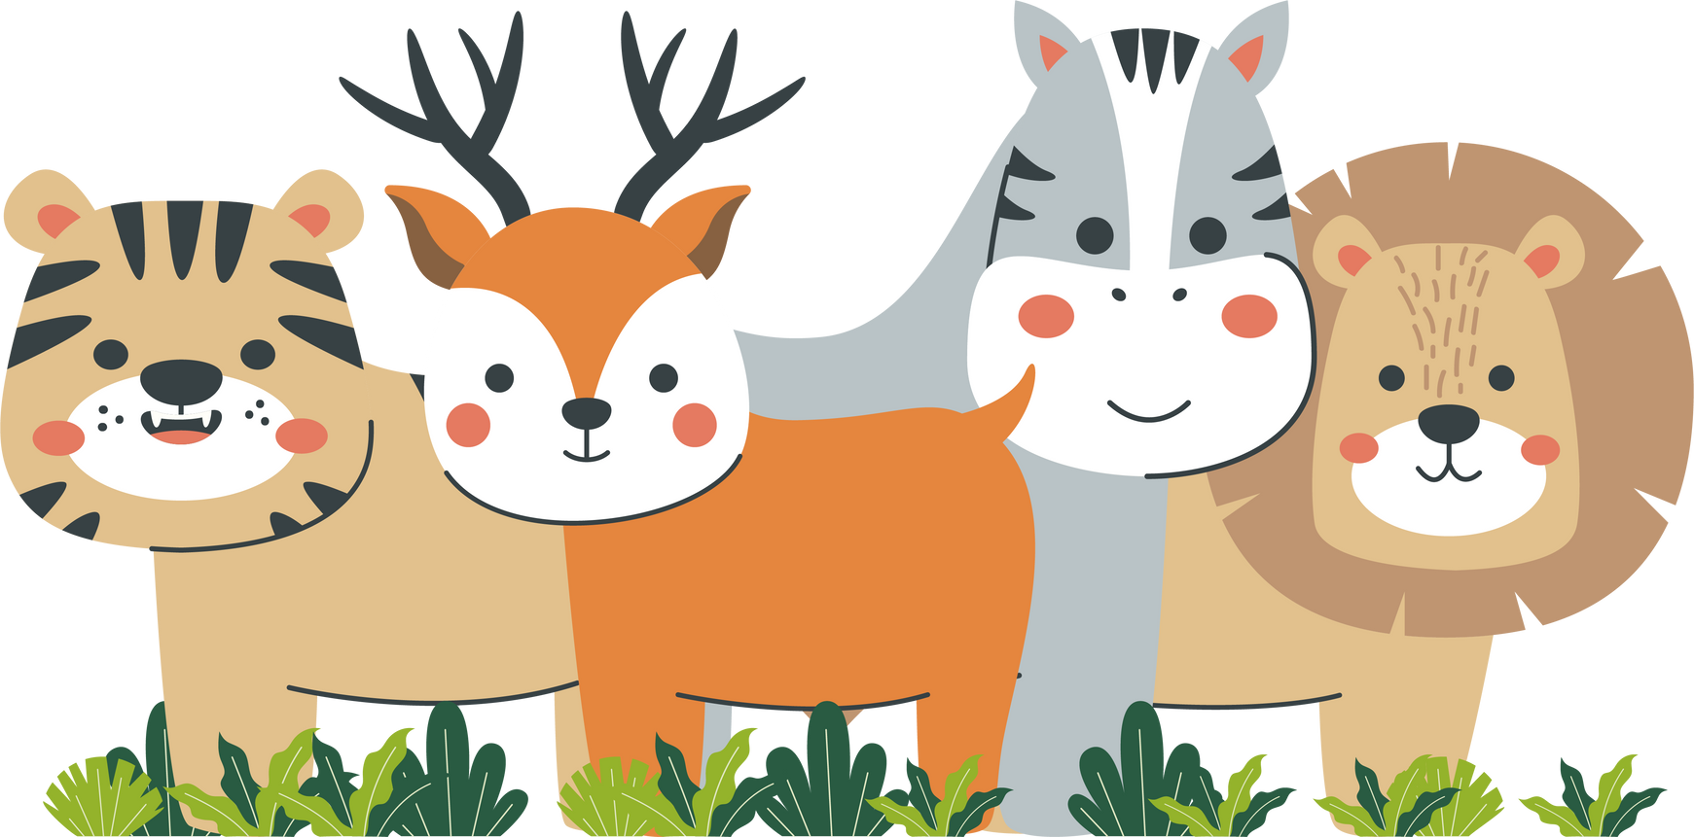




Unit 12
Fun time & project
Period 1

Slide 3



Review
will
- To talk about actions that we decide to do at the time of speaking.
- To talk about promises, hopes
E.g. I will clean my room tomorrow.
be going to
To talk about planned events in the near future
E.g. I am going to visit my aunt this Saturday.

Slide 4
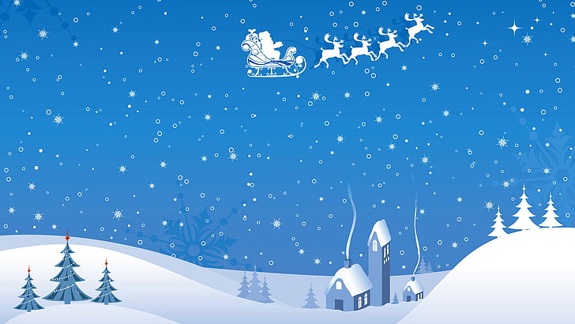


Back
Question 1
I haven't got my phone. That's OK. I _______ you mine.
a. will lend
b. am going to lend

Slide 5
Back
Question 2
It's Julia's birthday next week, so we ________ her some flowers.
a. are going to buy
b. will buy

Slide 6


Back
Question 3
Will you lend me £10? I promise
I ______ it back to you tomorrow.
a. will give
b. are going to give

Slide 7
Back
Question 4
We ______a barbecue tomorrow. It's all planned, so I hope it won't rain.
a. will have
b. are going to have

Slide 8
Back
Question 5
The sky is so black! It __________.
a. is going to rain
b. will rain

Slide 9
Back
Question 6
James is standing on the side of the pool. He _________in.
a. is going to jump
b. will jump

Slide 10
Back
Question 7
I think Barcelona _____the Champions League this year.
a. will win
b. is going to win

Slide 11
Back
Question 8
I’m sure Jane ______the present you’ve bought for her.
a. is going to like
b. will like

Slide 12
1. Find and write the weather words.
S | U | N | N | Y | O | D | C | B
N | C | U | A | I | F | P | L | O
O | L | A | R | D | O | C | O | F
W | K | S | A | O | G | W | U | N
Y | A | B | I | F | G | I | D | W
A | F | G | N | G | Y | S | Y | E
I | C | L | Y | S | N | O | R | A
W | I | N | D | Y | L | F | V | J
1. sunny
2. windy
3. snowy
4. rainy
5. foggy
6. cloudy

Slide 13

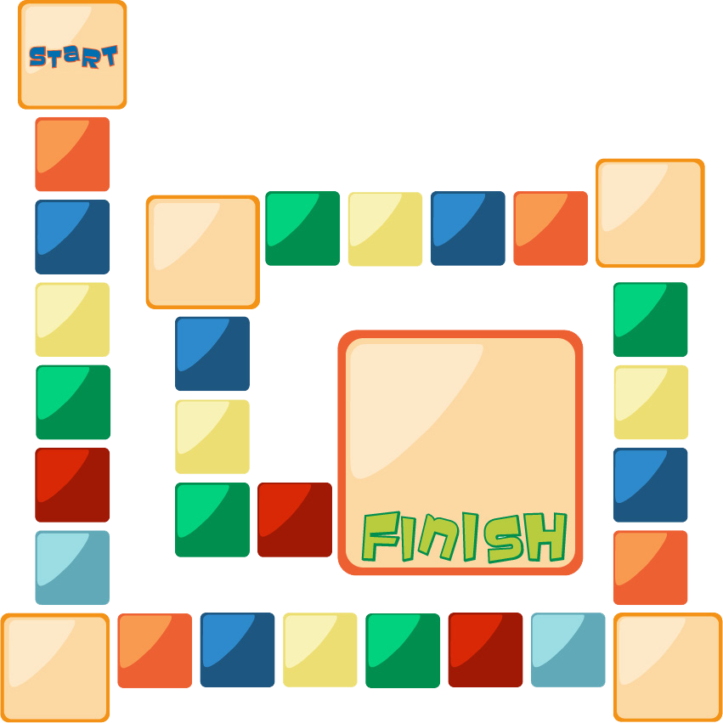



2. Board game
PAST SIMPLE
PLAY
STOP
have
Miss a turn
write
Oh no! Go back!
swim
leave
get
fly
ride
teach
catch
speak
run
eat
build
sleep
do
dream
go
make
Move ahead 2 spaces
drink
win
lie
pay
read
Go back 3 spaces
sit

Slide 14
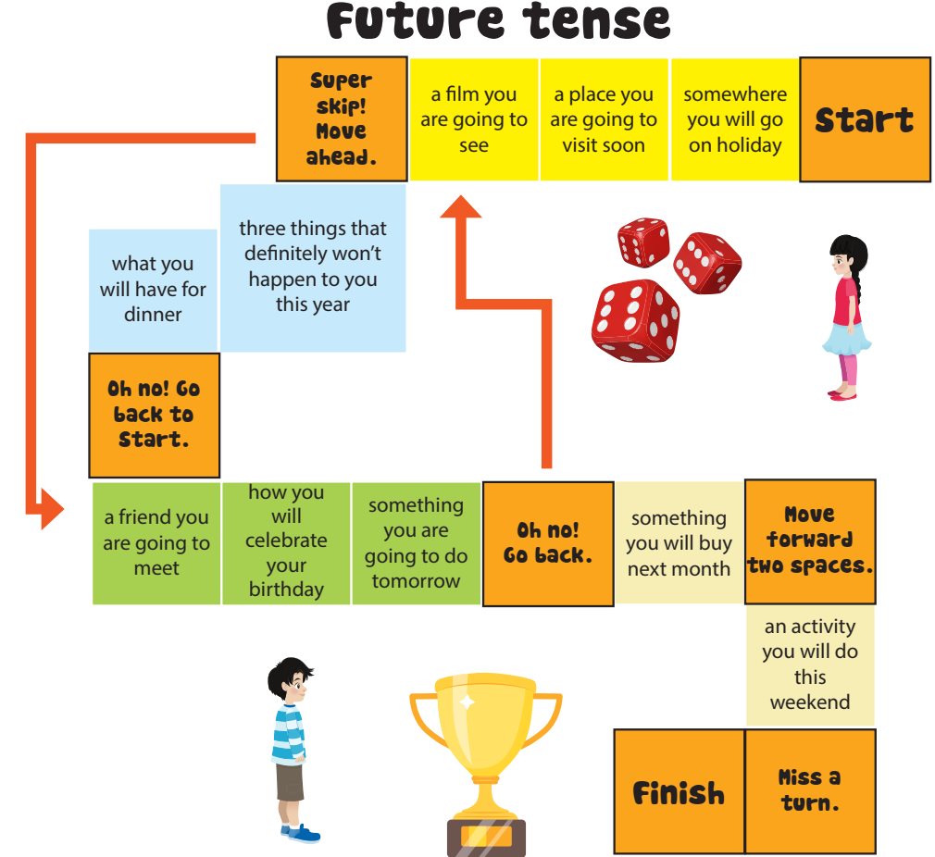
PLAY
STOP

Slide 15




Thank you & goodbye!

