Slide 1













Unit 10
PERFORMING ARTS
Lesson 2: Part 4-5-6

Slide 2









01
Warm-up
Greeting
My Pets

Slide 3

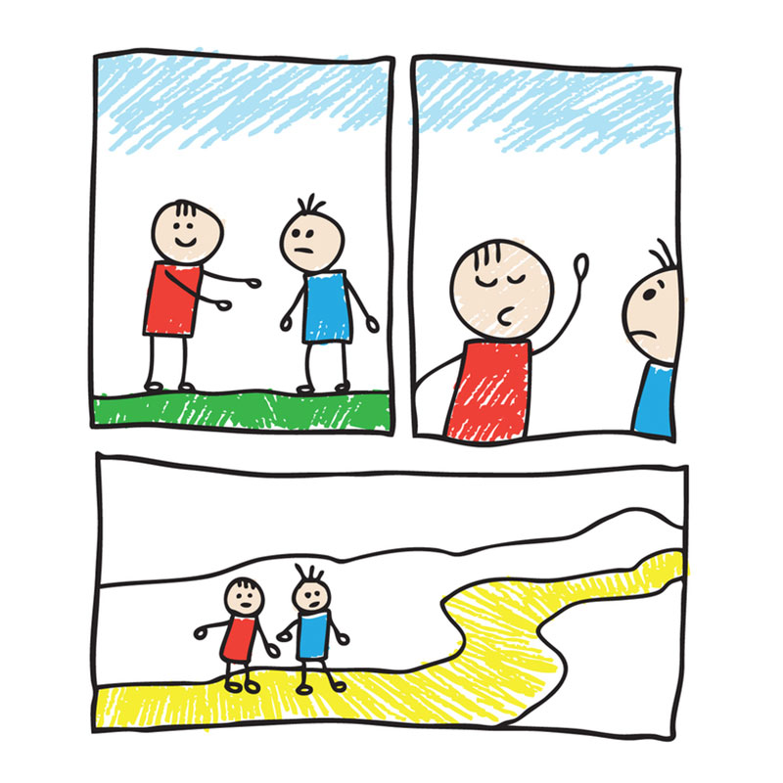
TIME’S UP
cartoon
WHEEL

Slide 4
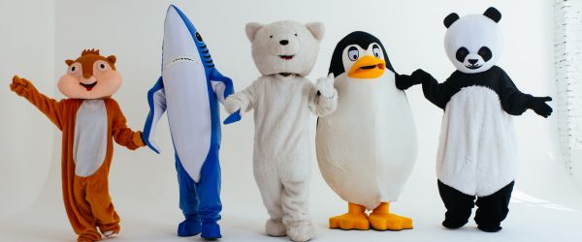
TIME’S UP
character
WHEEL

Slide 5
02
Presentation
Greeting
My Pets

Slide 6






4 Read and complete the text about Charlie Chaplin with the given words.
Then listen and check.
in 1889 in 1914 when he was 21 in 1977 at age five
Charlie Chaplin was a famous actor and film director. He was born in London(1) _______ . His famous character was a very funny man. He wore big trousers, big shoes and a black hat. He did crazy things on stage. He sang on stage (2) _________ because his mother was sick. (3) ___________ , he went to America and found a job at Keystone Film Company. He was in his first comedy (4) _______ . Charlie Chaplin made films for 65 years. His films were famous all over the world. He died (5) ______.
in 1889
at age five
when he was 21
in 1914
In 1977

Slide 7




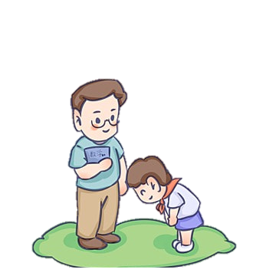

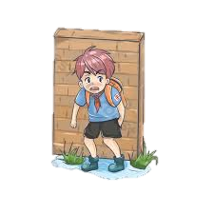



Wh-question: who/ what/ why/ when
who
what
Ex: Who was Charlie Chaplin?
Ex: What did she do yesterday?
/
asks about a person
asks about things or actions
why
where
Ex: Why did you play truant yesterday?
Ex: Where did you play football last weekend?
asks about the reason
asks about the places

Slide 8




$$Playing a game$$
Lucky star
Fill in the blank spaces using:
what/ who/ where/ when

Slide 9




4. ………… did he buy yesterday?
- He bought a car yesterday.
You are given 8 stars
What
GO HOME

Slide 10
8. ………… is Nancy reading?
- She is reading a newspaper.
You are given 7 stars
What
GO HOME

Slide 11
03
Practice
Greeting
My Pets

Slide 12



5 Read the text in Activity 4 again. Answer the questions below.
1 Who was Charlie Chaplin?
2 What did his famous character wear on his head?
3 Why did Charlie sing on stage at age five?
4 Where did he go when he was 21?
5 What did he do for 65 years?
He was a famous actor and film director.
He wore a black hat.
Because his mother was sick.
He went to America.
He made films for 65 years.

Slide 13
04
Production
Greeting
My Pets

Slide 14
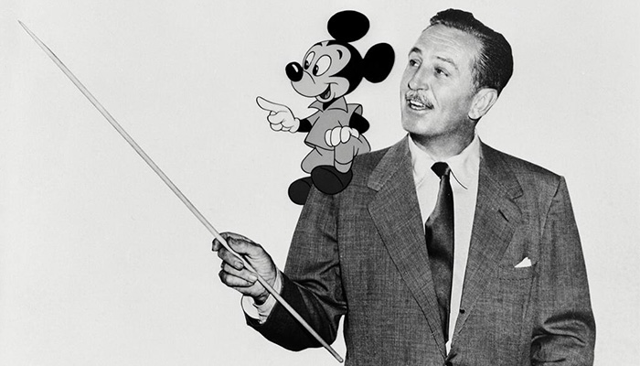
6 Let’s talk about Walt Disney. Use the prompts and your ideas.
1 Walt Disney / be / creative man
Walt Disney was creative man.
2 He / can / draw very well
He could draw very well.
3 He / go / to Hollywood and he / become / famous
He went to Hollywood and he became famous.
4 In 1923, he and his brother / found / the Walt Disney Company
In 1923, he and his brother founded the Walt Disney Company.

Slide 15
6 Let’s talk about Walt Disney. Use the prompts and your ideas.
5 In 1928, Walt Disney / create / the cartoon character, Mickey Mouse
In 1928, Walt Disney created the cartoon character, Mickey Mouse.
6 Mickey Mouse / become / famous around the world
Mickey Mouse became famous around the world.
7 1937 / he / make / first cartoon, Snow White and the Seven Dwarfs
In 1937, he made the first cartoon, Snow White and the Seven Dwarfs.
8 1955 / he / open / Disneyland in California
In 1955, he opened Disneyland in California.

Slide 16
05
Wrap-up & Assessment
Greeting
My Pets

Slide 17



Complete each question using: what/ who/ why/ where
What
1. _____ time did you wake-up?
2. _____ are you from?
Where
3. _____ was Charlie Chaplin?
Who
Why
4. _____ do you like the film?
Who
5. _____ are the main characters?
Where
6. _____ did you first meet?

Slide 18



Wrap-up
Unit 10: Performing arts Lesson 2 – Part 4-5-6
What have we learnt today?
Wh-question:
what/ who/ why/ where
What asks about things
Who asks about a person
Why asks about the reason
Where asks about the places

Slide 19



Thank You
for your attention

