Slide 1





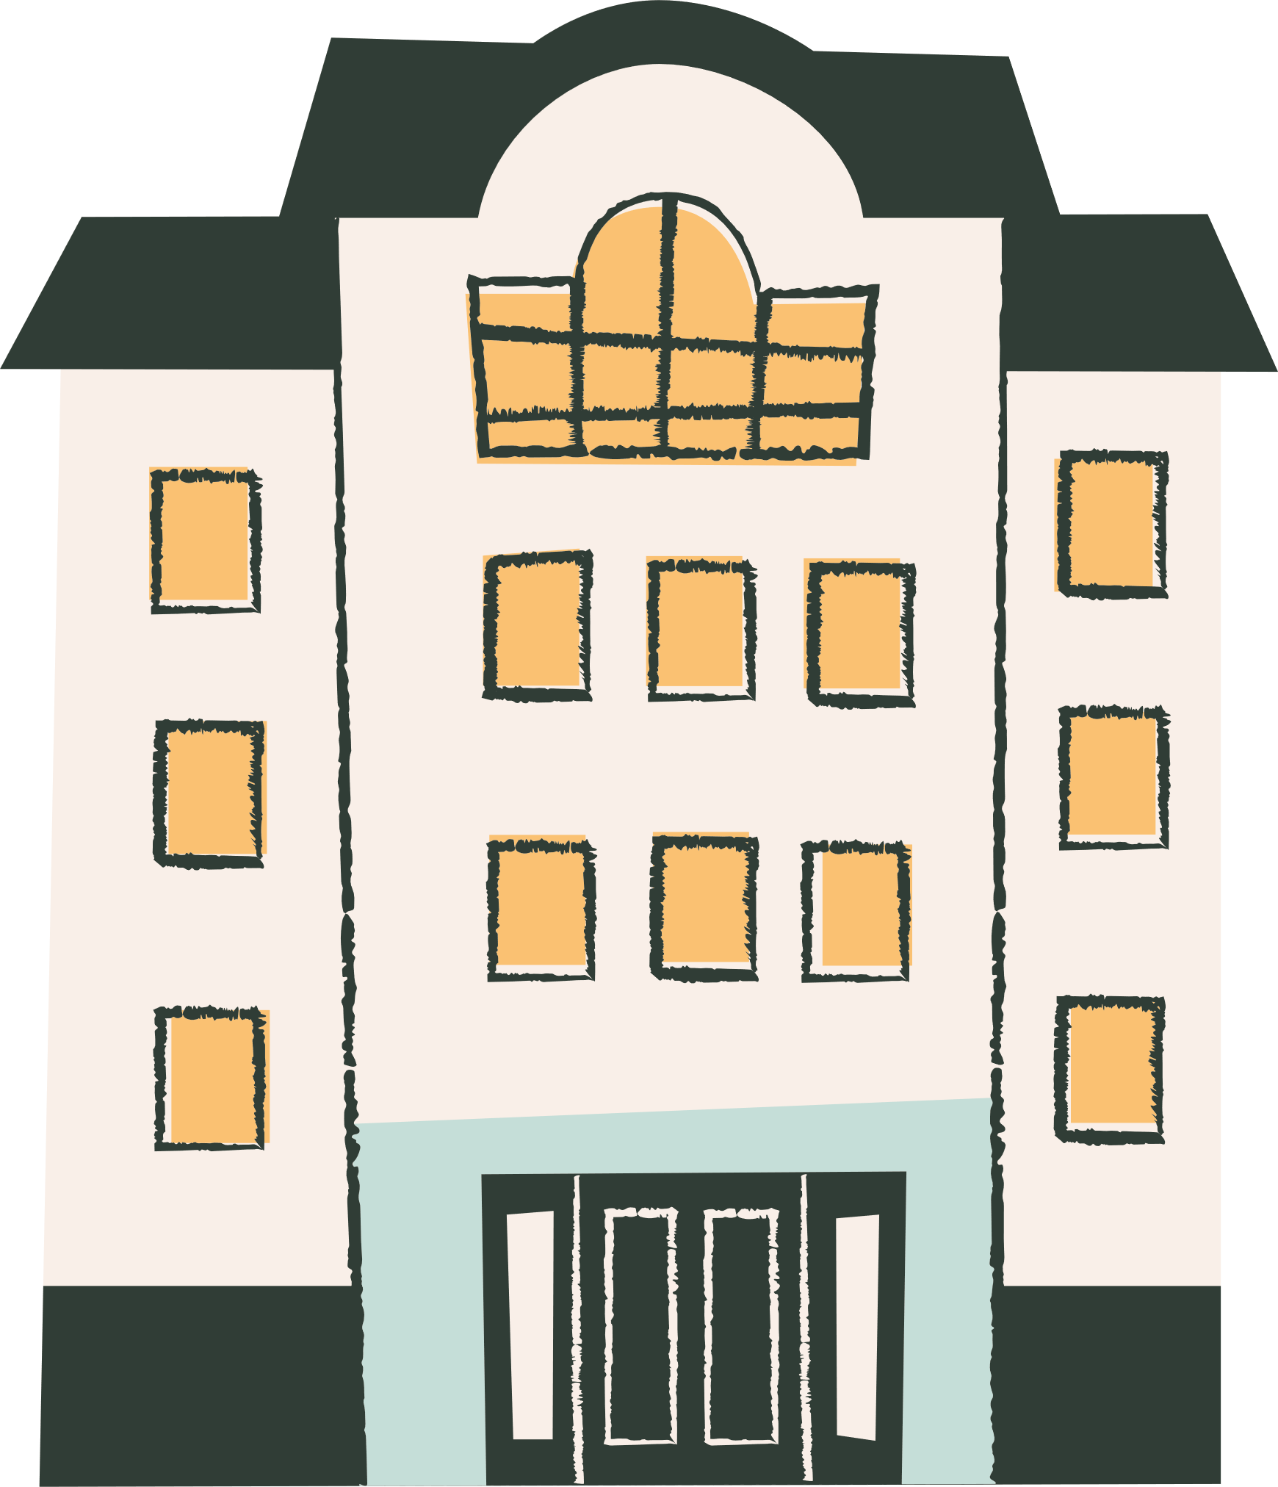
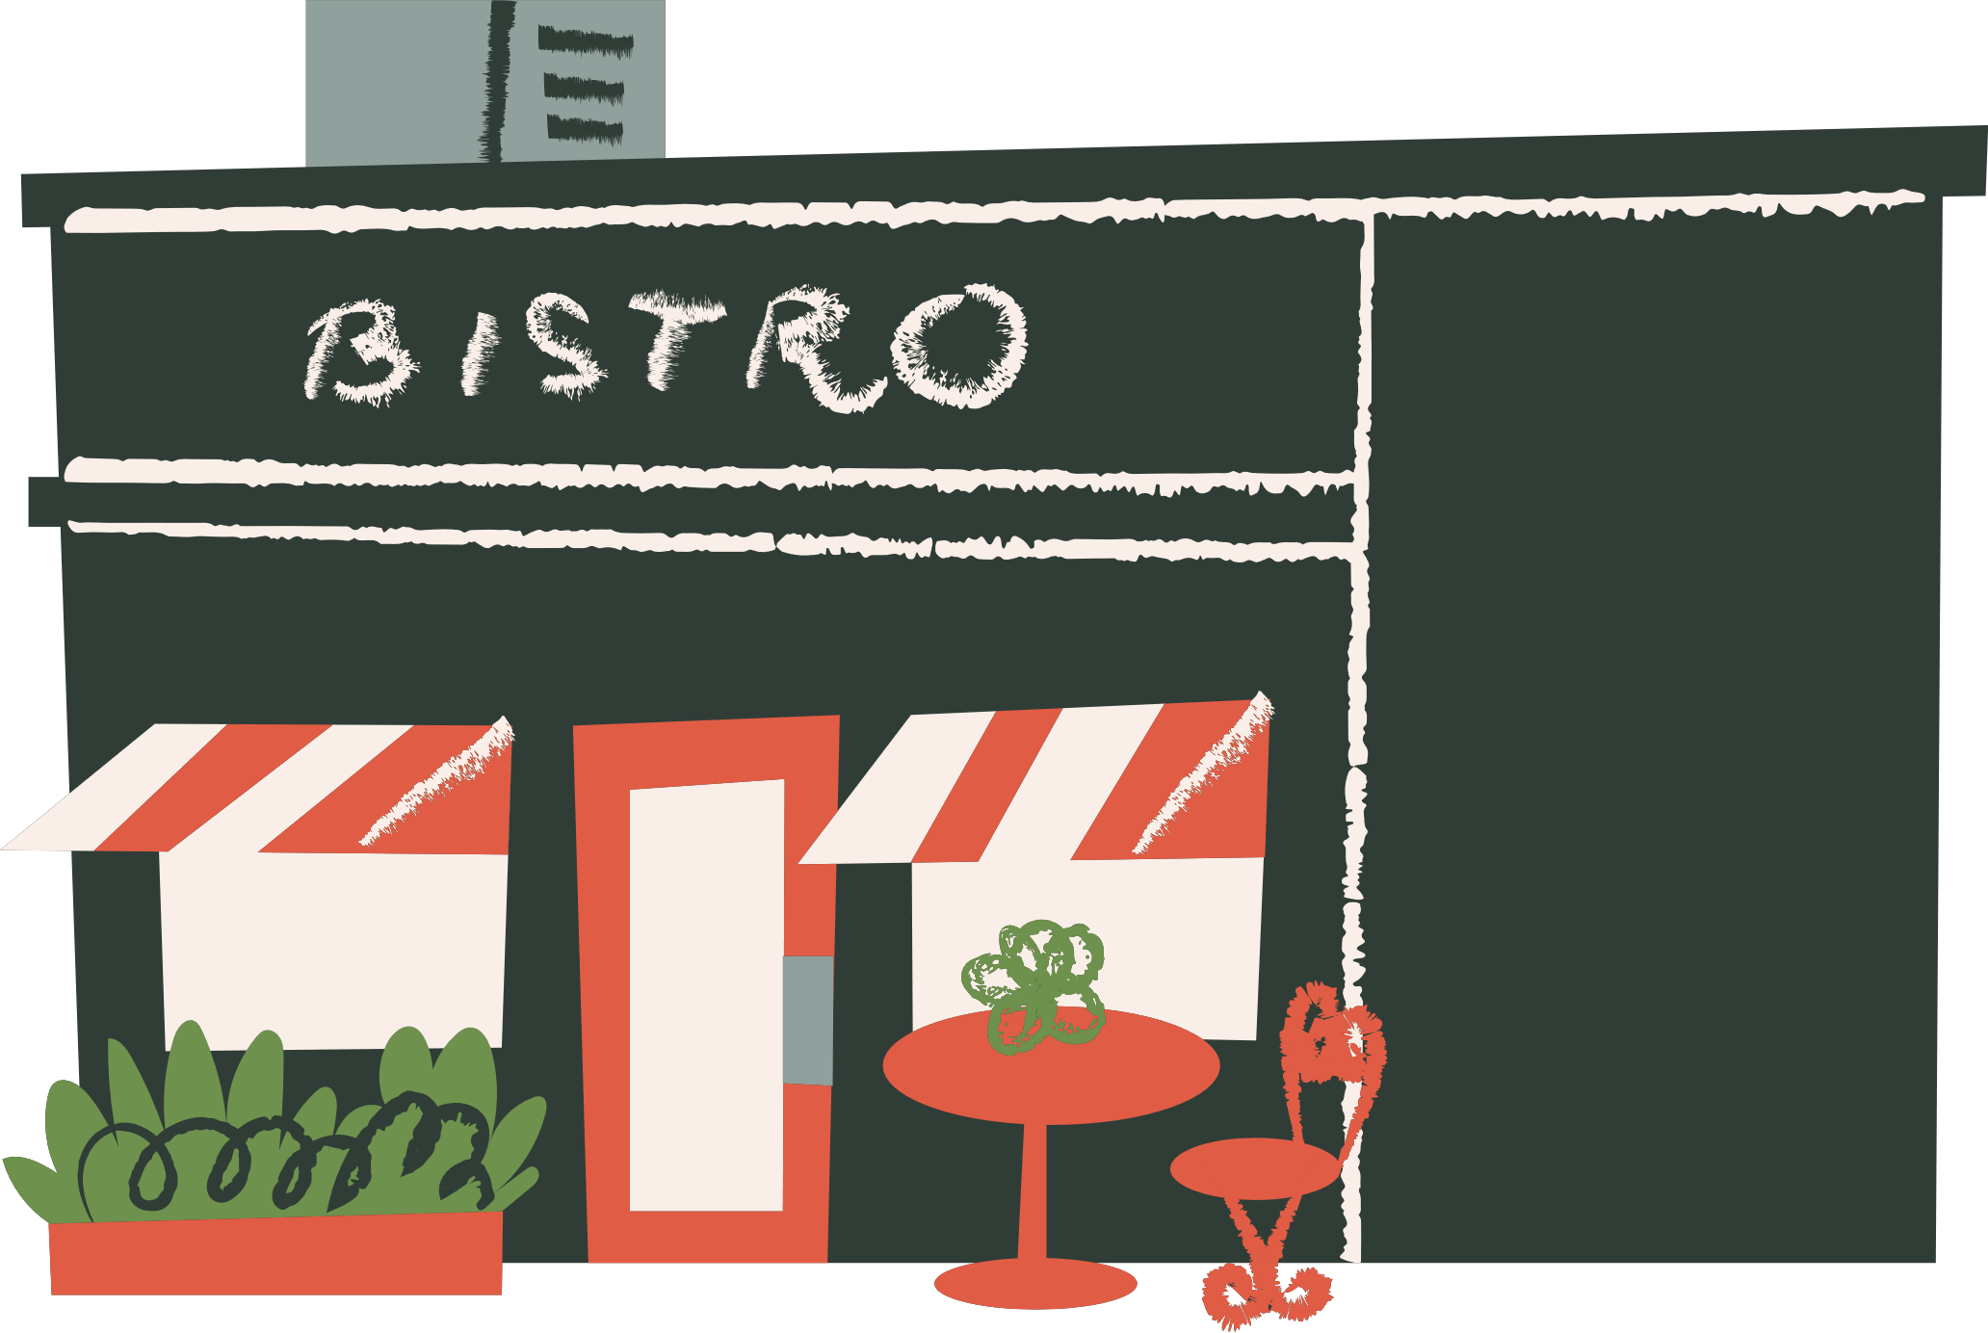


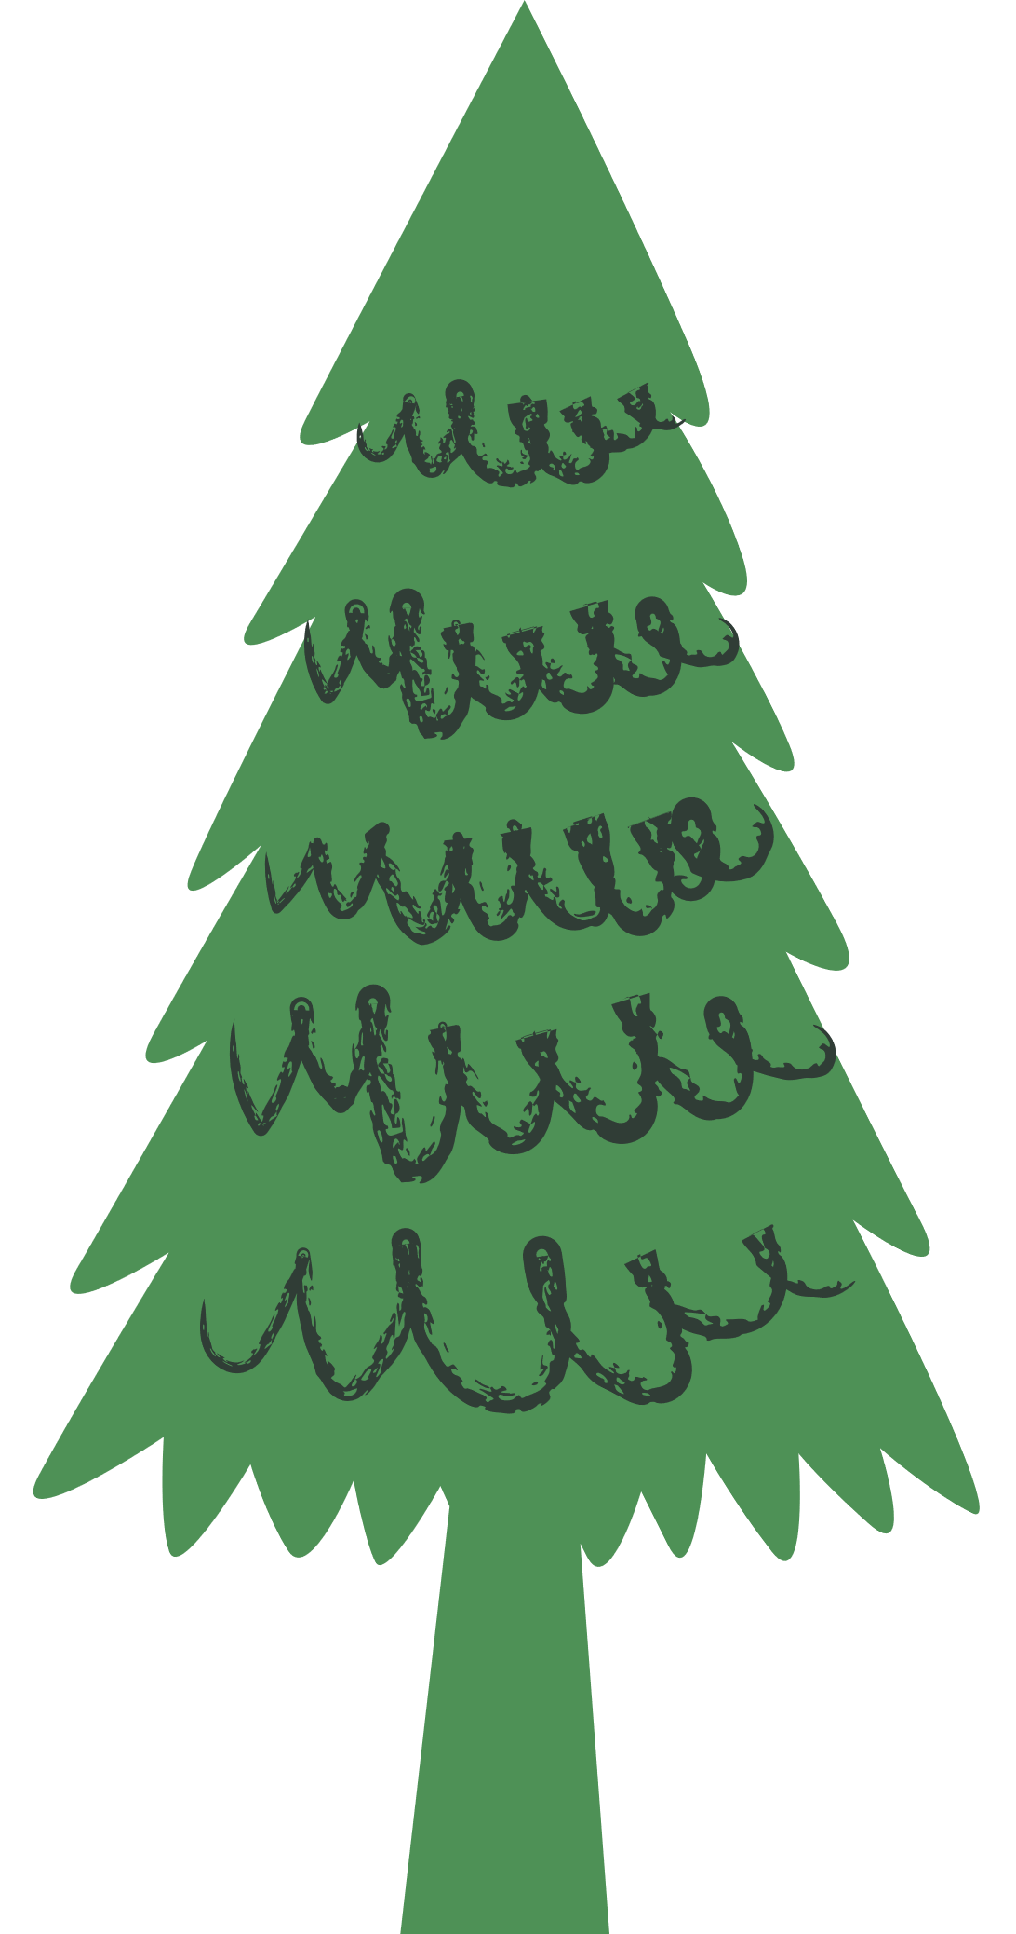

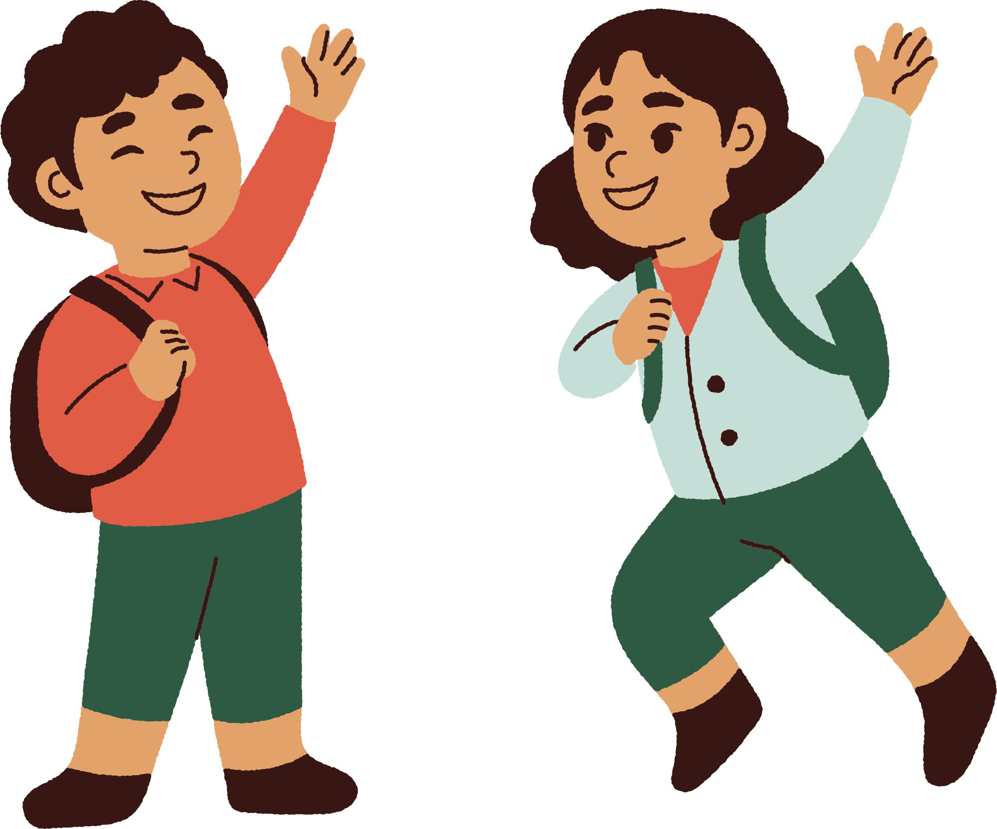




Unit 8
People and Places
LESSON 3
Activity 7, 8, 9

Slide 2



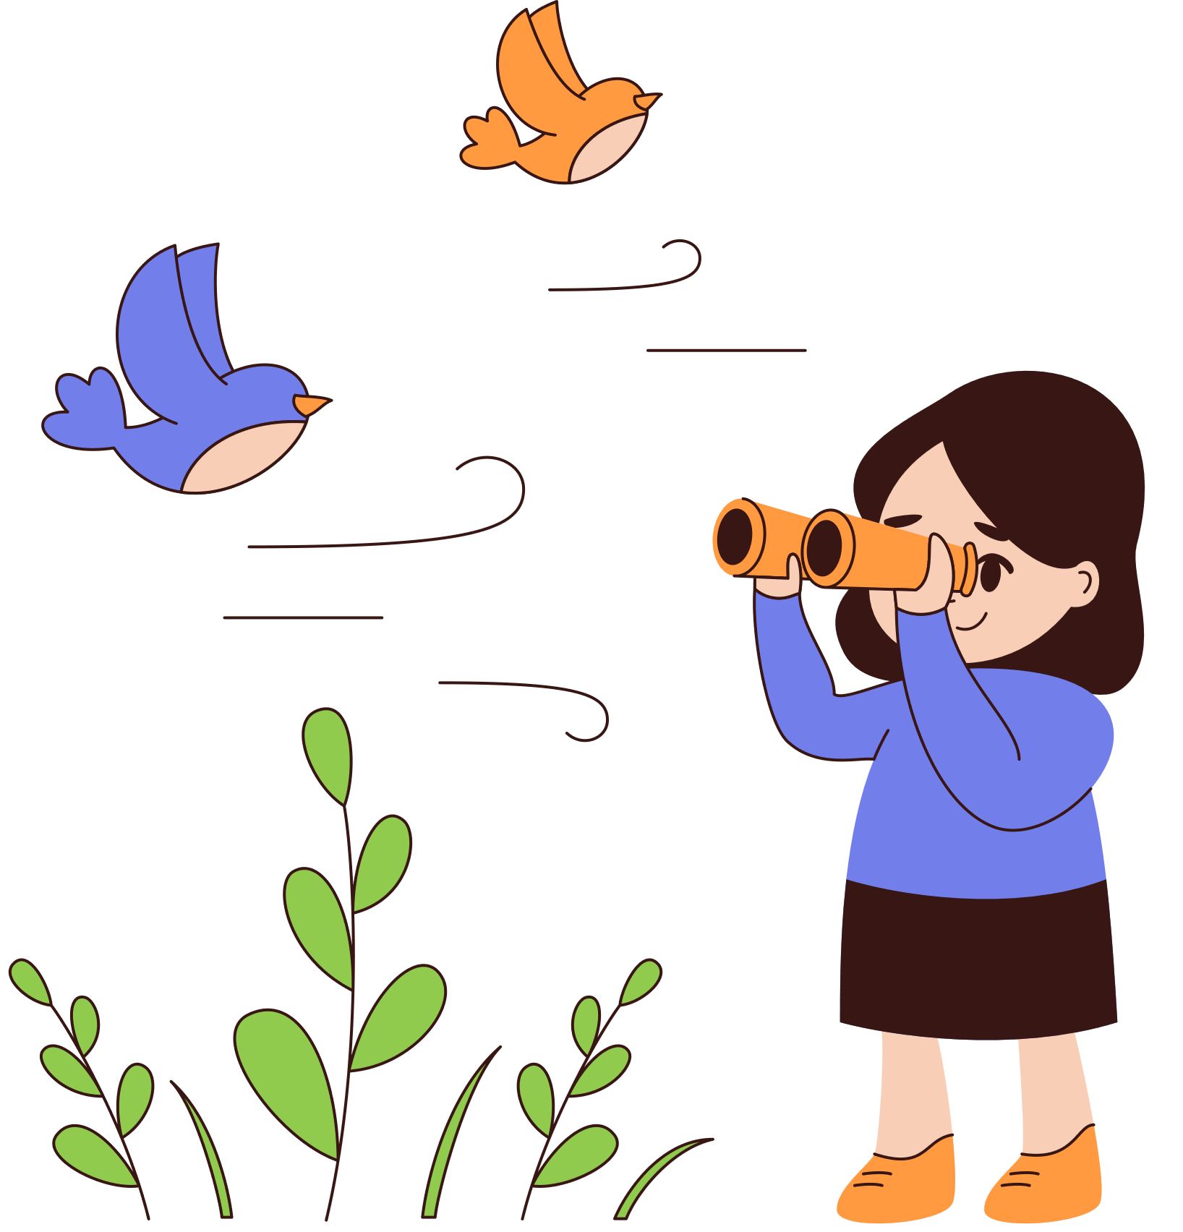

Clap the Rhythm!

Slide 3

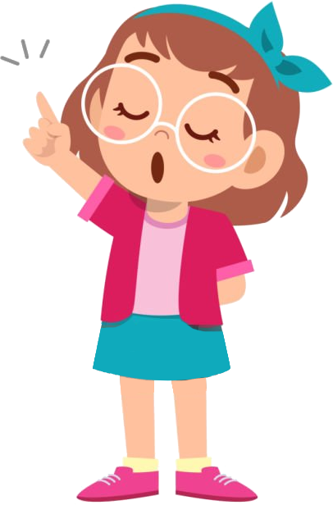
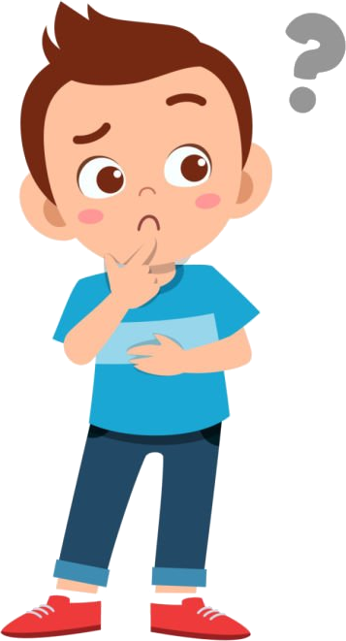
Sentence stress
Sentence stress is how we emphasize vocally particular words in our sentences.
1. What is sentence stress?
Sentence stress helps us indicate the words/phrases that are the most important, that we want listeners to pay attention to.
Example: He bought a red car for his daughter.
2. Why do we need sentence stress?

Slide 4
Sentence stress
Ex: Listen to the sentences below and identify the stressed words.
1. I asked you to buy me a bunch of red roses.
2. I asked you to buy me a bunch of red roses.
3. I asked you to buy me a bunch of red roses.
Notes:
Giáo viên giải thích, thường từ được nhấn trọng âm trong câu là Content words (nouns, adjectives, adverbs, and main verbs)

Slide 5
Sentence stress
Stressed words: Normally, we stress content words
- nouns: people, places, things - verbs: actions, states - adjectives: modify nouns - adverbs: modify verbs, adjectives, other adverbs or entire sentences - negative words: not, never, neither, etc. | - modals: should, could, might, etc. (but not will or can) - yes/no and auxiliary verbs in short answers: Yes, she does. - quantifiers: some, many, no, one, etc. - Wh-Question words): what, where, when, why, how, etc.

Slide 6
7 Listen and repeat.
1. We must wear our helmets.
2. You can have a snack in a café or go shopping.
3. It’s an apartment near the city centre.
4. It’s Saturday, so we can go to the shops.
5. It’s a house near a nice beach.
6. I go to the cinema on Fridays.
1. We must wear our helmets.
2. You can have a snack in a café or go shopping.
3. It’s an apartment near the city centre.
4. It’s Saturday, so we can go to the shops.
5. It’s a house near a nice beach.
6. I go to the cinema on Fridays.

Slide 7
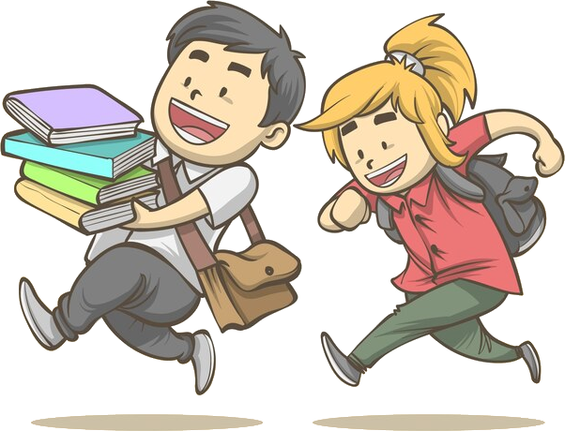

8 Read and underline the stressed words in the sentences.
Then listen and repeat.
1. It’s got a great view of the river.
2. It is a beautiful beach.
3. People also play music, dance and act in the streets.
4. There are many trees and a big lake.
5. We must go to school on time.

Slide 8


Julie went to the party on Saturday night by bus.
Julie went to the party on Saturday night by bike?
Julie went to the party on Saturday night by __________.
bus
NEXT

Slide 9
Underline the stressed word using the suggestion in the brackets.
1. I ran quickly to the desk. (emphasizes who is doing the running)
2. I ran quickly to the desk. (emphasizes what action is being done)
3. I ran quickly to the desk. (emphasizes the way in which you ran)
4. I ran quickly to the desk. (but emphasizes the direction in which you ran)
5. I ran quickly to the desk. (emphasizes the object or location to which you ran)

Slide 10





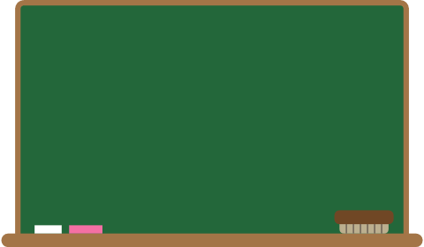

WRAP-UP
What have we learnt today ?
Sentence stress
Sentence stress is used to indicate words/phrases that are the most important or those that we want listeners to pay attention to.
Eg: He bought a red car for his daughter. (emphasis who is bought a red car for)

