Slide 1

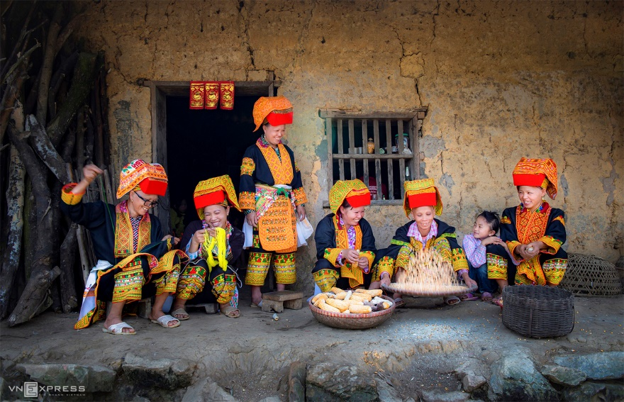
Unit
4
ETHNIC GROUPS OF VIET NAM
Unit
ETHNIC GROUPS OF VIET NAM
LESSON 6: SKILLS 2
LESSON 3: A CLOSER LOOK 2
Unit
HOBBIES

Slide 2


OBJECTIVES
By the end of the lesson, students will be able to:
- Use the lexical items related to the topic of the listening text.
- Develop the skill of listening for specific information.
- Write a paragraph about the things they do to help their family.

Slide 3
BRAINSTORMING
Look after the house
Clean the floor
What do you do to help your parents?
Collect the eggs
Cook meals
Feed the chicken

Slide 4
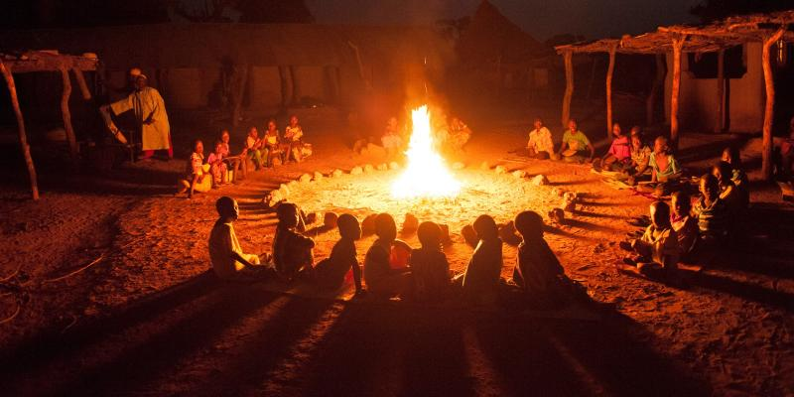
NEW WORDS
gather (v)
/ˈɡæðər/
tụ họp

Slide 5

NEW WORDS
pass on (v)
/pɑːs ɒn/
để lại,
truyền lại

Slide 6

NEW WORDS
legend (n)
/ˈledʒənd/
truyền thuyết

Slide 7
NEW WORDS
New words | Pronunciation | Meaning
1. gather (v) | /ˈɡæðər/ | tụ họp
2. pass on (v) | /pɑːs ɒn/ | để lại, truyền lại
3. legend (n) | /ˈledʒənd/ | truyền thuyết

Slide 8
VOCABULARY
New words |  | Meaning
1. gather (v)
2. pass on (v)
3. legend (n)
để lại
truyền thuyết
tụ họp

Slide 9
LISTENING
1
Match the phrases with the correct pictures.
1. catching fish
2. weaving clothing
3. growing crops
_______________
_______________
_______________

Slide 10


LISTENING
2
Listen and tick ( ) the activities that minority children do to help their families.
1. look after the house
2. weave clothing
3. prepare food
4. build houses
5. grow crops
6. raise livestock

Slide 11
LISTENING
3
Listen again and circle the correct answer A, B, or C.
1. Minority children usually learn to work at ______.
A. twelve B. ten C. six
2. Girls ______.
A. weave clothing
B. do the gardening
C. catch fish
3. Boys ______.
A. prepare food
B. raise livestock
C. do housework
4. Children learn traditions through _____
A. work B. music C. stories
5. The number of minority children going to school is ______.
A. going up
B. going down
C. staying the same

Slide 12
WRITING
4
Note five things you do to help your family.
Example: - cook meals

Slide 13
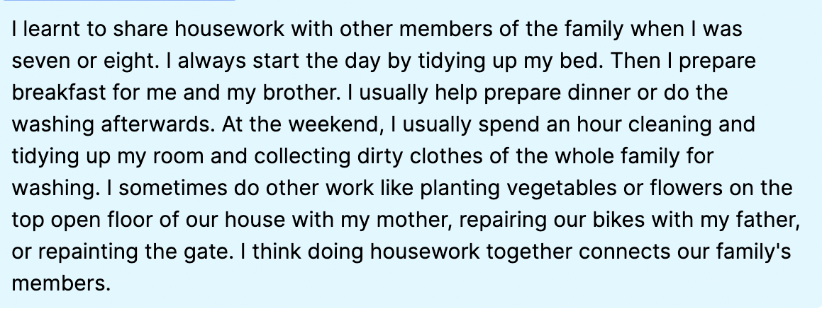
WRITING
5
Write a paragraph (80 - 100 words) about the things you do to help your family. Use the ideas in 4.

Slide 14

CONSOLIDATION
1
Wrap-up
In this lesson, you have:
learnt new words related the topic of the listening text.
understood more about ethnic children through listening tasks.
written a paragraph about the things you do to help your family.

Slide 15

CONSOLIDATION
2
Homework
Learn by heart all the new words.
Do exercises Part E in the workbook.
Prepare for Lesson 7 – Looking back & project.

Slide 16

Website: hoclieu.vn
Fanpage: facebook.com/www.tienganhglobalsuccess.vn/

Slide 17
LESSON 6: SKILLS 2
WARM-UP
Chatting
Vocabulary
Task 1: Match the phrases with the correct pictures.
Task 2: Listen and tick the activities that minority children do to help their families.
Task 3: Listen again and circle the correct answer A, B, or C.
LISTENING
Task 4: Note five things you do to help your family.
Task 5: Write a paragraph about the things you do to help your family. Use the ideas in 4.
WRITING
CONSOLIDATION
Wrap-up
Homework

