Slide 1

Hello everyone !!!

Slide 2

WARM-UP
Brainstorm

Slide 3
WARM-UP
OPTION 1
Questions:
- What beauty spots/ landscapes/ natural wonders you know?
Brainstorm
-Have you ever heard of or read about the Dolomites?
The Dolomites are a mountain range in Italy. It was recognised as a UNESCO World Heritage Site in 2009 The Dolomites are a mountain range in Italy. It was recognised as a UNESCO World Heritage Site in 2009

Slide 4
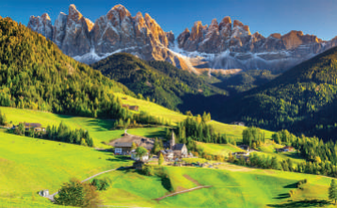
WARM-UP
Questions:
OPTION 2
1/ What do you see in the picture?
1
Beautiful nature
snow-covered mountain
forests, green grass
nice house at the foot of the mountain, …
2/ What activities do you think visitors can do there?
Cycling, walking, climbing mountains, skiing, trekking, taking pictures, camping, …

Slide 5

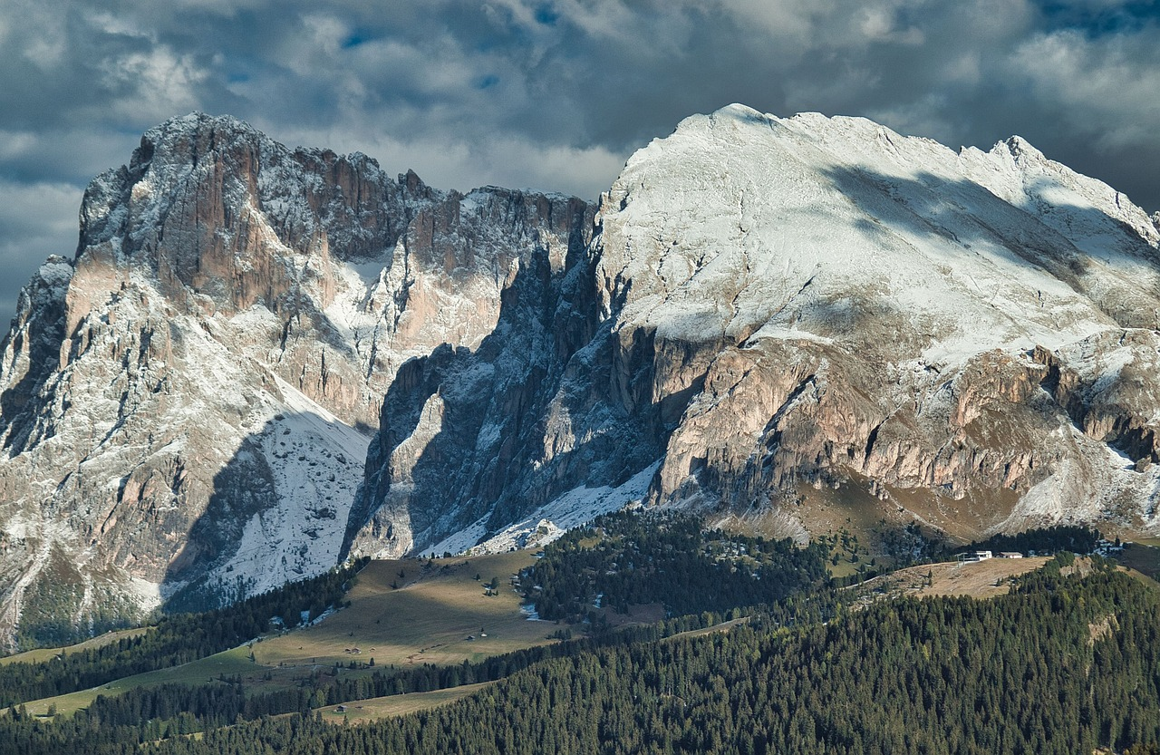



Unit
7
NATURAL WONDERS
LESSON 5: SKILLS 1

Slide 6

Unit
7
NATURAL WONDERS
LESSON 5: SKILLS 1

Slide 7


READING

Slide 8

* VOCABULARY
- majestic (adj)
beautiful, powerful
/məˈdʒestɪk/
Ex: The majestic Montana scenery will leave you breathless.
uy nghi, tráng lệ

Slide 9
* VOCABULARY
- occur (v)
happen (especially unexpected events)
/əˈkɜː/
xảy ra
Ex: I hope this never occurs again, but I'm prepared if it does.

Slide 10
* VOCABULARY
New words | Pronunciation | Meaning
1. majestic (adj) | /məˈdʒestɪk/ | uy nghi, tráng lệ
2. occur (v) | /əˈkɜː/ | xảy ra

Slide 11
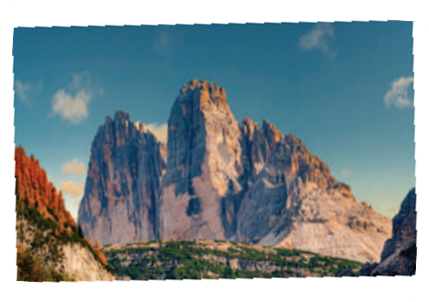
2
Read the text and match the highlighted words with their meanings or explanations.
The Dolomites – Paradise at Your Feet
The Dolomites – Paradise at Your Feet
If you haven’t decided on where to travel this holiday, consider the Dolomites!
The Dolomites are a mountain range in Italy. It was recognised as a UNESCO World Heritage Site in 2009. The Dolomites are part of the Alps, stretching from the Adige River to the Piave River valley. This mountain range has a total area of about 141,900 hectares. It has 18 peaks over 3,000 metres high. It is easy to get access to most parts of the Dolomites.
The Dolomites are a majestic site. They are widely regarded as being among the most attractive mountain landscapes in the world. There are steep rocky cliffs, sharp peaks, narrow and deep valleys, and white snow on the mountain top. Their natural scenery attracts tourists from many parts of the world.

Slide 12

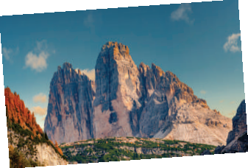
The Dolomites – Paradise at Your Feet
If you haven’t decided on where to travel this holiday, consider the Dolomites!
The Dolomites are a mountain range in Italy. It was recognised as a UNESCO World Heritage Site in 2009. The Dolomites are part of the Alps, stretching from the Adige River to the Piave River valley. This mountain range has a total area of about 141,900 hectares. It has 18 peaks over 3,000 metres high. It is easy to get access to most parts of the Dolomites.
The Dolomites are a majestic site. They are widely regarded as being among the most attractive mountain landscapes in the world. There are steep rocky cliffs, sharp peaks, narrow and deep valleys, and white snow on the mountain top. Their natural scenery attracts tourists from many parts of the world.
The Dolomites are a popular place for winter skiing, mountain climbing, hiking, and cycling any time of the year. An annual bicycle race covering seven mountain passes on the Dolomites occurs in the first week of July.So do not hesitate to book a tour to the Dolomites to see and do these things for yourself!
The Dolomites are a popular place for winter skiing, mountain climbing, hiking, and cycling any time of the year. An annual bicycle race covering seven mountain passes on the Dolomites occurs in the first week of July.So do not hesitate to book a tour to the Dolomites to see and do these things for yourself!

Slide 13
The Dolomites – Paradise at Your Feet
If you haven’t decided on where to travel this holiday, consider the Dolomites!
The Dolomites are a mountain range in Italy. It was recognised as a UNESCO World Heritage Site in 2009. The Dolomites are part of the Alps, stretching from the Adige River to the Piave River valley. This mountain range has a total area of about 141,900 hectares. It has 18 peaks over 3,000 metres high. It is easy to get access to most parts of the Dolomites.
The Dolomites are a majestic site. They are widely regarded as being among the most attractive mountain landscapes in the world. There are steep rocky cliffs, sharp peaks, narrow and deep valleys, and white snow on the mountain top. Their natural scenery attracts tourists from many parts of the world.
2
Read the text and match the highlighted words with their meanings or explanations.
Words | Meaning/Explanation
1. consider | a. impressive, magnificent | 1.
2. peaks | b. happens | 2.
3. majestic | c. to think about something carefully | 3.
4. occurs | d. pointed tops, mountains | 4.
c
d
a
b

Slide 14
3
Read the text again and choose the correct answer to each question.
According to the text, the Dolomites are a _______.
River B. work of art C. mountain range D. valley
2. The word "hesitate" in the last sentence of the text is closest in meaning to _______.
be unhappy B. be indecisive C. hurry D. decide
3. Which of the following is NOT true, according to the text?
The Dolomites are in Italy.
B. You can get access to the Dolomites easily
C. The Dolomites are a World Heritage Site.
D. You can cycle in the Dolomites only in July.
4. This text is probably taken from _______.
a travel brochure
a science journal
C. a novel
D. an arts magazine
Game

Slide 15
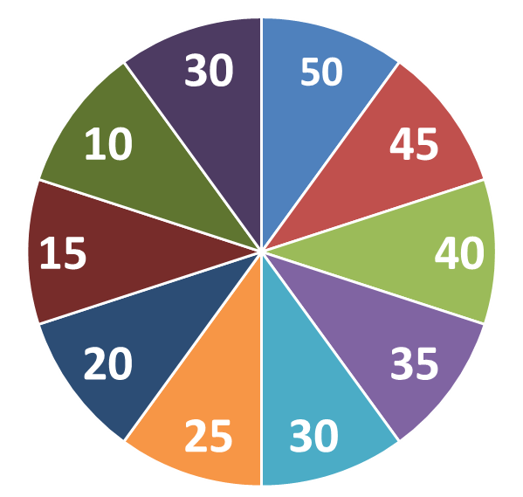

Spinning the number
Work in 2 groups
QUESTIONS
1
3
2
4

Slide 16
3
Read the text again and choose the correct answer to each question.
1. According to the text, the Dolomites are a ______.
A. river
C. mountain range
B. work of art
D. valley

Slide 17
3
Read the text again and choose the correct answer to each question.
“do dự , lưỡng lự”
2. The word “hesitate” in the last sentence of the text is closest in meaning to ______.
A. be unhappy
C. hurry
B. be indecisive
D. decide
“ thiếu quyết đoán”

Slide 18
3
Read the text again and choose the correct answer to each question.
3. Which of the following is NOT true, according to the text?
A. The Dolomites are in Italy.
B. You can get access to the Dolomites easily.
C. The Dolomites are a World Heritage Site.
D. You can cycle in the Dolomites only in July.
The Dolomites are a popular place for winter skiing, mountain climbing, hiking, and cycling any time of the year.

Slide 19
3
Read the text again and choose the correct answer to each question.
4. This text is probably taken from ______.
A. a travel brochure
B. a science journal
C. a novel
D. an arts magazine

Slide 20
3
Read the text again and choose the correct answer to each question.
According to the text, the Dolomites are a _______.
River B. work of art C. mountain range D. valley
2. The word "hesitate" in the last sentence of the text is closest in meaning to _______.
be unhappy B. be indecisive C. hurry D. decide
3. Which of the following is NOT true, according to the text?
The Dolomites are in Italy.
B. You can get access to the Dolomites easily
C. The Dolomites are a World Heritage Site.
D. You can cycle in the Dolomites only in July.
4. This text is probably taken from _______.
a travel brochure
a science journal
C. a novel
D. an arts magazine

Slide 21


SPEAKING

Slide 22
World Heritage Site (1981)
4
Work in pairs. Ask and answer about the Great Barrier Reef, using the facts below. Then prepare a short talk about it.
Location: the Coral Sea, Australia
World Heritage Site (1981)
Examples:
A: When did the Great Barrier Reef become a World Heritage Site?
B: In 1981.
A: Where is it located?
B: In the Coral Sea, Australia.…
Total area: about 334,400 km2
Location: the Coral Sea, Australia
Total area: about 334,400 km2
Over 400 different types of corals
Over 400 different types of corals
Tourists’ activities: coral watching, sailing, scuba diving
Tourists’ activities: coral watching, sailing, scuba diving

Slide 23
World Heritage Site (1981)
4
Work in pairs. Ask and answer about the Great Barrier Reef, using the facts below. Then prepare a short talk about it.
Location: the Coral Sea, Australia
World Heritage Site (1981)
C: What is the total area of the Great Barrier Reef?
D: The total area of the Great Barrier Reef is approximately 334,400 square kilometers.
C: How many different types of corals are found in the Great Barrier Reef?
D: Over 400 different types of corals are found within the Great Barrier Reef ecosystem.
Total area: about 334,400 km2
Location: the Coral Sea, Australia
Total area: about 334,400 km2
Over 400 different types of corals
Over 400 different types of corals
Tourists’ activities: coral watching, sailing, scuba diving
Tourists’ activities: coral watching, sailing, scuba diving

Slide 24
4
Work in pairs. Ask and answer about the Great Barrier Reef, using the facts below. Then prepare a short talk about it.
World Heritage Site (1981)
C: What are some activities that tourists can engage in at the Great Barrier Reef?
D: Tourists visiting the Great Barrier Reef can enjoy activities such as coral watching, sailing, and scuba diving to explore its vibrant marine life and breathtaking underwater scenery.
Location: the Coral Sea, Australia
Total area: about 334,400 km2
Over 400 different types of corals
Tourists’ activities: coral watching, sailing, scuba diving

Slide 25

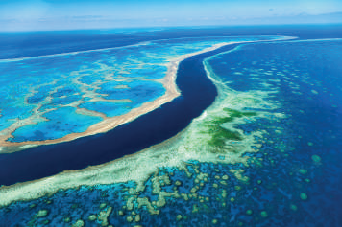

5
Work in groups. Introduce the Great Barrier Reef to the class.
- Work in groups to use the answers in Activity 4 and the vocabulary learnt in the unit to talk about the Great Barrier Reef

Slide 26
5
Work in groups. Introduce the Great Barrier Reef to the class.
Sample:
The Great Barrier Reef is a World Heritage Site. It was recognized by UNESCO in 1981. It’s located in the Coral Sea, Australia. The total area of this reef is about 334,400 km2. There are over 400 different types of corals living in the site. When you come here, you can take part in a lot of activities: coral watching, sailing, scuba diving, and so on. The Great Barrier Reef is the world's biggest single living structure. But this natural wonder is now in danger, and it needs much effort to protect it from damage.

Slide 27


CONSOLIDATION
What have we learnt in this lesson?
Read for general and specific information about the Dolomites - a travel destination;
Talk about the Great Barrier Reef;

Slide 28

Homework:
Do exercises in the workbook.
Prepair lesson 6- Skills 2

Slide 29




