Slide 1


ENGLISH 9
Hello everyone !!!

Slide 2


Slide 3

1. Ha Long Bay
2. Ba Be National Park
3. Hoang Lien Son
4. Ban Gioc Waterfall
5. Phu Quoc Island
6. Phong Nha-Ke Bang National Park
7. Marble Mountains
8. Mui Ne flying dunes
9. Dong Van Stone
10. Bai Sao
Those are the natural wonders
of Vietnam.
Do you know the natural wonders of the world?
Please name some natural wonders that you know

Slide 4
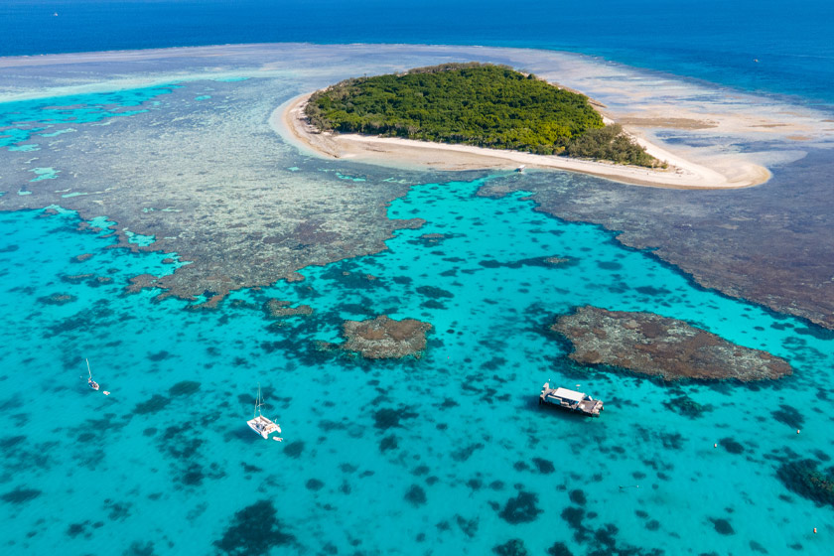
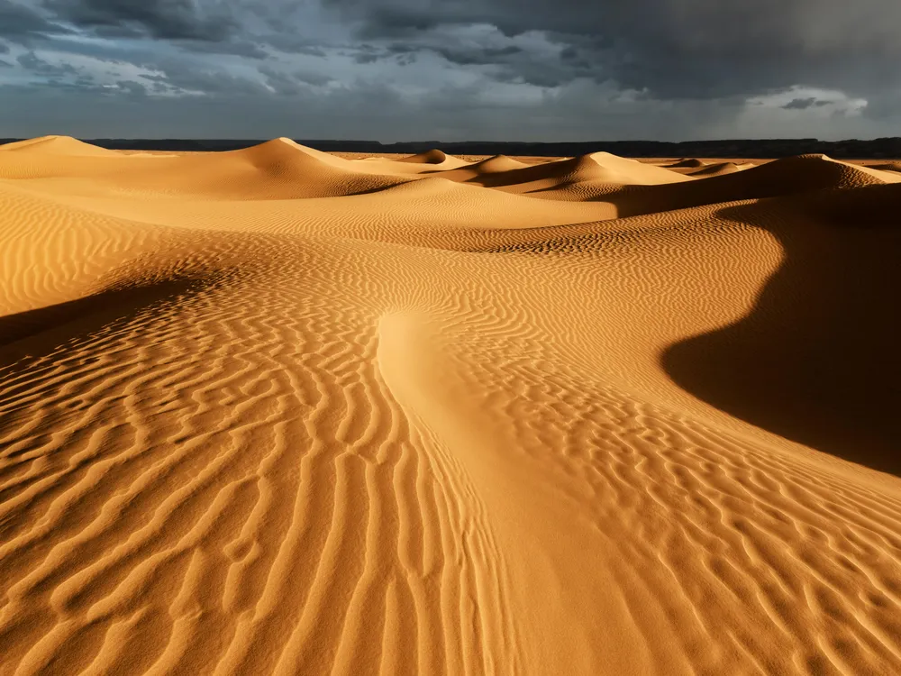
SAHARA DESERT

Slide 5
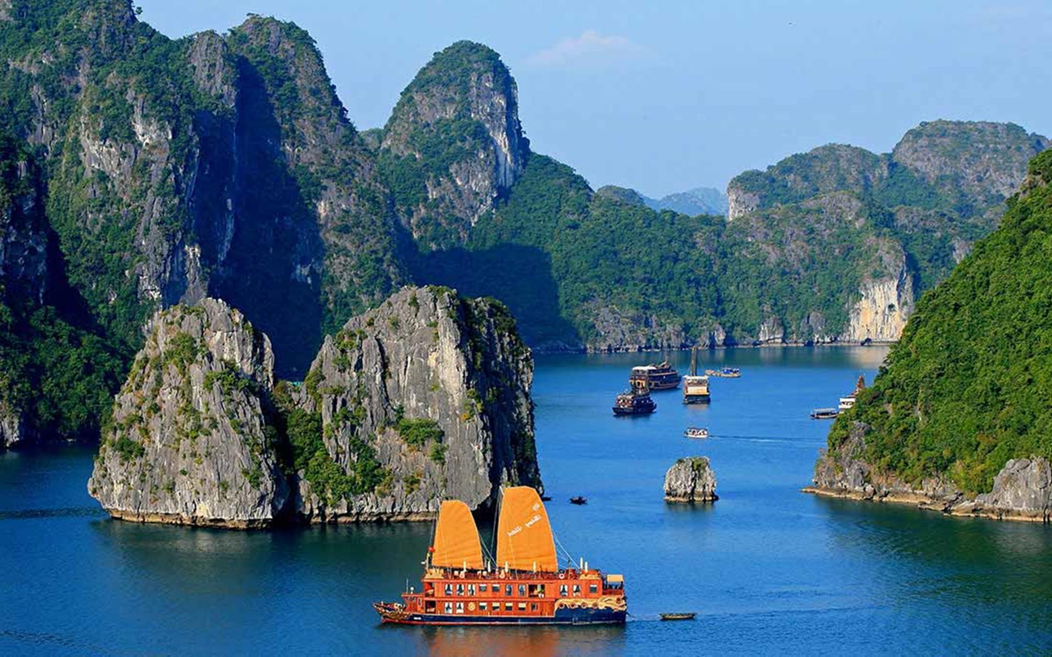
GREAT BARRIER
REEF

Slide 6
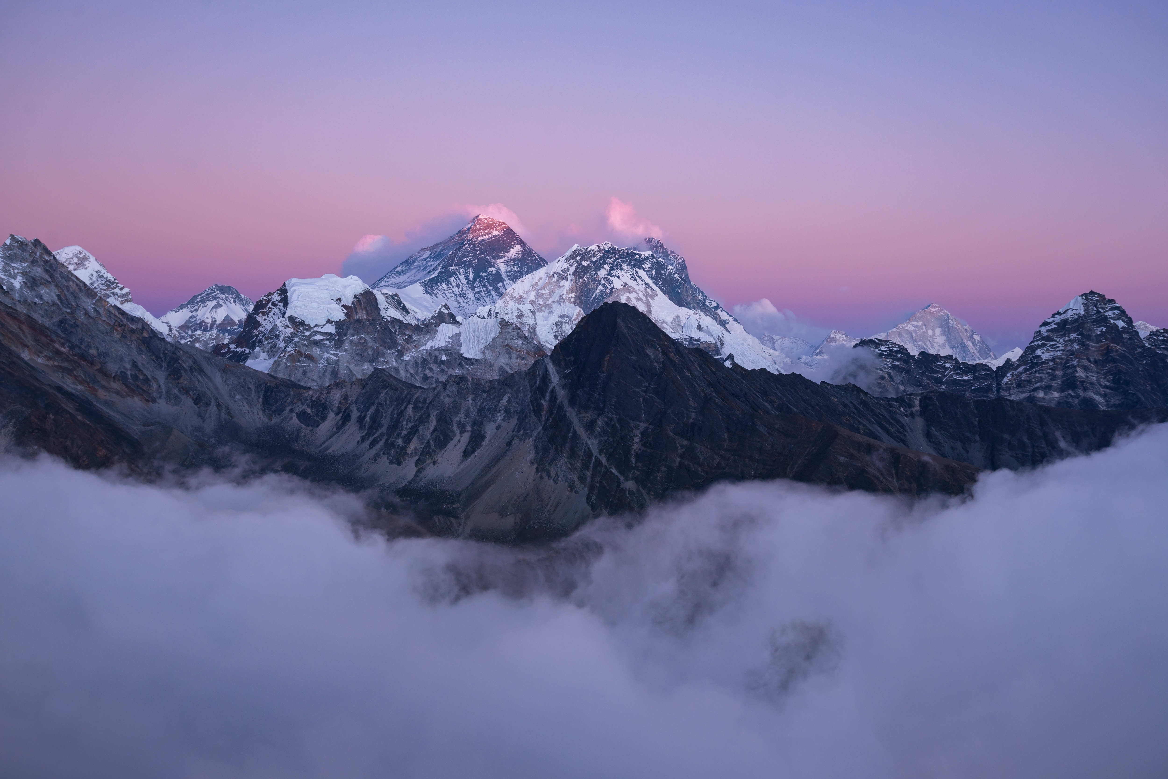


Unit
7
NATURAL WONDERS
LESSON 1: GETTING STARTED
Meeting on the corridor

Slide 7

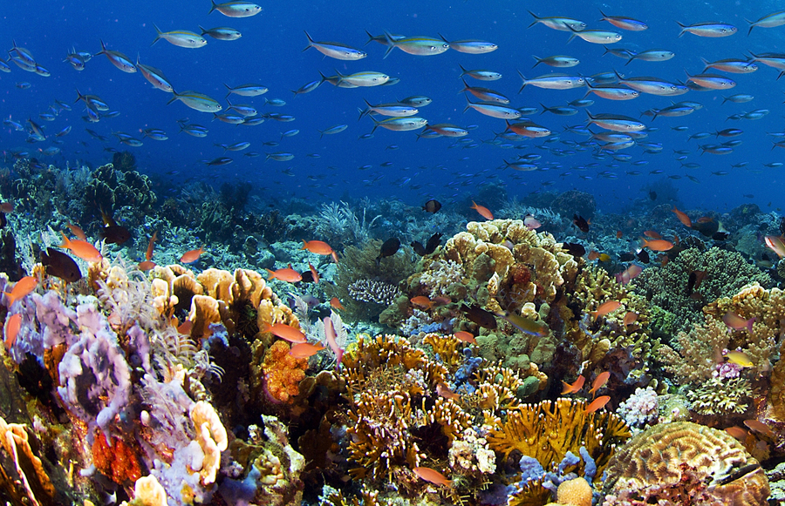
Vocabulary
-crazy (adj) about so/sth
like so/sth very much
/ˈkreɪzi/
Ex: I was crazy about baseball when I was seven.
thích mê

Slide 8
Vocabulary
- coral (n,adj)
/ˈkɒrəl/
san hô

Slide 9
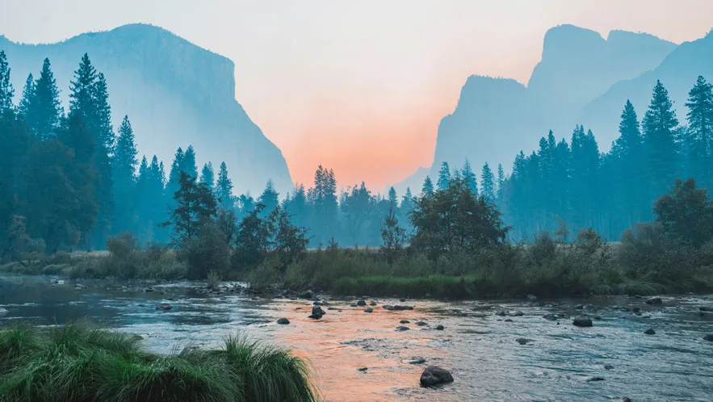
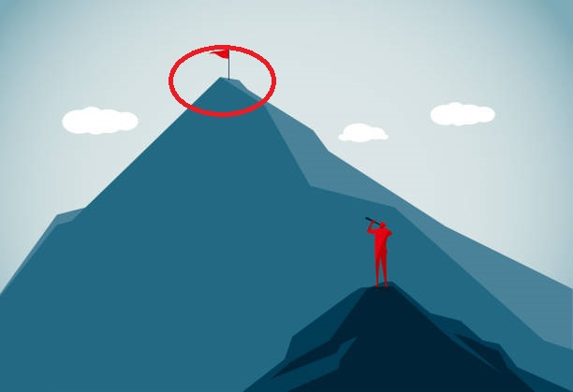
Vocabulary
a view or picture of the countryside, or the art of making such pictures.
landscape (n)
/ˈlænd.skeɪp/
phong cảnh

Slide 10
Vocabulary
the highest point
- peak (n)
/piːk/
đỉnh, đỉnh núi

Slide 11
Vocabulary
- charming (adj)
pleasant and attractive
/ˈtʃɑː.mɪŋ/
Đẹp, quyến rũ
Ex: What a charming street this is.

Slide 12

Vocabulary
able to be maintained or continued
sustainable (adj)
/səˈsteɪnəbl/
bền vững
To ensure sustainable tourism, measures are taken to limit the number of visitors to natural wonders.

Slide 13
Vocabulary
a place or position
- location (n)
/ləʊˈkeɪʃn/
địa điểm, nơi chốn

Slide 14
Vocabulary
- possess (v)
to have or own sth
/pəˈzes/
Our country possesses a rich variety of natural resources.
có, sở hữu

Slide 15
Vocabulary
New words | Pronunciation | Meaning
1. crazy (adj) about so/sth | /ˈkreɪzi/ | thích mê
2. coral (n,adj) | /ˈkɒrəl/ | san hô
3. landscape (n) | /ˈlænd.skeɪp/ | phong cảnh
4. peak (n) | /piːk/ | đỉnh, đỉnh núi
5. charming (adj) | /ˈtʃɑː.mɪŋ/ | Đẹp, quyển rũ
6. sustainable (adj) | /səˈsteɪnəbl/ | bền vững
7. location (n) | /ləʊˈkeɪʃn/ | địa điểm, nơi chốn
8. possess (v) | /pəˈzes/ | có, sở hữu

Slide 16
Checking Vocab
New words | Meaning
 | thích mê
 | san hô
 | phong cảnh
 | đỉnh, đỉnh núi
1. crazy (adj) about so/sth
2. coral (n,adj)
3. landscape (n)
4. peak (n)
 | Đẹp, quyển rũ
 | bền vững
 | địa điểm, nơi chốn
 | có, sở hữu
5. charming (adj)
6. sustainable (adj)
7. location (n)
8. possess (v)

Slide 17
PRACTICE
Answer the questions:
+ Have you ever been to Ha Long Bay?
+ Do you know that it is a famous natural wonder of the world?
+ Have you heard of / read about other wonders: Mt. Everest, the Dead Sea, …?

Slide 18
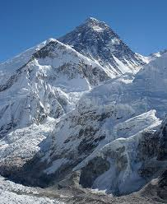
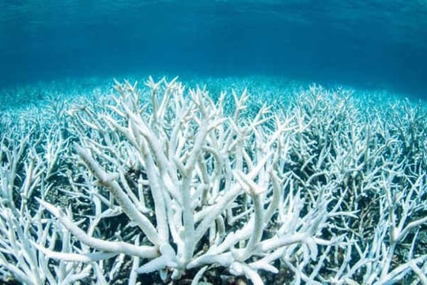
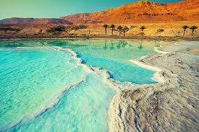
PRACTICE
Look at the pictures on pages 72 and answer:
What the conversation between Lan and Tom is about?
They are talking about some natural wonders
( Mount Everest, the Great Barrier Reef, and the Dead Sea)
Đỉnh Everest, rạn san hô Great Barrier và Biển Chết

Slide 19
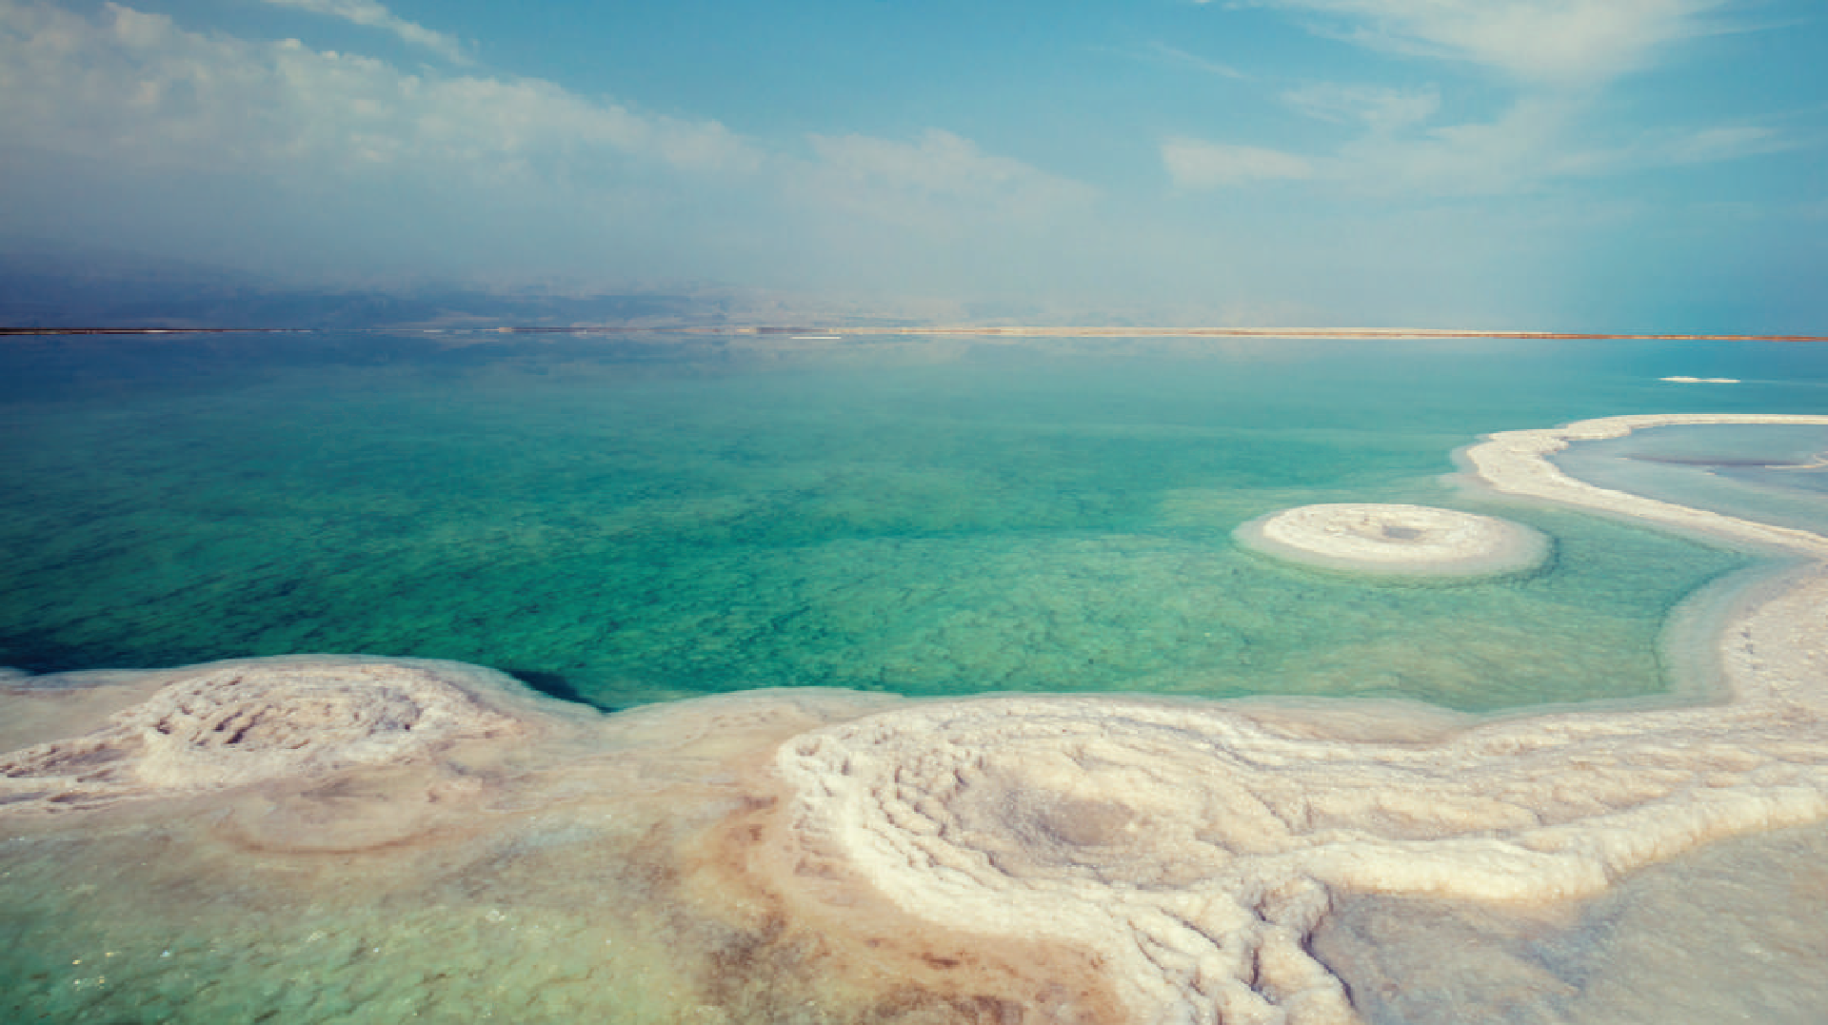
1
Listen and read (p.72)
Lan: Hi, Tom. I hear that you’ve won second prize in the Natural Wonders Contest. Congratulations!
Tom: Thanks, Lan. I like exploring the wonders of nature. I’m crazy about them.
Lan: What did you talk about in the contest?
Tom: I talked about some natural wonders like Mount Everest, the Great Barrier Reef, and the Dead Sea.
Lan: Wonderful! I’m interested in them too.
Tom: Well, you know our planet has so many beautiful landscapes, from snow-covered peaks to charming rivers, lakes, and other natural places that we can’t help admiring. So that’s what I talked about.
Lan: Oh yeah … And what else did you mention?
Tom: Well, I mentioned the risk of us, humans, destroying natural wonders,
and I suggested ways to preserve them and support sustainable development.
Lan: Sounds interesting. Do you want to visit any of these places?
Tom: The host also asked me if I wanted to visit those places, and I answered that I wanted to see two of them: the Grand Canyon and Ha Long Bay.
Lan: I’d love to visit them too.

Slide 20
Questions:
1. Which prize did Tom win?
2. Which natural wonders did Tom talk about?
3. Which risks did Tom mention?
4. Where will Tom visit?
the second prize in the Natural Wonders Contest
Mount Everest, the Great Barrier Reef, and the Dead Sea
humans, destroying natural wonders.
the Grand Canyon and Ha Long Bay.

Slide 21
2
Read the conversation again and tick (√) T (True) of F (False) for each sentence.
 | T | F
1. Tom took part in the Natural Wonders Contest.
2. Lan is not keen on natural wonders.
3. Tom suggested ways to preserve natural wonders.
4. Tom asked the host if he wanted to go to Ha Long Bay.
√
√
√
√

Slide 22
3
Complete the sentences with the words from the box.
explore
couldn’t help
landscape
support
development
1. A ___________________ is everything you can see in a large area of land, especially in the countryside.
2. It was risky for him to climb the peak, but we ______________ admiring his courage.
3.The best way to ____________ the Trang An Landscape Complex is by boat.
4. Environmentalists strongly ____________ measures to save these heritage trees.
5.Sustainable _______________ goals will guide us to create a more sustainable future for all.

Slide 23
4
Underline the correct answer to complete each sentence.
1. Charles is crazy / interested about football. He follows all the World Cup matches.
2. When you go to Mui Ne, you can see the unique location / landscape of a desert.
3. The children were very eager to explore/ possess the surrounding countryside.
4. Can you suggest / discover ways of boosting our local tourism?
5. Tourism develops / contributes millions of dollars to our country’s economy.

Slide 24
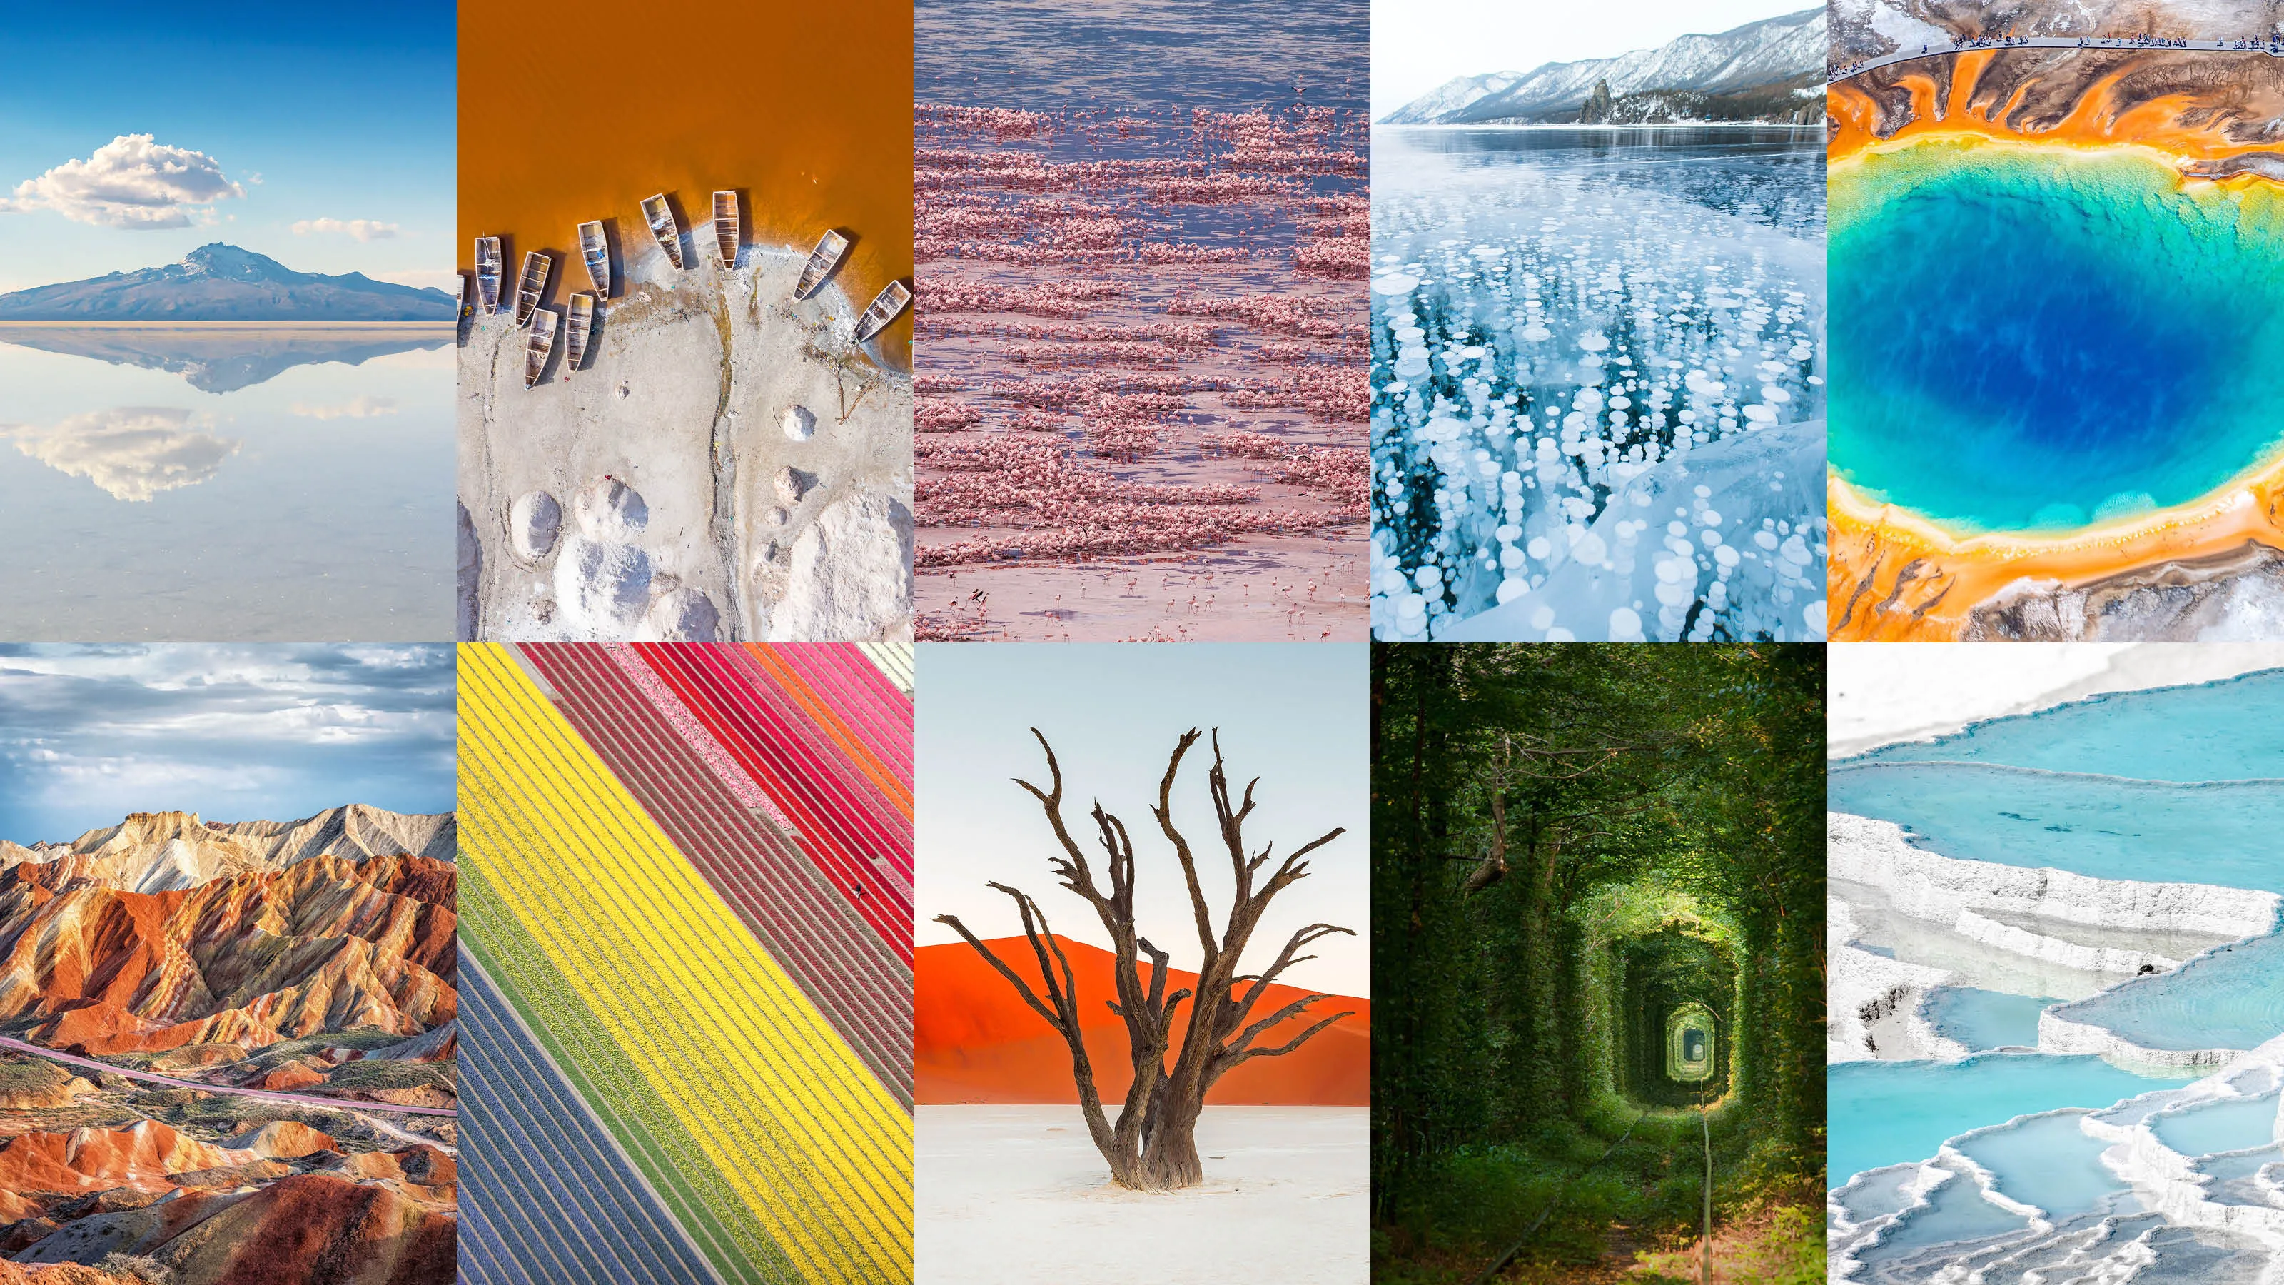
PRODUCTION
5
GAME: Natural Wonders Knowledge.
Work in groups. List some natural wonders and say where they are located. The group that has the most correct answers wins.
Example: The Amazon Rainforest - in Brazil / in South America
(Rừng nhiệt đới Amazon - ở Brazil / ở Nam Mỹ)

Slide 25
Some natural wonders of the world
Ha Long Bay – in Viet Nam (Vịnh Hạ Long – ở Việt Nam)
2. Mount Everest – in the Himalayas (Đỉnh Everest – trên dãy Himalaya)
3. Lake Baikal – in Russia (Hồ Baikal – ở Nga)
4. Dead Sea – in Israel/Jordan/Palestine (Biển Chết – ở Israel/Jordan/Palestine)
5. Grand Canyon – in the USA (Grand Canyon – ở Mỹ)
6. Great Barrier Reef – in Australia (Rặng san hô Great Barrier – ở Úc)
7. Parícutin Volcano – in Mexico (Núi lửa Parícutin – ở Mexico)
8. Angel Falls – in South America (Thác Angel – ở Nam Mỹ)
9. Mount Fuji – in Japan (Núi Phú Sĩ – ở Nhật Bản)
10. Jeju Island – in South Korea (Đảo Jeju – ở Hàn Quốc)

Slide 26
CONSOLIDATION
What have we learnt in this lesson?
Use the words related to natural wonders of the world
Gain vocabulary to talk about natural wonders of the world

Slide 27

Homework
Do exercises in the workbook.
Prepair lesson 2
Prepare for the Project of the unit
- Work in groups to design a poster.

Slide 28




