Slide 1







Welcome to our class!

Slide 2
GAME
GUESS THE WORDS
T opens the boxes
Students write the words
The quickest student gets 10 points for each

Slide 3
fishing
SHOW
KEY

Slide 4
weaving
SHOW
KEY

Slide 5
folk dance
SHOW
KEY

Slide 6
open fire
SHOW
KEY

Slide 7
minority group
SHOW
KEY

Slide 8
Listen and repeat
folk dance
fishing
weaving
minority group
open fire

Slide 9


Unit 4:
ETHNIC GROUPS OF VIET NAM
Lesson 7: Looking back + Project

Slide 10






VOCABULARY

Slide 11






2. Complete the sentences with the word and phrases from the box.
folk songs
sticky rice
musical instruments
staircase
communal house
1. Minority groups have their own _________________ like the dan tinh, gong, t’rung.
2. The Kinh use __________ to make banh chung and banh tet.
3. For most minority groups like the Bahnar and Ede, the ________________, usually known as Rong house, is the heart of the village.
4. My grandmother taught me to sing many ___________.
5. The __________of a Muong’s stilt house has an odd number of steps: 5, 7, or 9.

Slide 12
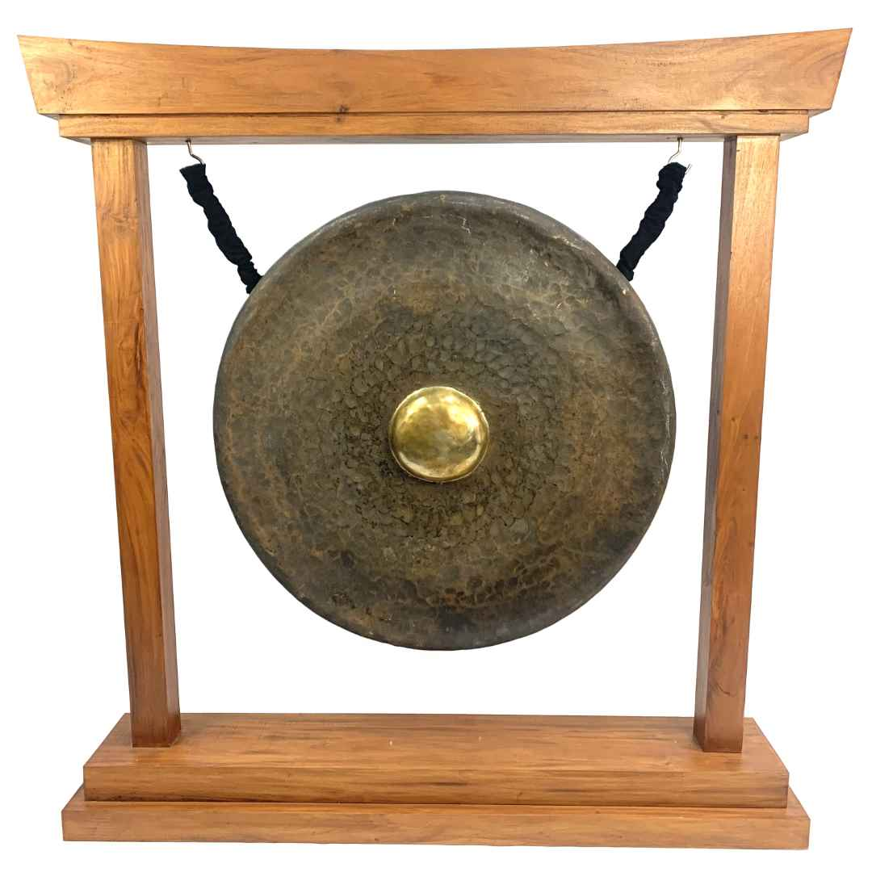
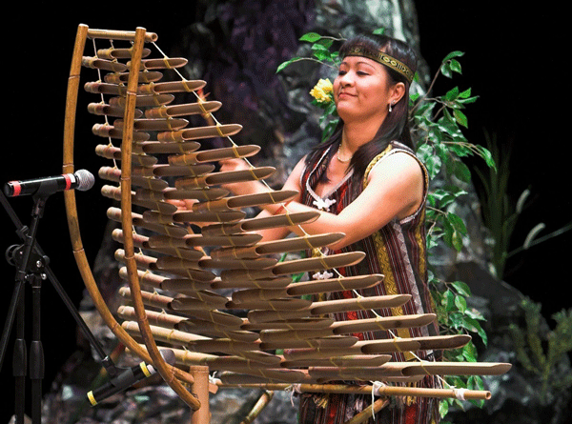
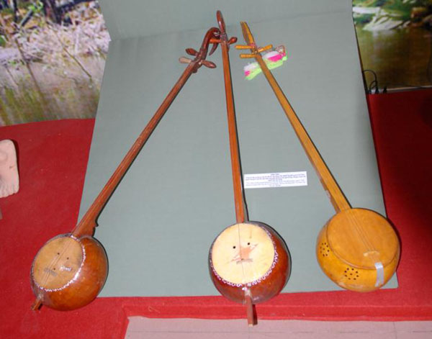
2. Complete the sentences with the word and phrases from the box.
folk songs
sticky rice
musical instruments
staircase
communal house
1. Minority groups have their own ______________________ like the dan tinh, gong, t’rung..

Slide 13
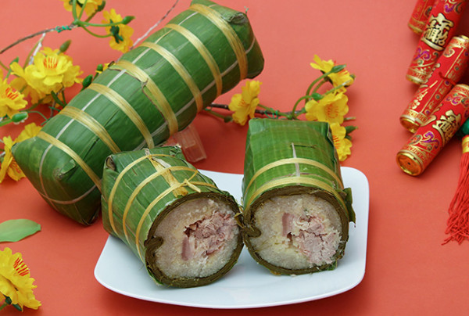
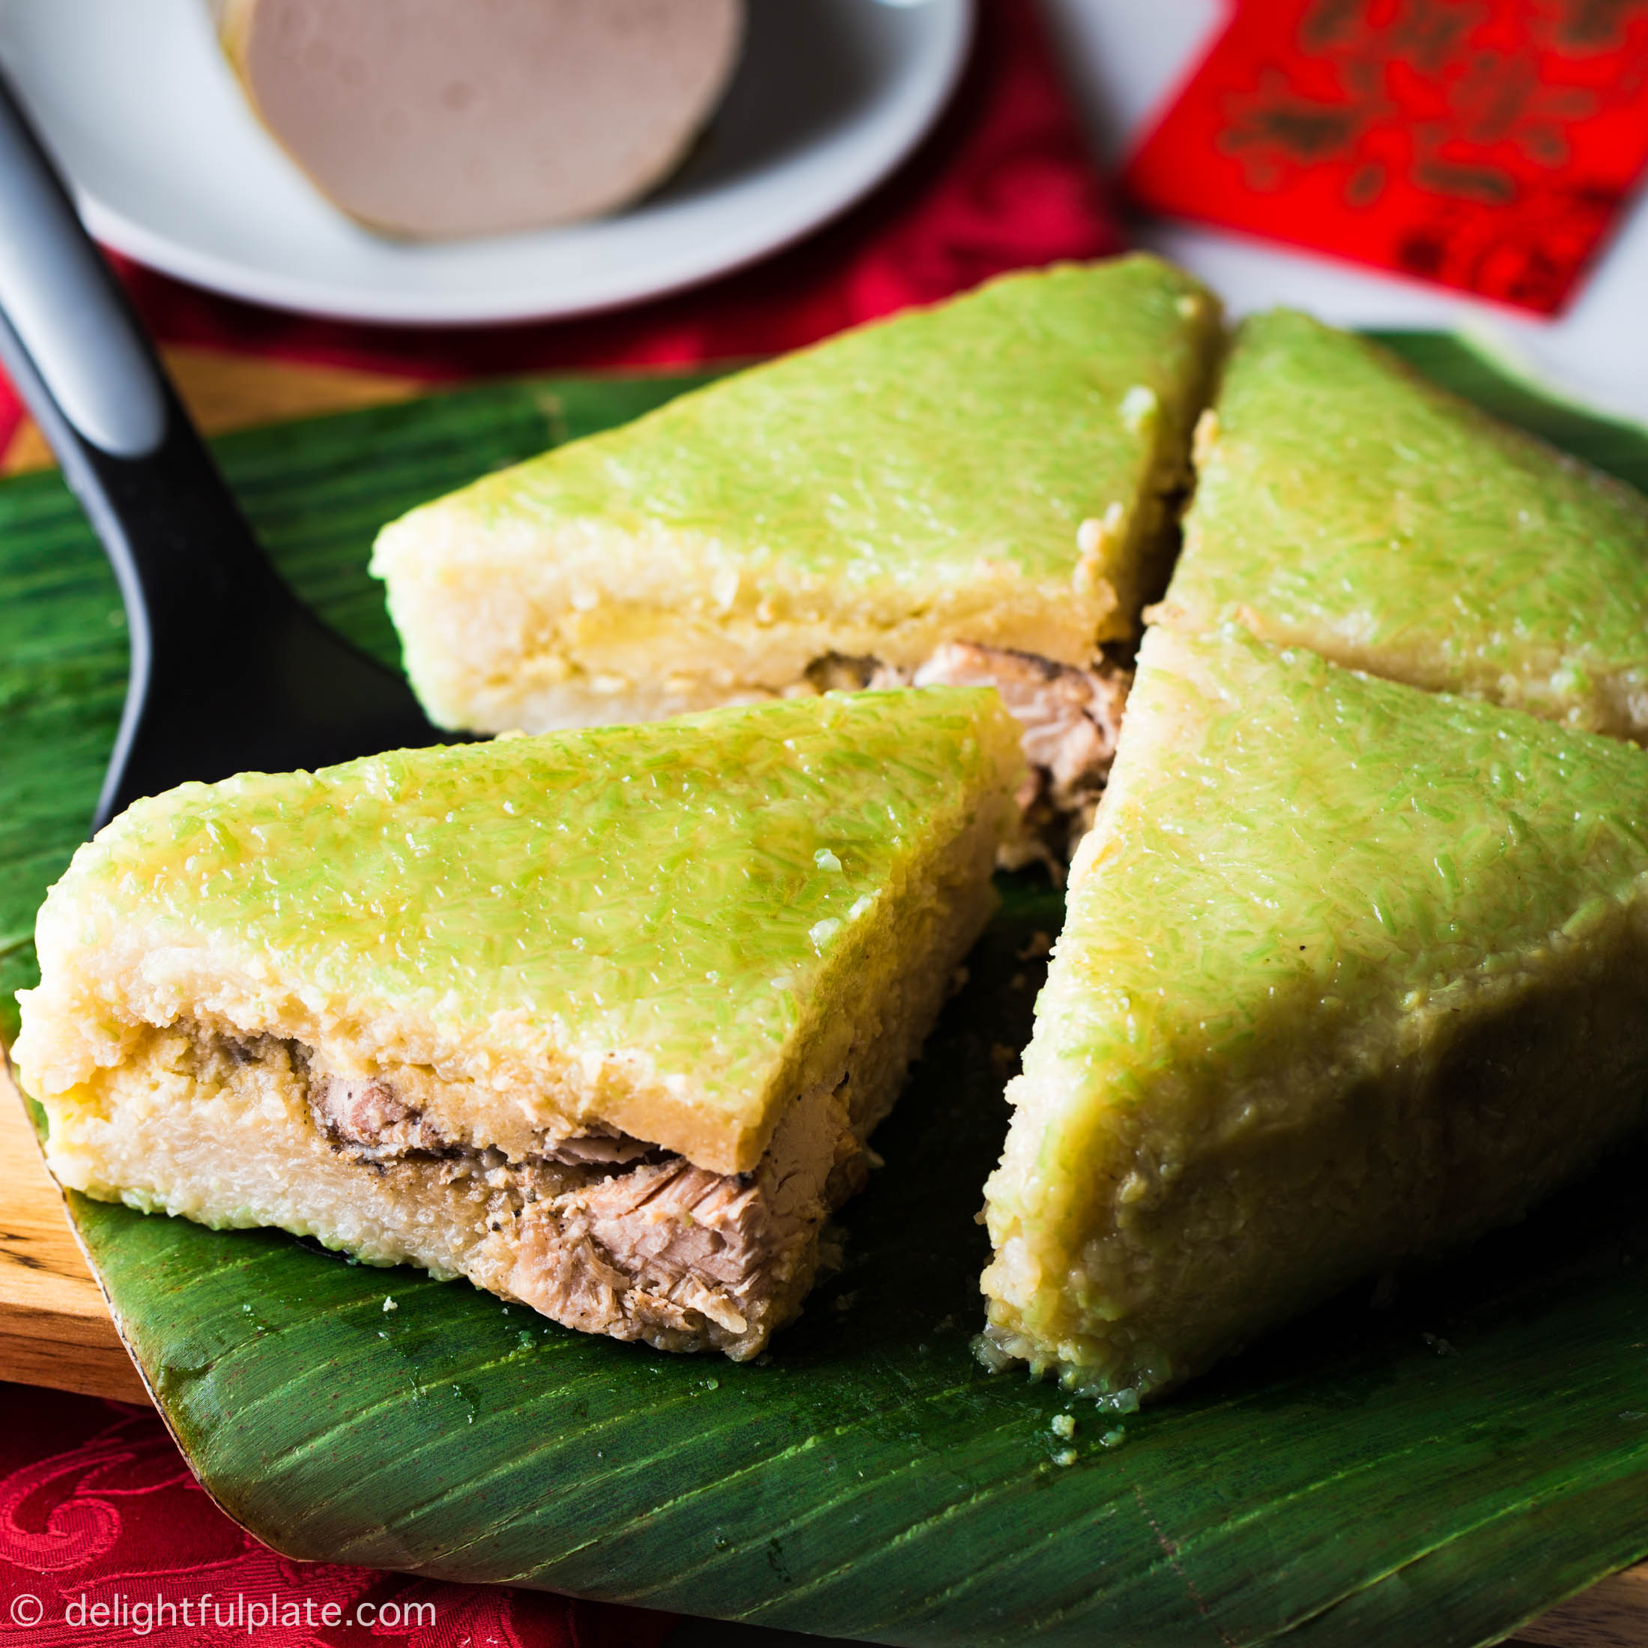
2. Complete the sentences with the word and phrases from the box.
folk songs
sticky rice
staircase
communal house
2. The Kinh use __________ to make banh chung and banh tet.

Slide 14
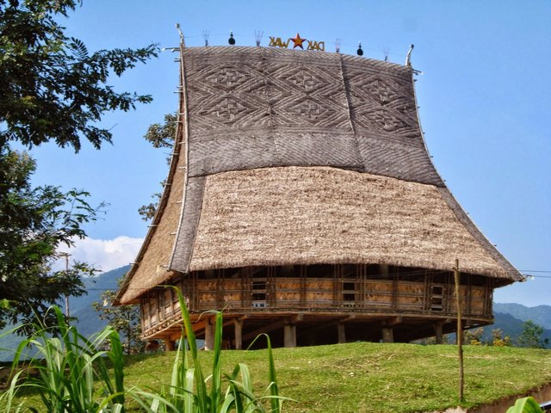
2. Complete the sentences with the word and phrases from the box.
folk songs
staircase
communal house
3. For most minority groups like the Bahnar and Ede, the ________________, usually known as Rong house, is the heart of the village.

Slide 15
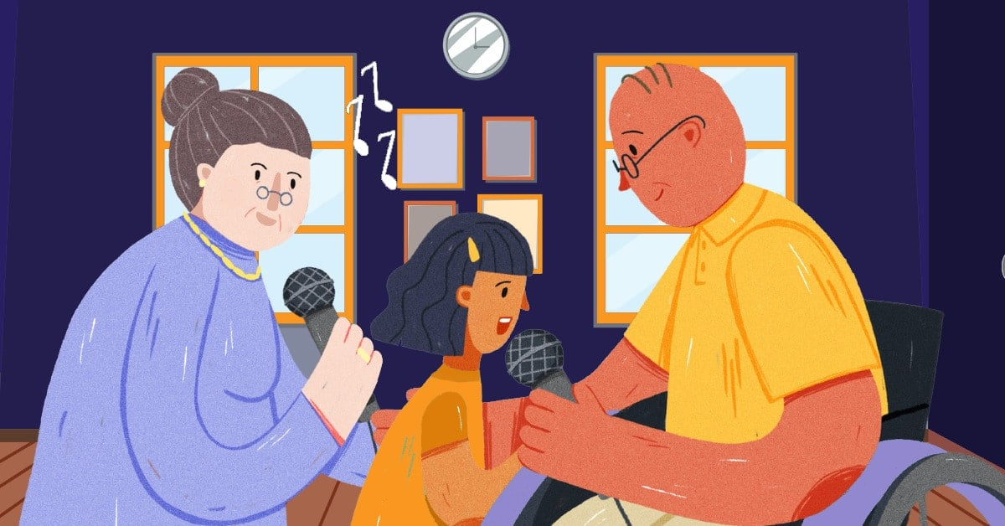
2. Complete the sentences with the word and phrases from the box.
folk songs
staircase
4. My grandmother taught me to sing many ___________.

Slide 16
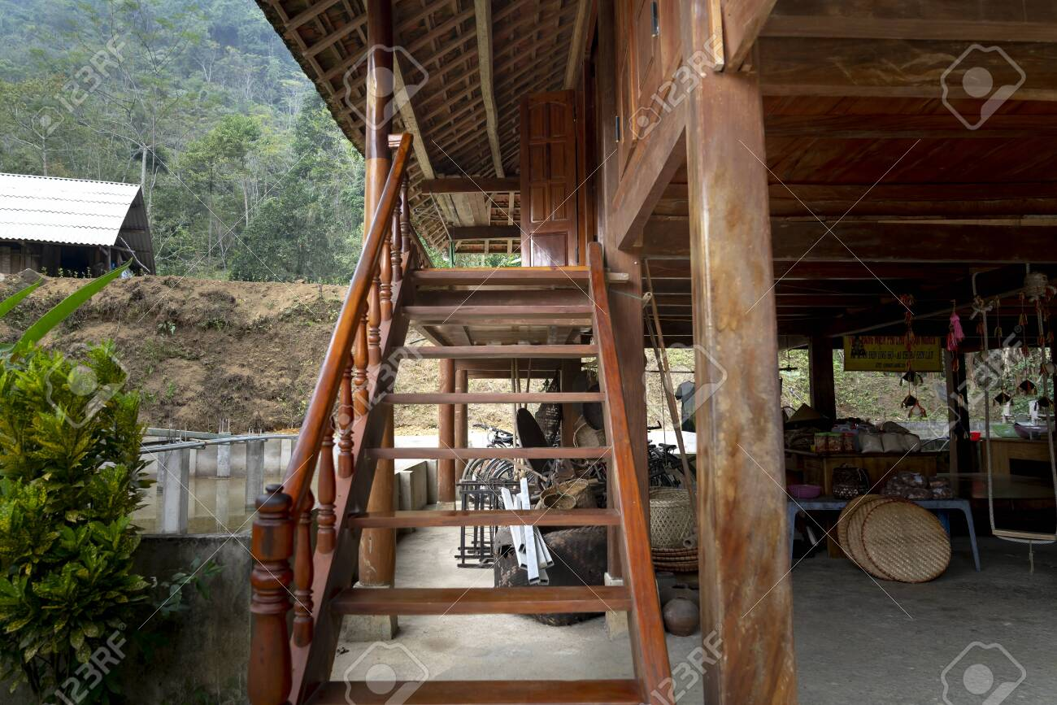
2. Complete the sentences with the word and phrases from the box.
staircase
5. The __________of a Muong’s stilt house has an odd number of steps: 5, 7, or 9.

Slide 17
Look at the answers again
1. Minority groups have their own musical instruments like the dan tinh, gong, t’rung.
2. The Kinh use sticky rice to make banh chung and banh tet.
3. For most minority groups like the Bahnar and Ede, the communal house usually known as Rong house, is the heart of the village.
4. My grandmother taught me to sing many folk songs.
5. The staircase of a Muong’s stilt house has an odd number of steps: 5, 7, or 9.

Slide 18
GRAMMAR

Slide 19
3. Write questions from the clues.
1. you / attend / the Khmer’s Moon Worship Festival / last year / ?
→ Did you attend the Khmer’s Moon Worship Festival last year?
2. How many / ethnic minority groups / Viet Nam / ?
→ How many ethnic minority groups are there in Viet Nam?
25%
3. Where / the Hmong / live / ?
→ Where do the Hmong live?
75%
4. What / you / do / the Ede’s Harvest Festival / last October / ?
→ What did you do at the Ede’s Harvest Festival last October?
5. How old / minority children / when / they / start helping / the family / ?
→ How old are the minority children when they start helping the family?

Slide 20
4. There is one incorrect underlined word in each sentence. Circle and correct it.
 | Correct word
1. A big stilt houses stands on high posts.
2. The Lahu build their houses from wood and wild banana leave.
3. Much people in remote areas travel on foot.
4. Most minority women weave clothes and do houseworks.
5. In the mountains, there is not many land for growing crops.
A + singular noun
→ house
leaves: lá cây
→ leaves
People: countable N
Many + countable N
Much + uncountable N
→ Many
→
housework
housework: uncountable N
land: uncountable N
→ much

Slide 21
PROJECT PRESENTATION

Slide 22



Wrap-up
In this lesson, you have:
revised more vocabulary items in the unit in different context.
revised Yes / No questions and Wh-questions.
revised the use of countable and uncountable nouns.
had an opportunity to research more deeply into an ethnic group you are interested in.

Slide 23


THE END

