Slide 1
UNIT 3:
My friends
Lesson 1: Getting started

Slide 2
OBJECTIVES
01
Have an overview about the topic “My friends”.
Use the lexical items to talk about body parts and appearance to describe people’s appearance.
02

Slide 3
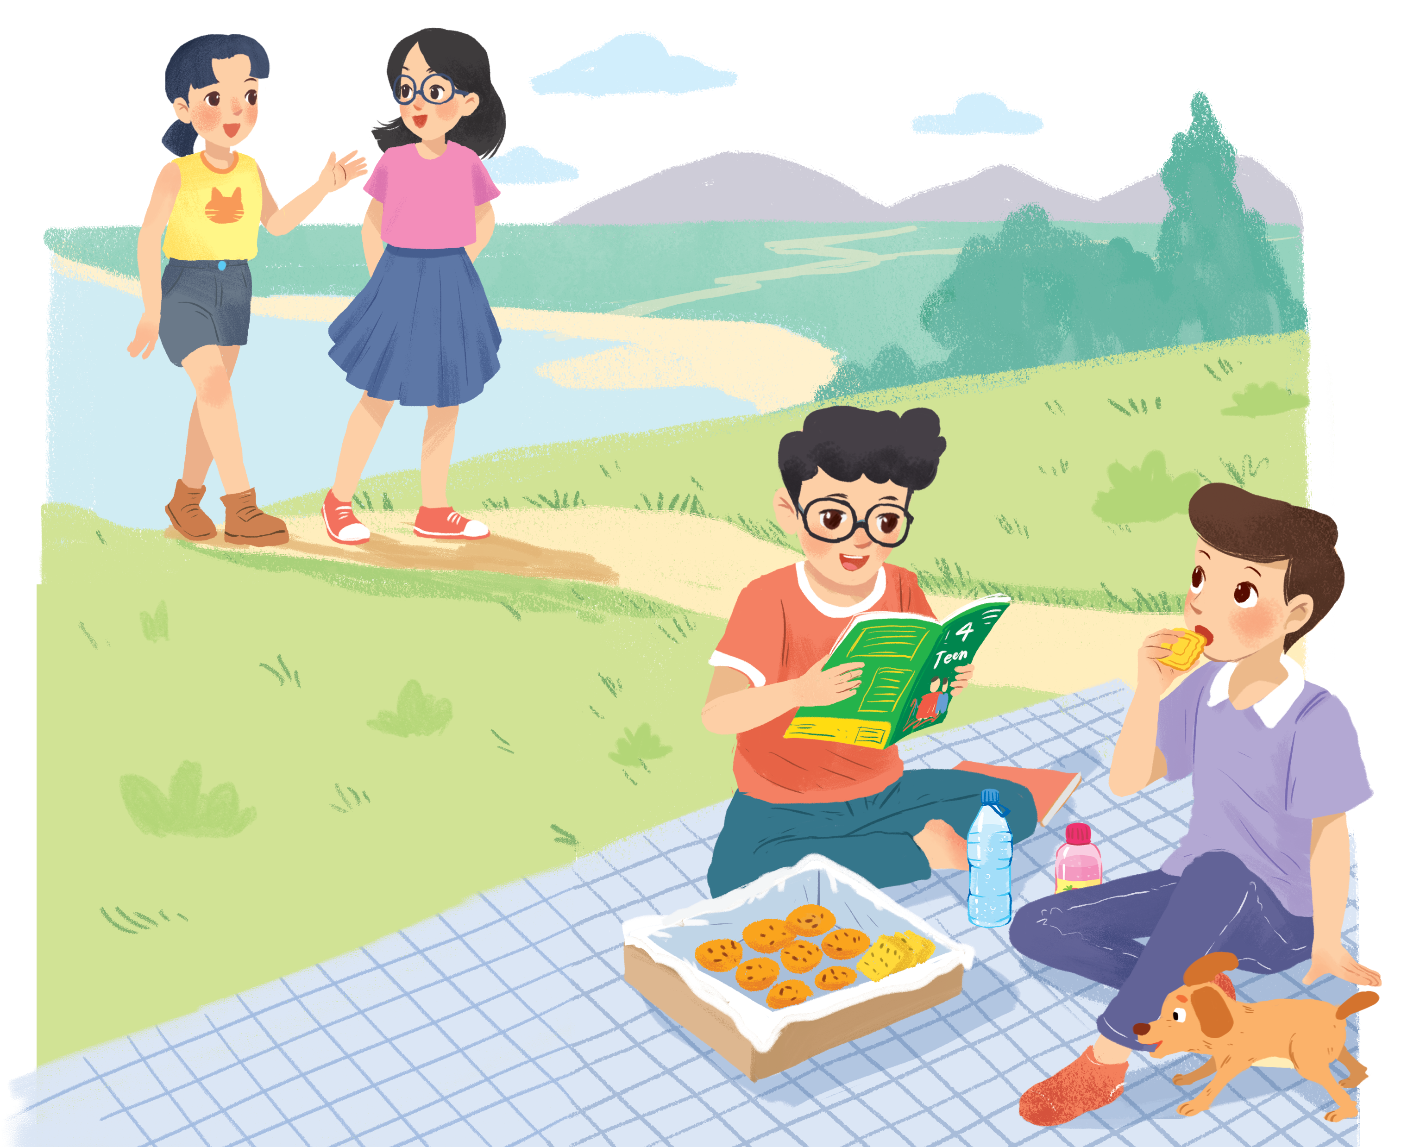
Look and answer.
1. Who are they?
They are Chau, Mai, Phong and Nam.
2. What is Phong doing?
He is reading a magazine.
Nam
3. What are Phong and Nam eating and drinking?
Chau
Mai
Biscuits and water.
4. What are they talking about?
Phong
Listen and check

Slide 4

Listen and read. (P.26)
Phong: That was a great idea, Nam. I love picnics!
Nam: Please pass me the biscuits.
Phong: Sure. Here you are.
Nam: Thanks. What are you reading, Phong?
Phong: 4Teen. It's my favourite magazine!
Nam: Look! It's Mai. And she is with someone.
Phong: Oh, who's that? She has glasses and long black hair.
Nam: I don't know. They're coming over.
Mai: Hi there. This is my friend Chau.
Phong & Nam: Hi, Chau. Nice to meet you.
Chau: Nice to meet you, too.
Nam: Would you like to sit down? We have lots of food.
Mai: Oh, sorry, we can't. We're going to the bookshop.
Chau: Bye for now.
Phong & Nam: Bye bye.

Slide 5
Let’s check!
4. What are they talking about?
A special guess.
Nam: Look! It's Mai. And she is with someone.
Phong: Oh, who's that? She has glasses and long black hair.
Nam: I don't know. They're coming over.
Mai: Hi there. This is my friend Chau.
Phong & Nam: Hi, Chau. Nice to meet you.
Chau: Nice to meet you, too.
Nam
Chau
Mai
Phong

Slide 6
2. Read again and fill in the blanks!
1. Phuc and Nam are having a ____________.
2. Teen is Phong's ____________________ .
3. Phong and Nam see _______ and ___________.
4. Chau has________, and _________________.
5. Mai and Chau _____________ the bookshop.

Slide 7
Let’s check!
1. Phuc and Nam are having a ____________.
picnic
Phong: That was a great idea, Nam. I love picnics!
Nam: Please pass me the biscuits.
2. 4Teen is Phong's __________________.
favourite magazine
Nam: Thanks. What are you reading, Phong?
Phong: 4Teen. It's my favourite magazine!

Slide 8
Let’s check!
3. Phong and Nam see ___________ and ___________.
Mai
Chau
Nam: Look! It's Mai. And she is with someone.
Phong: Oh, who's that? She has glasses and long black hair.
Nam: I don't know. They're coming over.
Mai: Hi there. This is my friend Chau.
Phong & Nam: Hi, Chau. Nice to meet you.

Slide 9
Let’s check!
4. Chau has _____________, and _________________.
glasses
long black hair
Nam: Look! It's Mai. And she is with someone.
Phong: Oh, who's that? She has glasses and long black hair.
Nam: I don't know. They're coming over.
Mai: Hi there. This is my friend Chau.
Phong & Nam: Hi, Chau. Nice to meet you.

Slide 10
Let’s check!
5. Mai and Chau _____________ the bookshop.
are going to
Phong & Nam: Hi, Chau. Nice to meet you.
Chau: Nice to meet you, too.
Nam: Would you like to sit down? We have lots of food.
Mai: Oh, sorry, we can't. We're going to the bookshop.

Slide 11
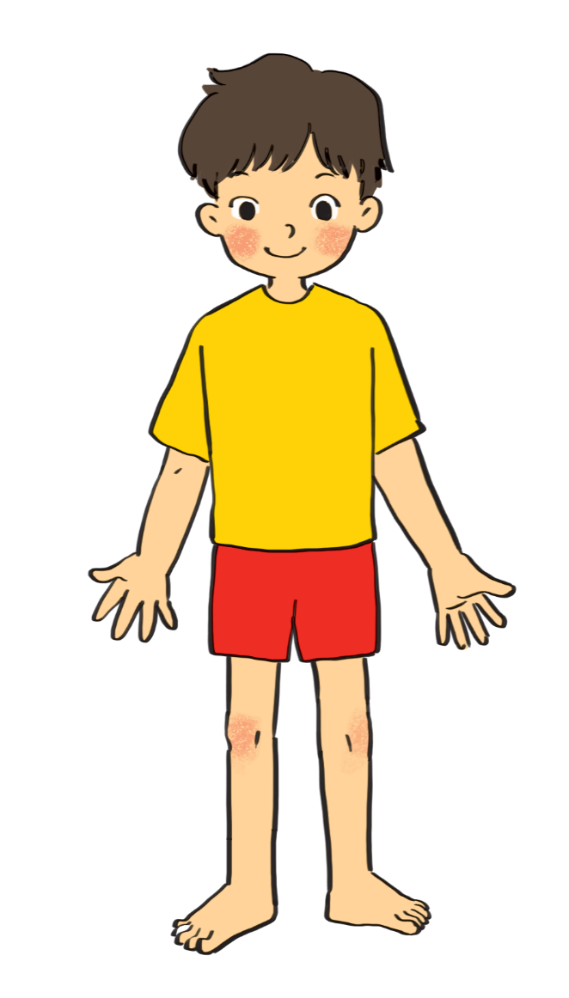
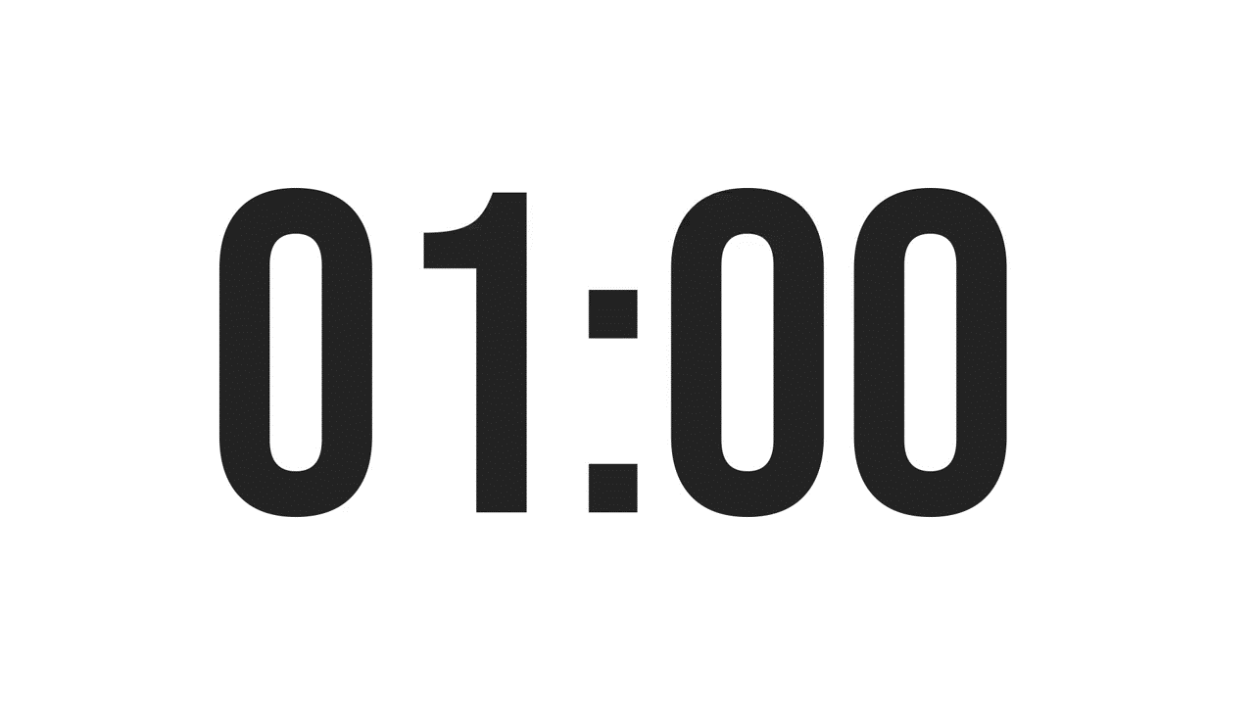
3. Label the body parts (p.27)
1.
eye
10.
hair
9.
cheek
Swap the answer with your partner
nose
2.
8.
mouth
3.
shoulder
7.
arm
4.
hand
5.
leg
6.
foot

Slide 12
How can you describe your friends?

She has long hair.
BFF
✗
She has long eyes.
Which one is correct?
Notes:
Some words go together but some don’t

Slide 13
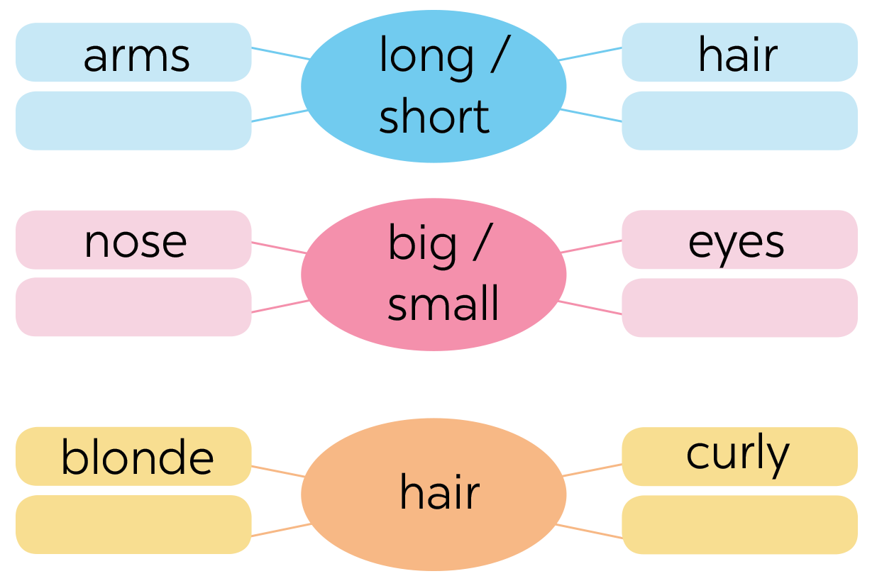

4. Work in group of 4. Complete the word webs.
legs
feet
hands
ears
black
straight

Slide 14
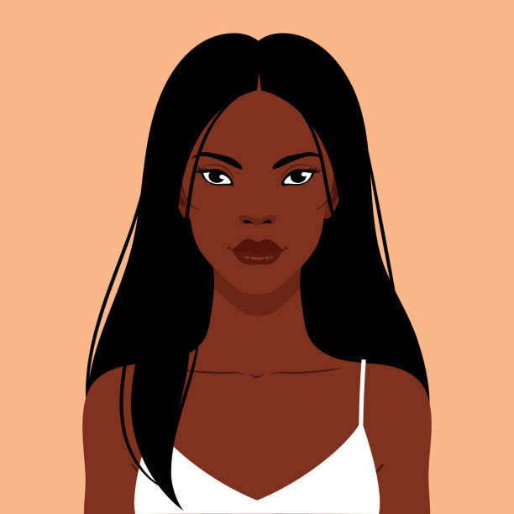
RECAP
What adjectives do we use to describe hair?
01


long
curly
small

blonde
big

straight
Which are correct?
02
She is black long hair.

She has long black hair.
She has straight long hair.

