Slide 1
UNIT 3
Teenagers
Lesson 5: Skills 1
GO!

Slide 2
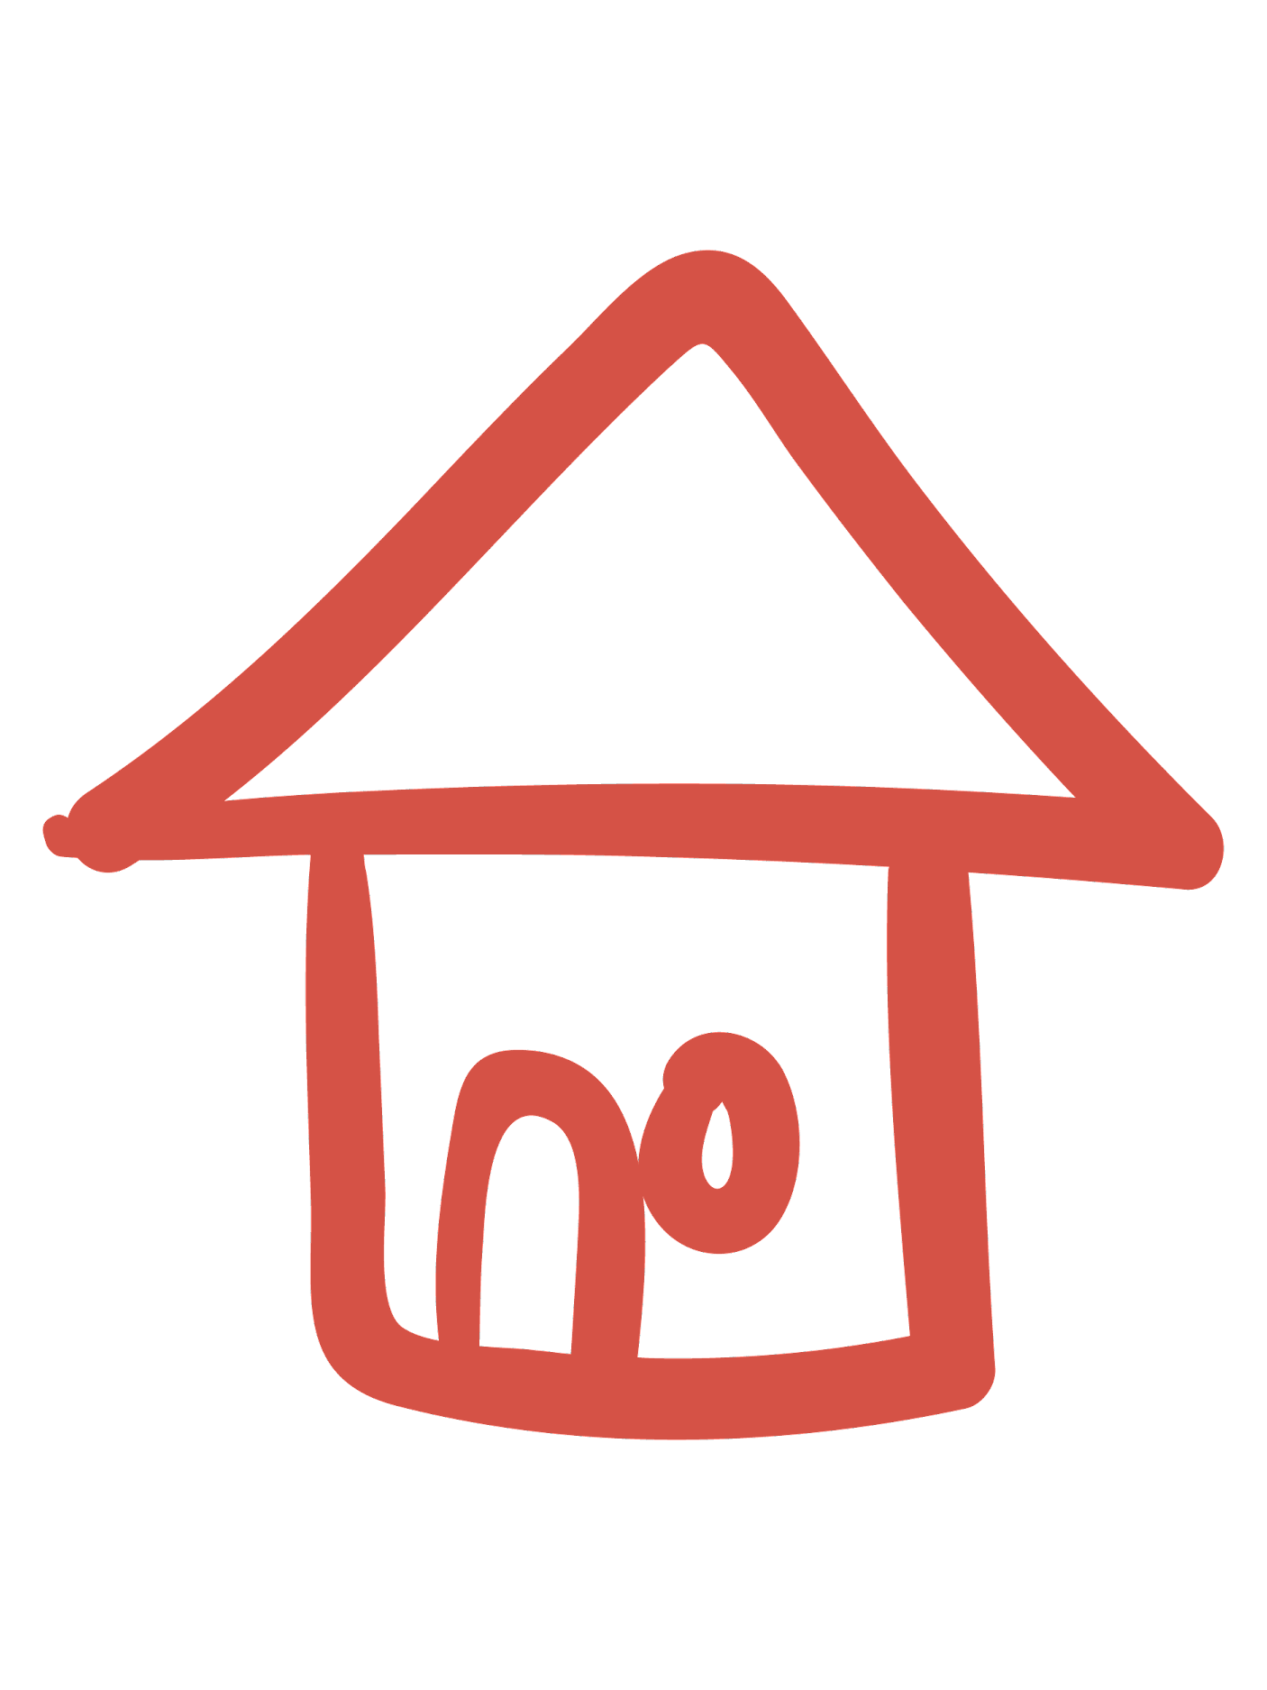


OBJECTIVE
1
READING
2
SPEAKING
After this lesson, students will be able to
read for general and specific information about school club activities;
ask and answer questions about school clubs

Slide 3
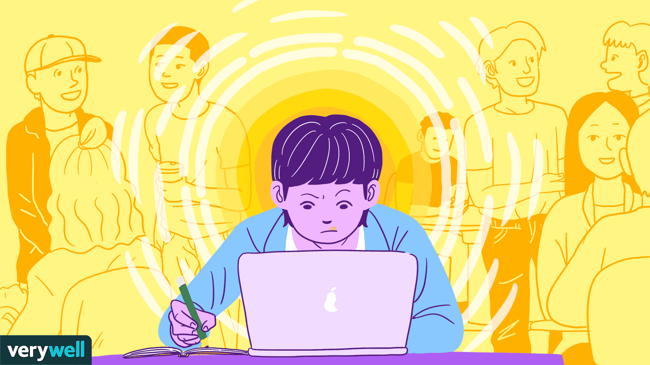

VOCABULARY
concentrate (v)
/ˈkɒnsntreɪt/
tập trung

Slide 4

VOCABULARY
focused (adj)
/ˈfəʊkəst/
chuyên tâm, tập trung

Slide 5

VOCABULARY
practical (adj)
/ˈpræktɪkl/
thực tế, thực tiễn

Slide 6
1
READING
SECTION 1
SECTION 2
SECTION 3
SECTION 4

Slide 7
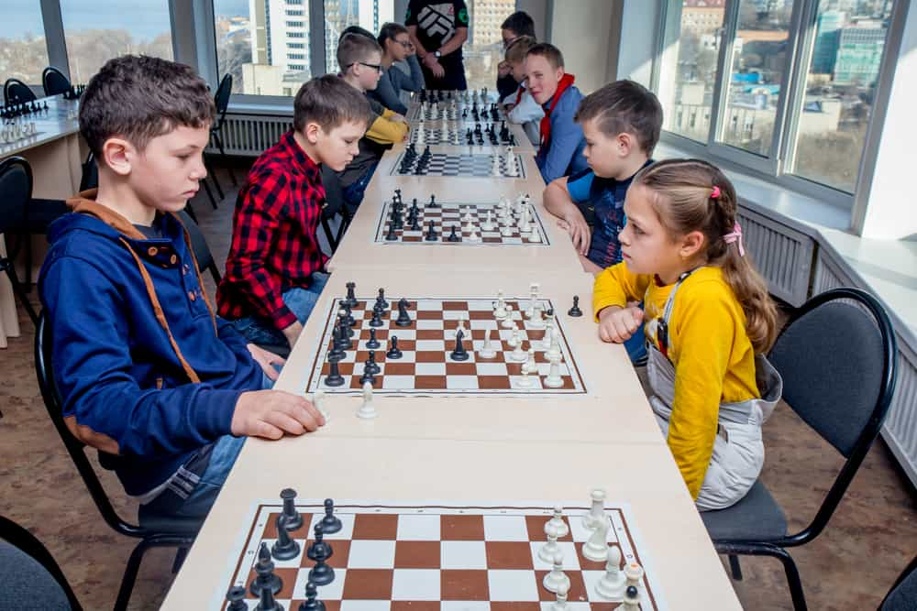
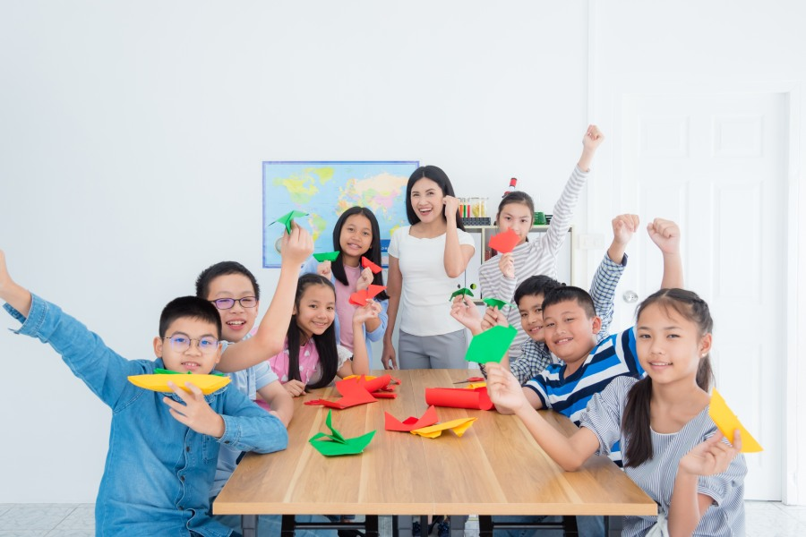
1 (p.33) Work in pair.
1a Look at each picture and say what club it is.
1b Which of your school clubs do you want to join?
chess club
art and craft club

Slide 8
2 (p.33) Read and tick (✓) T (True) or F (False).
Sentences | T | F
1. The school has badminton, chess, and arts and crafts clubs .
✓
Mai: Tom, so which club do you want to join?
Tom: I'm interested in two clubs: badminton and chess.
…
Let's join the chess club too.
…
Mai: Actually, this year there is a new arts and crafts club, and I want to join it. …

Slide 9
2 (p.33) Read and tick (✓) T (True) or F (False).
Sentences | T | F
2. The badminton club activities are after school.
✓
Mai: Tom, so which club do you want to join?
Tom: I'm interested in two clubs: badminton and chess.
Mai: I like badminton, too. It's relaxing.
Tom: Yes, I play it to keep fit. So let's join that club together.
Mai: OK. It's on Tuesdays and Fridays from 5:00 p.m. to 6:30 p.m. It starts 30 minutes after school, so we have enough time to get some snacks beforehand.

Slide 10
2 (p.33) Read and tick (✓) T (True) or F (False).
Sentences | T | F
3. Tom started playing chess when he was five.
✓
five years ago.
Mai: I know you like chess. Will you join the chess club?
Tom: Well, I started playing it five years ago. My mum first sent me to a chess club because she wanted me to be more focused. Now I find that I can concentrate better. Do you like chess? Let's join the chess club too.

Slide 11
2 (p.33) Read and tick (✓) T (True) or F (False).
Sentences | T | F
4. Members of the arts and crafts club do community activities.
✓
Mai: Actually, this year there is a new arts and crafts club, and I want to join it. I hear that the members will work together in small community service projects. Members can do art projects and also improve their practical skills and teamwork skills too.

Slide 12
3. Playing chess helps Tom ___
A. connect with other members
B. concentrate better
C. do community service
4. The word It refers to ___
A. chess club
B. arts and crafts club
C. community service
5. Mai will participate in the arts and crafts club to ___
A. help the school
B. coach her friends
C. do art projects
3 (p.33)Read again and choose the correct answer A, B, or C.
1. Tom and Mai are discussing ___.
A. their leisure time activities
B. their school club activities
C. their likes and dislikes
2. Tom started playing chess because ___.
A. he loved it
B. he wanted to stay focused
C. his mum wanted him to play

Slide 14
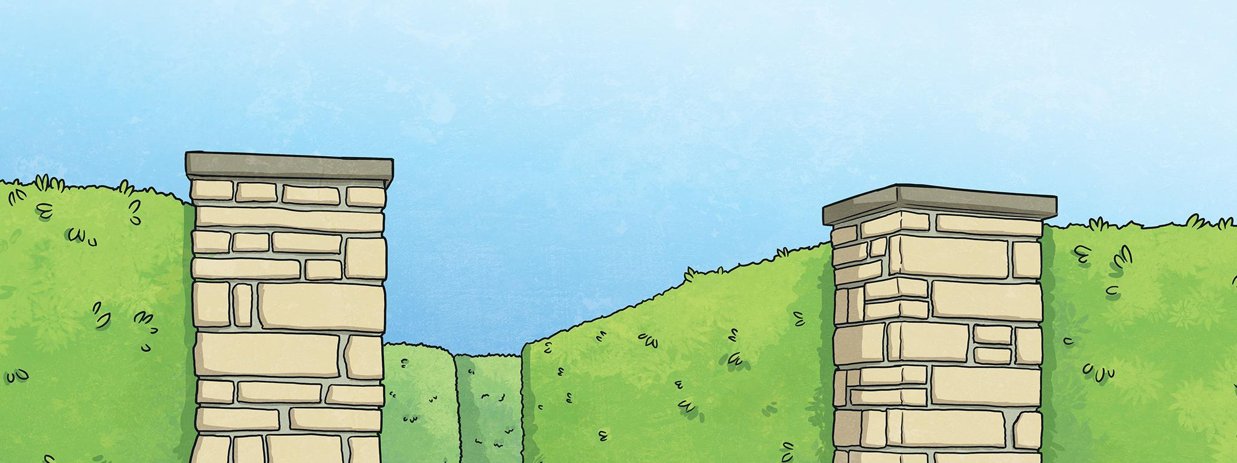
Can you find the center of the maze?
Choose the correct answer to the question to go the right way.
If you make a mistake, you might get lost!

Slide 15

1. Tom and Mai are discussing ___.
C. their likes and dislikes
(Turn back.)
B. their school club activities (Turn right.)
A. their leisure time activities (Turn left.)

Slide 16
3 (p.33)Read again and choose the correct answer A, B, or C.
1. Tom and Mai are discussing ___.
A. their leisure time activities
B. their school club activities
C. their likes and dislikes
Mai: Tom, so which club do you want to join?
Tom: I'm interested in two clubs: badminton and chess.
Mai: I like badminton, too. It's relaxing.
Tom: Yes, I play it to keep fit. So let's join that club together.

Slide 17
2. Tom started playing chess because ___.
A. he loved it
(Straight ahead.)
B. he wanted to stay focused
(Turn left.)
C. his mum wanted him to play
(Turn right.)

Slide 18
3 (p.33)Read again and choose the correct answer A, B, or C.
2. Tom started playing chess because ___.
A. he loved it
B. he wanted to stay focused
C. his mum wanted him to play
Hoa: … Will you join the chess club?
Tom: Well, I started playing it five years ago. My mum first sent me to a chess club because she wanted me to be more focused. Now I find that I can concentrate better. Do you like chess? Let's join the chess club too.

Slide 19
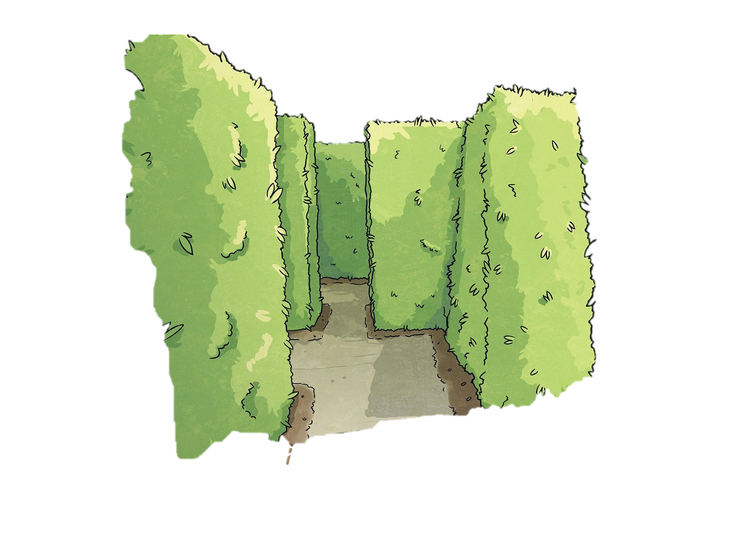
3. Playing chess helps Tom ___
A. connect with other members
(Straight ahead.)
B. concentrate better
(Take the second turn on your right)
C. do community service
(Turn right.)

Slide 20
3 (p.33)Read again and choose the correct answer A, B, or C.
3. Playing chess helps Tom ___
A. connect with other members
B. concentrate better
C. do community service
Hoa: … Will you join the chess club?
Tom: Well, I started playing it five years ago. My mum first sent me to a chess club because she wanted me to be more focused. Now I find that I can concentrate better. Do you like chess? Let's join the chess club too.

Slide 21
4. The word It refers to ___
A. chess club
(Straight ahead.)
B. arts and crafts club
(Turn left.)
C. community service
(Turn right.)

Slide 22
3 (p.33)Read again and choose the correct answer A, B, or C.
4. The word It refers to ___
A. chess club
B. arts and crafts club
C. community service
Mai: Actually, this year there is a new arts and crafts club, and I want to join it.

Slide 23
5. Mai will participate in the arts and crafts club to ___
C. do art projects
(Turn back.)
B. coach her friends
(Turn right.)
A. help the school
(Turn left.)

Slide 24
3 (p.33)Read again and choose the correct answer A, B, or C.
5. Mai will participate in the arts and crafts club to ___
A. help the school
B. coach her friends
C. do art projects
Mai: Actually, this year there is a new arts and crafts club, and I want to join it. I hear that the members will work together in small community service projects. Members can do art projects and also improve their practical skills and teamwork skills too.

Slide 25
Oh no! A dead end!
Click here to start again.

Slide 26
Congratulations! You found the center of the maze!

Slide 27
2
SPEAKING
SECTION 1
SECTION 2
SECTION 3
SECTION 4

Slide 28




4 (p.34) Work in pairs. Make conversations using the given information.
GUITAR CLUB
Time: Mondays, 5:00 pm. - 6:30 p.m.
Venue: Music room, 2nd floor
Contact number: 0084 623486
Coach: Mr Quang, a professional guitarist
Benefits: Enjoy music and make new friends
What time does the guitar club meet?
It meets on Mondays, from 5:00 p.m. to 6:30 p.m.
PAINTING CLUB
Time: Saturdays, 9:00 a.m. -10:30 a.m. Venue: School Hall, 1st floor
Contact number: 0084135798
Coach: Ms Hoa, a school art teacher Benefits: Do art and relax
A
B

Slide 29
4 (p.34) Work in pairs. Make conversations using the given information.
GUITAR CLUB
Time: Mondays, 5:00 pm. - 6:30 p.m.
Venue: Music room, 2nd floor
Contact number: 0084 623486
Coach: Mr Quang, a professional guitarist
Benefits: Enjoy music and make new friends
SUGGESTED QUESTIONS
What time does the guitar club meet?
Where does it meet?
What is the contact number of the club?
PAINTING CLUB
Time: Saturdays, 9:00 a.m. -10:30 a.m. Venue: School Hall, 1st floor
Contact number: 0084135798
Coach: Ms Hoa, a school art teacher Benefits: Do art and relax
Who will coach the club?
What are the benefits you get when you join the club? / Why do you want to join this club?
A
B

Slide 30
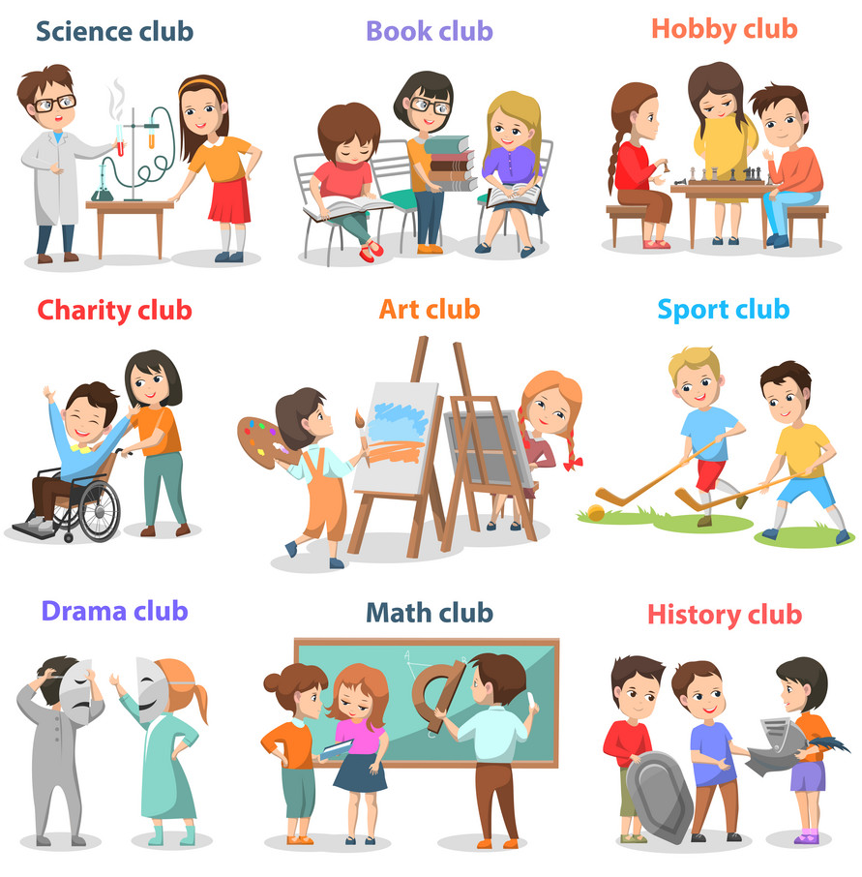

4a (p.34) Take note about a club at your school.
... CLUB
Time: ...
Venue: ...
Contact number: ...
Coach: ...
Benefits: ...

Slide 31
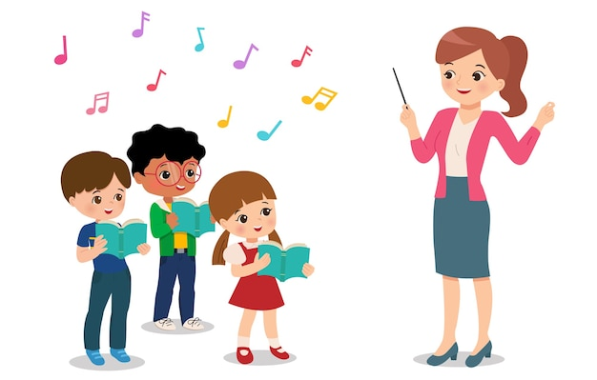

4b (p.34)
Work in group.
Ask and answer, using your note.
MUSIC CLUB
Time: Tuesdays, 5:00 p.m. - 6:30 p.m. Venue: music room, third floor
Contact number: ...
Coach: ...
Benefits: ...

Slide 32
4c (p.34) Report the answers to the whole class.
Example:
The music club at my school meets on Tuesdays, from 5:00 p.m. to 6:30 p.m. It meets in the music room, on the third floor ...
MUSIC CLUB
Time: Tuesdays, 5:00 p.m. - 6:30 p.m. Venue: music room, third floor
Contact number: ...
Coach: ...
Benefits: ...

Slide 33
WRAP UP
What have you learned in the lesson today?
✓
□ read about teen stress and pressure;
□ read about school club activities;
□ do a survey about daily activites of teenagers
✓
□ ask and answer questions about school clubs

Slide 34
THANKS FOR
YOUR ATTENTION!

